Slide 1
Intermediate Workshop
SPSS
CSU Stanislaus
May 13, 2016
Ed Nelson – CSU Fresno
ednelson@csufresno.edu

Slide 2
Social Science Research and Instructional Council (SSRIC)
Discipline council for the social sciences made up of representatives from each campus in the CSU. List of campus representatives can be found at the SSRIC website by clicking on "The Council" and then on “Contact Information“.
Promotes use of data analysis in research and teaching.
Provides an opportunity for students to present their research at the Social Science Student Symposium.
Other information can be found by going to the SSRIC website.

Slide 3
Social Science Data Bases
The SSRIC helps maintain and promote the use of the social science data bases in the CSU.
Data bases include:
  Inter-university Consortium for Political and Social Research (ICPSR)
  The Field (California) Poll
  The Roper Center for Public Opinion Research

Slide 4
Agenda for the Intermediate
SPSS Workshop
Cross tabulations
  Bivariate
  Multivariate
Comparing means
  Independent sample t test
  Paired-sample t test
  One-way analysis of variance
Regression and correlation
  Bivariate
  Multivariate
Graphs/Charts

Slide 5
Getting More Information about the Screen Captures
The images in this PowerPoint are screen captures from SPSS and various web sites.
To see a description of the screen capture, right click on the image and then click on Format Picture. Click on Alt Text and a description of the image will appear.
To close the Alt Text box click on Close.

Slide 6
Overview of SPSS
SPSS is a statistical package for beginning, intermediate, and advanced data analysis.
Other statistical packages include SAS, Stata and R.
Online statistical packages that don’t require site licenses include SDA and Roper Explorer.

Slide 7
Text – SPSS for Windows
Version 22 A Basic Tutorial
Authors: Linda Fiddler (Bakersfield), John Korey (Pomona), Ed Nelson (Fresno), Elizabeth Nelson (Fresno).
Available on the web by going to the SSRIC website and clicking on "Teaching Resources" and then on "Online Textbooks" and then clicking on the SPSS book title. The data set for this tutorial can be downloaded at this site.
Version 23 will be available sometime during summer, 2016.

Slide 8
SPSS Files and Extensions
Portable file -- .por
Data file -- .sav
Output file -- .spv
Syntax file -- .sps

Slide 9
Opening SPSS
Go to start and find SPSS for Windows.
Click on SPSS 22 or the version you have on your computer to open.
You’ll need to update your SPSS license every year (or your school technician will do it for you).

Slide 10
Opening an Existing File
Often you will want to open a data set that you got from someplace else such as:
  ICPSR
  Roper Center
  Field
These files will usually be in the form of a:
  SPSS portable file (.por)
  SPSS data file (.sav)
  Raw data file with a SPSS syntax file (.sps)
  Raw data file without a syntax file

Slide 11
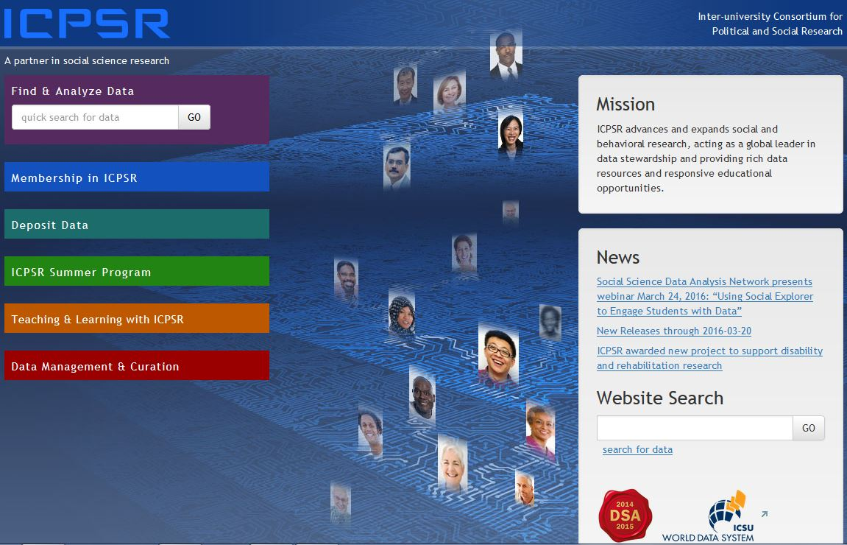
ICPSR

Slide 12
Searching for Data from ICPSR
Click on Find and Analyze Data.
Enter “immigration” in the “Find Data” box.
Explore the different ways of browsing.
Click on “Go”.

Slide 13
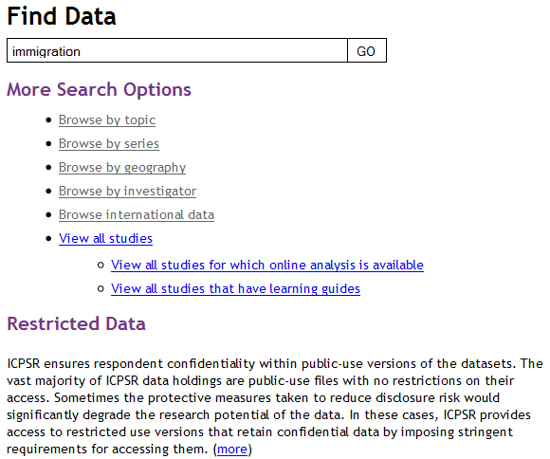
Searching for Data – Find Data

Slide 14
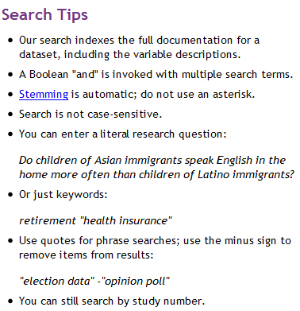
Searching Tips

Slide 15
Sorting by Time Period
When you have your search results, you can sort by time period by clicking “Sort by” and then selecting “Time Period”.
Your search results will now be sorted by time period with the newest surveys first.

Slide 16
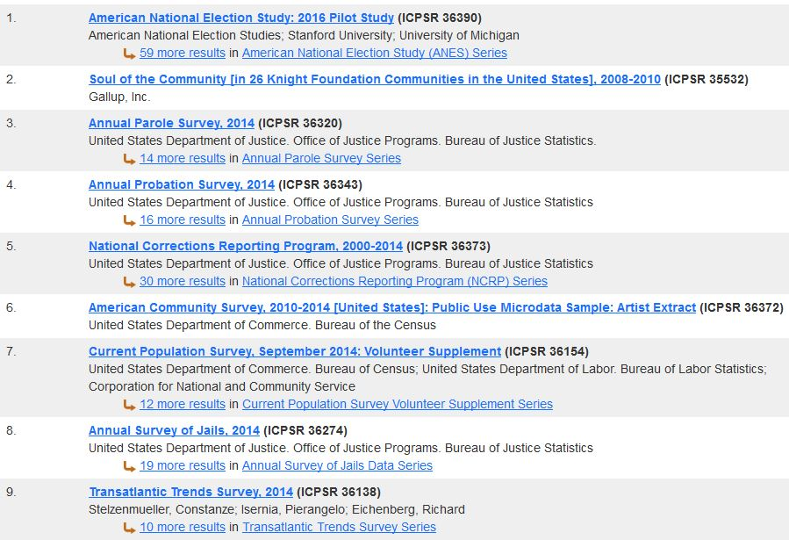
Search Results

Slide 17
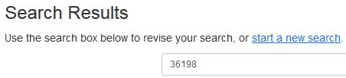
Data Set We’re Using
We’re going to use ICPSR study number 36198. If you know the study number you can search for it by number. When you do, the study 36198 should be near the top of the search results list and will be the study on the next slide.

Slide 18

Study We’re Going to Use

Slide 19
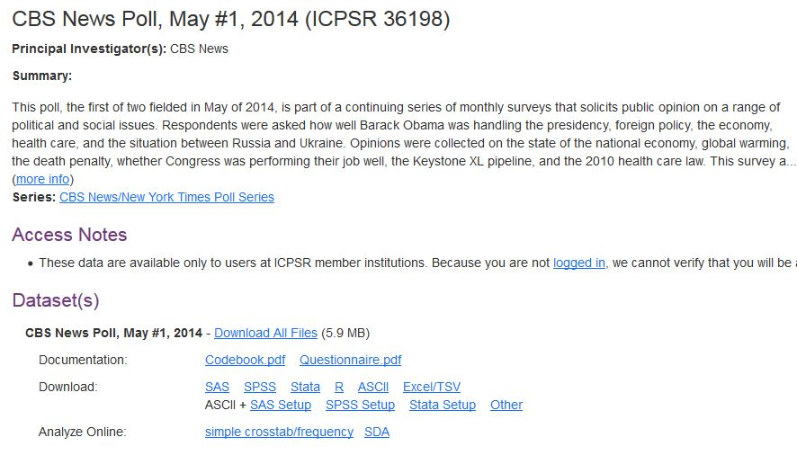
More Information about Study
Double click on the study title to get more information about the study.

Slide 20
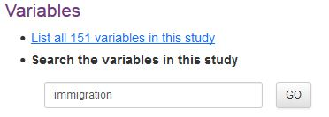
More Information about Variables
Scroll down the study results until you see Variables. Enter “immigration” into the box and click Go.

Slide 21
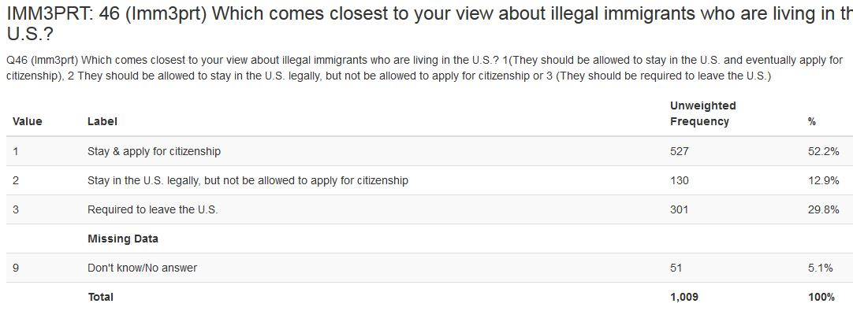
IMM3PRT
Double click on IMM3PRT to see the frequency distribution for this variable.

Slide 22
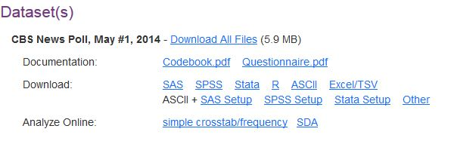
Downloading a File from ICPSR
Find the section in the study results that describes the data sets.
Click on whatever you want to download.

Slide 23
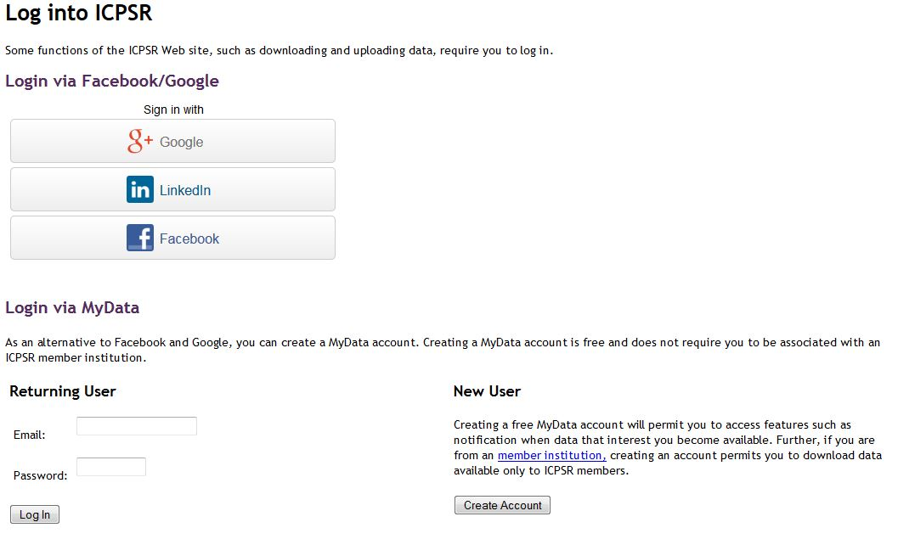
Sign in to ICPSR

Slide 24
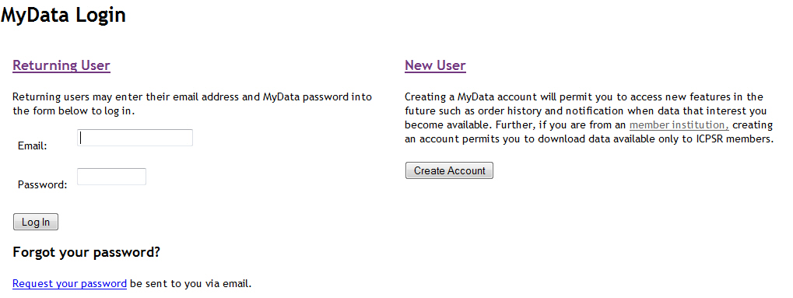
Creating a MyData Account

Slide 25
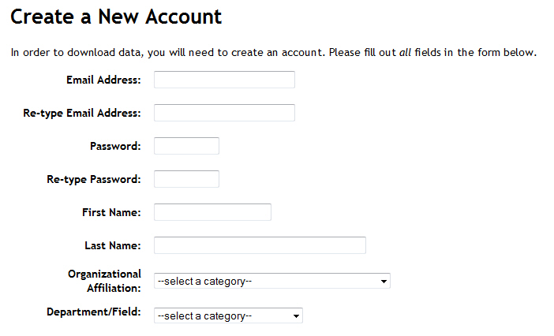
Filling Out the New
Account Form

Slide 26
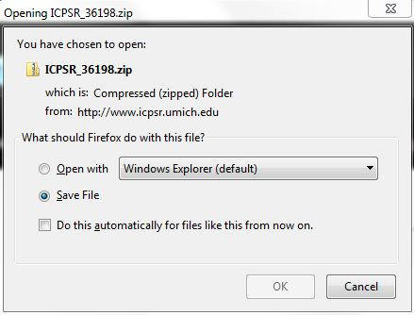
Downloading Box

Slide 27
Downloading Instructions
Select “Save File”.
In Firefox, the file will be saved to your downloads folder.
File will be saved as a zip file.
Open the zip file.
Keep opening folders until you see codebook.pdf, questionnaire.pdf and data.sav.

Slide 28
Opening the .sav File
You can move the zip file from the downloads folder to wherever you want to keep it on your hard drive.
Open SPSS and then open the .sav file.

Slide 29
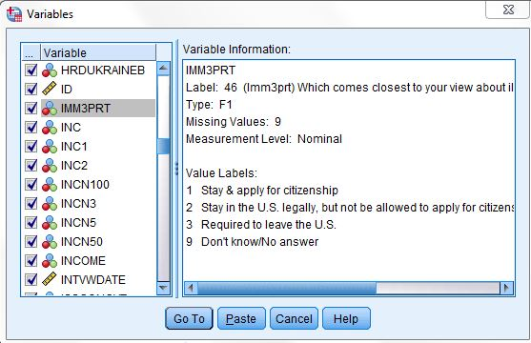
Mini-codebook
Utilities/Variables

Slide 30
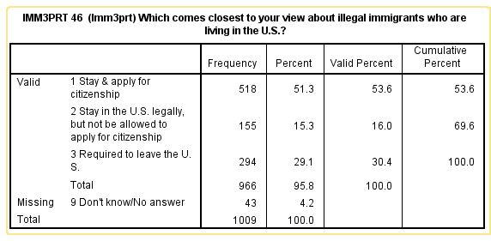
Frequency Distribution for IMM3PRT

Slide 31
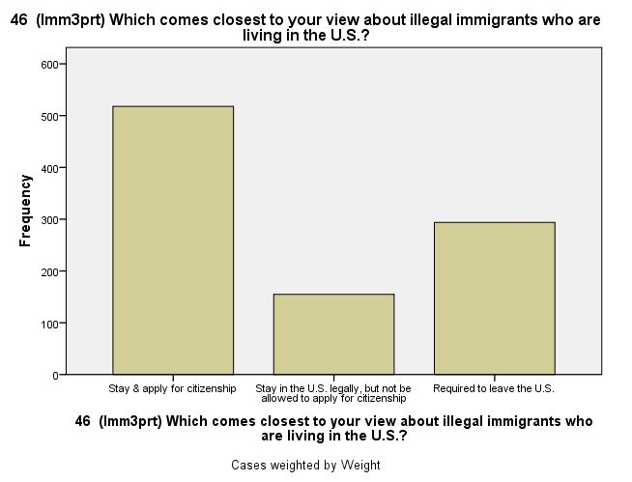
Bar chart for IMM3PRT

Slide 32
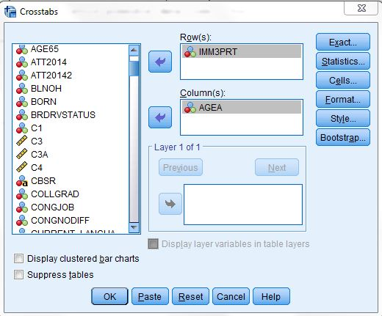
Crosstabs – Bivariate – for IMM3PRT by AGEA (see chapter 5 in text)

Slide 33
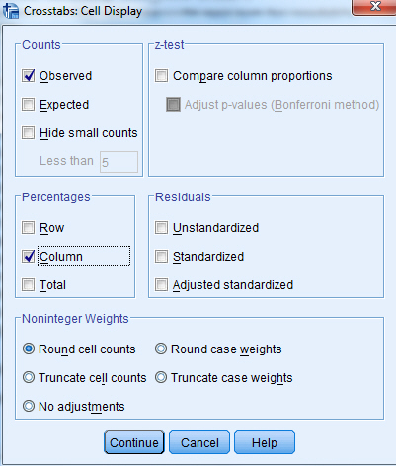
Cells Display Box for IMM3PRT by AGEA

Slide 34
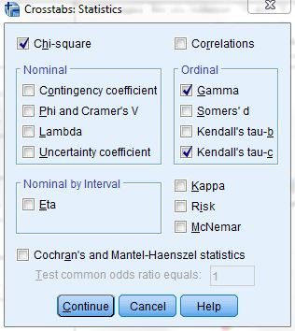
Crosstabs Statistics Box for IMM3PRT

Slide 35
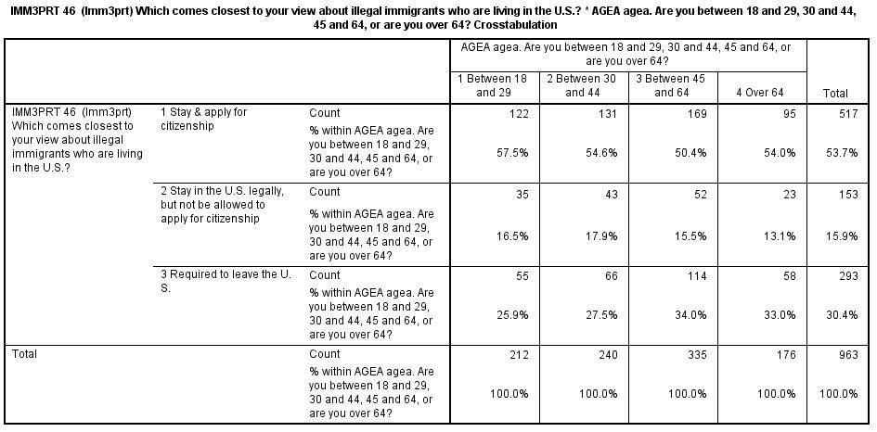
Percentaged Crosstabs Table for IMM3PRT by AGEA

Slide 36
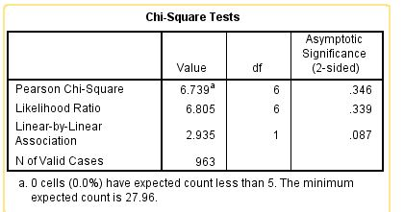
Chi Square Table for IMM3PRT

Slide 37
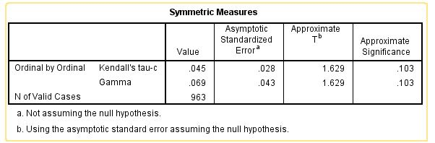
Gamma and Kendall’s Tau c for IMM3PRT

Slide 38
Crosstabs –Another Example
Now let’s run a table with INCN5 (family income) as our independent variable and IMM3PRT as our dependent variable.

Slide 39
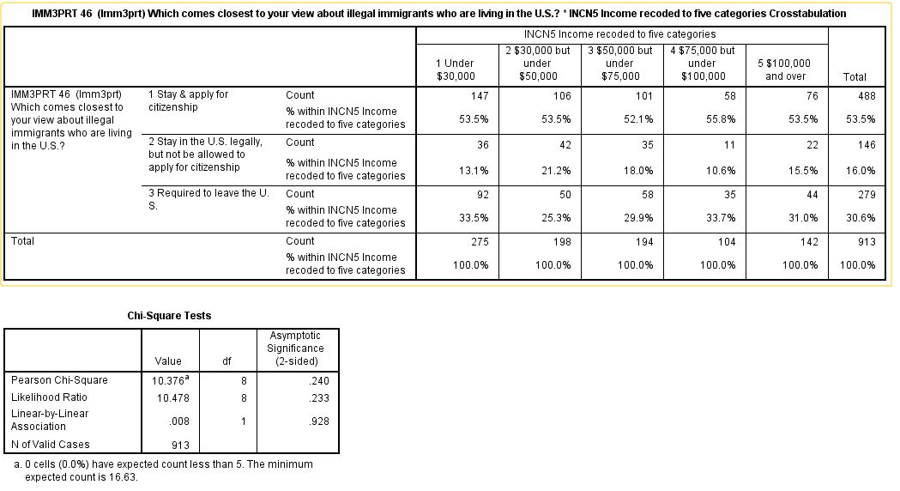
Percentaged Crosstabs Table for IMM3PRT by INCN5

Slide 40
Exercises for Crosstabs -- Bivariate
Now you try some two-variable crosstabs with IMM3PRT as your dependent variable and some other independent variables such as:
  Region of country – CBSR
  Hispanic origin or descent – HISP
  Political party – PRTY
  Political views – PPHL
  Sex – SEX

Slide 41
Crosstabs -- Multivariate
Let’s run a three- variable table
  Dependent variable – IMM3PRT
  Independent variable– AGE4
  Control variable – sex – SEX

Slide 42
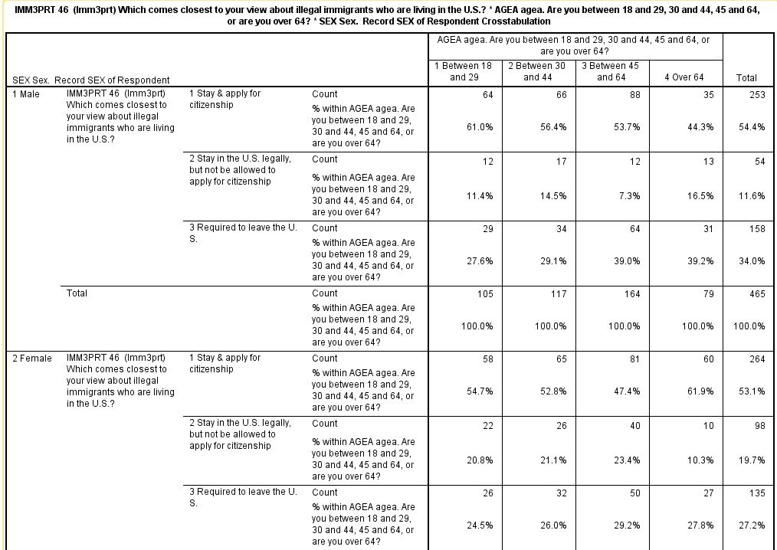
Crosstabs
IMM3PRT by AGEA by SEX

Slide 43
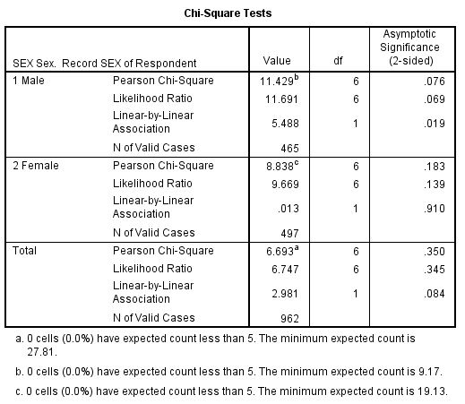
Chi Square Table for
IMM3PRT by AGEA by SEX

Slide 44
Ways to Compare Means
(see ch. 6 in text)
Independent-sample t test
Paired-sample t test
One-way analysis of variance
For this part of the workshop, we’re going to switch to the 2014 General Social Survey (GSS) and use a subset that I created for my classes called GSS14A.sav. You’re welcome to use this subset for your own use.
There is also a subset for the 2012 GSS called GSS12A.sav which can be downloaded from the web page for the Version 22 edition of the online SPSS book.

Slide 45
Comparing Means
Click on Analyze/Compare Means and then on “Means”.
Move AGEKDBRN into the “Dependent List”.
Move SEX into the “Independent List”
Click on OK.

Slide 46
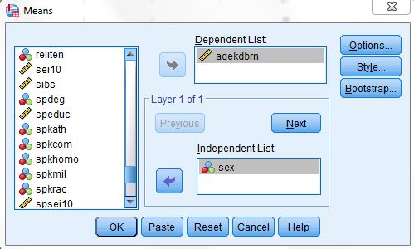
Comparing Means –
Means Table for Agekdbrn by Sex

Slide 47
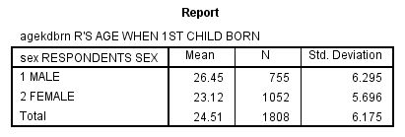
Means Output for Agekdbrn by Sex

Slide 48
Comparing Means – Other Statistics and Further Breakdowns
Requesting other statistics – click on “Options” and select the other statistics you would like.
Further breakdowns – Click on “Next” and select a further breakdown. Move DEGREE into “Layer 2” and keep SEX in “Layer 1”. Click on “OK”.

Slide 49
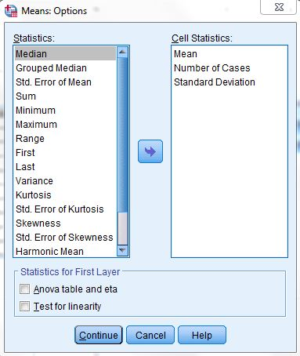
Comparing Means -- Statistics

Slide 50
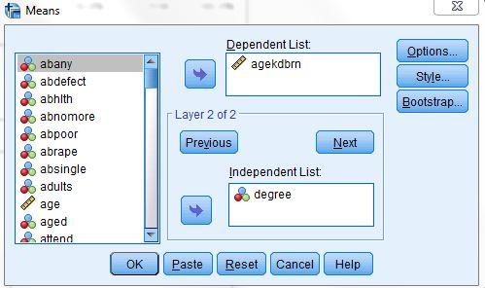
Comparing Means – SES in Layer 1 Box and DEGREE in Layer 2 Box

Slide 51
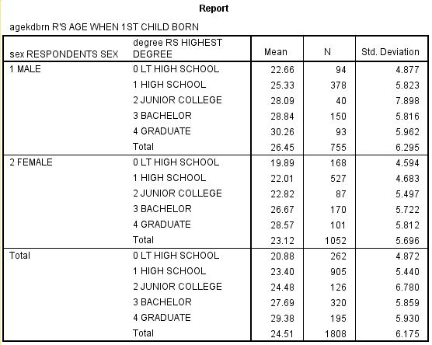
Comparing Means Output – Sex in Layer 1 and DEGREE in Layer 2

Slide 52
Exercises for Comparing Means
Compute the mean age (AGE) of respondents who voted for Obama and Romney (PRES12). Which group had the youngest mean age and which had the oldest mean age?
Compute the mean number of hours that people with different levels of education (DEGREE) watch television (TVHOURS). Who watches more television – those with less education or those with more education?

Slide 53
Independent Sample t Test
Independent samples are samples where the composition of one sample does not influence the composition of the other sample.
Click on Analyze/Compare Means/Independent Sample T Test.
Select the “Test Variable”. This is the variable that you want to use to compare the two groups. Let’s use AGEKDBRN as our test variable.
Click on “Define Groups” to define the two groups that you want to compare.

Slide 54
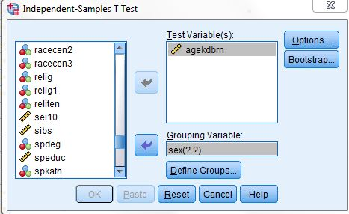
Independent Sample Box for
Agekdbrn by Sex

Slide 55
Defining the Groups
Now indicate the values that define the two groups.
Males are coded 1 and females are coded 2.
So enter 1 in the Group 1 box and 2 in the Group 2 box.
Then click on “Continue” and then on “OK”.

Slide 56
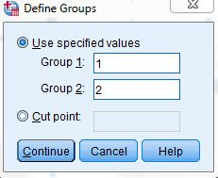
Independent Sample t Test --Define Groups

Slide 57
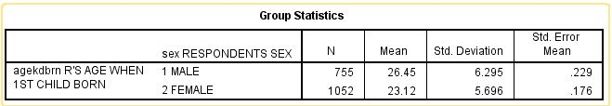
Independent Sample t Test – Group Statistics

Slide 58
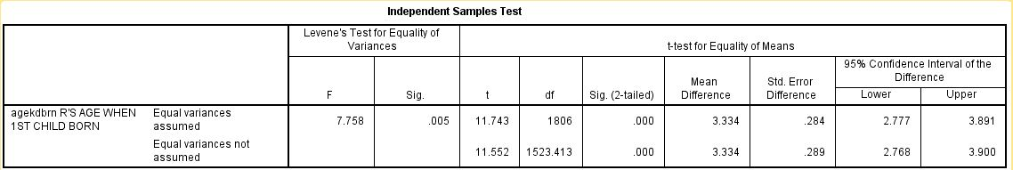
Independent Sample t Test – t Values

Slide 59
Exercises for Independent Sample t Test
Use the independent sample t test to compare the mean age (AGE) of respondents who believe and do not believe in life after death (POSTLIFE). Which group had the highest mean age? Was the difference statistically significant at the .05 level of significance?
Compare the mean family income (INCOME06) of men and women (SEX). Who had the higher income? Was it statistically significant at the .05 level of significance?

Slide 60
Paired Samples t Test
Paired samples are samples where the composition of one sample determines the composition of the other sample (e.g., sample of husbands and wives married to each other).
Click on Analyze/Compare Means/Paired Samples T Test.

Slide 61
Paired Samples t Test -- Continued
Select your paired variables by clicking on the first variable in the list on the left and then clicking on the arrow. Then click on the second variable and click on the arrow again. They should now be in the “Paired Variables” box on the right. Let’s use MAEDUC and PAEDUC as our paired variables.
Move these two paired variables to the “Paired Variables” box.
Click on “OK.”

Slide 62
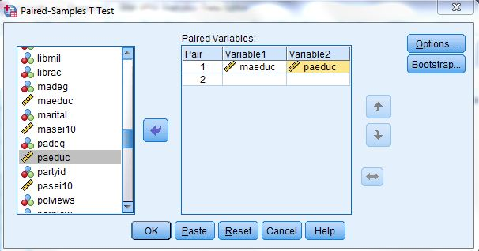
Paired Samples t Test Box

Slide 63
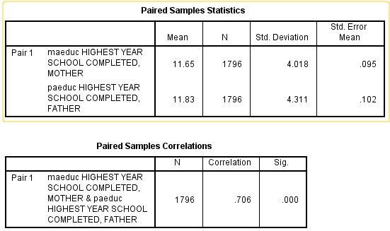
Paired Samples t Test – Group Statistics

Slide 64
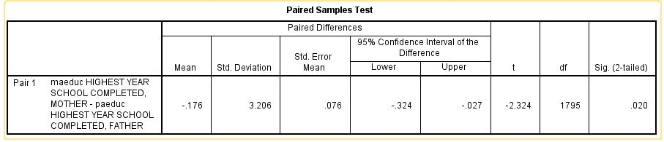
Paired Samples t Test – t test value

Slide 65
Exercises for Paired Sample t Test
Use the paired-sample t test to compare mother’s socioeconomic status (MASEI10) and father’s socioeconomic status (PASEI10). Who has the highest mean socioeconomic status – mothers or fathers? Was the difference statistically significant?
Compare the mean years of school completed for respondents (EDUC) and their spouses (SPEDUC). Who has the higher years of school completed? Was the difference statistically significant?

Slide 66
One-Way Analysis of Variance
Now we want to compare means for more than two groups.
Click on Analyze/Compare Means/Means.
Select the variable that defines your groups by clicking on it and moving it to the “Independent List” box. Do this for DEGREE.
Select the variable that you want to use as your comparison variable and move it to the “Dependent List” box. Let’s use AGEKDBRN as our comparison variable.

Slide 67
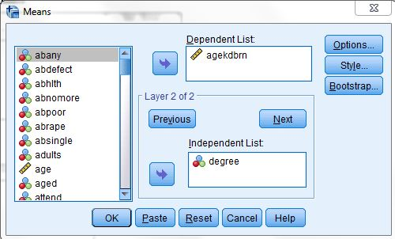
One-Way Analysis of Variance – Means Box

Slide 68
One-Way Analysis of Variance (continued)
Click on “Options” to open the “Means: Options” box.
Click in the “Anova table and eta” box to select it and indicate that you want to do a One-Way ANOVA.
Click on “Continue” and on “OK.”

Slide 69
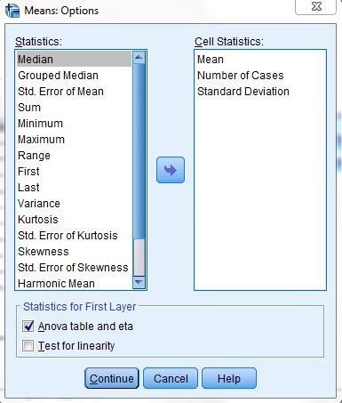
One-Way Analysis of Variance – Means: Options Box

Slide 70
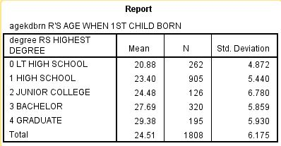
One-Way Analysis of Variance – Statistics Report

Slide 71
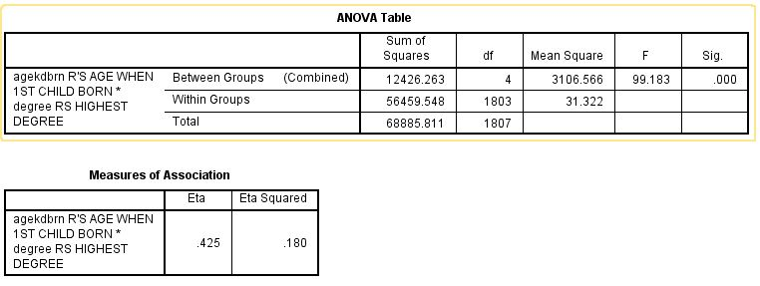
One-Way Analysis of Variance – ANOVA Table

Slide 72
Exercises for One-Way ANOVA
Compare the number of hours watching television (TVHOURS) for people of different levels of education (DEGREE). Who watches more television – those with more education or those with less education? Was the F-value statistically significant?

Slide 73
Correlation and Regression
(see chs. 7 and 8 in text)
Let’s use HRS1 (number of hours worked last week) as our dependent variable.
We’ll use AGE, EDUC (years of school completed), INCOME06 (family income) and SEI10 (socioeconomic index) as our independent variables.
Click on “Correlation” and then on “Bivariate” and select these variables.

Slide 74
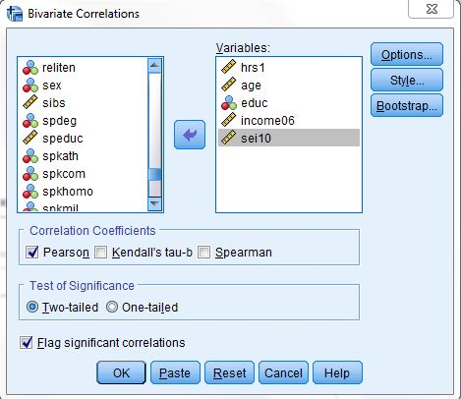
Bivariate Correlation Box

Slide 75
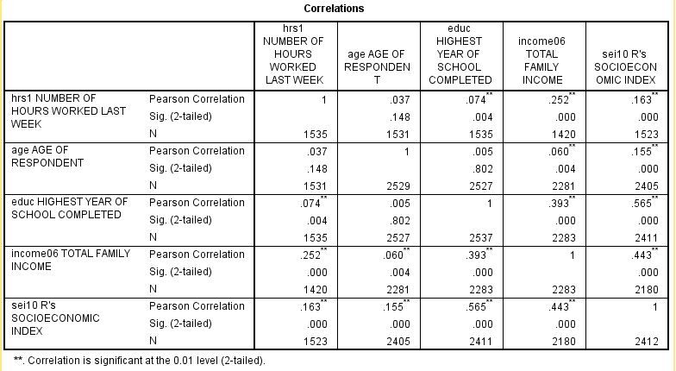
Correlation Matrix

Slide 76
Multicollinearity
Multicollinearity is a potential problem when two or more of the independent variables are highly intercorrelated.
The correlation between EDUC and SEI10 is .565. That’s pretty high but not so high as to be a serious problem.
If it was higher, then we would probably want to drop one of these two variables.

Slide 77
Regression
Now let’s run a multiple regression.
Click on Analyze/Regression/Linear.
Enter HRS1 in the “Dependent” box.
Enter AGE, EDUC, INCOME06, and SSE10- in the “Independent” box.
Click on “OK”.

Slide 78
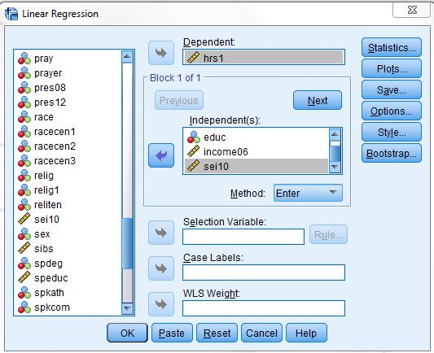
Linear Regression Box

Slide 79
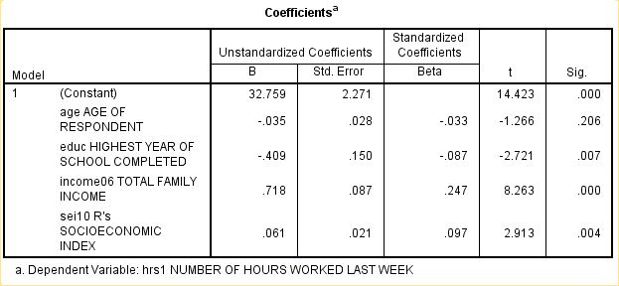
Regression Coefficients

Slide 80
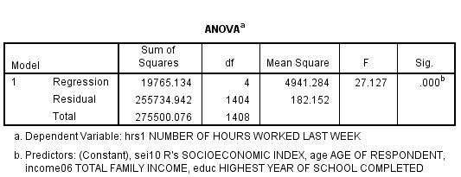
Regression ANOVA Table

Slide 81
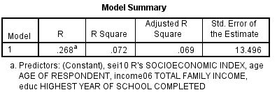
Regression R and
R Squared Values

Slide 82
Regression -- Multicollinearity
If we’re still worried about multicollinearity, let’s run another regression equation leaving out SEI10.
Dropping SEI10 will allow us to see if the regression coefficients for age and education change without SEI10 in the equation.

Slide 83
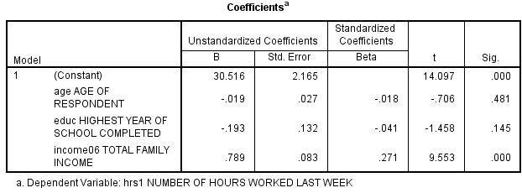
Regression Coefficients – Checking on Multicollinearity

Slide 84
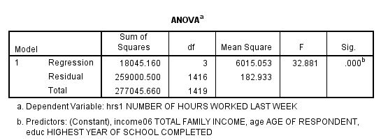
ANOVA Table when SEI10 is Dropped from the Equation

Slide 85
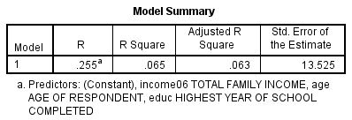
R and R Squared when SEI10 is Dropped from the Equation

Slide 86
Charts/Graphs
(see ch. 9 in text)
Bar charts
Boxplots

Slide 87
General Information About Graphs
There are several ways to produce charts in SPSS.
We’ll be using chart builder.

Slide 88
Bar Chart
We’ll use the GSS14A data set.
Click on “Graphs” and then on “Chart Builder”.
Make sure that the Gallery tab is selected and then click on Bar.
Click on the top left bar chart (i.e., simple bar chart) and drag it up to the top box.
Click on DEGREE and drag it to the X axis so your screen looks like the next slide.
Click on “OK”.

Slide 89

Chart Builder – Bar Chart

Slide 90

Bar Chart for Degree

Slide 91
Bar Chart Instructions for
Displaying Percents
Now let’s change the bar chart so it displays percents.
Click on “Graphs” again and then on “Chart Builder.”
You’ll see the Elements Properties box on the right. Click on “Bar 1”.
Under statistics click on the drop-down arrow and select “Percentage ()”.
Now you screen should look like the next slide.

Slide 92

Bar Chart Properties Box

Slide 93
Bar Chart Instructions for
Adding Title
Click on “”Apply.
Now let’s give the chart a title.
Click on the “Titles/Footnotes” tab and then check the “Title 1” Box.
Enter “Highest Degree Earned” in the “Content” box.
Your screen should look like the next slide.

Slide 94

Chart Builder – Adding Title and Percentages

Slide 95

Bar Chart For Degree with Title and Percentages
Click on “Apply” and then on “OK” and your bar chart should appear.

Slide 96
Boxplots
Click on “Graphs” and then on “Chart Builder”.
Make sure the Gallery tab is selected.
Click on “Reset” to make sure you are starting with a blank slate.
Click on “Boxplot” and then click on the top left boxplot (i.e., simple boxplot) and drag it to the window above.
Click on HRS1 (i.e., hours worked last week) and drag it to the Y axis.
Your screen should look like the next slide.

Slide 97

Boxplots Chart Builder

Slide 98

Boxplots for hrs1
Click on “OK” and your boxplot should appear.

Slide 99
Interpreting the Boxplot
The top of the box is the third quartile and the bottom of the box is the first quartile.
The solid horizontal line in the box is the median or second quartile.
The lines extending up and down from the box are measures of variation.
The circles are extreme outliers and the numbers next to the circles are the case identification numbers of the outliers..

Slide 100
Getting Separate Boxplots for Males and Females
Now let’s get two boxplots – one for males and one for females.
Click on SEX and drag it to the X axis so your screen looks like the next slide.
Then click on “OK” to get the boxplots.

Slide 101

Getting Boxplots for Males and Females

Slide 102

Boxplots for Males and Females

Slide 103
Where do you go from here?
Explore the help menu.
Spend some time playing with SPSS.
Try out different ways of analyzing your data.
Consult a person trained in statistics if you have questions about what statistical procedures to use or how to interpret them.

Slide 104
How to contact me
Ed Nelson
CSU Fresno
ednelson@csufresno.edu
559-978-9391 (cell)

