Slide 1
Intermediate Workshop
SPSS
CSU Stanislaus
May 2, 2014
Ed Nelson – CSU Fresno

Slide 2
Social Science Research and Instructional Council (SSRIC)
Discipline council for the social sciences made up of representatives from each campus in the CSU. List of campus representatives can be found at the SSRIC website by clicking on "The Council" and then on “Contact Information“.
Promotes use of data analysis in research and teaching.
Other information can be found by going to the SSRIC website.

Slide 3
Social Science Data Bases
The SSRIC helps maintain and promote the use of the social science data bases in the CSU.
Data bases include:
  Inter-university Consortium for Political and Social Research (ICPSR)
  The Field (California) Poll
  The Roper Center for Public Opinion Research

Slide 4
Agenda for the Intermediate
SPSS Workshop
Cross tabulations
  Bivariate
  Multivariate
Comparing means
  Independent sample t test
  Paired-sample t test
  One-way analysis of variance
Regression and correlation
  Bivariate
  Multivariate
Graphs/Charts

Slide 5
Getting More Information about the Screen Captures
The images in this PowerPoint are screen captures from SPSS and various web sites.
To see a description of the screen capture, right click on the image and then click on Format Picture. Click on Alt Text and a description of the image will appear.
To close the Alt Text box click on Close.

Slide 6
Overview of SPSS
SPSS is a statistical package for beginning, intermediate, and advanced data analysis.
Other statistical packages include SAS, Stata and R.
Online statistical packages that don’t require site licenses include SDA.

Slide 7
Text – SPSS for Windows
Version 19 A Basic Tutorial
Authors: Linda Fiddler (Bakersfield), Laura Hecht (Bakersfield), Ed Nelson (Fresno), Elizabeth Nelson (Fresno), Jim Ross (Bakersfield).
Available from McGraw-Hill Learning Solutions. Call 800-338-3987 to order. Request ISBN
0-07-804018-3.
Available on the web by going to the SSRIC website and clicking on "Teaching Resources" and then on "Online Textbooks" and then clicking on the SPSS book title. The data set for this tutorial can be downloaded at this site.
Version 22 will be available soon online.

Slide 8
SPSS Files and Extensions
Portable file -- .por
Data file -- .sav
Output file -- .spo
Syntax file -- .sps

Slide 9
Opening SPSS
Go to start and find SPSS for Windows.
Click on SPSS 19.0 or the version you have on your computer to open.
You’ll need to update your SPSS license every year (or your school technician will do it for you).

Slide 10
Opening a SPSS Data File
File that you created. We talked about this in the last workshop.
File that you got from someplace else.

Slide 11
Opening an Existing File
You Got Somewhere Else
Often you will want to open a data set that you got from someplace else such as:
  ICPSR
  Roper Center
  Field
These files will usually be in the form of a:
  SPSS portable file (.por)
  SPSS data file (.sav)
  Raw data file with a SPSS syntax file (.sps)
  Raw data file without a syntax file

Slide 12
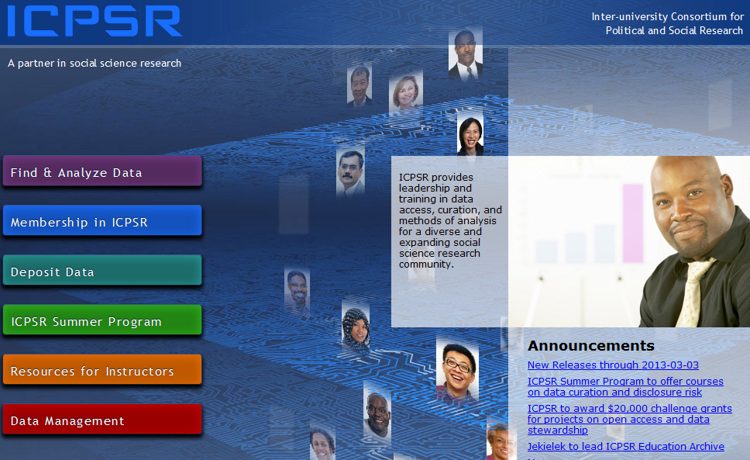
ICPSR

Slide 13
Searching for Data from ICPSR
Click on Find and Analyze Data.
Enter “immigration” in the “Find Data box.
Explore the different ways of browsing.
Click on “Go”.

Slide 14
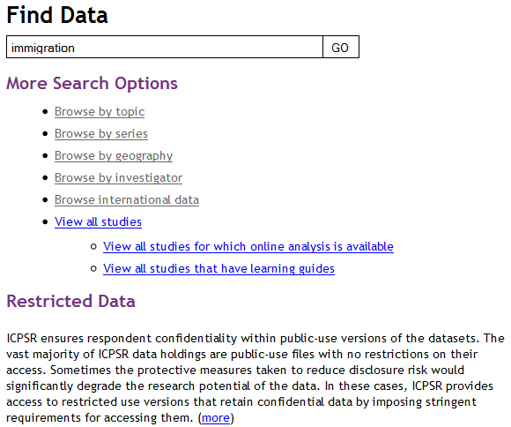
Searching for Data – Find Data

Slide 15
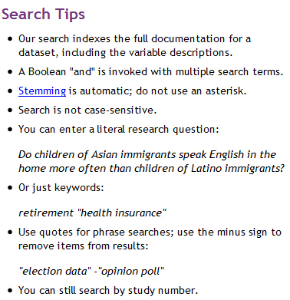
Searching Tips

Slide 16
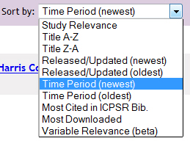
Sorting by Time Period
Arrange the data sets so they go from earliest to latest.

Slide 17
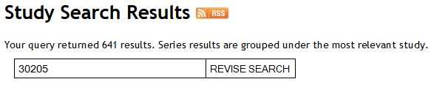
Data Set We’re Using
We’re going to use ICPSR study number 30205. If you know the study number you can search for it by number. When you do the study 30205 should be near the top of the search results list and will be the study on the next slide.

Slide 18
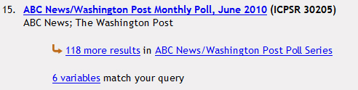
Study We’re Going to Use

Slide 19
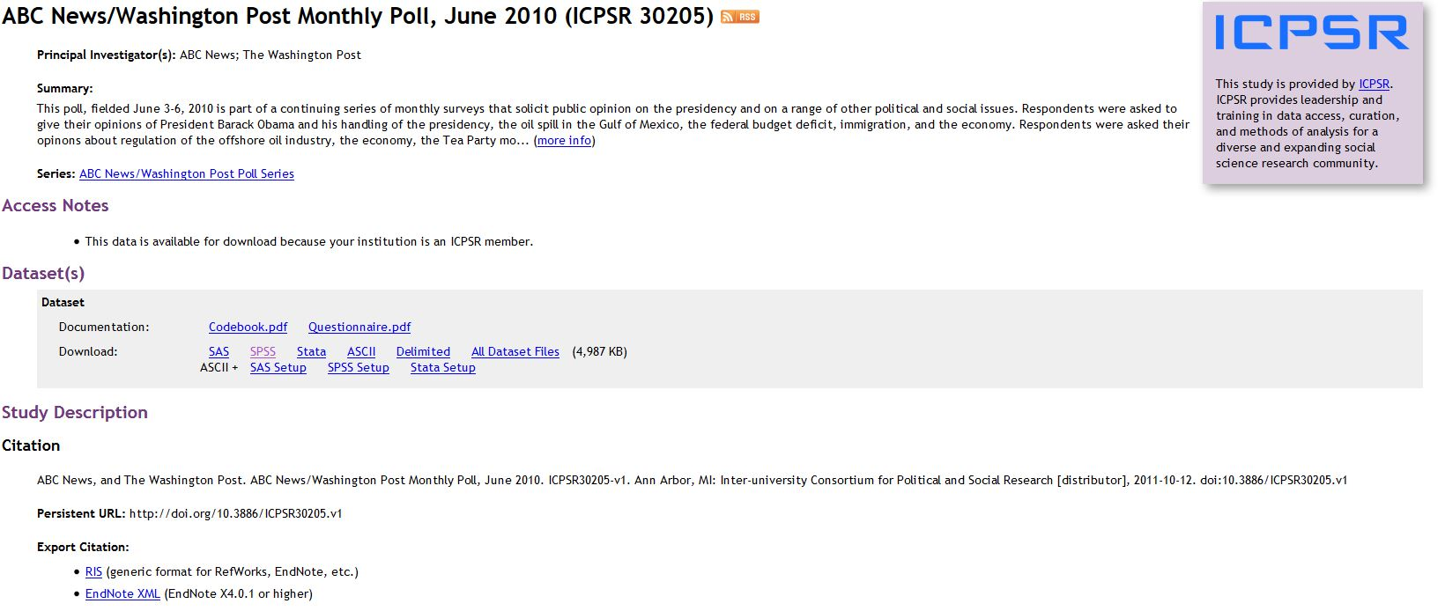
More Information about Study
Double click on the study title to get more information about the study.

Slide 20
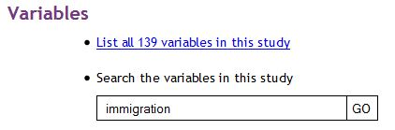
More Information about Variables
Scroll down the study results until you see Variables. Enter “immigration” into the box and click Go.

Slide 21
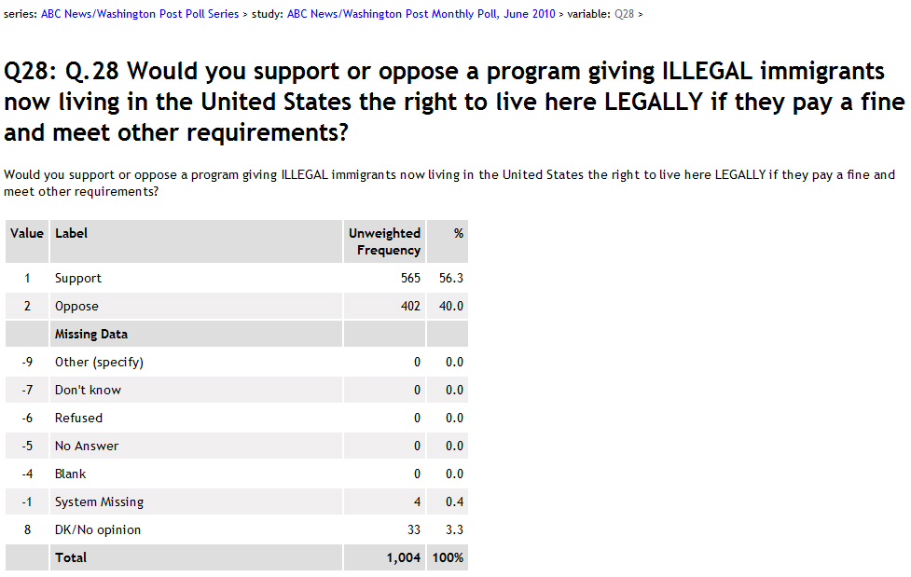
Q28
Double click on Q28 to see the frequency distribution for this variable.

Slide 22
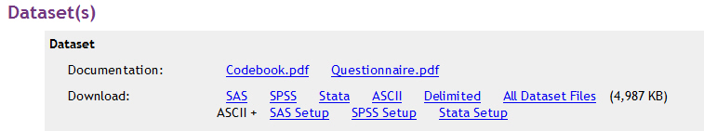
Downloading a File from ICPSR
Find the section in the study results that describes the data sets.
Click on whatever you want to download.

Slide 23
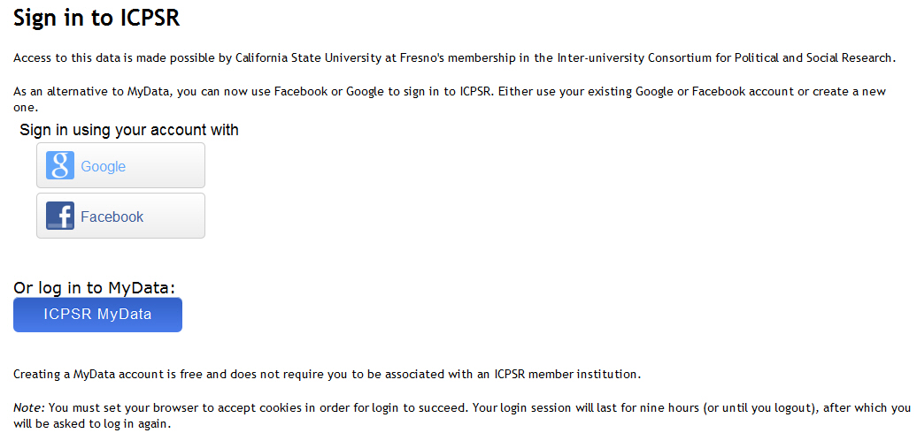
Sign in to ICPSR

Slide 24
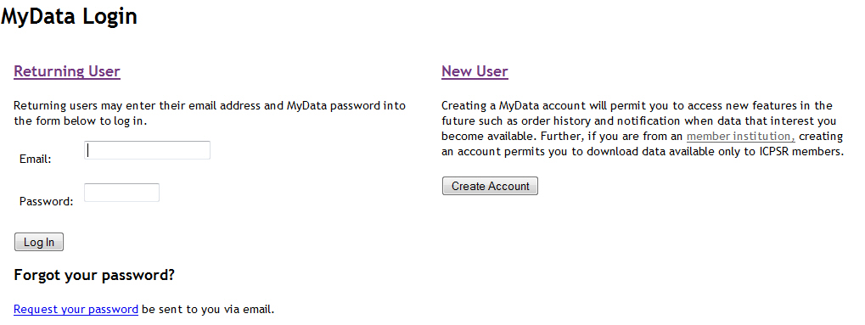
Creating a MyData Account

Slide 25
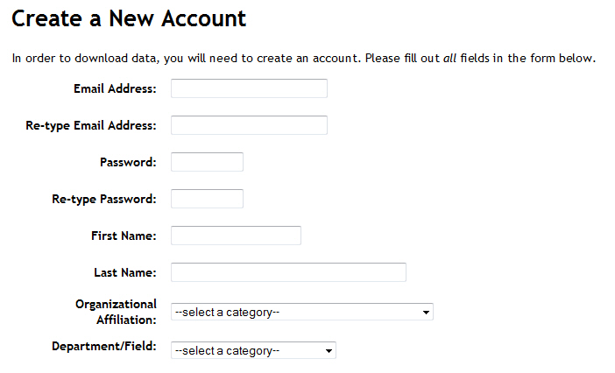
Filling Out the New
Account Form

Slide 26
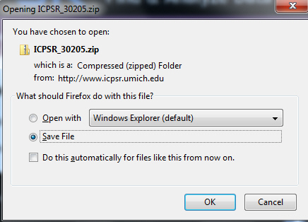
Downloading Box

Slide 27
Downloading Instructions
Select “Save File”.
In Firefox file will be saved to your downloads folder.
File will be saved as a zip file.
Open the zip file.
Keep opening folders until you see codebook.pdf, questionnaire.pdf and data.sav.

Slide 28
Opening the .sav File
You can move the zip file from the downloads folder to wherever you want to keep it on your hard drive.
Open SPSS and then open the .sav file.

Slide 29
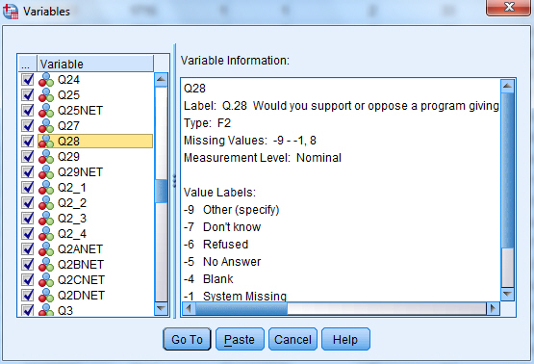
Mini-codebook
Utilities/Variables

Slide 30
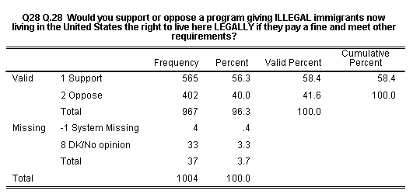
Frequency Distribution for Q28

Slide 31
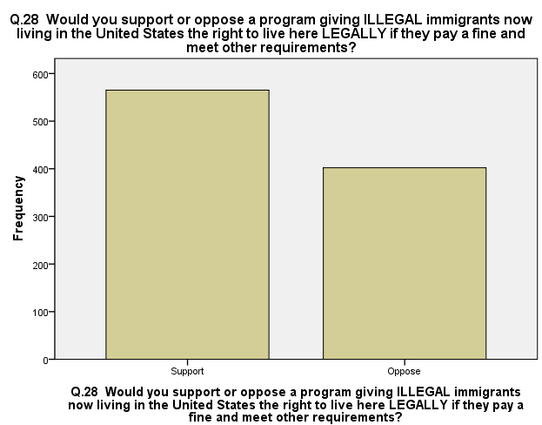
Bar chart for Q28

Slide 32
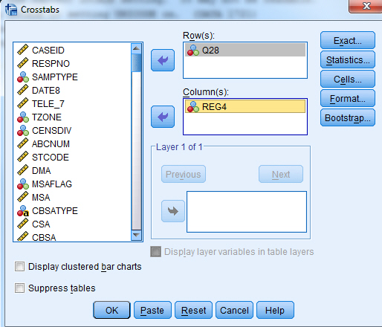
Crosstabs – Bivariate
(see chapter 5 in text)

Slide 33
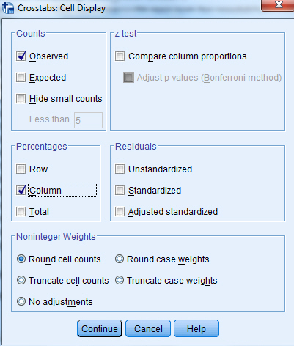
Cells Display Box

Slide 34
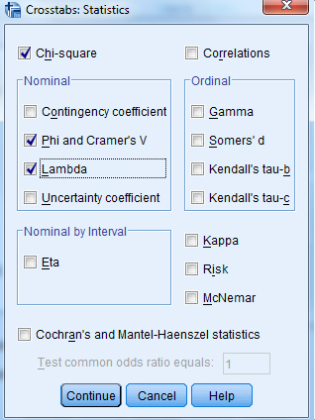
Crosstabs Statistics Box

Slide 35
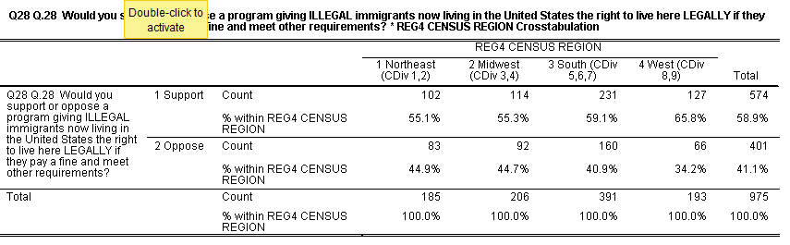
Percentaged Crosstabs Table for Q28 by REG4

Slide 36
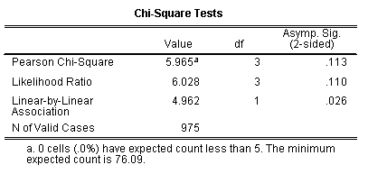
Chi Square Table

Slide 37
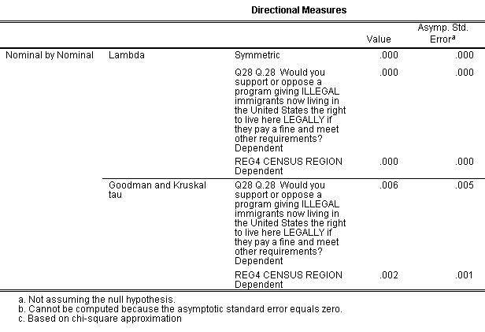
Lambda and Goodman and Kruskal Tau

Slide 38
Crosstabs –Another Example
Now let’s run a table with USR (urban, suburbs, rural) as our independent variable and Q28 as our dependent variable.

Slide 39
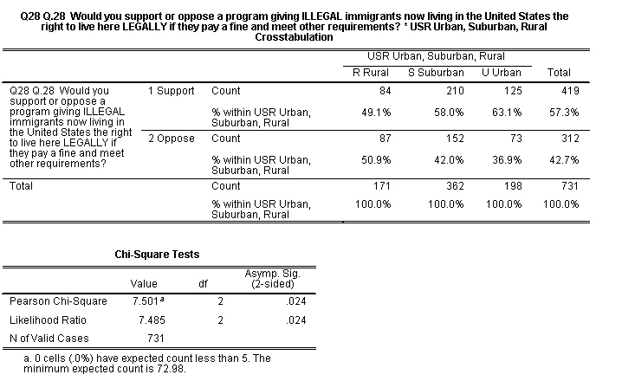
Percentaged Crosstabs Table for Q28 by USR

Slide 40
Exercises for Crosstabs -- Bivariate
Now you try some two-variable crosstabs with Q28 as your dependent variable and some other independent variables such as:
  Education – EDUCBREAK
  Race – Q918
  Income – INCOME2
  Age – AGEBREAK
  Sex – Q921

Slide 41
Crosstabs -- Multivariate
Let’s run a three- variable table
  Dependent variable – Q28
  Independent variable– AGEBREAK
  Control variable – Q921 (sex)

Slide 42
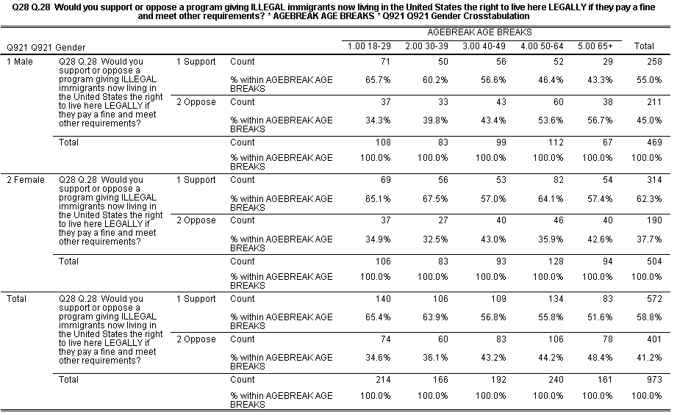
Crosstabs – Multivariate
Table for Q28 by Agebreak by Q921 (sex)

Slide 43
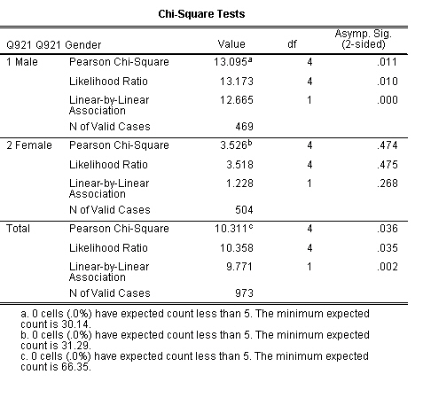
Crosstabs – Chi Square Table

Slide 44
Crosstabs – Multivariate Table – Interchanging the Control and Independent Variables
Now let’s interchange the control and independent variables
  Dependent variable – Q28
  Independent variable – Q921 (sex)
  Control variable -- AGEBREAK

Slide 45
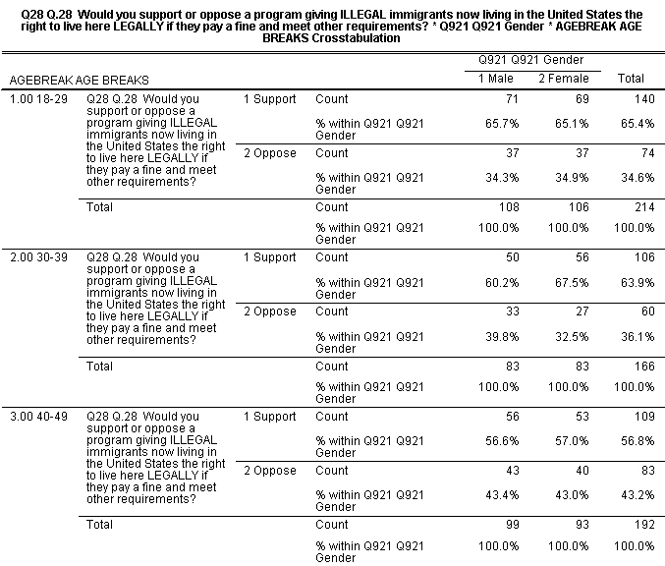
Crosstabs – Multivariate Table for Q28 by Q921 (sex) by Agebreak

Slide 46
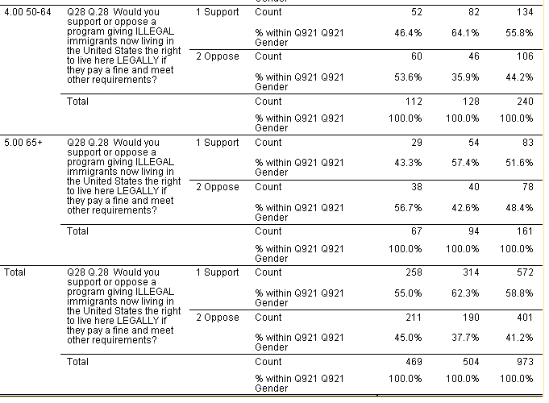
Crosstabs – Rest of the Table

Slide 47
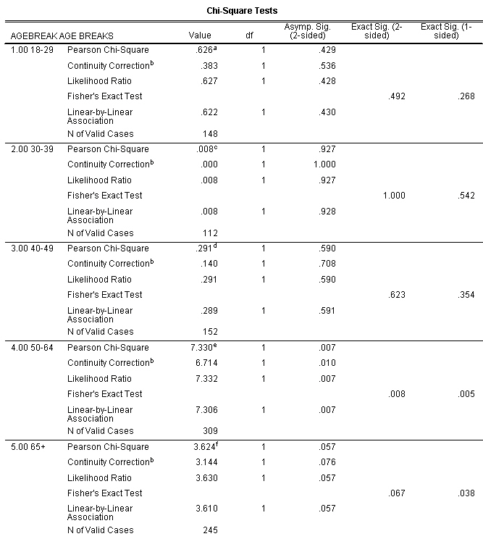
Crosstabs – Chi Square Table for Q28 by Q921 (sex) by Agebreak

Slide 48
Ways to Compare Means
(see ch. 6 in text)
Independent-sample t test
Paired-sample t test
One-way analysis of variance
For this part of the workshop, we’re going to switch to the 2010 General Social Survey (GSS) and use a subset that I created for my classes called GSS10a.sav. You’re welcome to use this subset for your classes.
There is also a subset for the 2012 GSS called Gss12a.sav.

Slide 49
Comparing Means
Click on Analyze/Compare Means and then on Means.
Move AGEKDBRN into the “Dependent List”.
Move SEX into the “Independent List”
Click on OK.

Slide 50
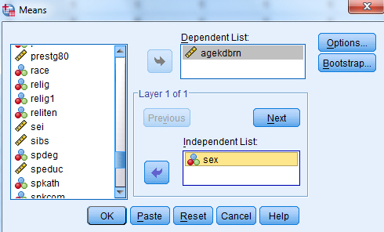
Comparing Means –
Means Table for Agekdbrn by Sex

Slide 51
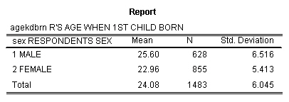
Means Output for Agekdbrn by Sex

Slide 52
Comparing Means – Other Statistics and Further Breakdowns
Requesting other statistics – click on “Options” and select the other statistics you would like.
Further breakdowns – Click on “Next” and select a further breakdown.
  Move DEGREE into the “Layer 2” box and click on “OK” and click on OK. again
  After you have done this, move DEGREE into the “Layer 1” box and SEX into the “Layer 2” box and click on OK.

Slide 53
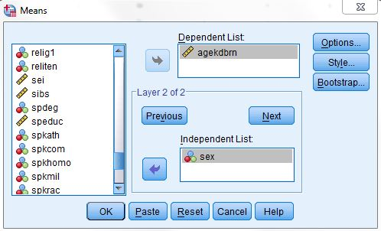
Comparing Means –
Agekdbrn by Degree by Sex

Slide 54
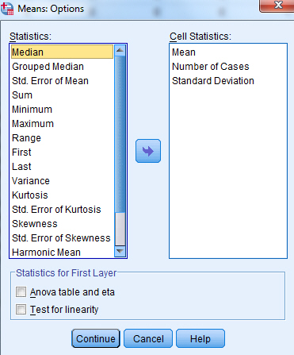
Comparing Means -- Statistics

Slide 55
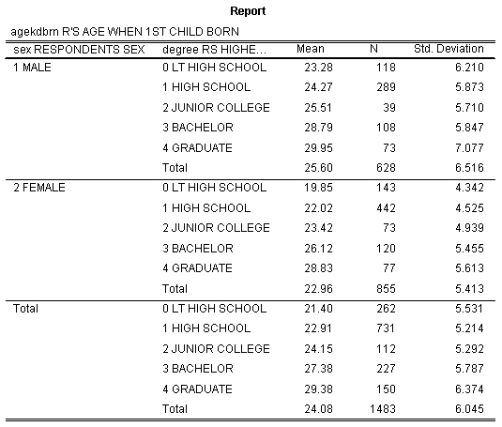
Comparing Means – Chi Square Table for Agekdbrn by Degree by Sex

Slide 56
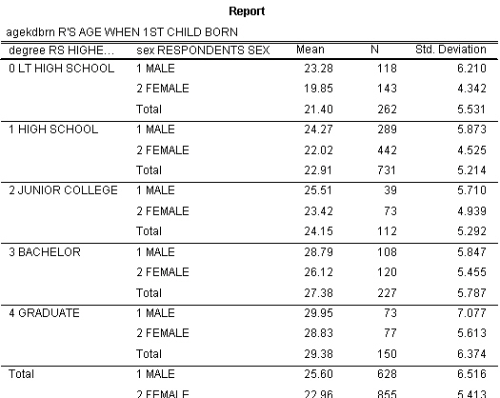
Comparing Means -- Agekdbrn by Sex by Degree

Slide 57
Exercises for Comparing Means
Compute the mean age (AGE) of respondents who voted for Bush, Kerry, and someone else (PRES04). Which group had the youngest mean age and which had the oldest mean age?
Compute the mean number of hours that people with different levels of education (DEGREE) watch television (TVHOURS). Who watches more television – those with less education or those with more education?

Slide 58
Independent Sample t Test
Independent samples are samples where the composition of one sample does not influence the composition of the other sample.
Click on Analyze/Compare Means/Independent Sample T Test.
Select the “Test Variable”. This is the variable that you want to use to compare the two groups. Let’s use AGEKDBRN as our test variable.
Click on Define Groups to define the two groups that you want to compare.

Slide 59
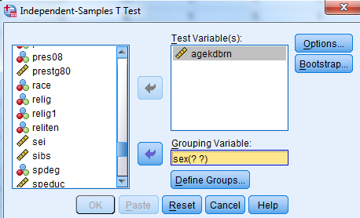
Independent Sample Box for
Agekdbrn by Sex

Slide 60
Defining the Groups
Now indicate the values that define the two groups.
Males are coded 1 and females are coded 2.
So enter 1 in the Group 1 box and 2 in the Group 2 box.
Then click on Continue and then on OK.

Slide 61
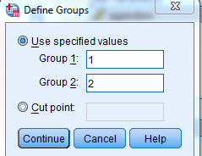
Independent Sample t Test --Define Groups

Slide 62
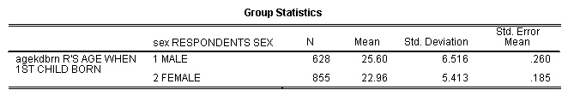
Independent Sample t Test – Group Statistics

Slide 63
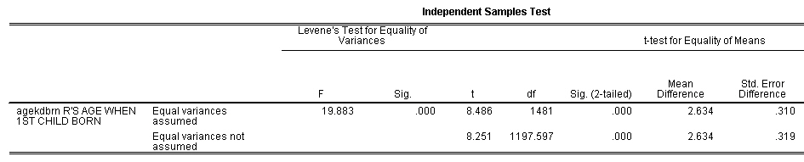
Independent Sample t Test – t Values

Slide 64
Exercises for Independent Sample t Test
Use the independent sample t test to compare the mean age (AGE) of respondents who believe and do not believe in life after death (POSTLIFE). Which group had the highest mean age? Was the difference statistically significant at the .05 level of significance?
Compare the mean family income (INCOME06) of men and women (SEX). Who had the higher income? Was it statistically significant at the .05 level of significance?

Slide 65
Paired Samples t Test
Paired samples are samples where the composition of one sample determines the composition of the other sample (e.g., sample of husbands and wives married to each other).
Click on Analyze/Compare Means/Paired Samples T Test.

Slide 66
Paired Samples t Test -- Continued
Select your paired variables by clicking on the first variable in the list on the left and then clicking on the arrow. Then click on the second variable and click on the arrow again. They should now be in the “Paired Variables” box on the right. Let’s use MAEDUC and PAEDUC as our paired variables.
Move these two paired variables to the “Paired Variables” box.
Click on “OK.”

Slide 67
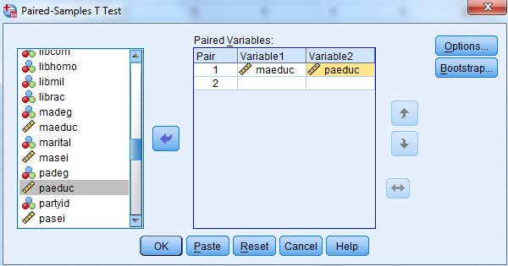
Paired Samples t Test Box

Slide 68
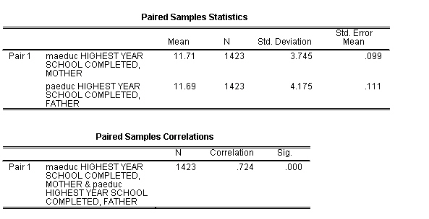
Paired Samples t Test – Group Statistics

Slide 69
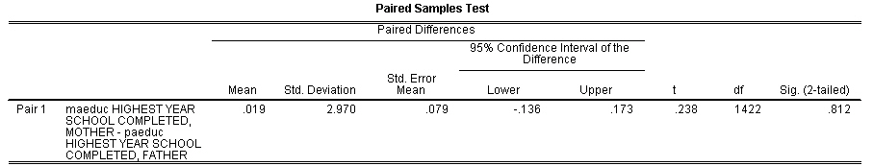
Paired Samples t Test – t test value

Slide 70
Exercises for Paired Sample t Test
Use the paired-sample t test to compare mother’s socioeconomic status (MASEI) and father’s socioeconomic status (PASEI). Who has the highest mean socioeconomic status – mothers or fathers? Was the difference statistically significant?
Compare the mean years of school completed for respondents (EDUC) and their spouses (SPEDUC). Who has the higher years of school completed? Was the difference statistically significant?

Slide 71
One-Way Analysis of Variance
Now we want to compare means for more than two groups.
Click on Analyze/Compare Means/Means.
Select the variable that defines your groups by clicking on it and moving it to the “Independent List” box. Do this for DEGREE.
Select the variable that you want to use as your comparison variable and move it to the “Dependent List” box. Let’s use AGEKDBRN as our comparison variable.

Slide 72
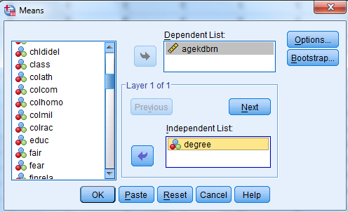
One-Way Analysis of Variance – Means Box

Slide 73
One-Way Analysis of Variance (continued)
Click on “Options” to open the “Means: Options” box.
Click in the “Anova table and eta” box to select it and indicate that you want to do a One-Way ANOVA.
Click on “Continue” and on “OK.”

Slide 74
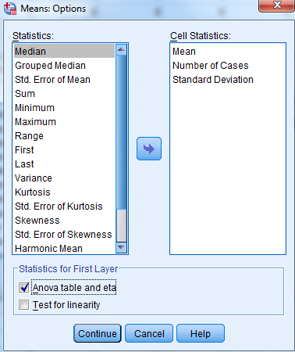
One-Way Analysis of Variance – Means: Options Box

Slide 75
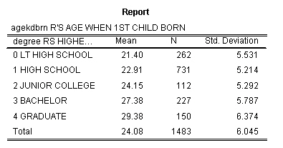
One-Way Analysis of Variance – Statistics Report

Slide 76
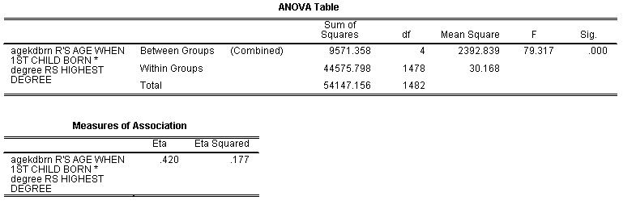
One-Way Analysis of Variance – ANOVA Table

Slide 77
Exercises for One-Way ANOVA
Compare the number of hours watching television (TVHOURS) for people of different levels of education (DEGREE). Who watches more television – those with more education or those with less education? Was the F-value statistically significant?

Slide 78
Correlation and Regression
(see chs. 7 and 8 in text)
Let’s use HRS1 (number of hours worked last week) as our dependent variable.
We’ll use AGE, EDUC (years of school completed), INCOME06 (family income) and SEI (socioeconomic index) as our independent variables.

Slide 79
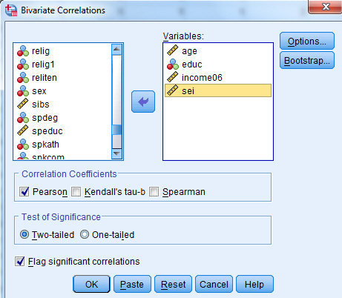
Bivariate Correlation Box

Slide 80
Correlation
Check for multicolinearity which means that two or more of the independent variables are highly intercorrelated.
The correlation between EDUC and SEI is .529. That’s pretty high but not so high as to be a serious problem.
If it was higher, then we would probably want to drop one of these two variables.

Slide 81
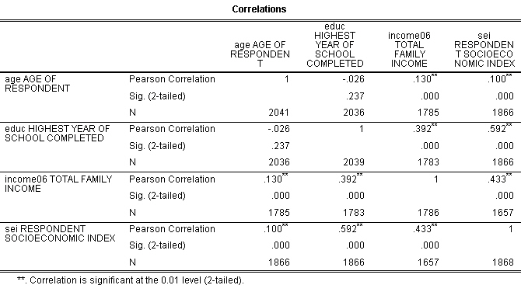
Correlation Matrix

Slide 82
Regression
Now let’s run a multiple regression.
Click on Analyze/Regression/Linear.

Slide 83
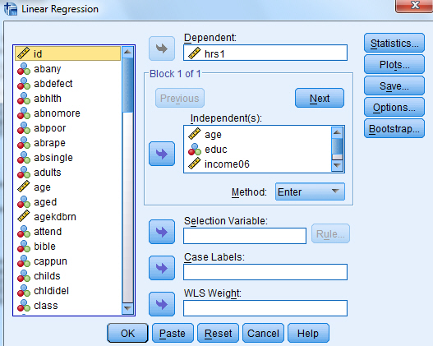
Linear Regression Box

Slide 84
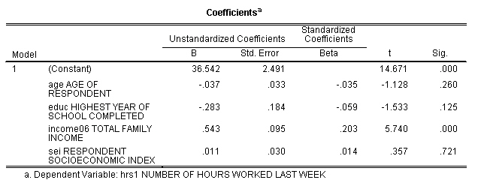
Regression Coefficients

Slide 85

Regression ANOVA Table

Slide 86

Regression R and
R Squared Values

Slide 87
Regression -- Multicolinearity
If we’re still worried about multicolinearity, let’s run another regression equation leaving out SEI.
Dropping SEI will allow us to see if the regression coefficients for age and education change without SEI in the equation.

Slide 88

Regression Coefficients – Checking on Multicolinearity

Slide 89

ANOVA Table when SEI is Dropped from the Equation

Slide 90

R and R Squared when SEI is Dropped from the Equation

Slide 91
Charts/Graphs
(see ch. 9 in text)
Bar charts
Boxplots

Slide 92
General Information About Graphs
There are several ways to produce charts in SPSS.
We’ll be using chart builder.

Slide 93
Bar Chart
We’ll use the GSS10A data set.
Click on Graphs and then on Chart Builder.
Make sure that the Gallery tab is selected and then click on Bar.
Click on the top left bar chart (i.e., simple bar chart) and drag it up to the top box.
Click on DEGREE and drag it to the X axis so your screen looks like the next slide.

Slide 94

Chart Builder – Bar Chart

Slide 95

Bar Chart for Degree

Slide 96
Bar Chart Instructions for
Displaying Percents
Now let’s change the bar chart so it displays percents.
You’ll see the Elements Properties box on the right. Click on Bar 1.
Under statistics click on the drop-down arrow and select percentages.
Now you screen should look like the next slide.

Slide 97

Bar Chart Properties Box

Slide 98
Bar Chart Instructions for
Adding Title
Click on Apply.
Now let’s give the chart a title.
Click on the Titles/Footnotes tab and then check the Title 1 Box.
Enter “Highest Degree Earned” in the Content box.
Your screen should look like the next slide.

Slide 99

Chart Builder – Adding Title and Percentages

Slide 100

Bar Chart For Degree with Title and Percentages
Click on Apply and then on OK and your bar chart should appear.

Slide 101
Boxplots
Click on Graphs and then on Chart Builder.
Make sure the Gallery tab is selected.
Click on boxplot and then click on the top left boxplot (i.e., simple boxplot) and drag it to the window above.
Click on HRS1 (i.e., hours worked last week) and drag it to the Y axis.
Your screen should look like the next slide.

Slide 102

Boxplots Chart Builder

Slide 103

Boxplots for hrs1
Click on OK and your boxplot should appear.

Slide 104
Interpreting the Boxplot
The top of the box is the third quartile and the bottom of the box is the first quartile.
The solid horizontal line in the box is the median or second quartile.
The lines extending up and down from the box are measures of variation.
The circles are extreme outliers and the numbers next to the circles are the case identification numbers of the outliers..

Slide 105
Getting Separate Boxplots for Males and Females
Now let’s get two boxplots – one for males and one for females.
Click on SEX and drag it to the X axis so your screen looks like this.
Then click on OK to get the boxplots.

Slide 106

Getting Boxplots for Males and Females

Slide 107

Boxplots for Males and Females

Slide 108
Where do you go from here?
Explore the help menu.
Spend some time playing with SPSS.
Try out different ways of analyzing your data.
Consult a person trained in statistics if you have questions about what statistical procedures to use or how to interpret them.

Slide 109
How to contact me
Ed Nelson
CSU Fresno
ednelson@csufresno.edu
559-978-9391 (cell)

