Slide 1
Roper Center for Public Opinion Research
Social Science Research and Instructional Council
January, 2016

Slide 2
Getting More Information about the Screen Captures
The images in this PowerPoint are screen captures from the Roper Center website.
To see a description of the screen capture, right click on the image and then click on Format Picture. Click on Alt Text and a description of the image will appear.
To close the Alt Text box click on Close.

Slide 3
What is the Roper Center?
Archive of public opinion data produced by commercial and media centers.
Contains over 22,000 data sets from over 100 countries many of which can be downloaded with RoperExpress.
iPOLL is a collection of over 650,000 survey questions which can be searched.
RoperExplorer is a data analysis tool that produces frequency distributions and crosstabulations.

Slide 4
How do we get access to the Roper Center for Public Opinion Research?
CSU campuses subscribe yearly to the social science databases which include:
  The Roper Center for Public Opinion Research
  The Field Poll
  The Inter-university Consortium for Political and Social Research
Campuses that subscribe have free access to all these databases for their students, faculty and staff.

Slide 5
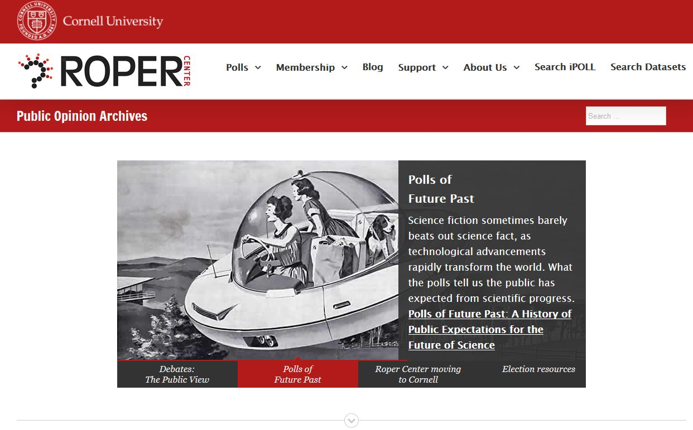
The Roper Center Website

Slide 6
Getting an Account
The first thing you need to do is to create your own personal account at the Roper Center.
You’ll need this account to search the archive of data sets and questions, download data sets and analyze data online.
These accounts are free.
To create your own account, you’ll need be on a computer on a CSU campus that has subscribed to the social science data bases.
Click on “Search iPOLL” in the upper right of the Roper home page.

Slide 7
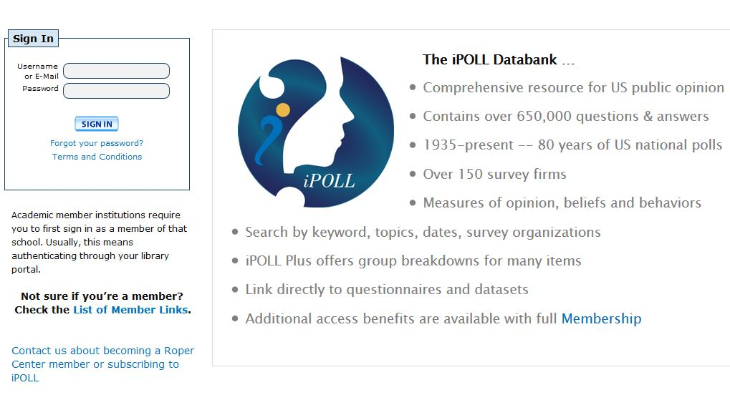
Signing Into your Account
If you have an account already, click on “Sign In” in the upper left of the screen and then log into your account.
If you don’t have an account, click on “Register” in the upper right. You should see the screen on the next slide.

Slide 8
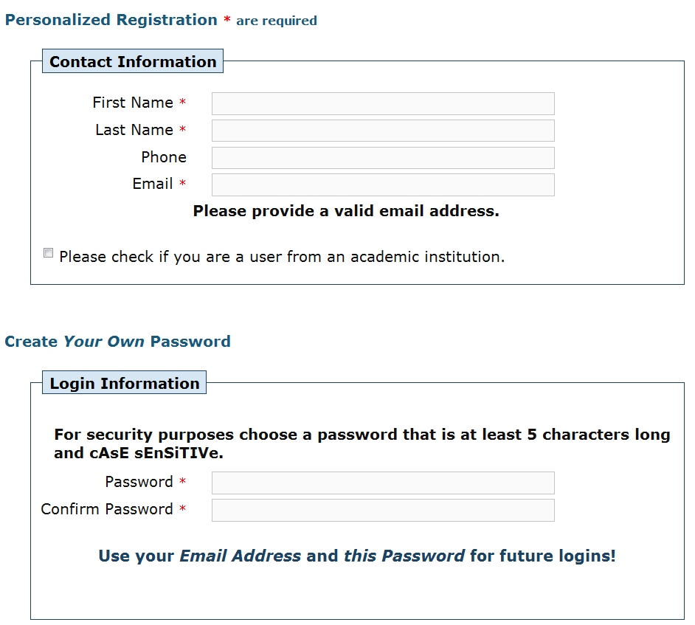
Creating your Own Account
Fill in the form to create your account.
Click “Submit” and your account will be created.

Slide 9
Logging onto your Account
From now on, when you want to use the Roper Center and it asks you to sign into your account, use your email address as your user name and the password you just created.
Now that you have your account, you can access the Roper Center from off campus.
When you need to sign into your account, it will ask you to do so.

Slide 10
iPOLL
The first thing you will see is the iPOLL search page which is on the next slide.
iPOLL is a searchable database of over 650,000 survey questions.
iPOLL allows you to search by keywords you think would be used in the questions.
It’s important to keep in mind that Roper does not have the data set for every one of these questions.

Slide 11
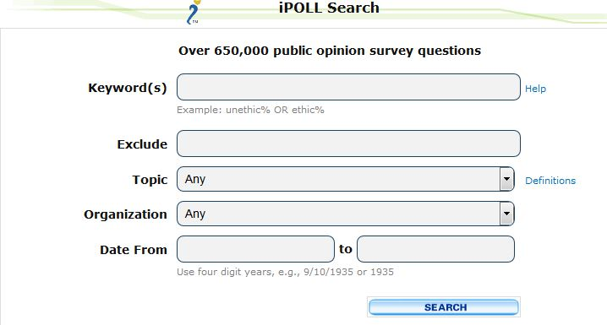
iPOLL Search Page

Slide 12
Doing an iPOLL Search
Enter your search words in the “Keyword(s)” box. We’re going to start by searching for “religion”.
You can exclude questions that contain specific words in the “Exclude” box. We’re going to leave this blank.
You can select certain topics and survey organizations. Click on the drop down arrow to see what these are.
You can specify a date range. We’re going to search for 2000 to 2016.
Click on “SEARCH.”

Slide 13
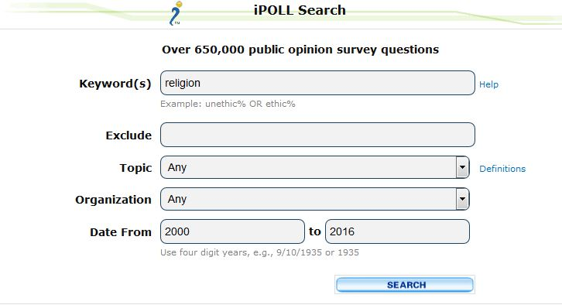
Example of an iPOLL Search

Slide 14
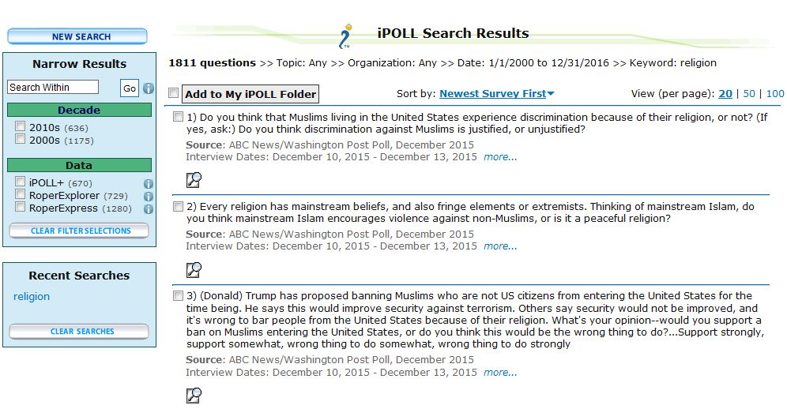
Example of iPOLL Search Results
(your results may differ)

Slide 15
What’s in the Search Results?
The search results show you the survey question, source and interview dates.
The results are sorted by the newest survey first. You can click on “Newest Survey First” to change this to sorting by oldest search first.

Slide 16
Viewing the Question Details
In the lower-left of each question you will see an icon that looks like a magnifying glass.
Click on this icon for one of the questions listed. You ought to see something similar to the next slide.
The question details will show you how respondents answered this question.

Slide 17
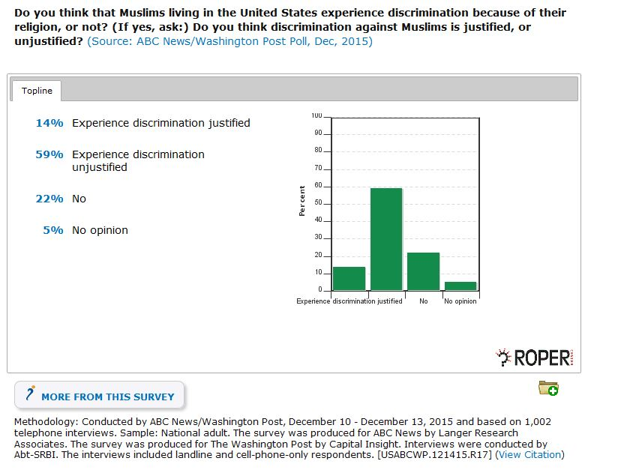
Question Details

Slide 18
RoperExpress and RoperExplorer
Below some of the questions, you will see the RoperExpress and RoperExplorer icons.
The RoperExpress icon looks like a slanted X.
The RoperExplorer icon looks like a four-pointed star.
Sometimes the icons will be combined and will look like a slanted X with the star to its right.
Depending on your search results you may have to look through several pages of results to find a question with this icon.
You should see something similar to the example on the next slide.

Slide 19
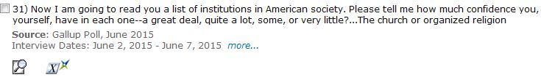
Example of a Question that has both the RoperExpress and RoperExplorer Icons

Slide 20
Using RoperExpress and RoperExplorer
RoperExpress is used to download data and RoperExplorer is used to get frequency distributions and crosstabulations.
Click on the RoperExpress and RoperExplorer icon.
You should see a page similar to the example on the next slide.
We’ll look at RoperExpress and RoperExplorer later in this PowerPoint.

Slide 21
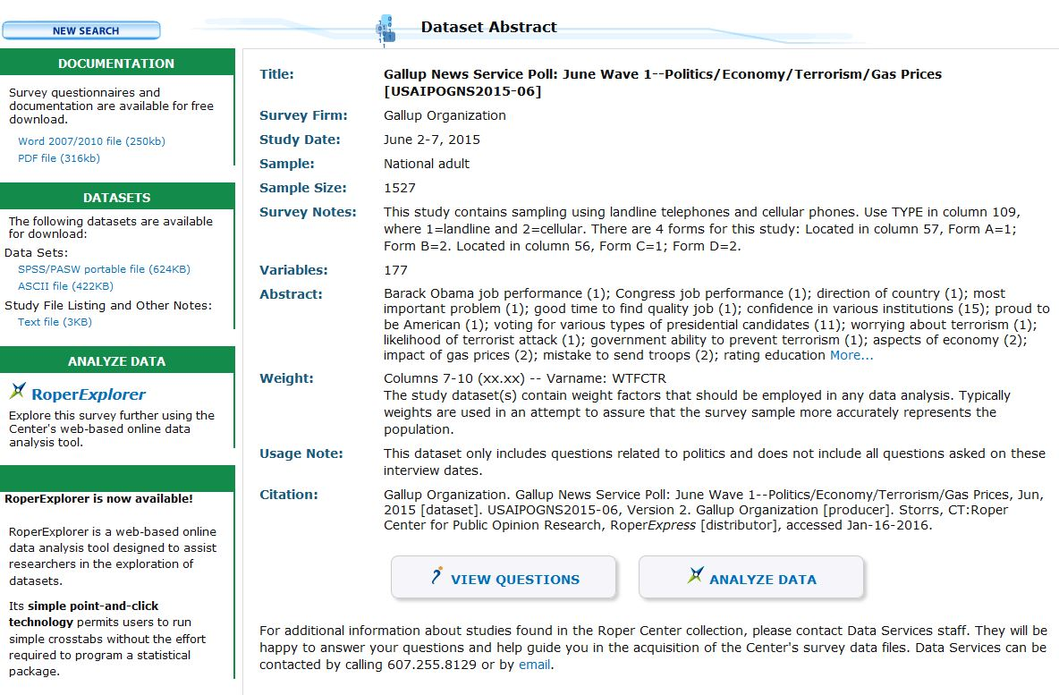
Click on the RoperExpress and RoperExplorer Icons

Slide 22
Searching Within a Search
You recall that our original search for “religion” gave us a lot of questions. Let’s narrow it down.
Let’s go back and look at the search again. The easiest way to do this is to click on new search and repeat the search by entering “religion” into the keywords box and the dates 2000 to 2016 into the date box.
At the left of the search results you will see “Narrow Results.” Under “Narrow Results: you’ll see a Search Box that says “Search Within.”

Slide 23
Searching Within a Search Continued
In the “Search Within” box, enter “attend”.
This will search all the questions for the word “attend”.
Click on “Go”.
You should get something like the next slide.

Slide 24
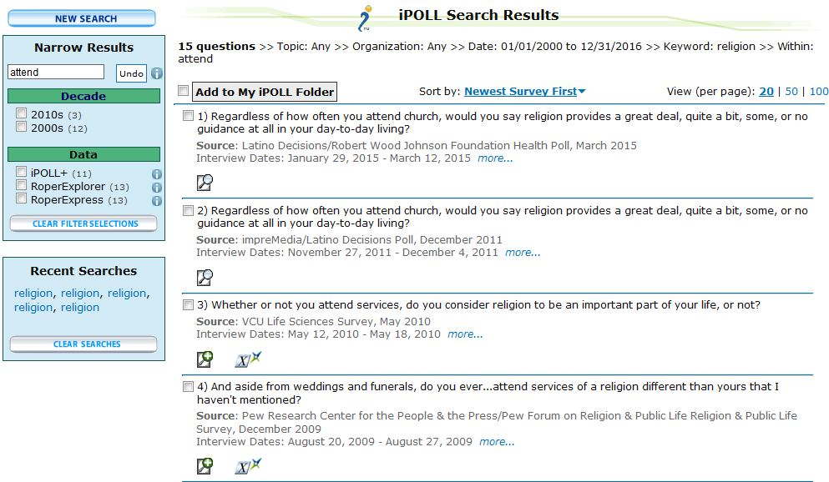
Searching Within a Search Results
(your results may differ)

Slide 25
Searching Within a Search Results Continued
Now we have limited our search to a smaller number of questions that contain the word “attend” in the question.
We can also narrow the search by decade and limit the search to questions that have downloadable data sets through RoperExpress and questions where the data can be analyzed with RoperExplorer.
We can also go back to our original search and try limiting it in other ways. Try entering the word “important” and then do it again entering the word “pray” in the search box and see what you get. Remember to go back to the original search where you searched for “religion.”

Slide 26
Downloading Data Using RoperExpress
Now let’s talk about downloading Roper Center data.
About 60% of the data sets in the Roper Archive can be downloaded by using RoperExpress.
Let’s download a data set.
Click on “Datasets” in the upper right of your screen. You should see the page on the next slide.

Slide 27
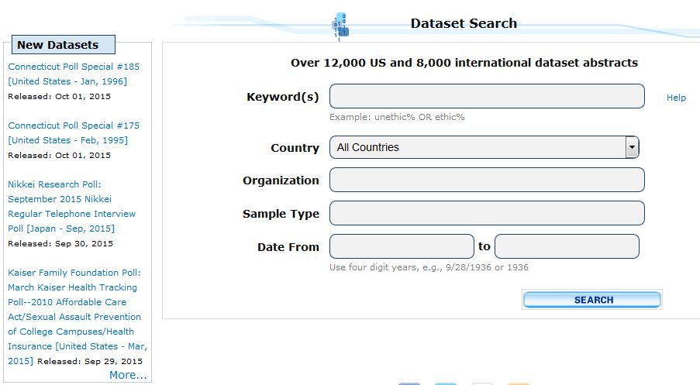
Search for Datasets

Slide 28
Search for Datasets Instructions
The “Search for Datasets” dialog box looks very similar to the iPOLL box.
“Search for Datasets” searches the abstracts of the studies, unlike iPOLL that searches the questions.
Enter “religion” in the “Keyword(s)” box and use 2000 to 2016 for the date range.
The countries box allows you to search for surveys from a particular country. We’ll use the default which is “All Countries.”
Leave the other boxes blank and click on the “Search” button.

Slide 29
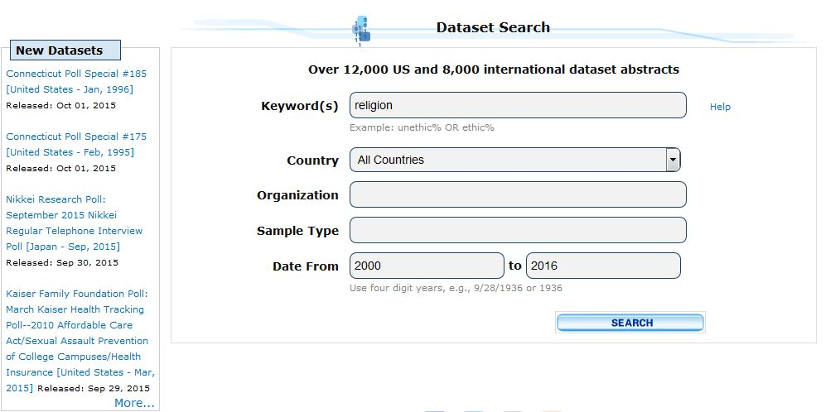
Example of Searching for Datasets

Slide 30
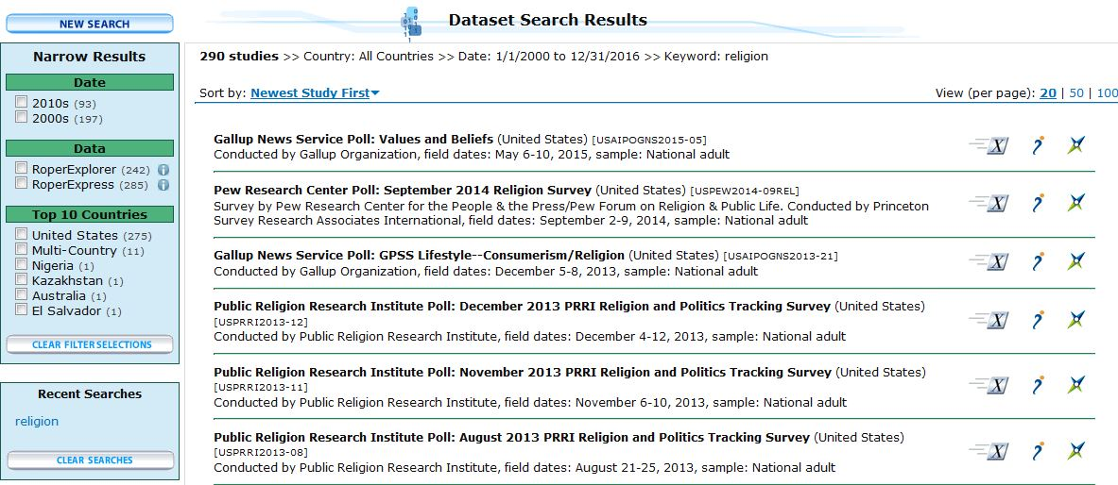
Search for Datasets Results
(your results may differ)

Slide 31
Search Results
One of the surveys listed is the Pew Research Center’s Poll on religion conducted in September, 2014. Your first result may differ.
The RoperExpress icon (looks like a slanted X) indicates that this dataset can be downloaded directly to your computer with RoperExpress.

Slide 32
Search Results Continued
The iPOLL icon indicates that you can view the questions in iPOLL.
The RoperExplorer icon indicates that you can analyze the survey results with RoperExplorer.
Note that you can narrow your results by date, country and by limiting your search to studies that can be downloaded by RoperExpress and analyzed by RoperExplorer.
Let’s download the dataset.

Slide 33
Downloading the Dataset
Click on the RoperExpress icon for the Pew Research Center’s Poll on religion conducted in September, 2014.
You should see a page similar to the next slide.
If there isn’t a RoperExpress icon, that means that the dataset isn’t available through RoperExpress. Copy and paste the information about the dataset into an email to the Roper Center at data-services@ropercenter.org. You can also call them at 607-255-8129. They will process the data and let you know when it is available through RoperExpress.

Slide 34
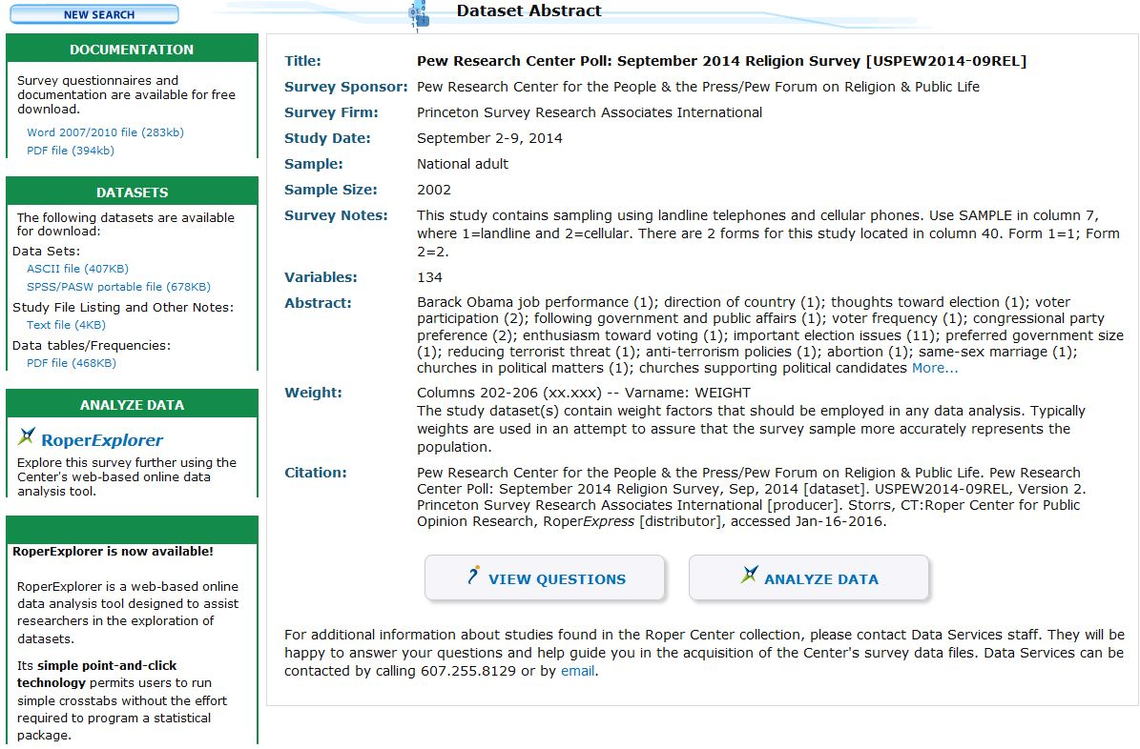
Dataset Abstract

Slide 35
Downloading the Dataset
In the dataset abstract you will see information about this dataset.
On the left you will see information about the documentation for this data set including the questionnaire. For this dataset you can download the documentation as a Word or PDF file.
You will also see information about downloading the dataset itself.

Slide 36
Downloading the Dataset Continued
If this is the first time you have downloaded a Roper dataset, you will need to create a Roper Center account and choose a username and password and then sign into your account. See the beginning of this PowerPoint for a description of how to get your own account.
This dataset can be downloaded as either an ASCII file or a SPSS portable file.
Let’s download the SPSS file by pointing to “SPSS/PASW portable file” and clicking on it. You should see the box on the next screen.

Slide 37
More on Downloading the Dataset
We want to save the file so select “Save File” and click “OK”.
The file will now be downloaded to wherever downloaded files are stored on your computer.
Go to your download folder and you should see a file with a .por extension. For this dataset it’s called “p201409rel.por”.
You will need to have SPSS on your computer to open the file. Remember that it is a portable (.por) file.

Slide 38
Using RoperExplorer
Now let’s use RoperExplorer to analyze some of the data contained in the dataset.
You will need your own account to use RoperExplorer. See the beginning of this PowerPoint for a description of how to get your account.
Let’s take a look again at the Dataset Abstract page that we got when we clicked on the RoperExpress icon. This page appears on the next slide.

Slide 39
Dataset Abstract for Data Set
We Want to Analyze

Slide 40
RoperExplorer
In the lower left there is a link that you can click to open RoperExplorer. Click on it now.
Remember that you could also get to RoperExplorer by clicking on the RoperExplorer icon on the search results page.
You should see the page on the next slide.

Slide 41
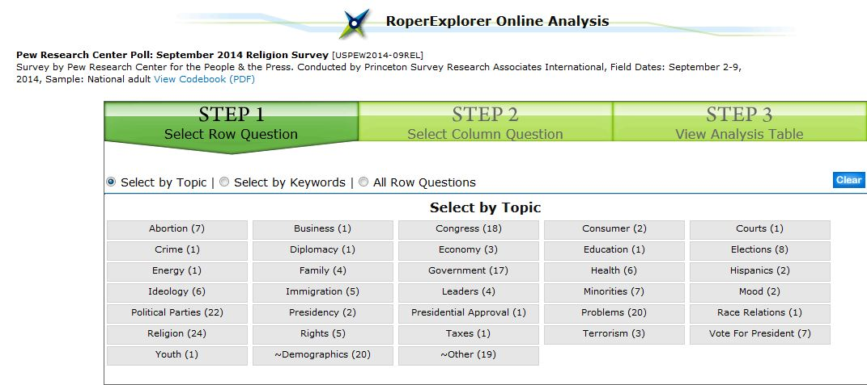
RoperExplorer Screen

Slide 42
Choosing the Row Variable
The first step is to choose your row variable. This will be your dependent variable.
Let’s look at the questions about their religion. There are 24 questions in this category. Click on that category.
Some of these 24 questions are on the next page.
Let’s use the question which asks their opinion on whether religion is increasing or losing influence on American life. This variable is called “Q38” in the data set. Click on that variable.

Slide 43
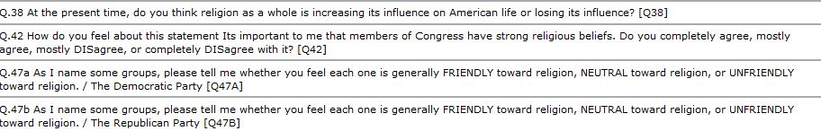
Row Variable – Q38

Slide 44
Choosing the Column Variable
Now we need to choose the column variable which will be your independent variable.
Let’s select the category “demographics” which has 20 questions.
The next slide shows the some of the questions in this category.
Let’s use the region of the country in which the respondent lives which is called “CREGION”. Click on that variable.

Slide 45
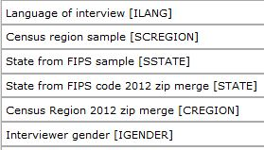
Column Variable – CREGION

Slide 46
Viewing the Table
After you select both your row and column variables, you should see the crosstabulation which is on the next slide.
Note that the percentages sum down to 100% which is what you want if the column variable is your independent variable. So be sure to put the independent variable in the column.
You have the option of printing the table, downloading it as an Excel file, or downloading it as a PDF file.

Slide 47
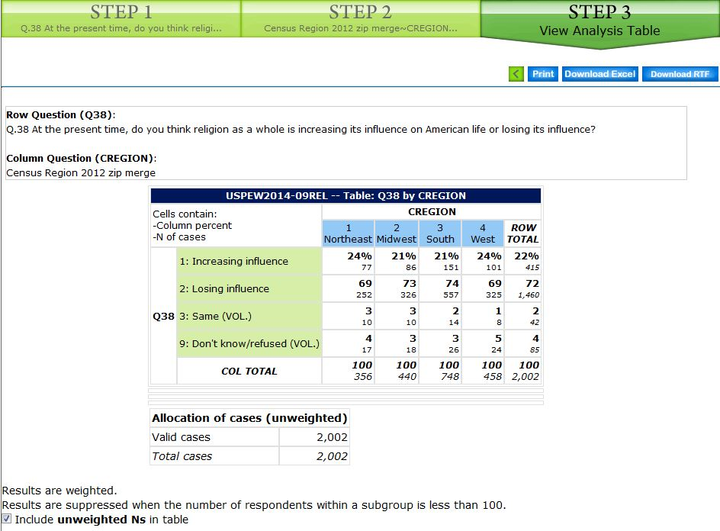
Table

Slide 48
Additional Statistical Analysis
RoperExplorer gives you a quick look at frequency distributions and crosstabulations.
If you want a frequency distribution, chose the variable as the row variable in step 1, skip step 2 and click on step 3. Your frequency distribution will appear.
If you want to do further analysis, download the dataset as a SPSS file.

Slide 49
Teaching Resources
Roper has a number of teaching resources.
Go back to the Roper home page. You can do that easily by clicking on Roper logo on the top left of each screen.
Roper has two excellent discussions of polling. Point your mouse at “Support” on the home page and click on “Polling Concepts.” You’ll see two documents on “Polling Fundamentals” and “Analyzing Polls.”
You can also point your mouse to “Support” and click on “Classroom Materials.”

Slide 50
Learning More about Roper
There are a number of resources for learning more about Roper on their website.
On the Roper home page point your mouse at “Support” and then click on “Roper Center Tools.” You’ll find a number of resources that will help you use the Roper website.

Slide 51
Social Science Research and Instructional Council (SSRIC)
Another way to learn more about the Roper Center is by going to the SSRIC’s web site.
The home page is on the next slide.
Click on “Roper” under “Data” in the upper left.
Explore the SSRIC web site while you are there. There is lots of information about other data archives (e.g., Field and ICPSR) and teaching resources.

Slide 52
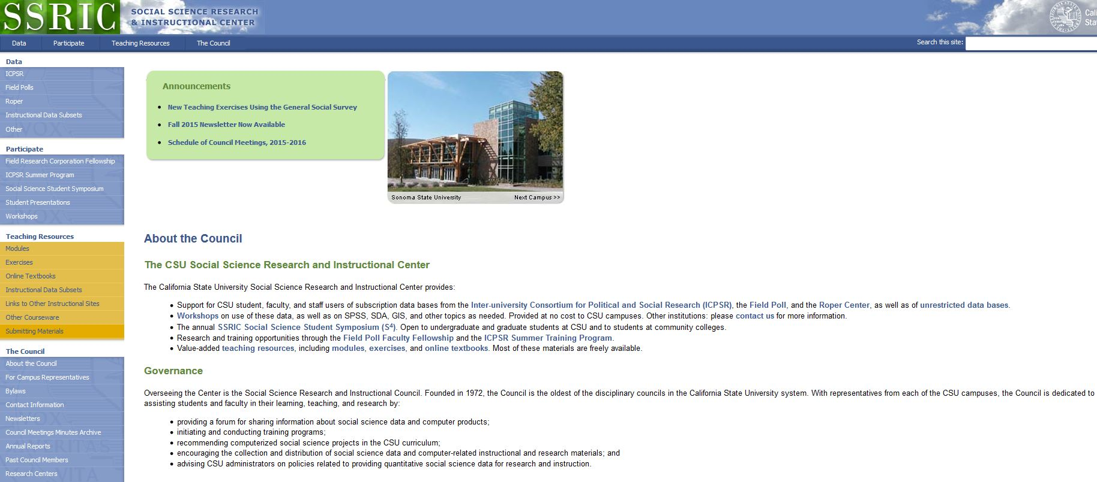
SSRIC

Slide 53
SSRIC Resources
Here are some of the resources you will find on the SSRIC web site. Some of these resources are available only to faculty and students in the CSU.
  Under “Data” on the left you can get information about ICPSR, Field, Roper and instructional data sets.
  Under “Participate” there is information about the Field Faculty Fellow, the ICPSR Summer Program, the SSRIC’s Social Science Student Symposium, and workshops that the SSRIC will come to your CSU campus and offer.

Slide 54
SSRIC Resources Continued
Under “Teaching Resources” there are exercises and data sets that you could use in your classes. There is also an extensive set of links to other sites of methodological and statistical relevance. These resources are typically available to everyone regardless of whether you are part of the CSU or not.
Under “Council” you can look up the SSRIC campus representative on your campus and learn more about the SSRIC Council.

