Slide 1
Inter-University Consortium for Political and Social Research
Social Science Research and Instructional Council
June, 2015

Slide 2
Getting More Information about the Screen Captures
The images in this PowerPoint are screen captures from various web sites.
To see a description of the screen capture, right click on the image and then click on Format Picture. Click on Alt Text and a description of the image will appear.
To close the Alt Text box click on Close.

Slide 3
What is the ICPSR?
Archive of social science data sets for all disciplines in the social sciences which can be searched and downloaded.
Includes an archive of over 4 million questions and an archive of publications that can both be searched.
Contains exercises and modules that can be used in the classroom.

Slide 4
How do we get access to the ICPSR?
CSU campuses subscribe yearly to the social science databases which include:
  The Inter-university Consortium for Political and Social Research
  The Roper Center for Public Opinion Research
  The Field Poll
Campuses that subscribe have free access to all these databases for their students, faculty and staff.

Slide 5
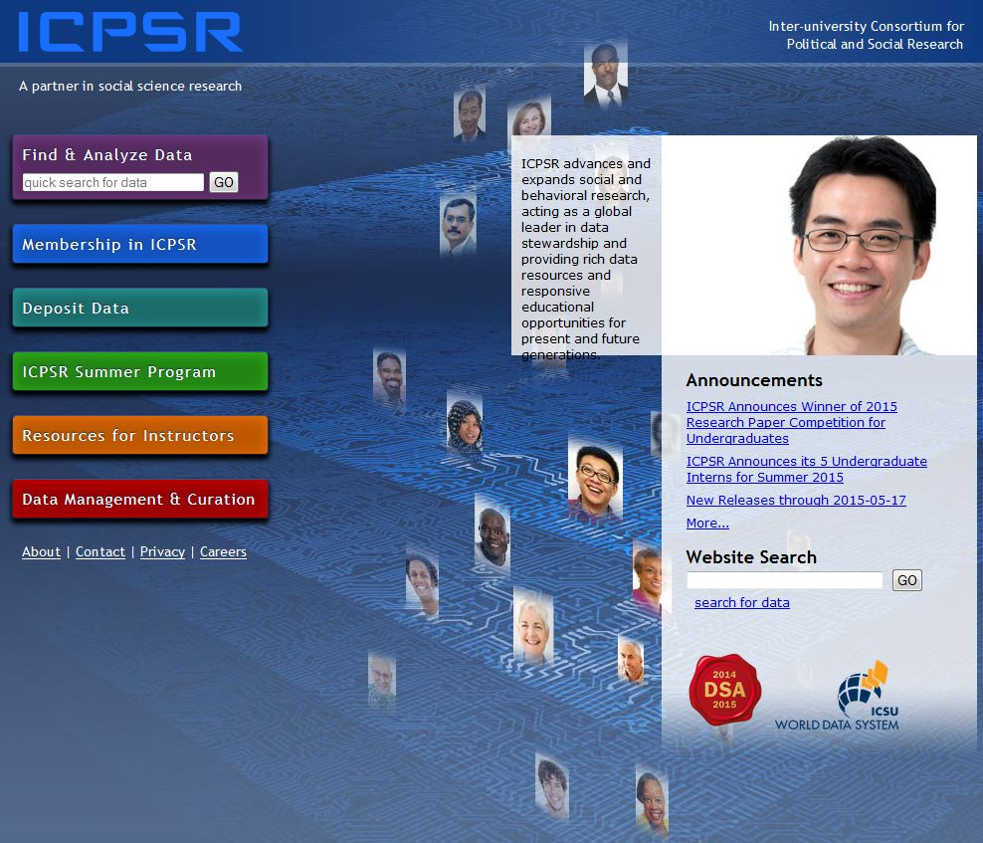
Inter-University Consortium for Political and Social Research
Click on Find and Analyze Data to begin searching for data sets.

Slide 6
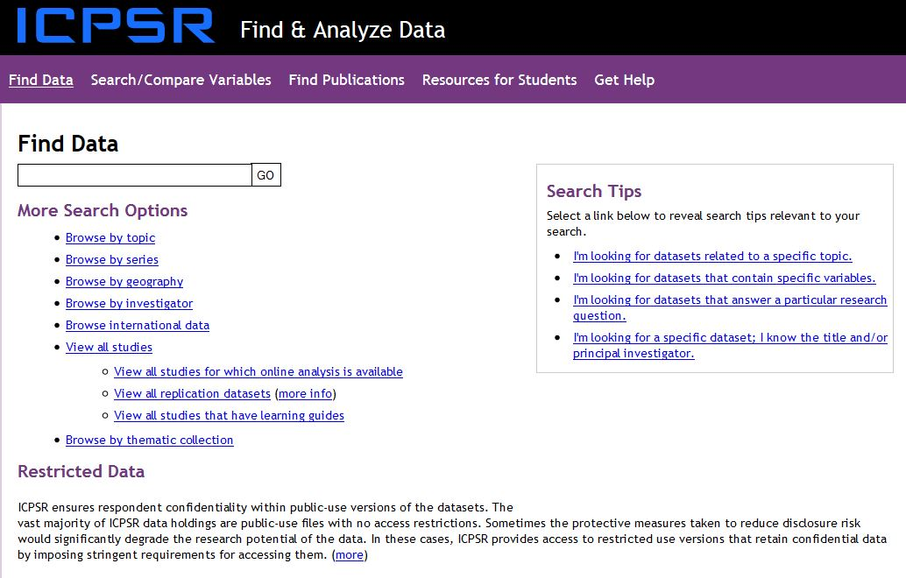
Find and Analyze Data

Slide 7
Searching for Data from ICPSR
Enter “immigration” in the “Find Data” box.
Explore the different ways of browsing.
Click on “Go”.

Slide 8
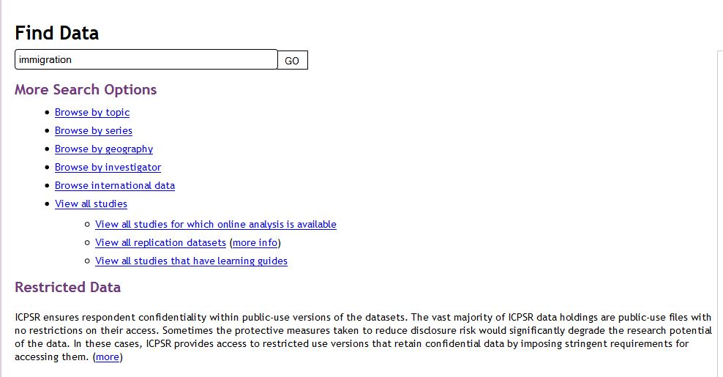
Find Data Box

Slide 9
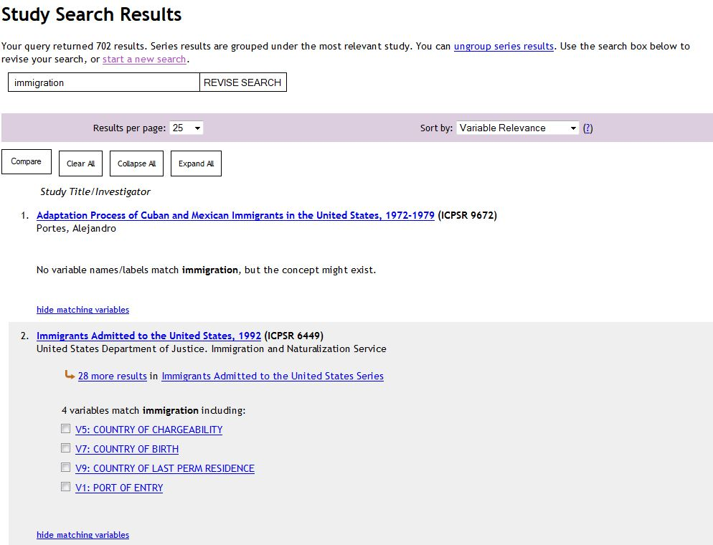
Search Results (Your results may differ)

Slide 10
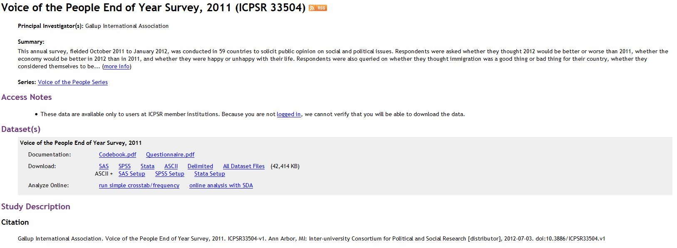
Voice of the People (ICPSR 33504)
We’re going to use the Voice of the People 2011 survey.
The easiest way to find this study is to search by the ICSPR study number.
Enter 33504 in the search box and click Go.
Click on the link to the survey in the search results.

Slide 11
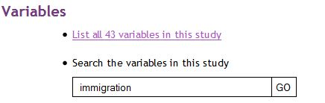
Getting More Information About the
Variables in the Data Set
Search for variables that include immigration in the text.
Click on Go.
Then click on the variable it finds – Q4.

Slide 12
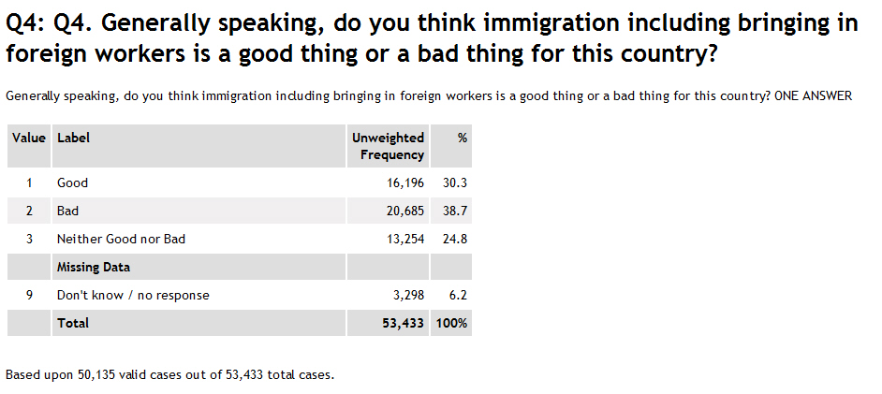
Looking at a Key Variable (Q4)

Slide 13
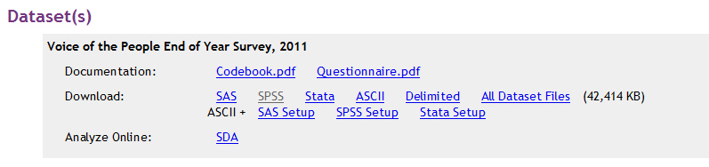
Downloading the Data Set
Click on the file you want to download.
In our case, click on the SPSS file.

Slide 14
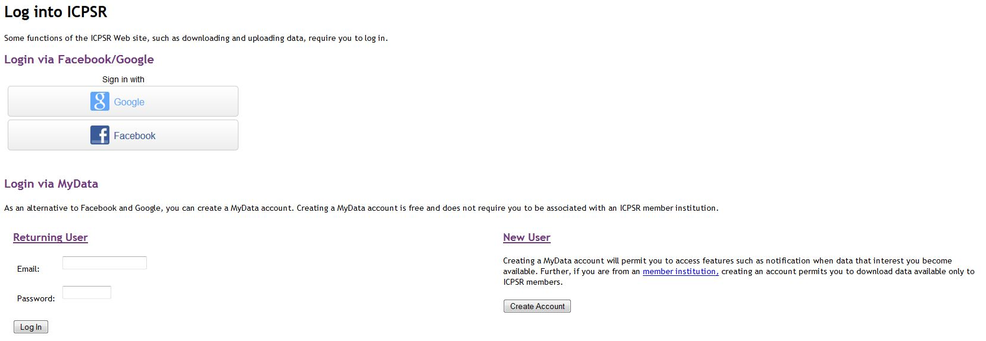
Logging On to Your Account at ICPSR

Slide 15
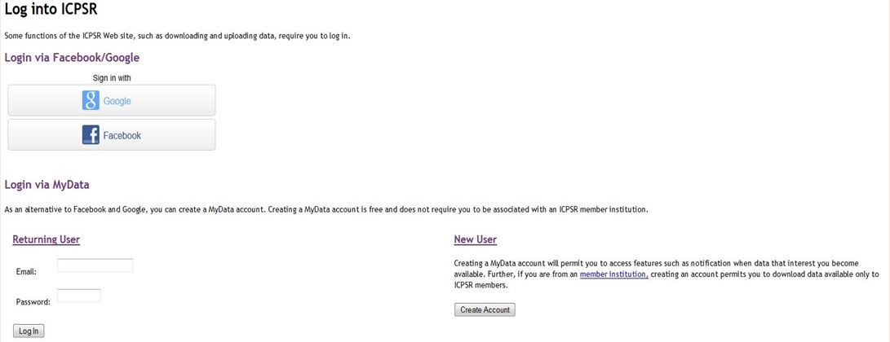
Creating a MyData Account
Before you can download data you must create an account if you don’t already have one.
We’re going to create a MyData account by clicking on “Create Account” under “New User.”

Slide 16
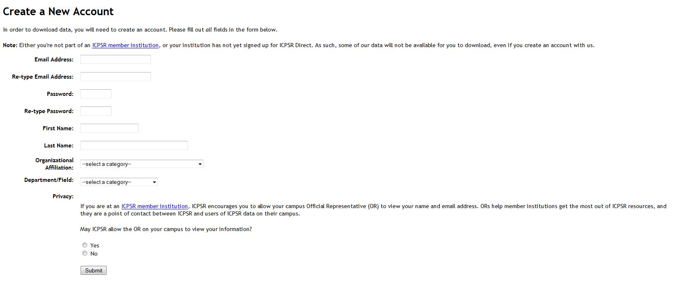
Filling Out the Form to
Create Your MyData Account

Slide 17
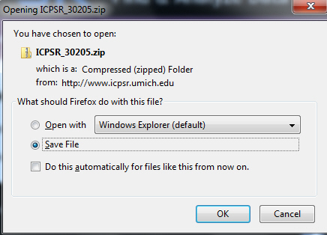
Downloading the Data File

Slide 18
Downloading Instructions
Select “Save File”.
In Firefox the file will be saved to your download folder.
File will be saved as a zip file.
Open the zip file.
Keep opening folders until you see codebook.pdf, questionnaire.pdf and data.sav.

Slide 19
Opening the .sav File
You can move the zip file from the download folder to wherever you want to keep it on your hard drive.
Open SPSS and then open the .sav file.
We’re not going to discuss SPSS in this PowerPoint. If you’re not familiar with SPSS, you can look at a SPSS tutorial on the SSRIC Website.

Slide 20
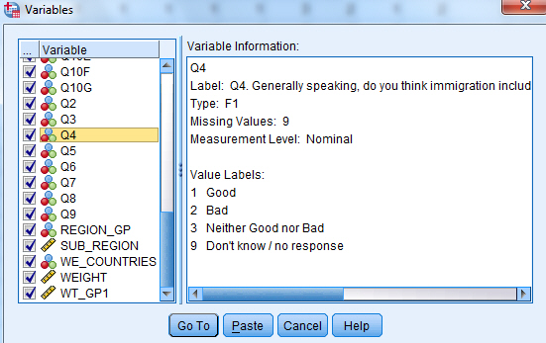
Mini Codebook
Utilities/Variables
You can look at a mini-codebook by clicking on Utilities in the menu bar and then clicking on Variables.

Slide 21
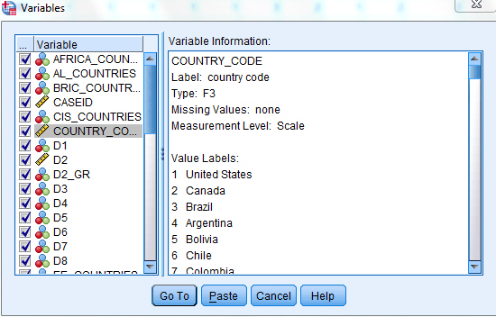
Mini Codebook
Utilities/Variables Continued

Slide 22
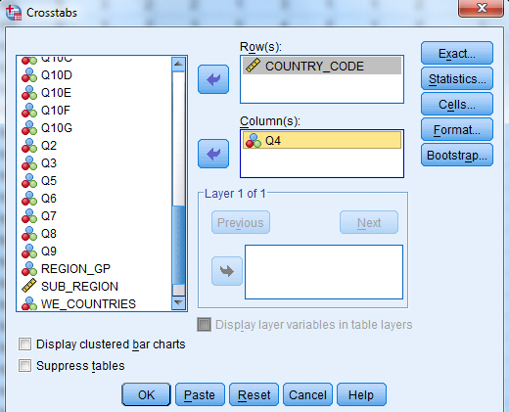
Getting a Crosstab in SPSS

Slide 23
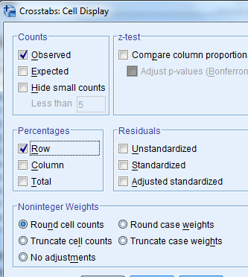
Crosstabs: Cell Display box

Slide 24
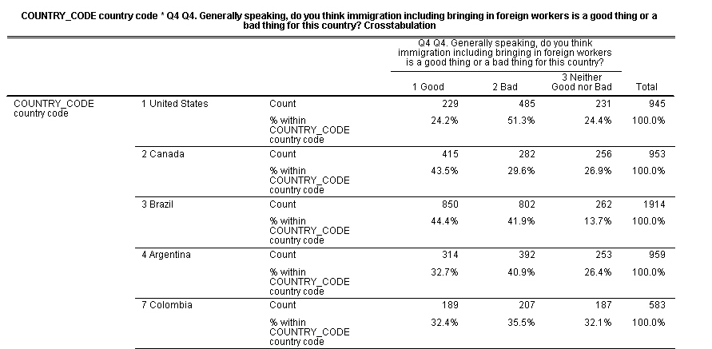
Crosstabs Output

Slide 25
Searching the Variables Database
“Search/Compare Variables” is found on the menu bar under Find & Analyze Data.
The Social Science Variables Database contains over 4 million questions.
Represents about 76% of the ICPSR collection.
Let’s search for questions on immigration.

Slide 26
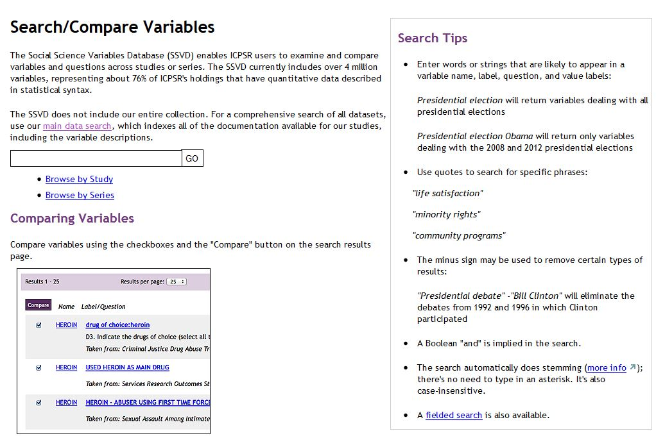
Click on Search/Compare Variables

Slide 27
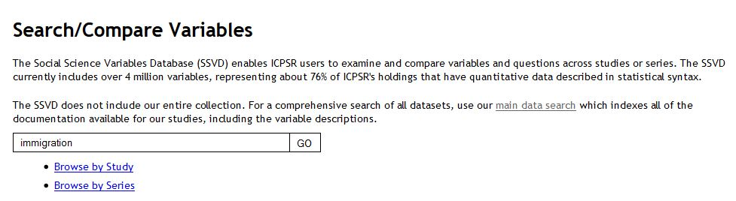
Searching Variables

Slide 28
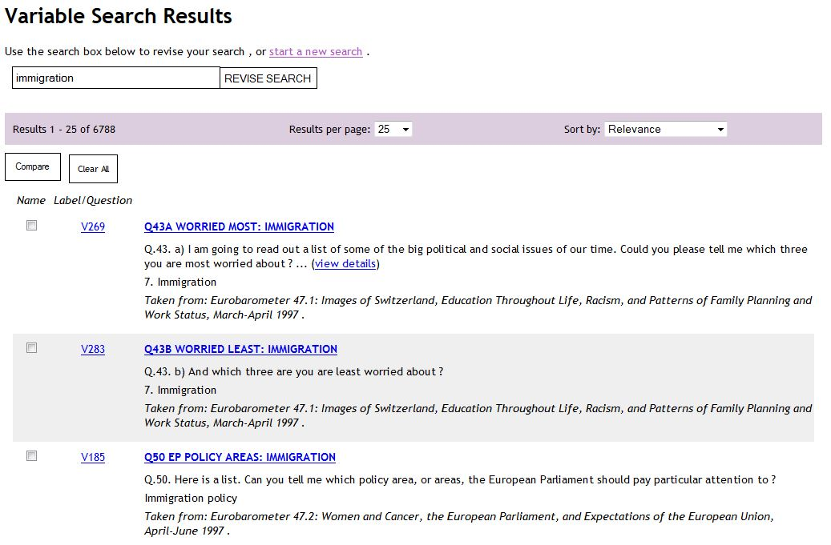
Searching Variables Results

Slide 29
Publications
You can also search the publications archive which includes articles and books that have used ICPSR data.
“Find Publications” is found on the menu bar under Find & Analyze Data.
Let’s search for articles and books on immigration.

Slide 30
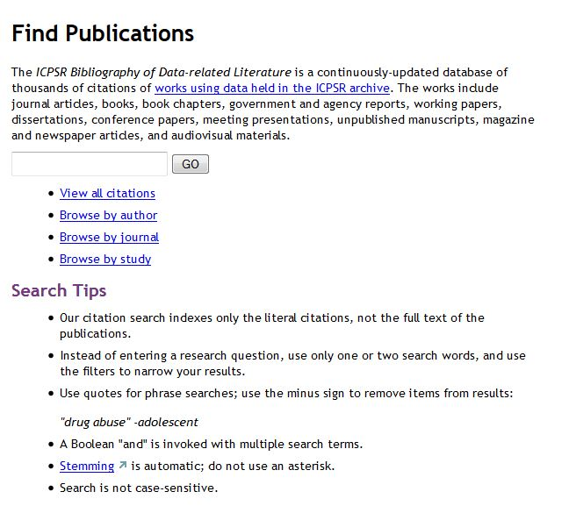
Click on Find Publications

Slide 31
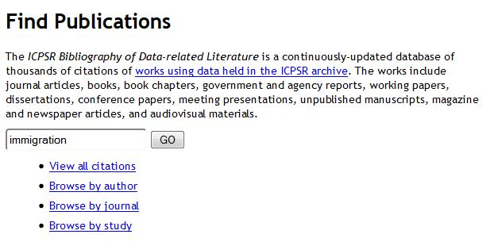
Searching Publications

Slide 32
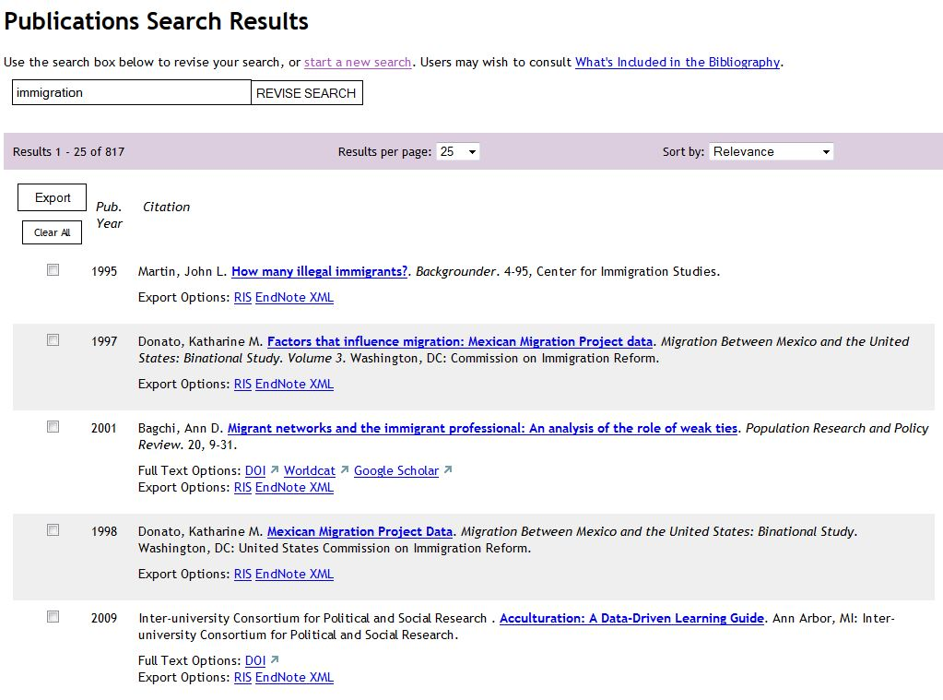
Search Publications Results
(your results may differ)

Slide 33
Resources for Instructors
Click on Resources for Instructors on the ICPSR home page.

Slide 34
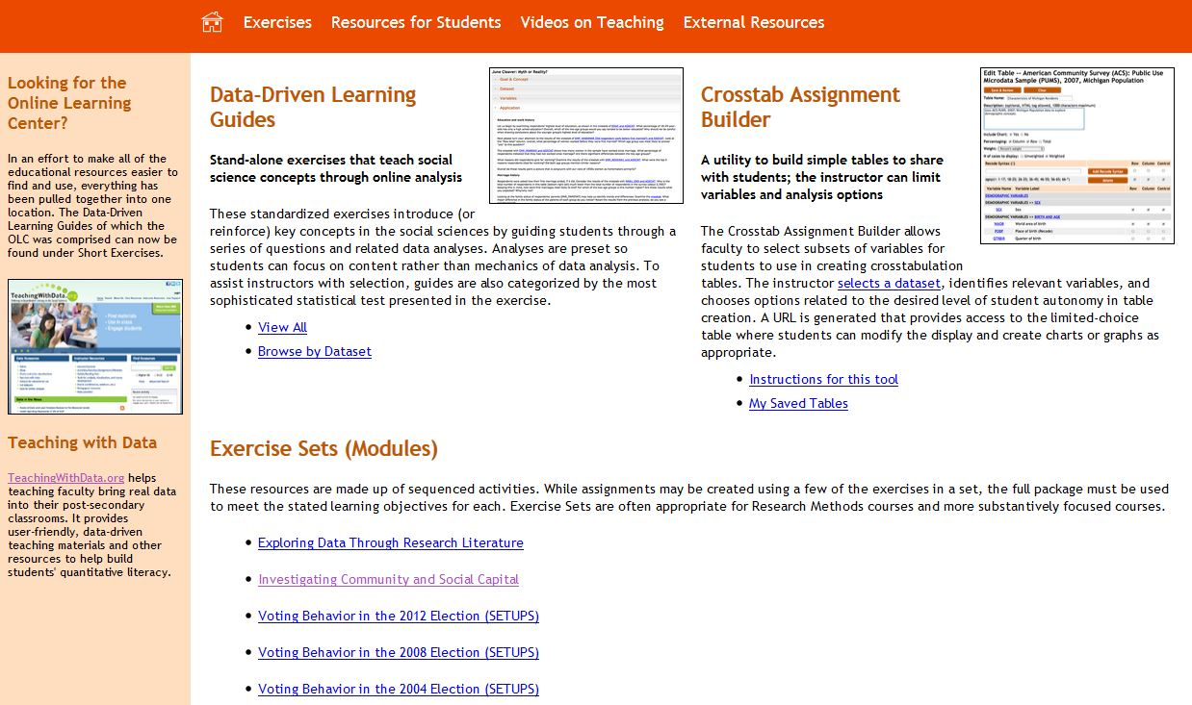
Exercises

Slide 35
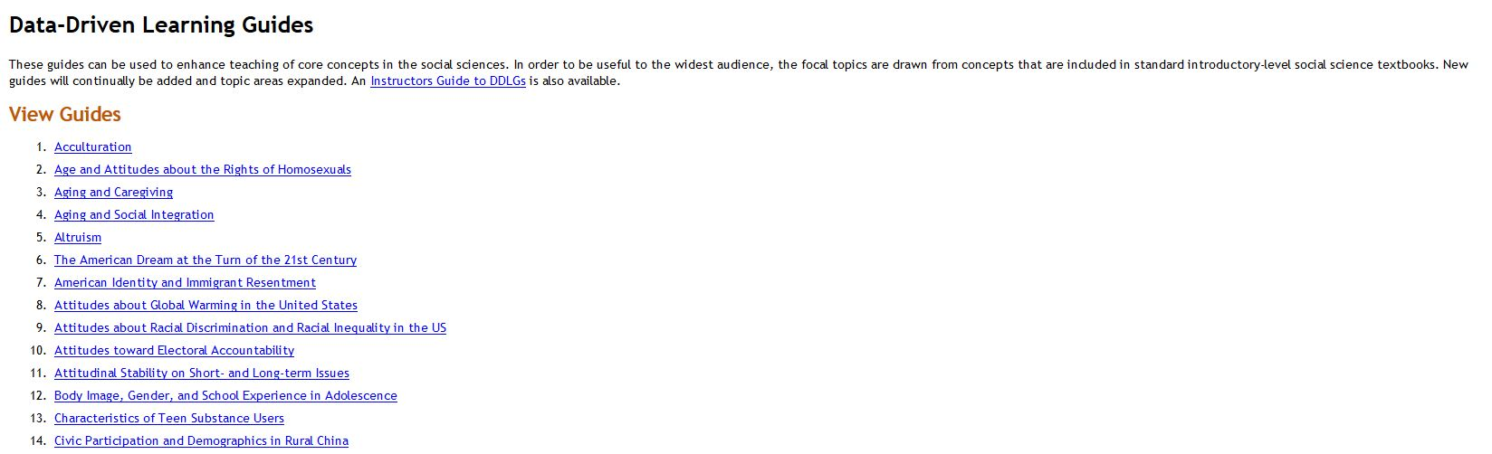
Data-Driven Learning Guides

Slide 36
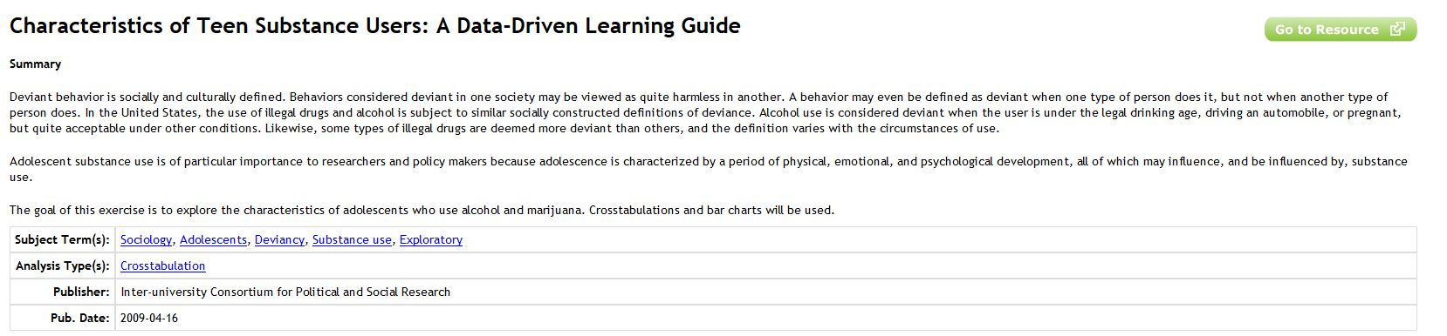
Characteristics of Teen Substance Users

Slide 37
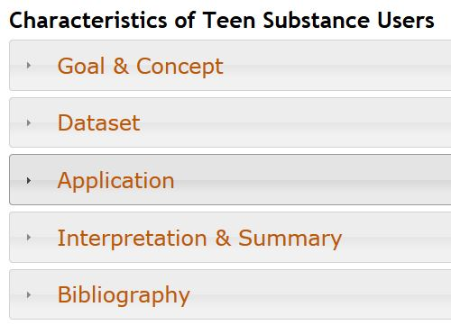
Characteristics of Teen Substance Users
Continued

Slide 38
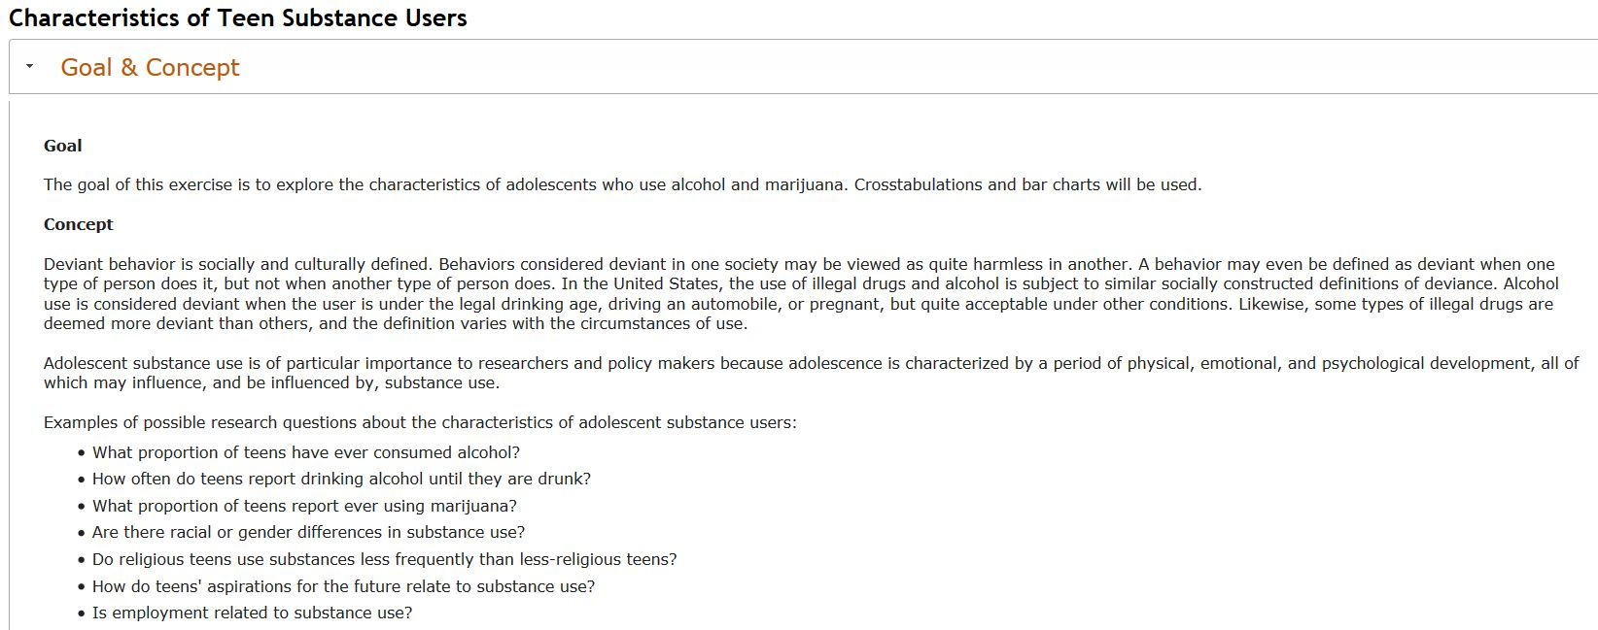
Characteristics of Teen Substance Users
Goals & Concepts

Slide 39
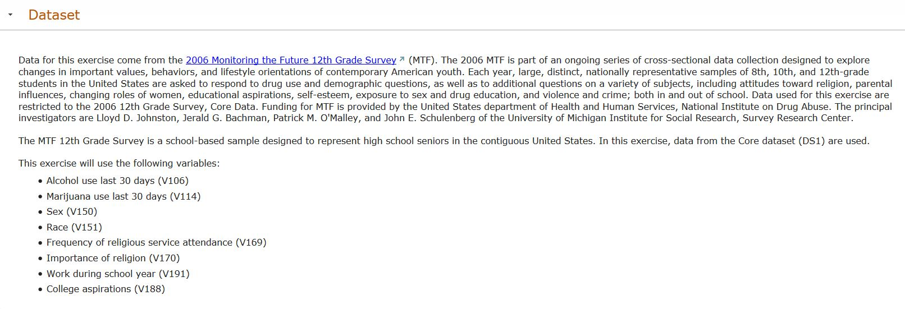
Characteristics of Teen Substance Users
Dataset

Slide 40
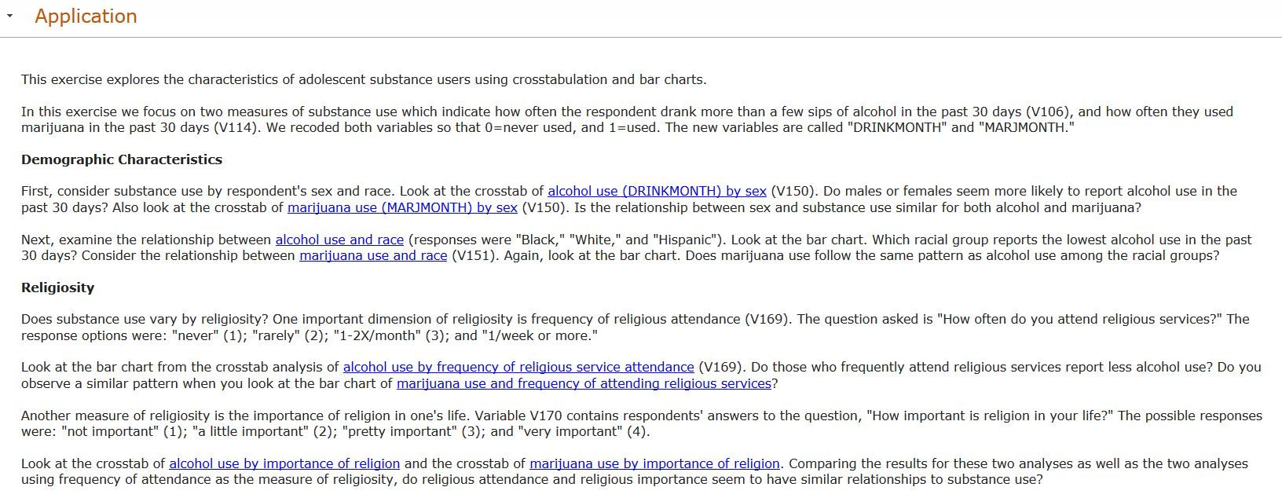
Characteristics of Teen Substance Users
Application (Student Exercise)

Slide 41
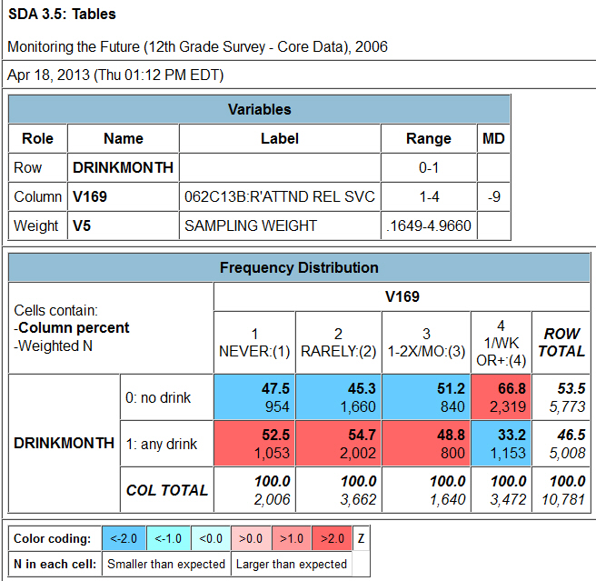
Characteristics of Teen Substance Users
Crosstab from SDA

Slide 42
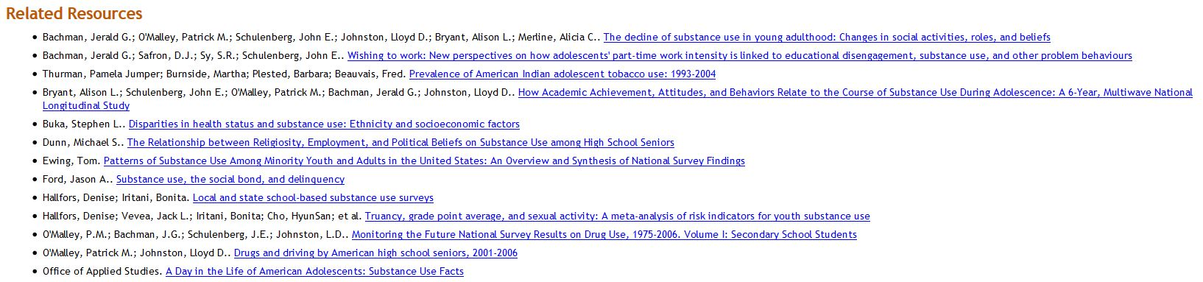
Characteristics of Teen Substance Users
Bibliography

Slide 43
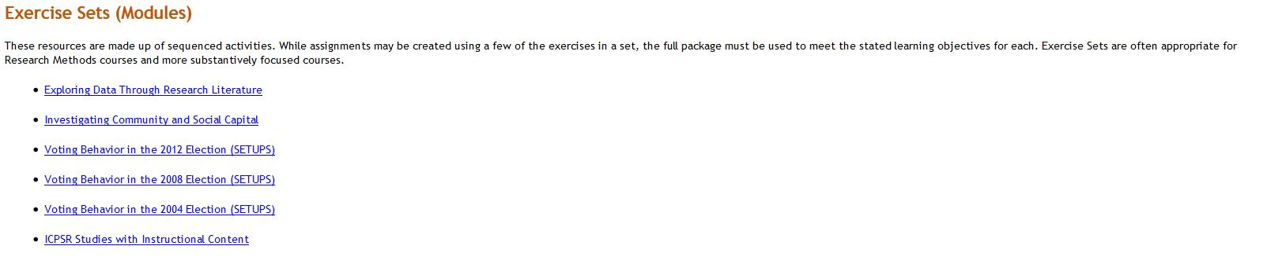
Modules

Slide 44

Investigation Community and Social Capital – Lori Weber (Chico)

Slide 45
Social Science Research and Instructional Council (SSRIC)
Another way to learn more about ICPSR is by going to the SSRIC’s web site.
Click on “ICPSR” under “Data” in the upper left.
Explore the SSRIC web site while you are there. There is lots of information about other data archives (e.g., ICPSR, Field and Roper) and teaching resources.

Slide 46
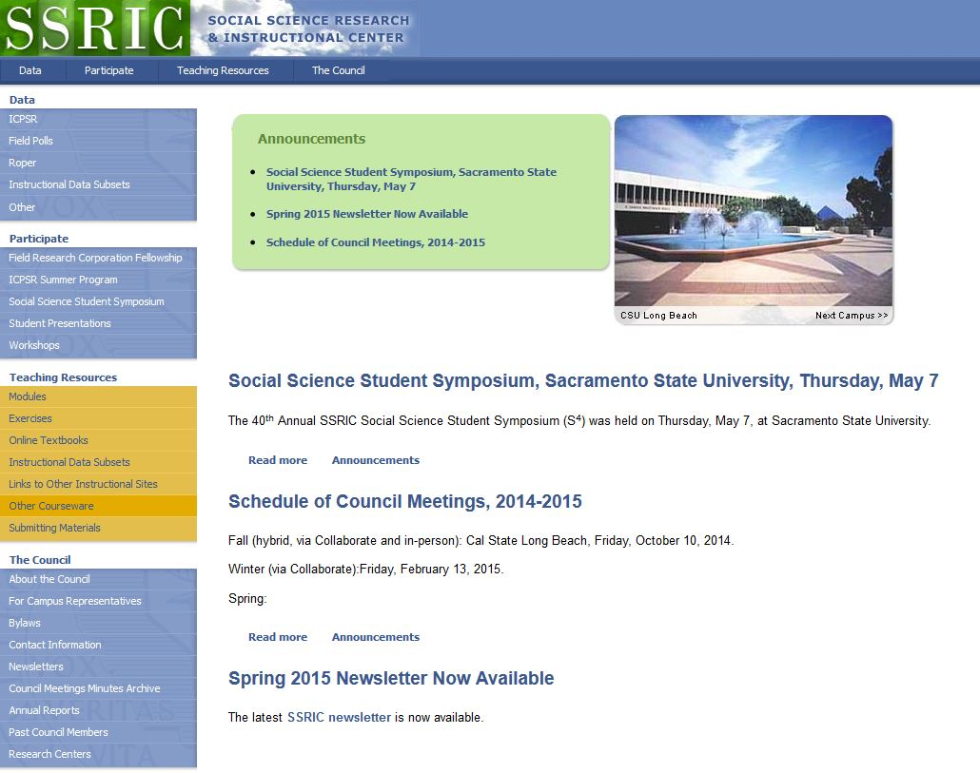
Social Science Research and Instructional Center

Slide 47
SSRIC Resources
Here are some of the resources you will find on the SSRIC web site. Some of these resources are available only to faculty and students in the CSU.
  Under “Data” on the left you can get information about ICPSR, Field, Roper and instructional data sets.
  Under “Participate” there is information about the Field Faculty Fellow, the ICPSR Summer Program, the Social Science Student Symposium, and workshops that the SSRIC will come to your CSU campus and offer.

Slide 48
SSRIC Resources Continued
Under “Teaching Resources” there are exercises and data sets that you could use in your classes. There is also an extensive set of links to other sites of methodological and statistical relevance. These resources are typically available to everyone regardless of whether you are part of the CSU or not.
Under “Council” you can look up the SSRIC campus representative on your campus and learn more about the SSRIC Council.

