Slide 1
Teaching Resources
Social Science Research and Instructional Council
August, 2014

Slide 2

Teaching with Data

Slide 3
Teaching Resources Covered
Teaching with Data
Merlot
ICPSR
SSDAN
Roper Center
Field Poll
SSRIC

Slide 4
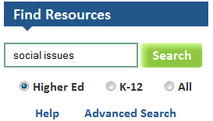
Find Resources

Slide 5
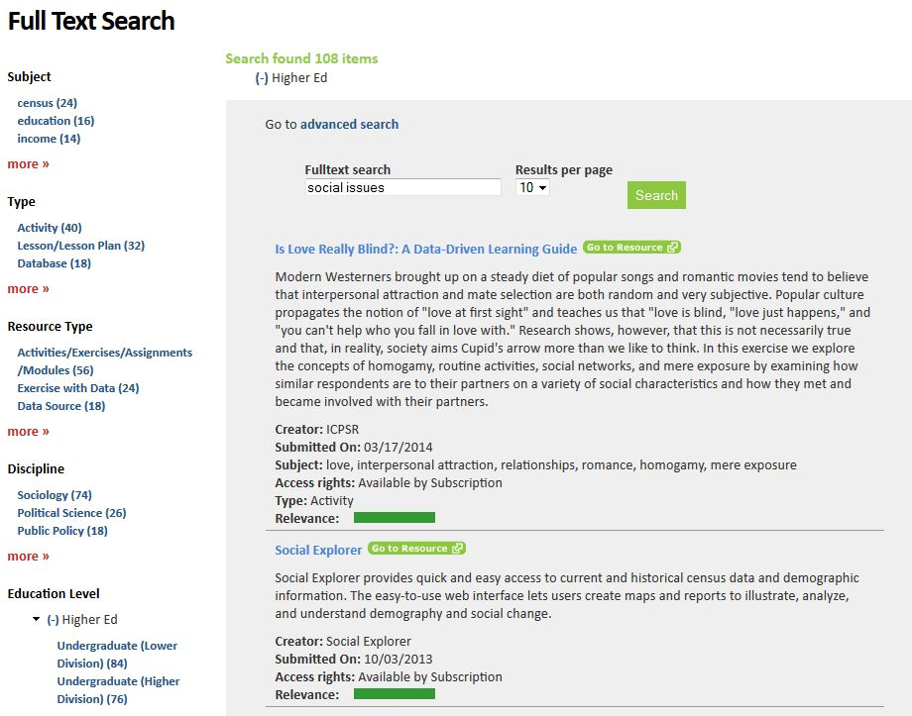
Search Results

Slide 6
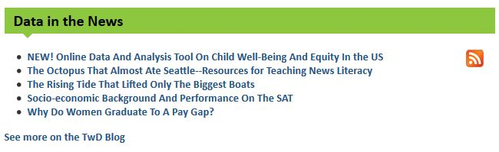
Data in the News

Slide 7

Merlot

Slide 8
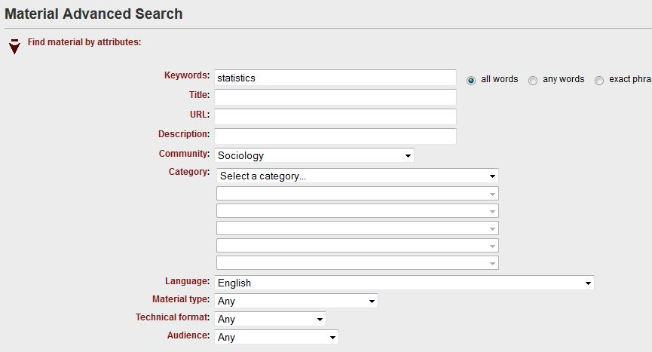
Searching Merlot

Slide 9
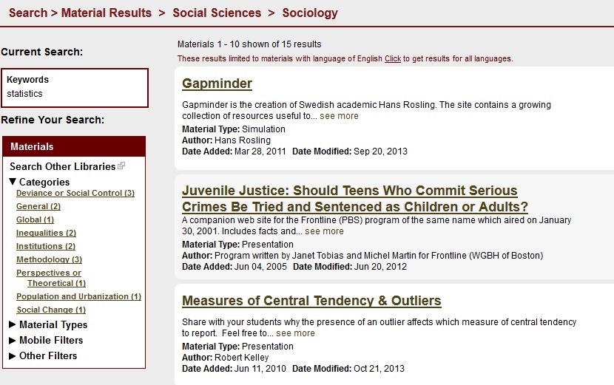
Gapminder

Slide 10
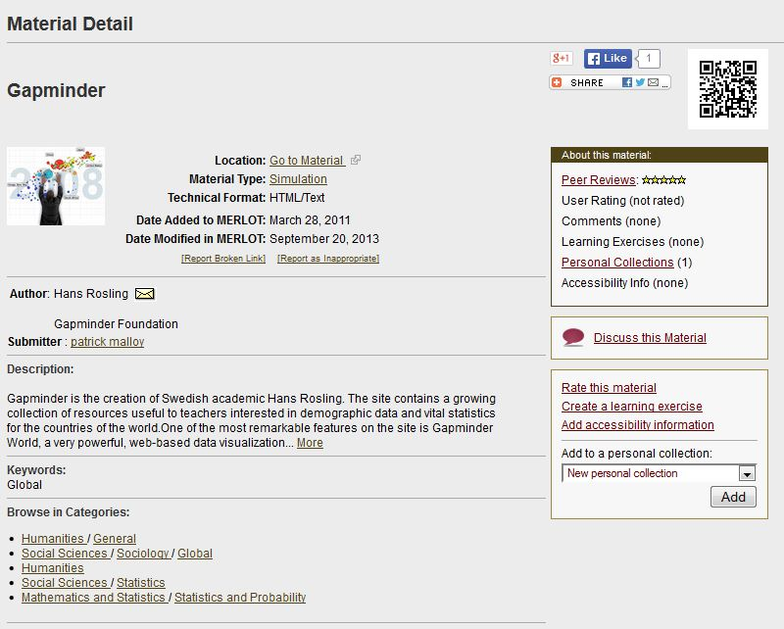
Material Detail

Slide 11
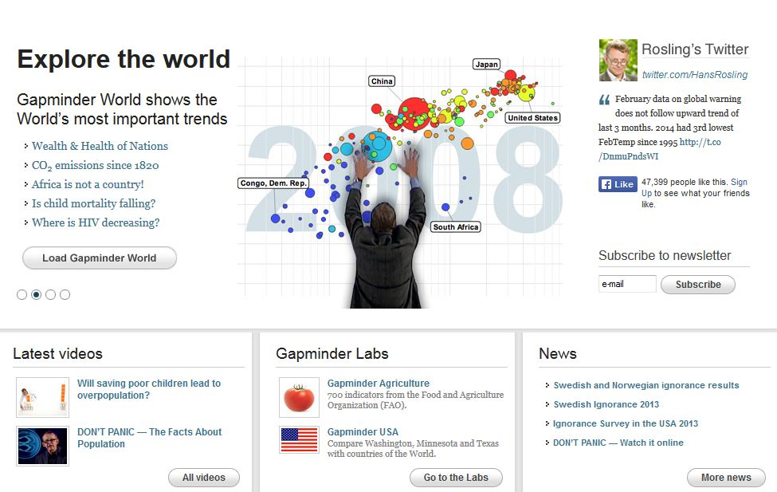
Gapminder Website

Slide 12
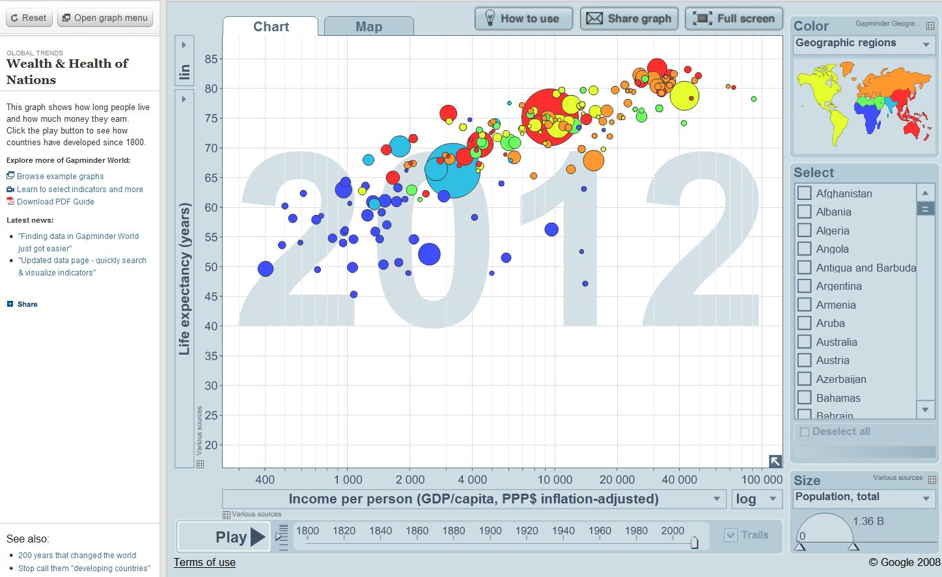
Wealth & Health of Nations

Slide 13
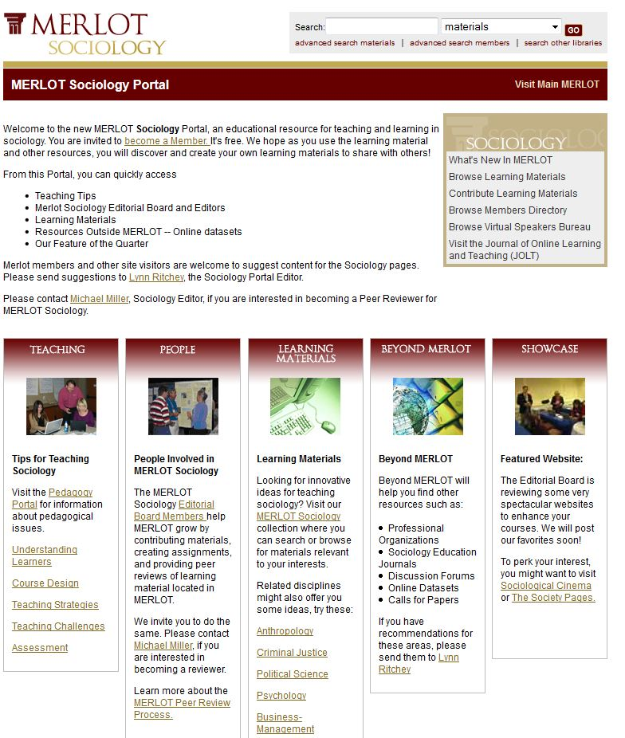
Merlot Sociology Portal

Slide 14

Featured Websites

Slide 15
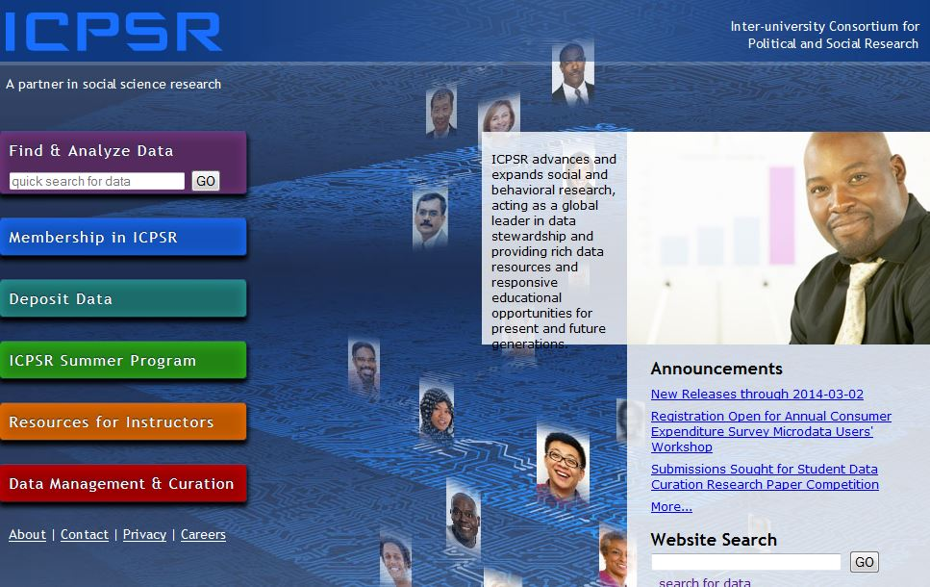
ICPSR

Slide 16
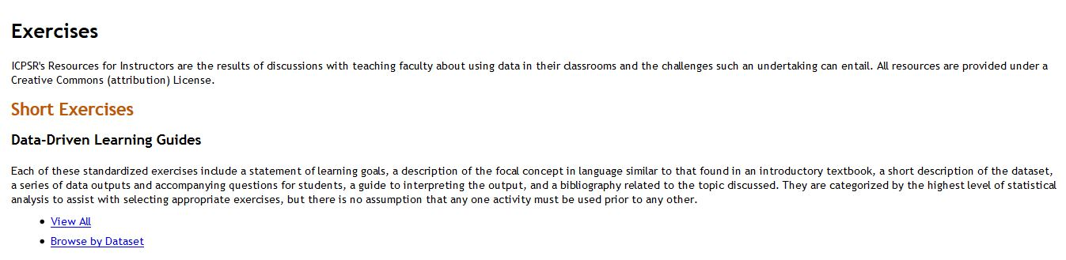
Exercises

Slide 17
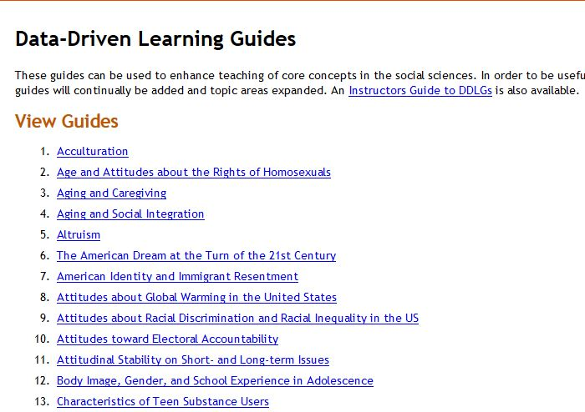
Data-Driven Learning Guides

Slide 18
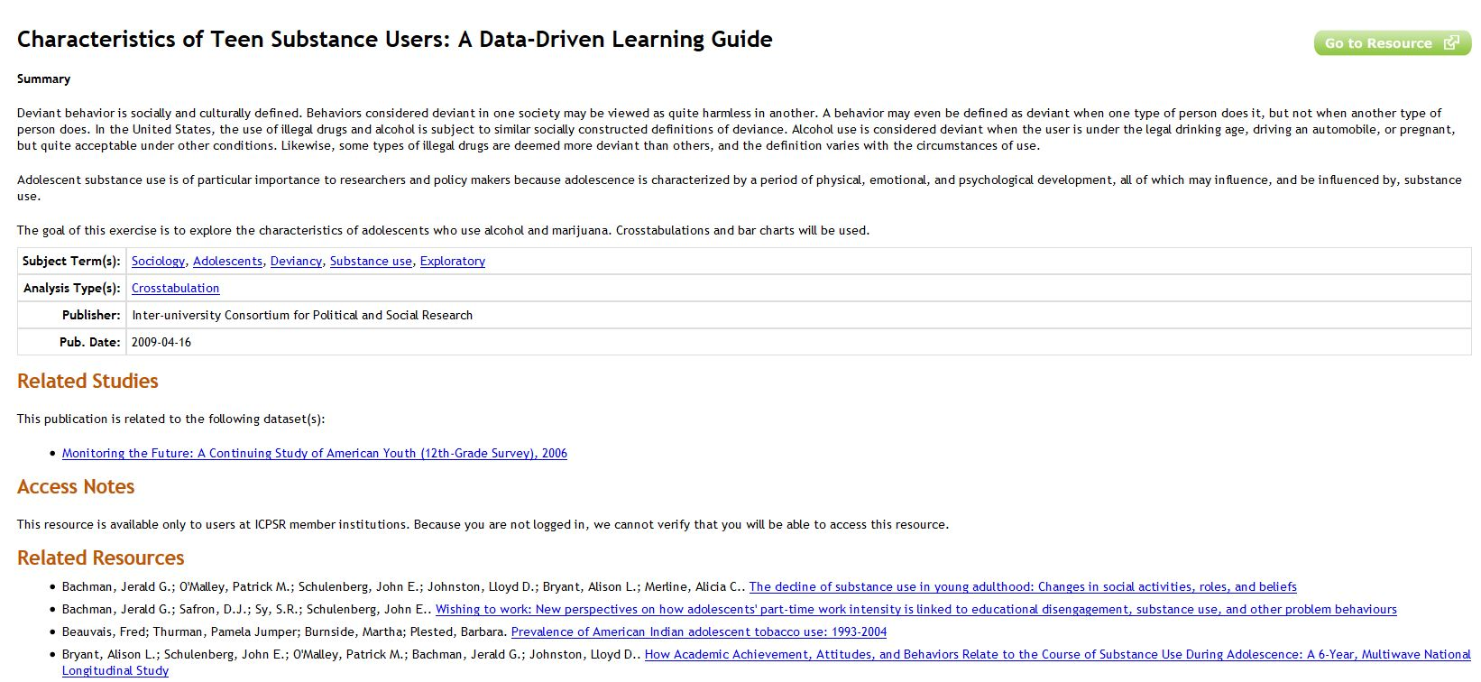
Characteristics of Teen
Substance Users

Slide 19
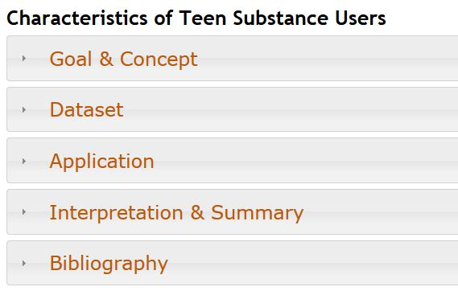
Sections of Each Data-Driven
Learning Guide

Slide 20
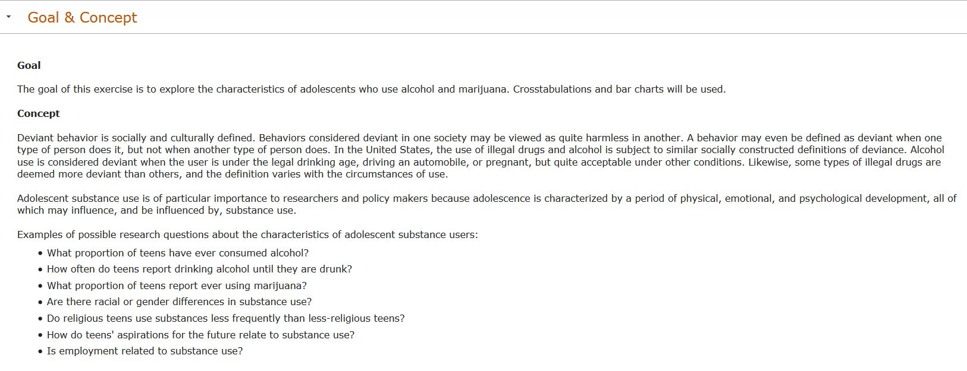
Goal & Concept

Slide 21
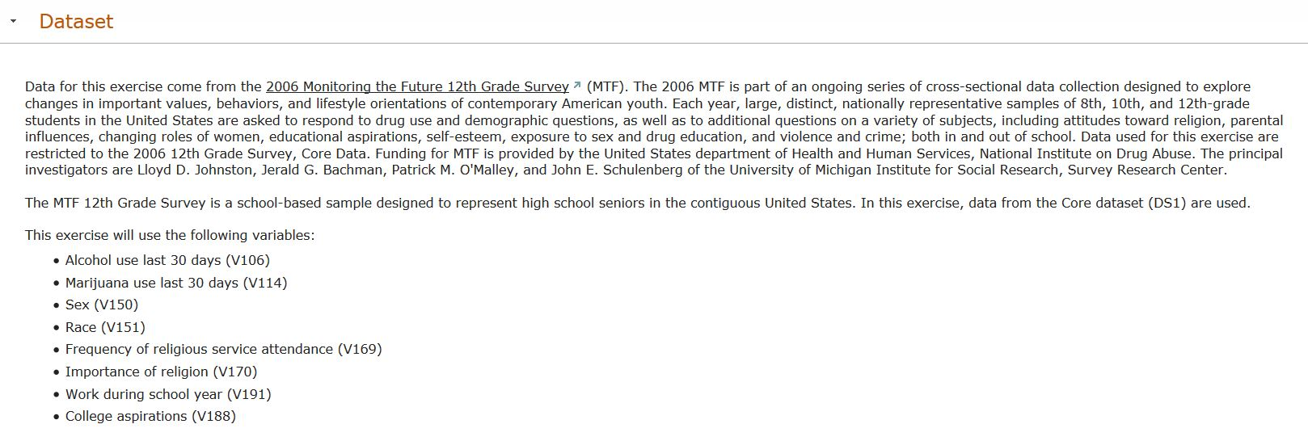
Dataset

Slide 22
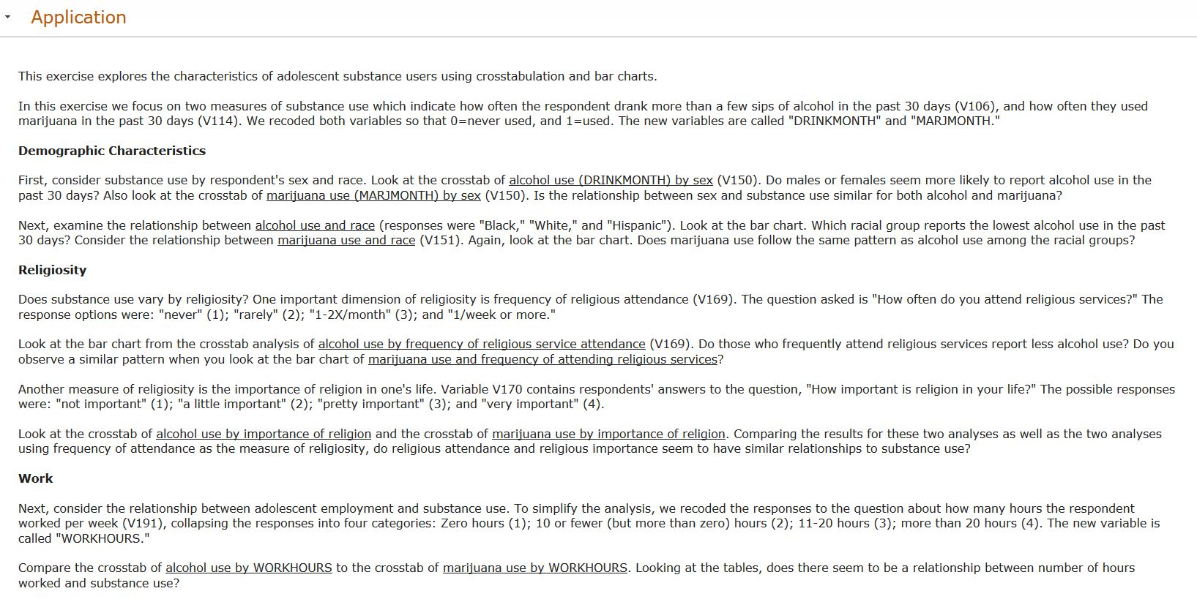
Application or Assignment

Slide 23
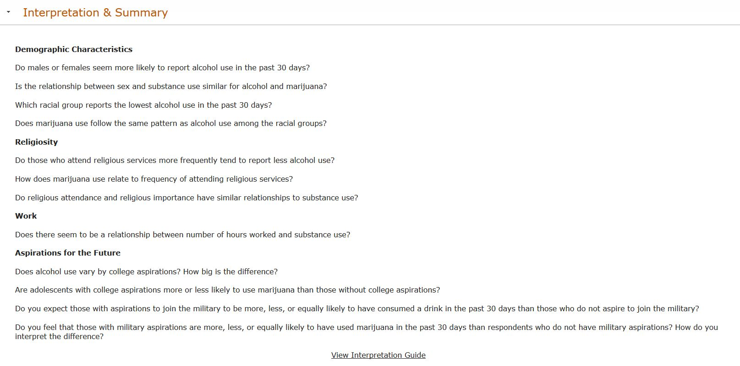
Interpretation & Summary

Slide 24
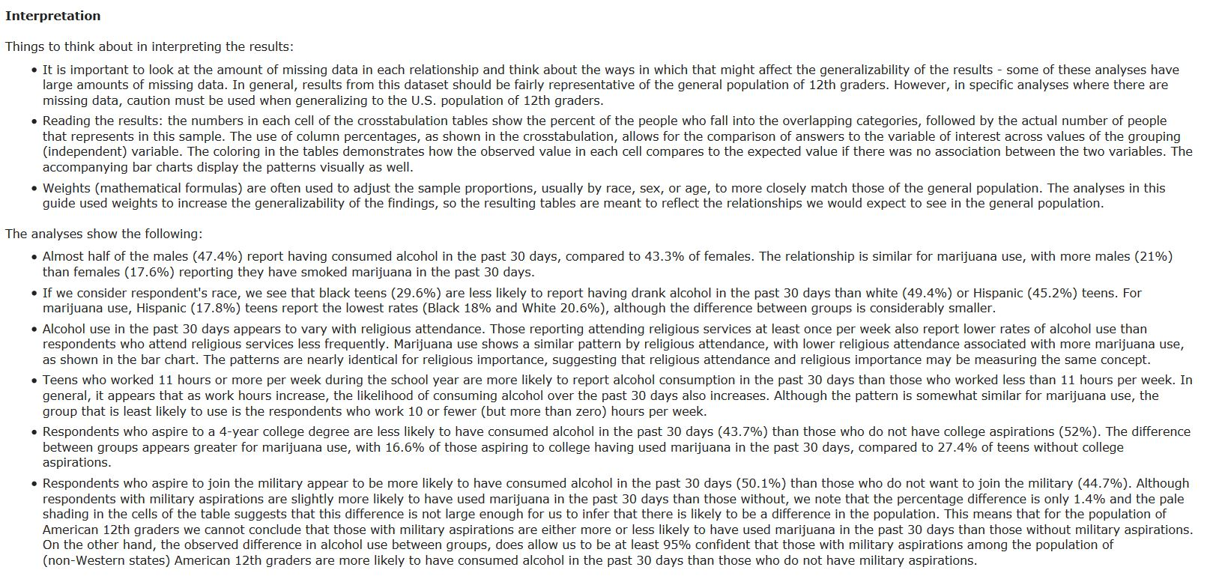
Interpretation Guide

Slide 25
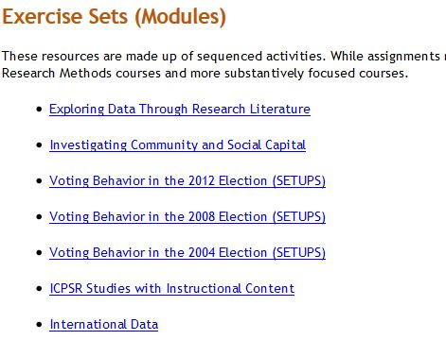
Modules

Slide 26

Investigating Community and
Social Capital

Slide 27
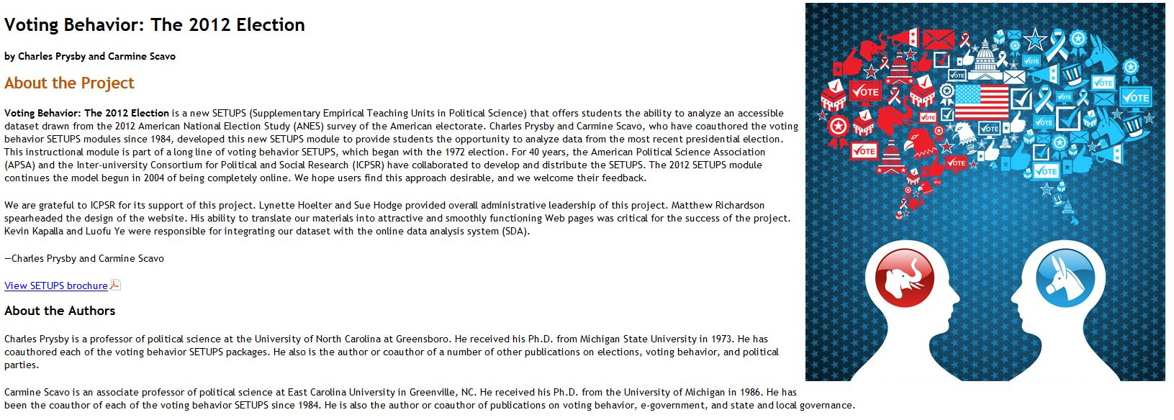
Voting Behavior: The 2012 Election

Slide 28
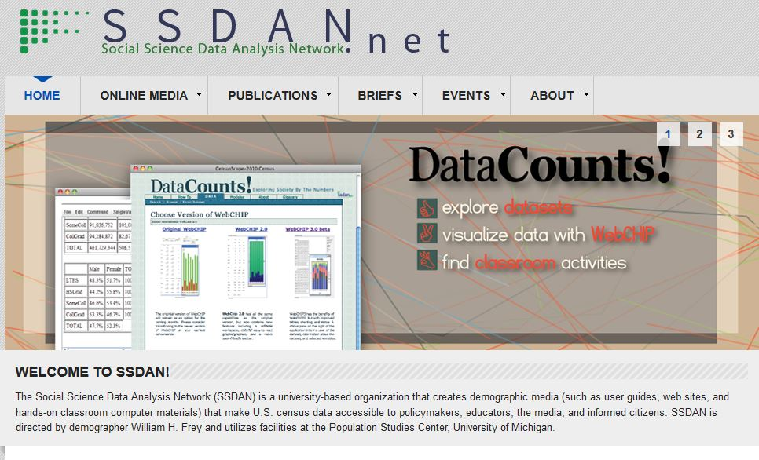
Social Science Data Analysis Network

Slide 29
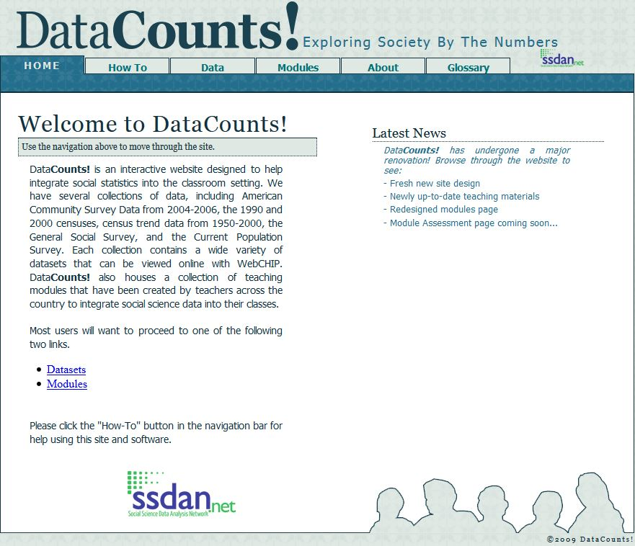
SSDAN – DataCounts!

Slide 30
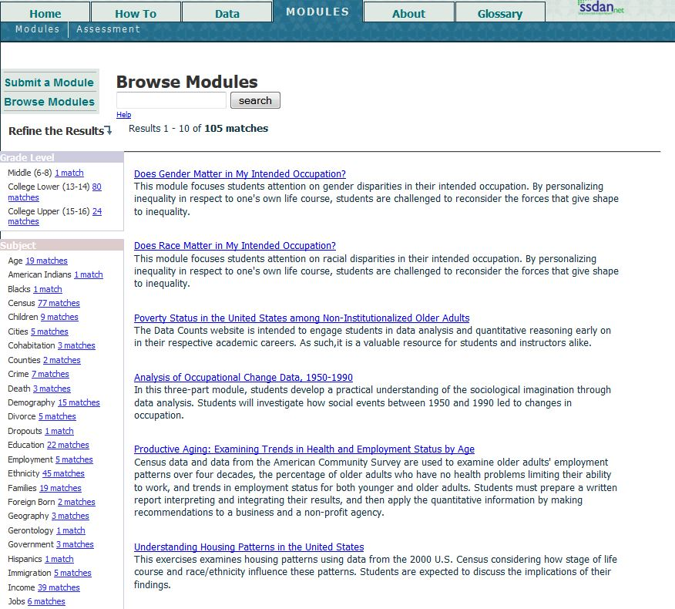
Browsing the Modules

Slide 31
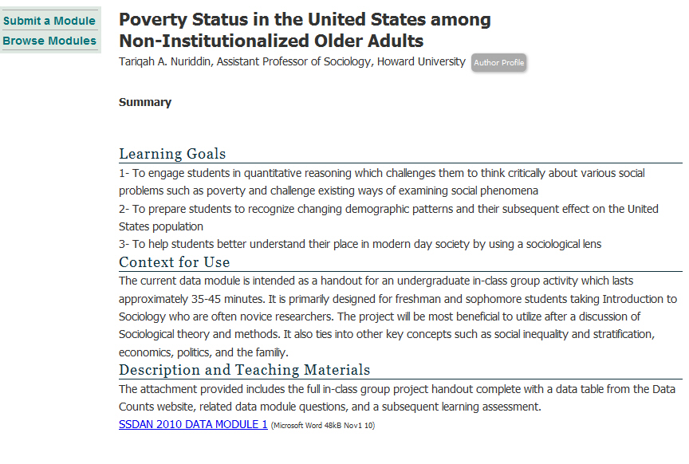
Poverty Status in the United States

Slide 32
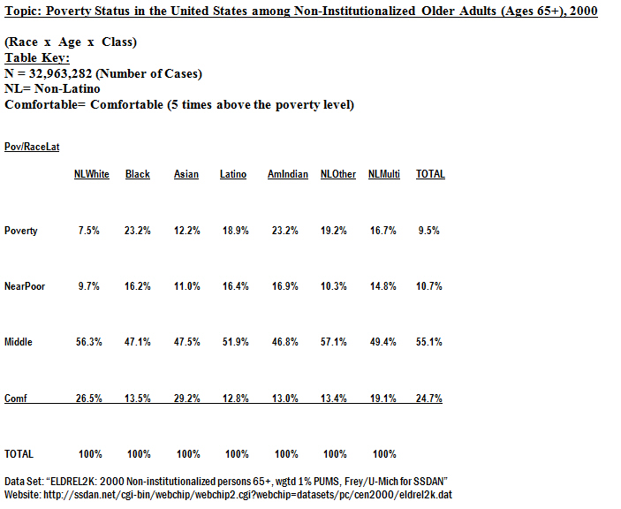
Table from Poverty Status in the U.S.

Slide 33
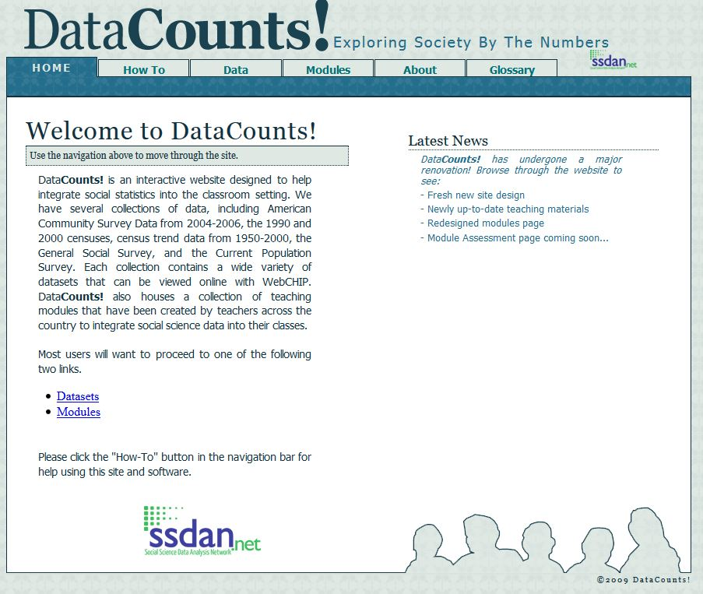
Data Sets in DataCounts!

Slide 34
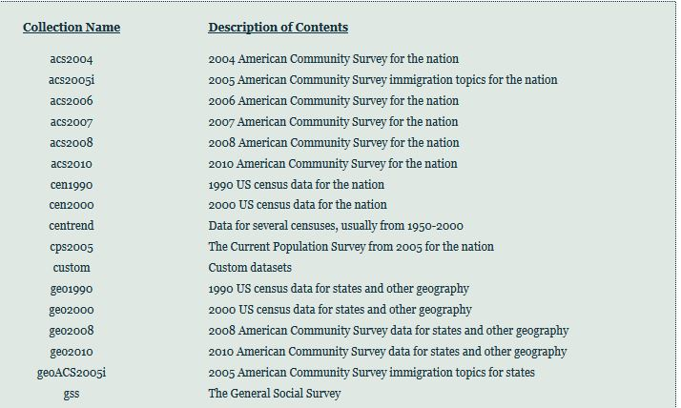
Examples of Data Sets Used in DataCounts!

Slide 35
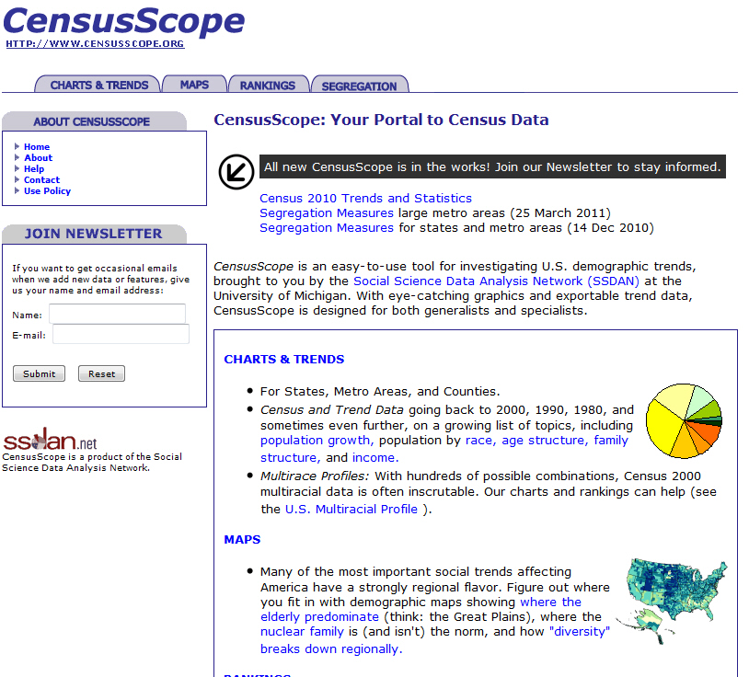
SSDAN – CensusScope

Slide 36
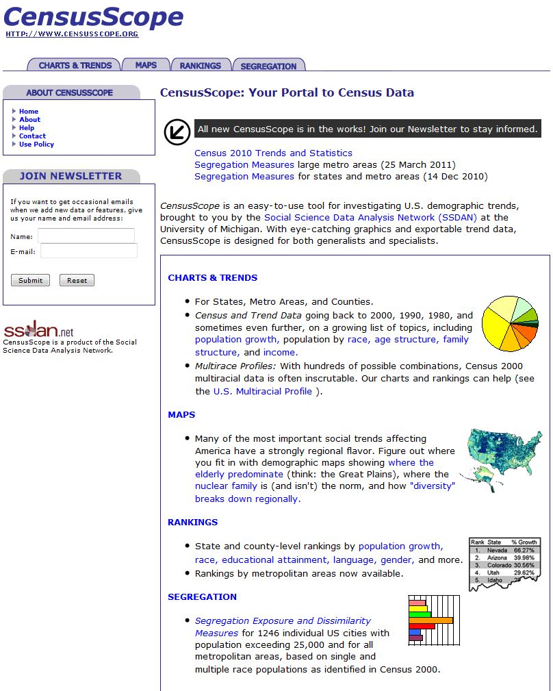
Age Structure

Slide 37
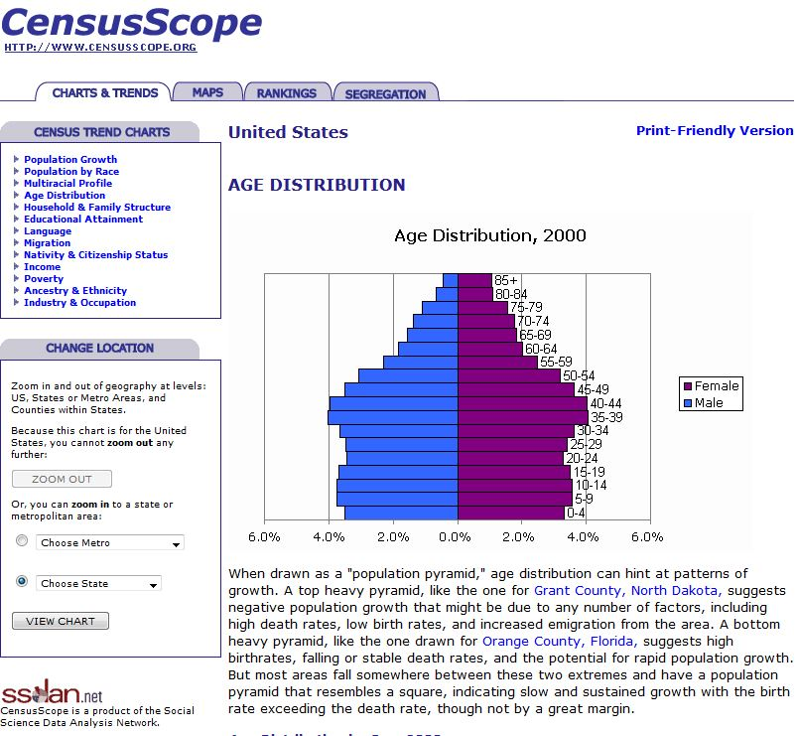
Age Distribution

Slide 38
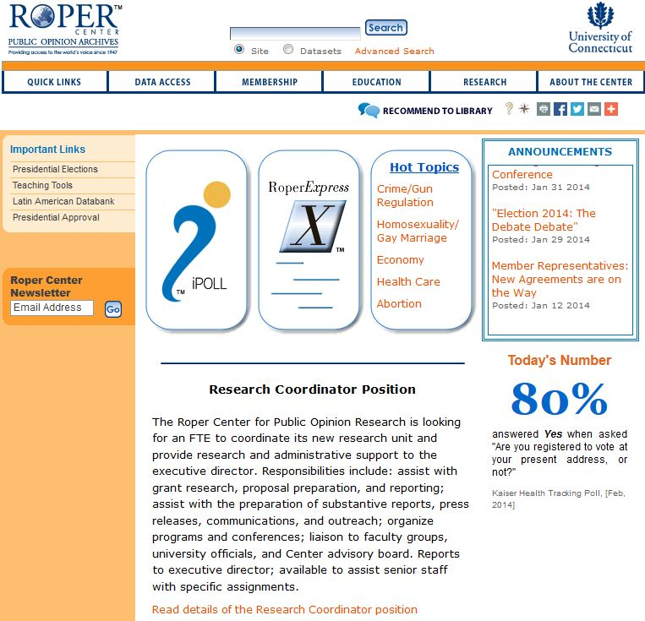
Roper Center

Slide 39
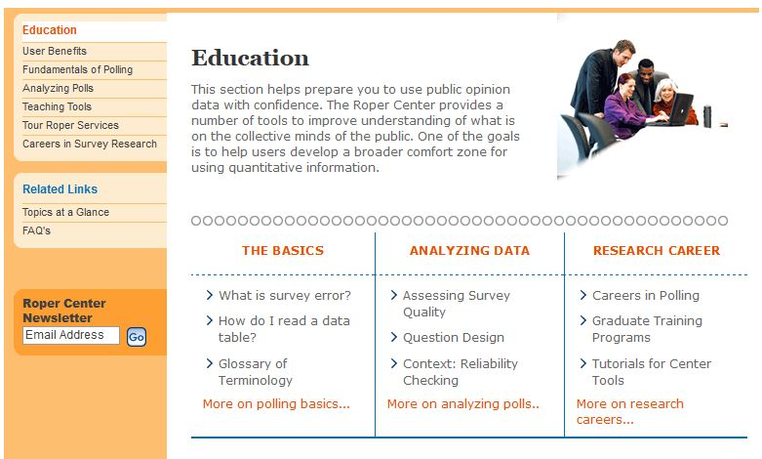
Education

Slide 40
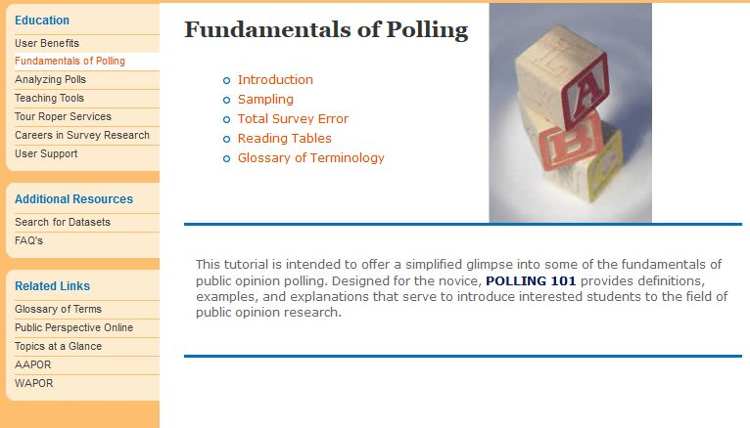
Fundamentals of Polling

Slide 41
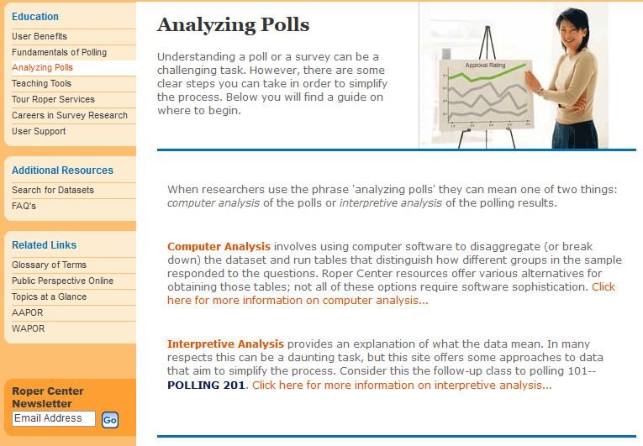
Analyzing Polls

Slide 42
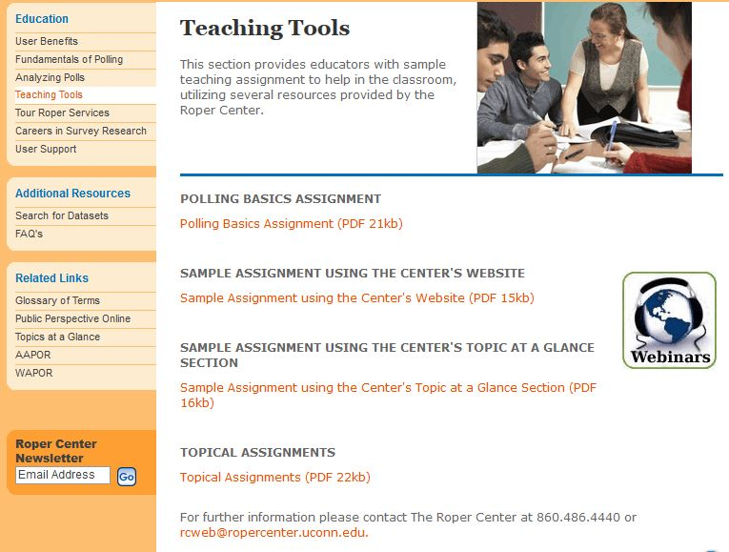
Teaching Tools

Slide 43
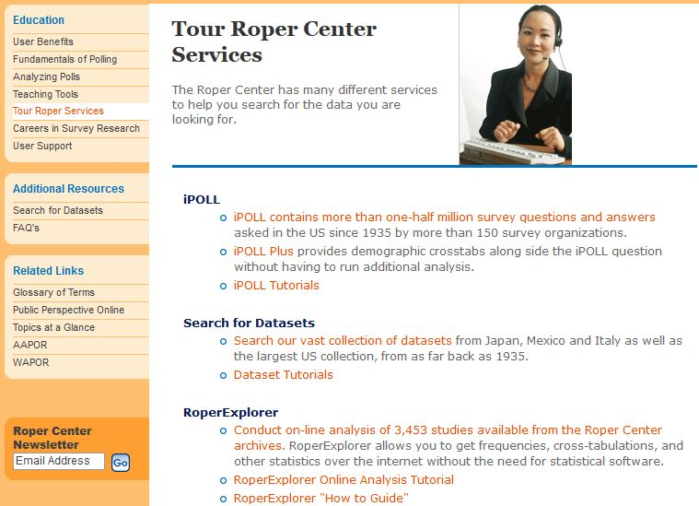
Touring Roper Services

Slide 44

Field Institute

Slide 45
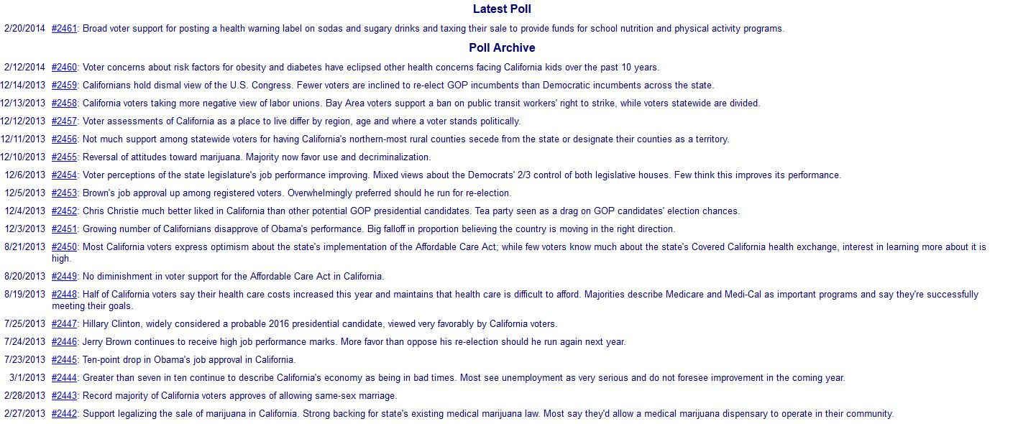
Field Poll Archives

Slide 46
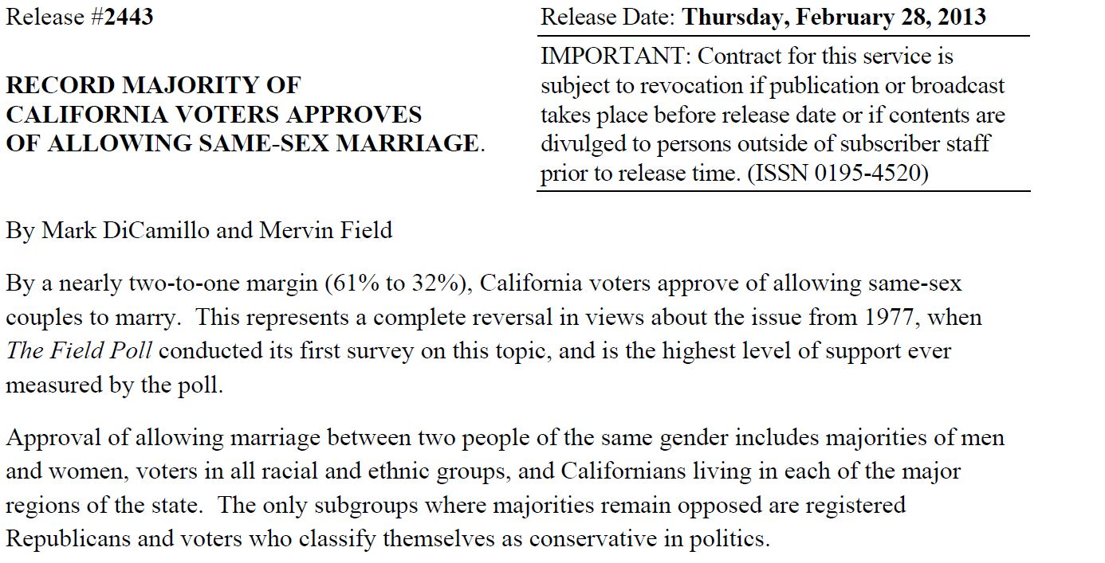
Example of a Field Poll Report

Slide 47
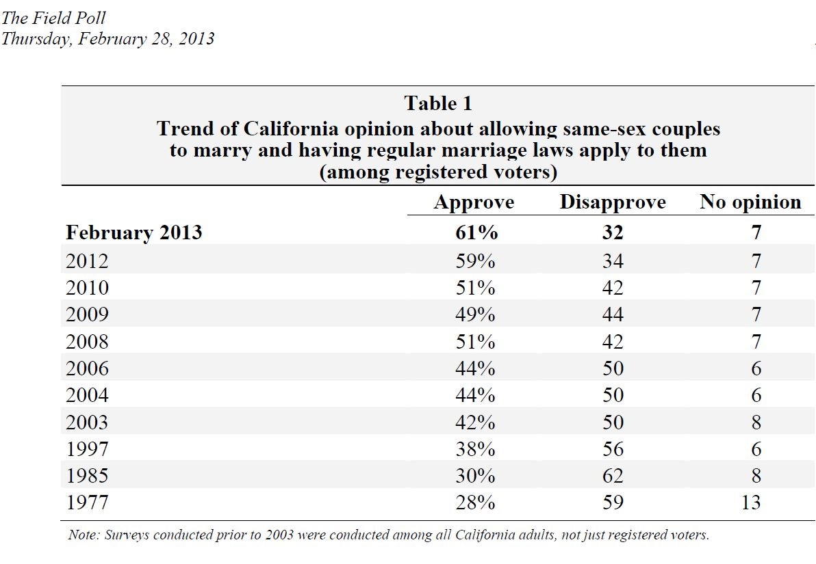
Table from a Field Poll Report

Slide 48
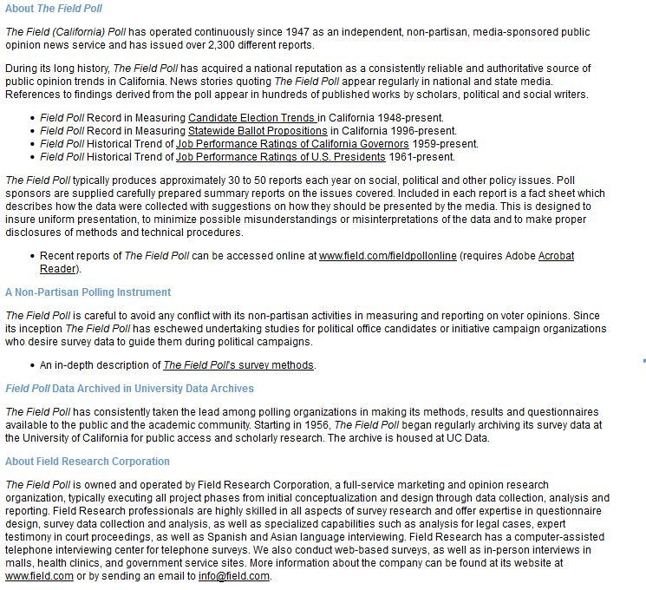
Learning More About the Field Poll

Slide 49
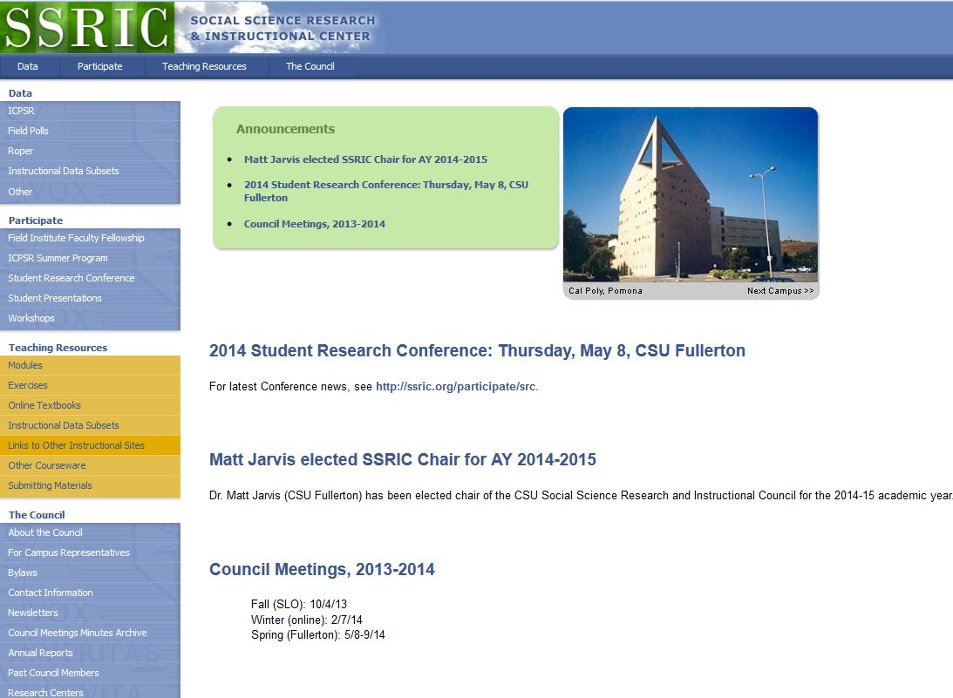
SSRIC

Slide 50
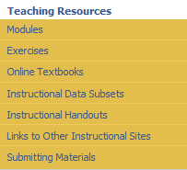
SSRIC Teaching Resources

Slide 51
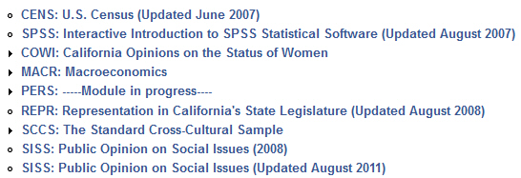
SSRIC Modules

Slide 52
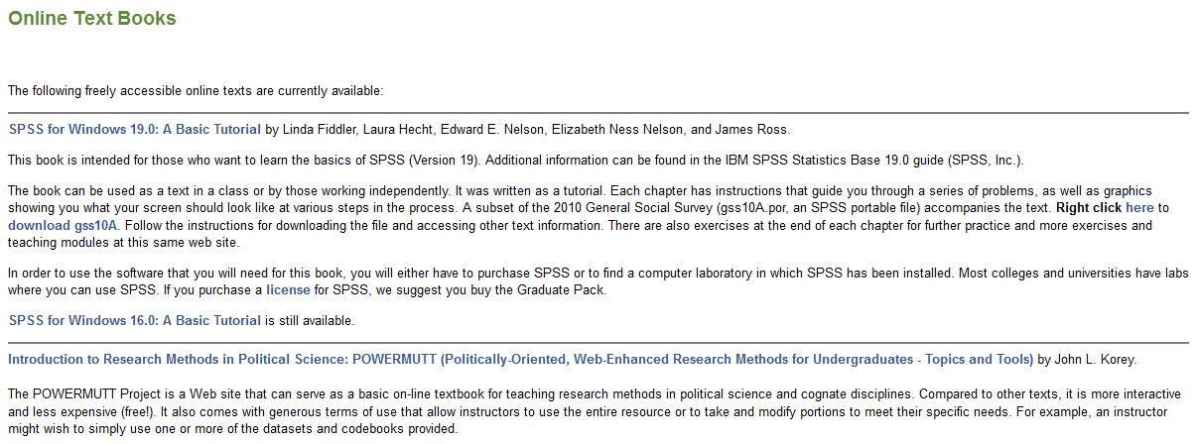
Online Textbooks

Slide 53
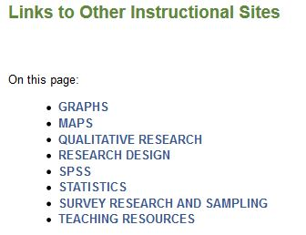
Links to Other Instructional Sites

Slide 54
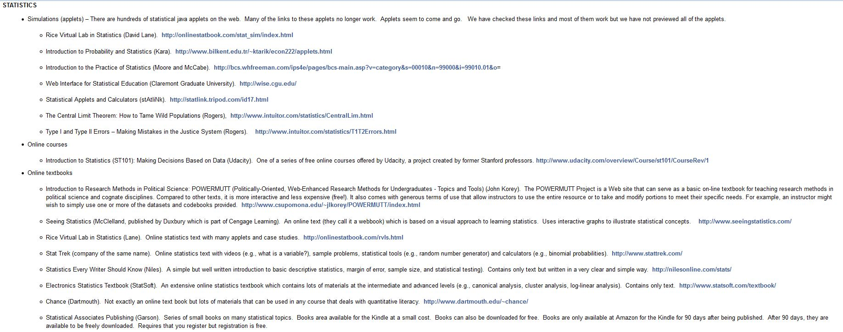
Links to Sites on Statistics

