Slide 1

Social Science Research and Instructional Council (SSRIC)
May 10, 2013

Slide 2
Workshop Agenda
Overview of the SSRIC
Data Archives
  ICPSR
  Field
  Roper
Other teaching resources

Slide 3
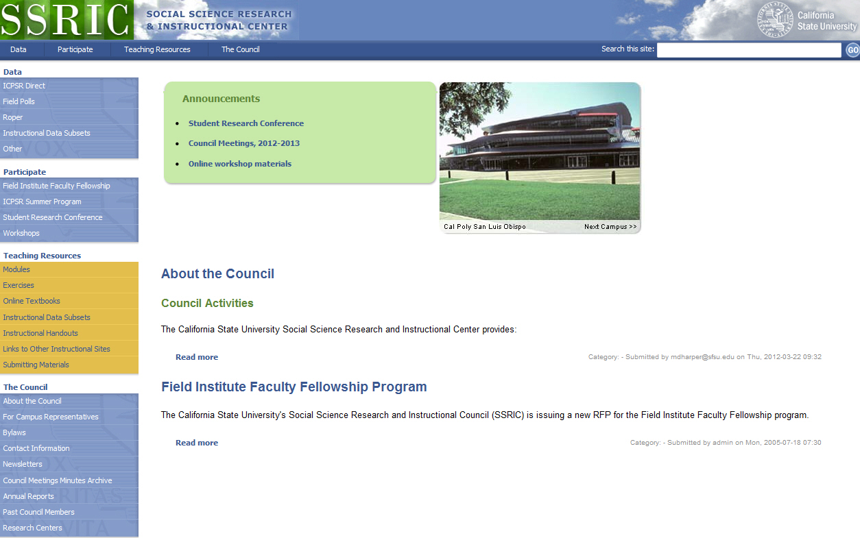
SSRIC http://www.ssric.org

Slide 4
The Council
Oldest CSU affinity group (since 1972)
Promotes use of data analysis in research and teaching
List of teaching resources is available on our website
Campus representatives
http://www.ssric.org/reps

Slide 5
The Council
Annual student research conference
  May 8, CSU Fullerton
  http://www.ssric.org/participate/src
Sponsors travel to ICPSR summer workshops in Ann Arbor, Michigan
  http://www.ssric.org/participate/icpsr_summer
Field Poll Faculty Fellowship (deadline April 15) http://www.ssric.org/participate/field_institute

Slide 6
Social Science Databases
The California State University subscribes to social science databases to support
  teaching
  research
  administration
Available to campuses by annual subscription

