Slide 1

Social Science Data Base Workshop
April 24, 2015
San Diego State University

Slide 2
Introduction - 1
Presenter: John L. Korey
Political Science (Emeritus)
Cal Poly Pomona
jlkorey@csupomona.edu

Slide 3
Introduction - 2
  Workshop Materials
    These Powerpoint Slides
    The only URL you need: List of Links Used in This Workshop

Slide 4
Introduction - 3
Workshop Agenda
  Overview of the SSRIC
  Data Archives
    ICPSR
    Roper
    Field
  Data in the Classroom
    Instructional Resources
  Other SSRIC Workshops

Slide 5
Social Science Research and Instructional Council (SSRIC)
Oldest CSU affinity group (since 1972)
  Representatives from CSU campuses meet three times per year
  Cal Poly, Pomona campus representative: Ginger Shoulders

Slide 6
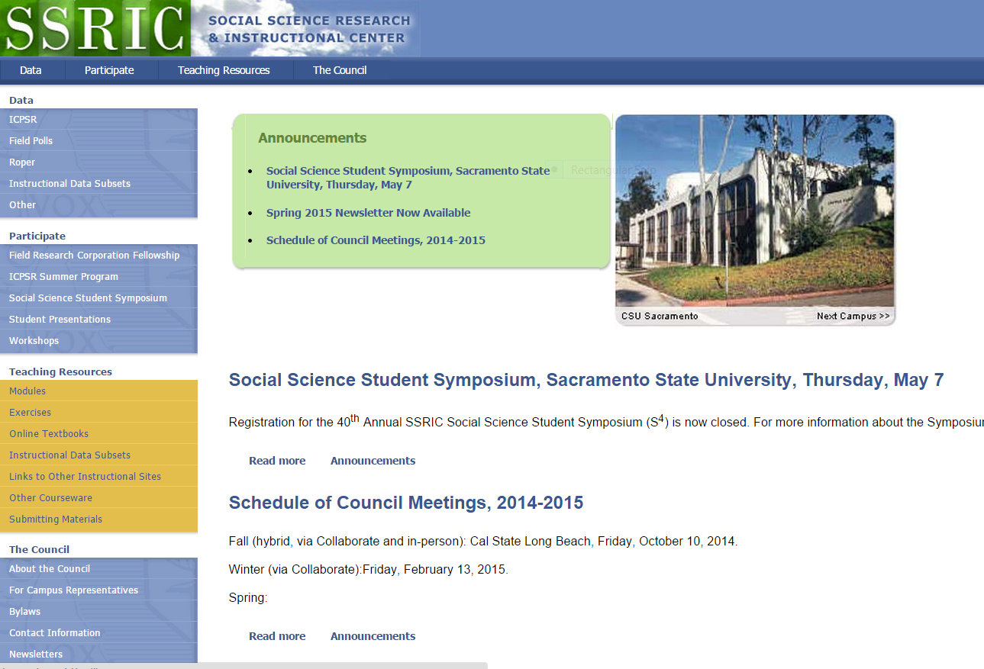
SSRIC Home Page

Slide 7
SSRIC Data
Data (see “Data” tab at ssric.org)
  Subscription Data Bases
    Inter-university Consortium for Political and Social Research (ICPSR)
    Roper
    Field Poll
  Other

Slide 8
SSRIC Programs
See “Participate” tab at ssric.org
  Field Poll Faculty Fellowship
  ICPSR summer program in Ann Arbor, Michigan
  40th Annual Social Science Student Symposium
  May 7, CSU Sacramento
  Workshops (like this one)

Slide 9
SSRIC Teaching Resources
See “Teaching Resources” tab at ssric.org
  Modules and Exercises
  Online Textbooks
  Instructional Subsets
  Links to Other Instructional Sites
  Handouts, etc.

Slide 10
Social Science Data Bases
The California State University subscribes to social science databases to support
  teaching
  research
  administration
Available to campuses by annual subscription

Slide 11
Assistance from the SSRIC
Note: SSRIC members are not staff data consultants or technical assistance providers, but we will do what we can to help students, faculty, and staff to access data
List of Campus Representatives

Slide 12
Accessing Subscription Data Bases
On-campus access - IP authenticated
Off-campus access
  Field: not available for download (could try VPN?), but can be analyzed online with SDA
  ICPSR and Roper: first time, on-campus or use library proxy server (same as other library databases); after that, you can access from anywhere

Slide 13
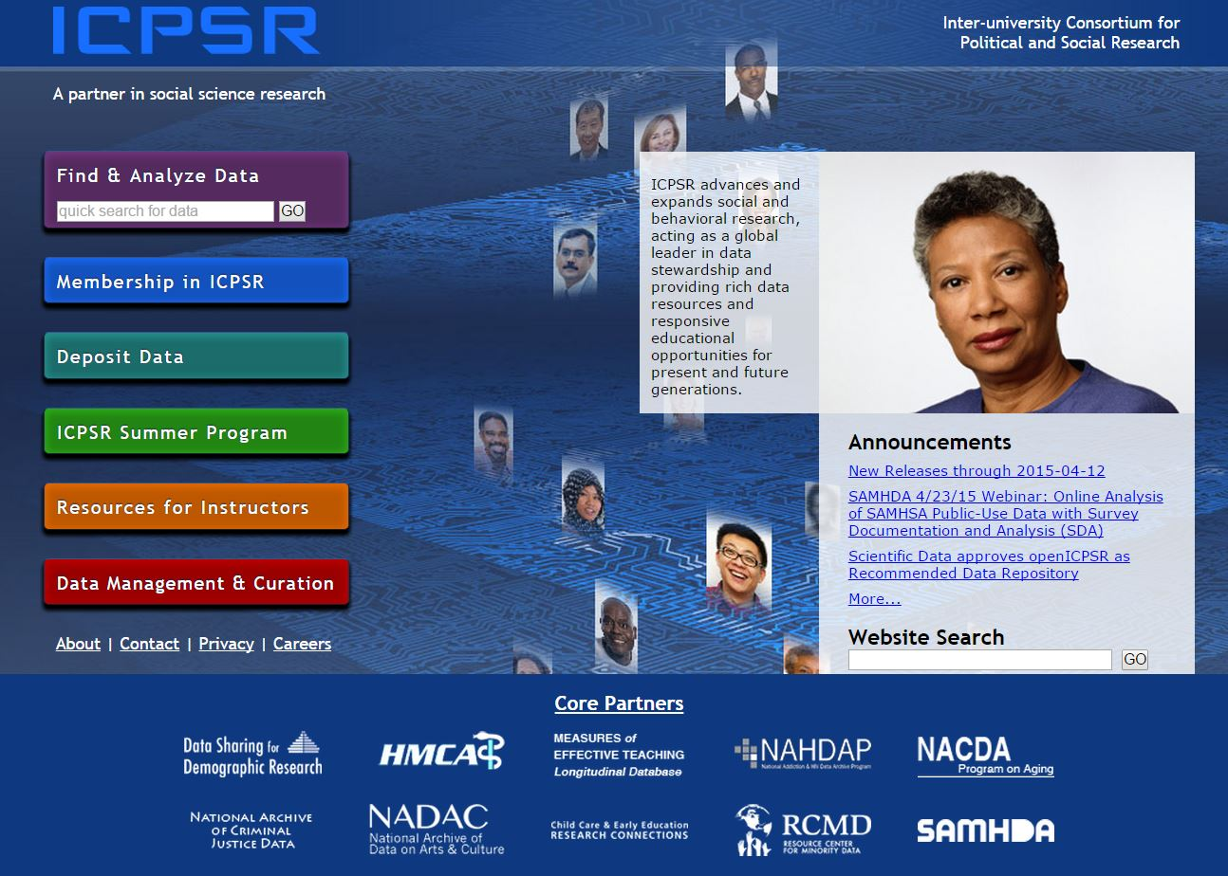
ICPSR
Inter-university Consortium for Political and Social Research

Slide 14
What is the ICPSR?
Primary social science data archive for the U.S.
Founded in 1962; CSU joined in 1972
  Over 700 member institutions worldwide
Services
  Vast data archive accessible via the web
  Summer program
  Instructional resources

Slide 15
Using ICPSR Data
Log on/Create an Account
Locate the study
Select the data for download
Download the data
Save the data for analysis

Slide 16
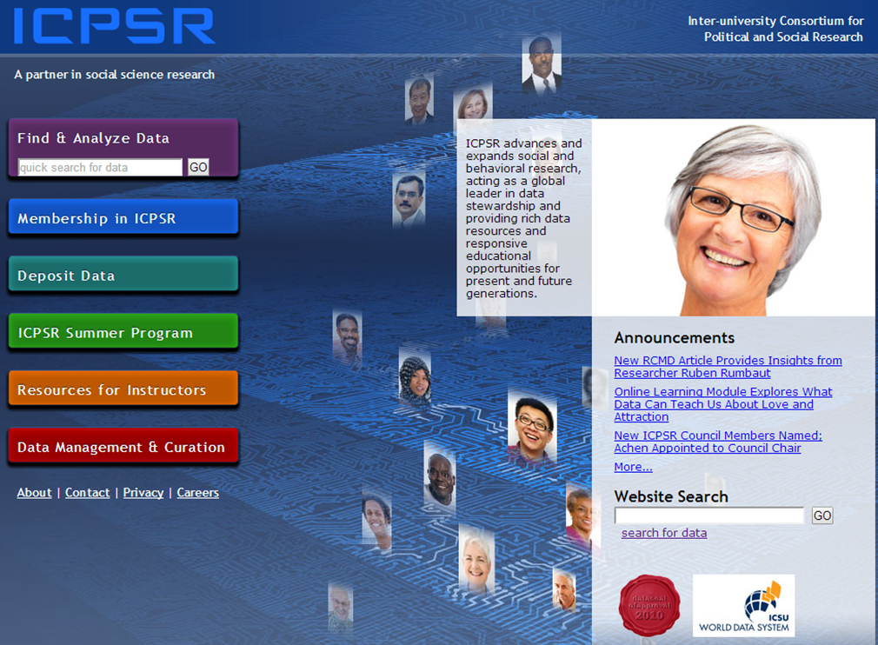
Creating An Account – Step 1
Notes:
Click on "Find and Analyze Data" (or any tab on right sidebar)

Slide 17
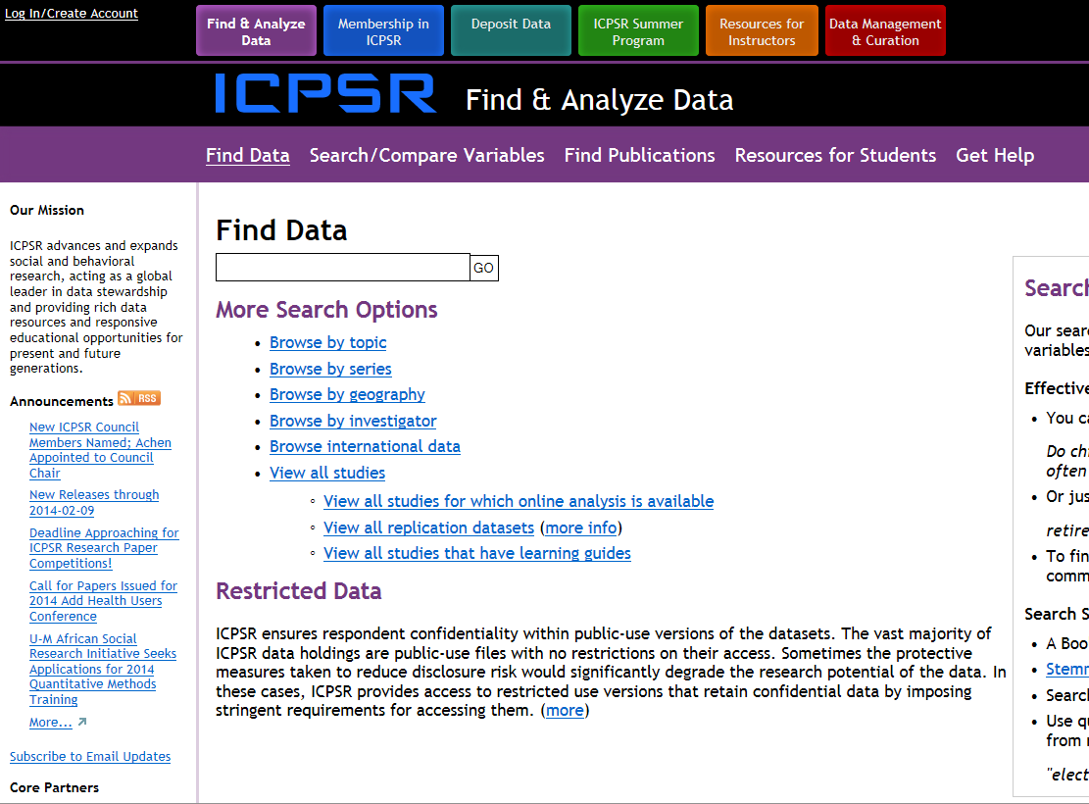
Creating an Account – Step 2
Notes:
Click on “Log In/Create Account”

Slide 18
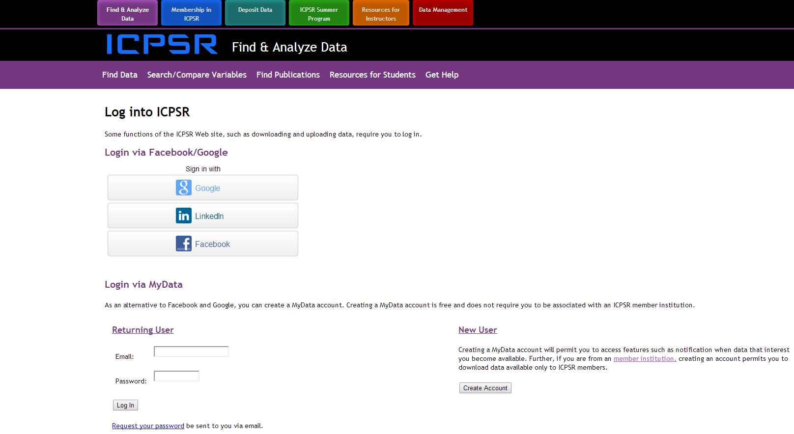
Creating an Account – Step 3
Notes:
If you already have a MyData Account, log in as a returning user. If not, create a MyData account, or log in via Facebook, Google, or LinkedIn – you can then create a MyData account.

Slide 19
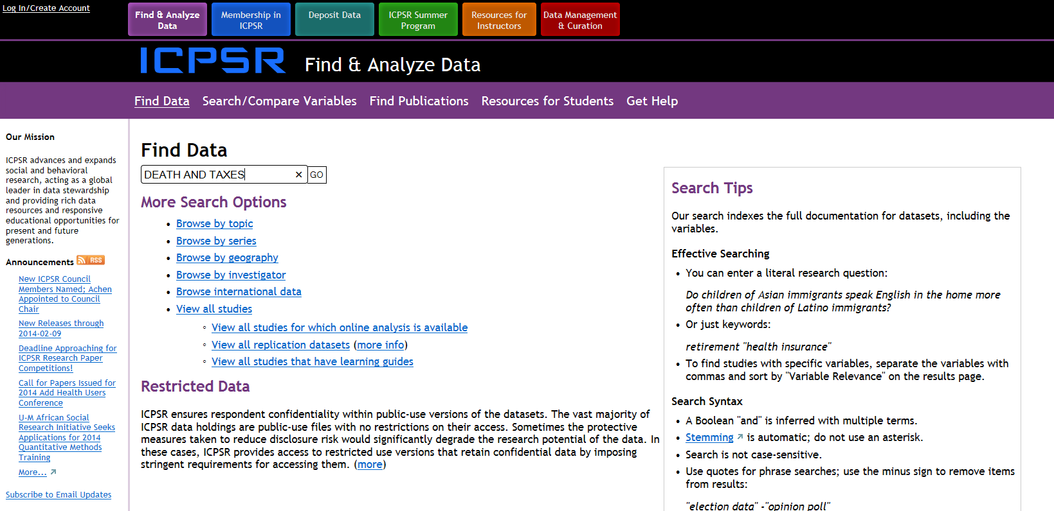
Locate the Study -1
Notes:
In the “Find Data” box, type in “DEATH AND TAXES” without the quotation marks (not case sensitive). Leaving out “AND” or typing “OR” produces same results. Typing just one of the keywords produces more; putting term in quotes produces fewer.

Slide 20
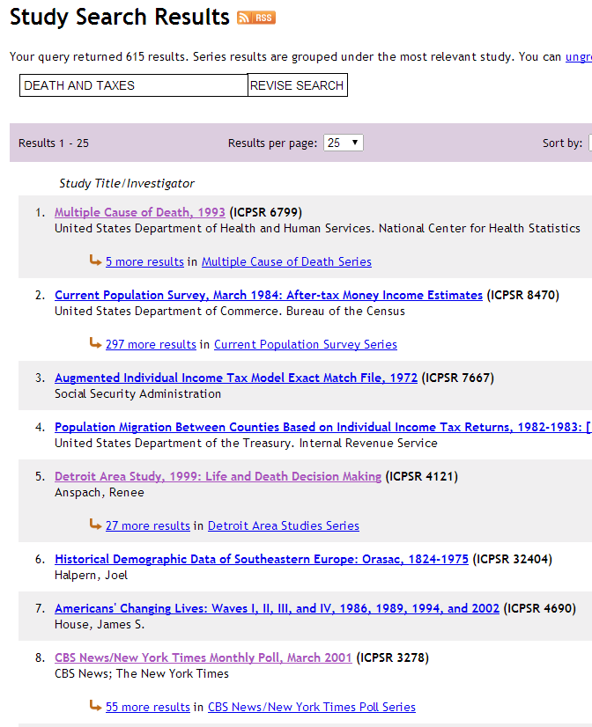
Locate the Study - 2

Slide 21
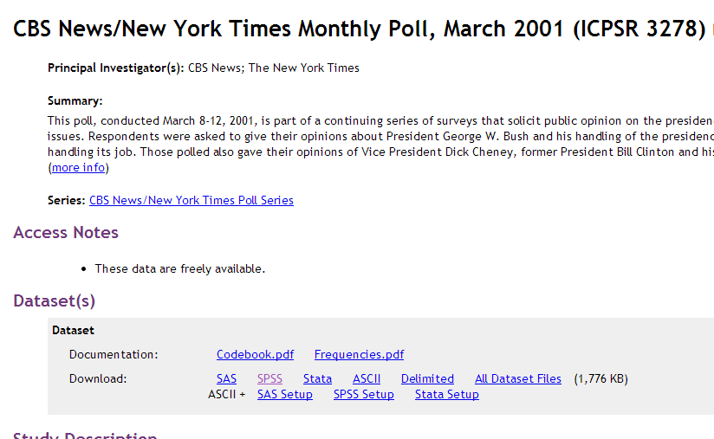
Select Data for Download
Notes:
Under “Download,” near bottom of screen, click on “SPSS.”

Slide 22
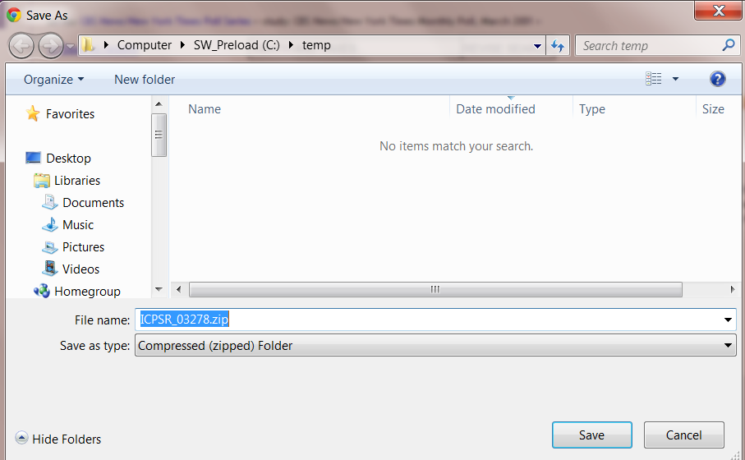
Download the Data

Slide 23
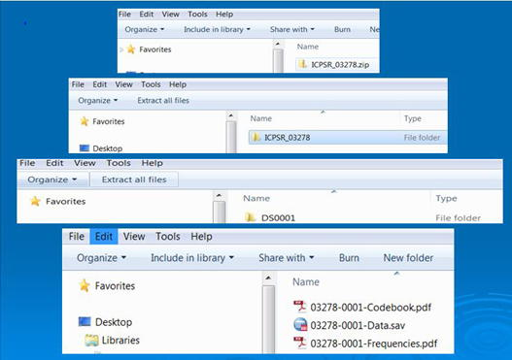
Save the Data for Analysis
Notes:
Click on each of the files shown until you get to the bottom screen. The first two of the files found there (the codebook in PDF format and the data in SPSS system file format) are the ones you want.

Slide 24
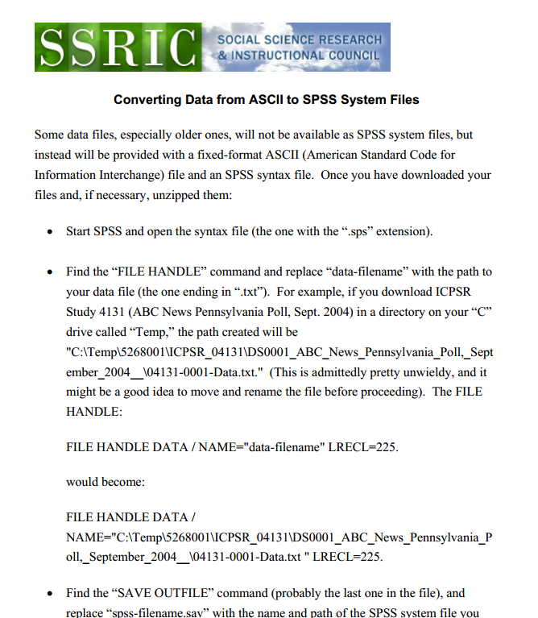
Converting ASCII Files
Notes:
Some old datasets come with only a raw data ASCII (American Standard Code for Information Interchange) file and an SPSS “syntax” file. By running the data against the syntax file, you can create an SPSS system file. You’ll need to made a few changes in the syntax file. The handout linked to this page will show you how.

Slide 25
SPSS Syntax Files
Manfred te Grotenhuis and Chris Visscher, How to Use SPSS Syntax: An Overview of Common Commands (Thousand Oaks, CA: Sage, 2014).
Notes:
On even rarer occasions, you won’t even gat a syntax file, and will have to create your own. The book cited here will show you how.

Slide 26
Other Research Tools
Search/Compare Variables
Bibliography of Data Related Litrerature
Online Data Analysis
Archive Partners

Slide 27
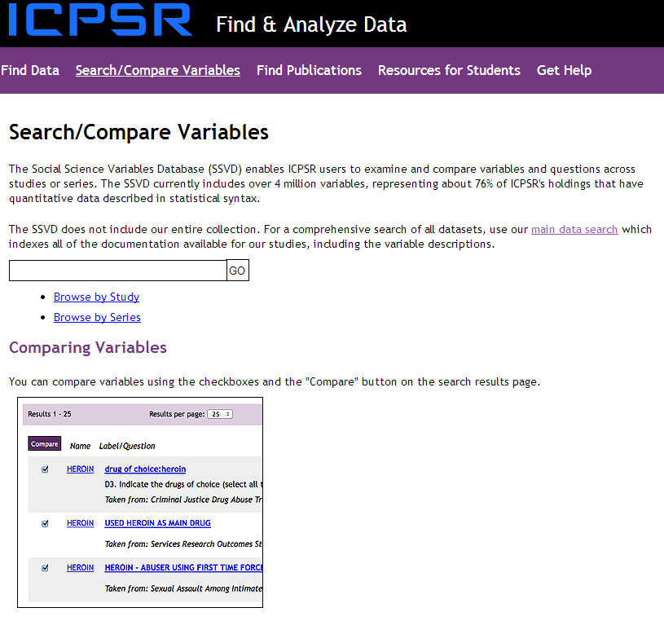
Search/Compare Variables
Notes:
This feature is useful if you plan to design your own questionnaire ad would like to see how others have dealt with making the same or similar measurements.

Slide 28
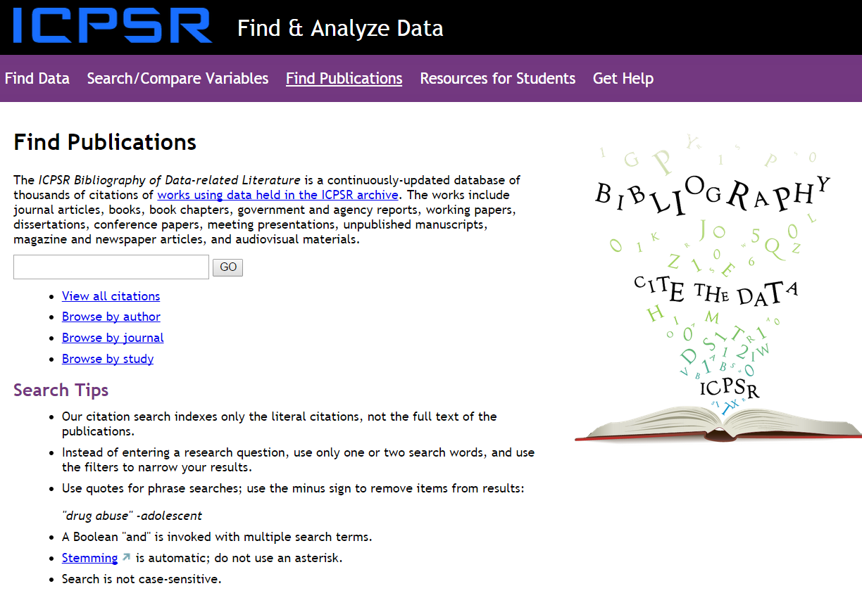
Find Publications
Notes:
This feature will let you know of works that have used a particular dataset in the ICPSR archives.

Slide 29
Online Data Analysis
Simple Crosstabs: if a dataset decription says that you can perform simple crosstabs, you can do so online by clicking on the link and following the instructions.
SDA: some datasets also allow more extensive analyses using SDA (Survey Documentation and Alalysis). The SSRIC offers a separate workshop on SDA.

Slide 30
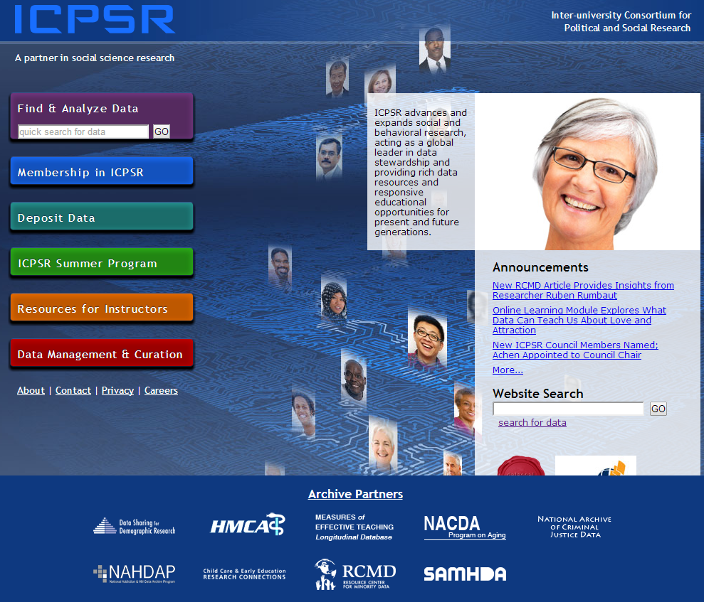
Archive Partners
Notes:
The bottom of this screen lists various organizations partnered with the ICPSR

Slide 31
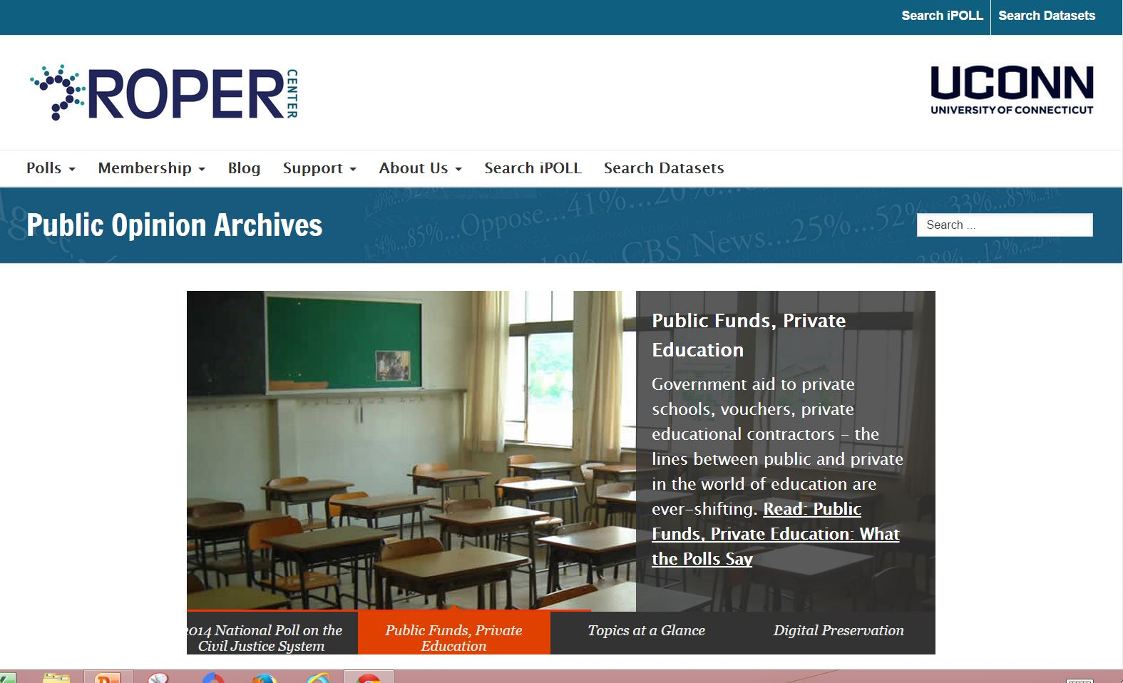
The Roper Center

Slide 32
What is the Roper Center?
Roper Express (datasets for download)
Roper Explorer (online analysis)
iPoll (survey questions)

Slide 33
Creating your Own Account
The first thing you need to do is to create your own personal account at the Roper Center.
You’ll need this account to download data sets and to analyze data online.
These accounts are free.
To create your own account, you’ll need be on a computer on a CSU campus that has subscribed to the social science data bases.
Point your mouse at “Quick Links” in the upper left of the Roper home page. Click on “iPOLL Login” as shown on the next slide.
Click on “Register” at the top of the page as indicated in the next slide.

Slide 34
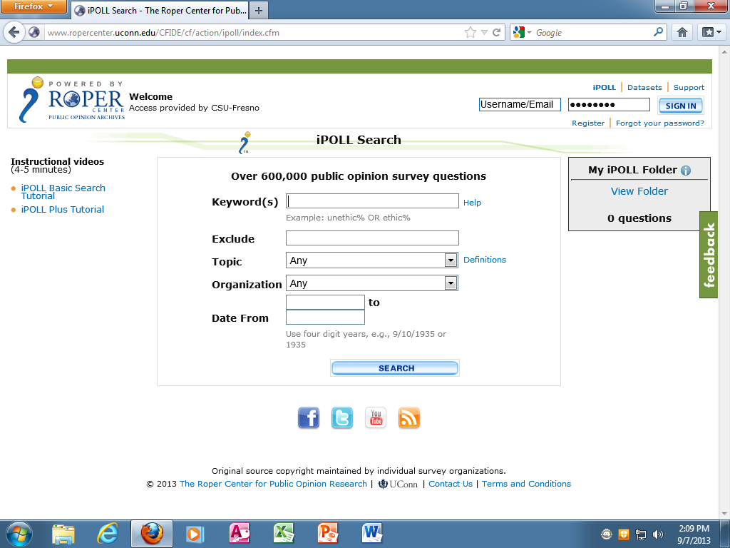
Creating your Own Account - 1
Notes:
Click on “Register” (near upper right)

Slide 35
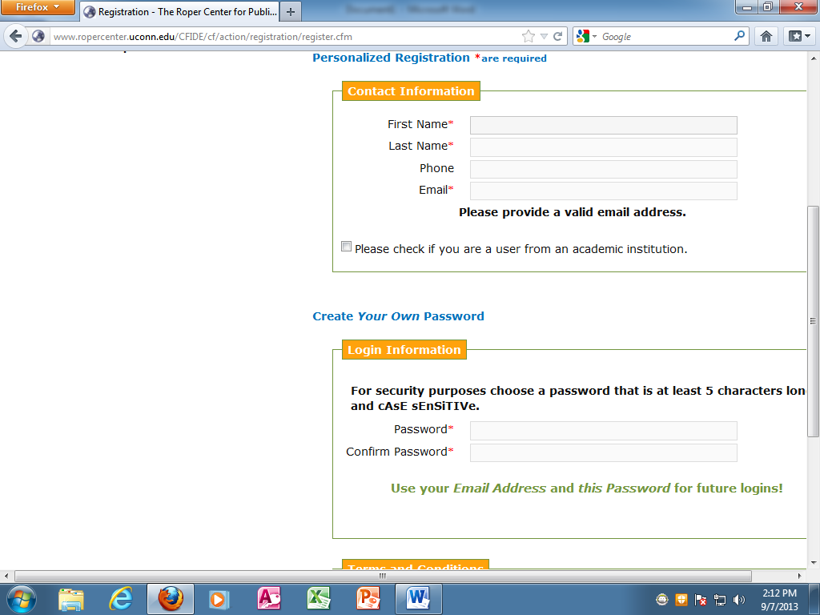
Creating your Own Account - 2
Notes:
In the spaces provided, enter the information requested and create a password

Slide 36
Logging onto your Account
When you want to use the Roper Center and it asks you to sign into your account, use your email address as your user name and the password you just created as your password.
Now that you have your account, you can access the Roper Center from off campus.
When you need to sign into your account, it will ask you to do so.

Slide 37
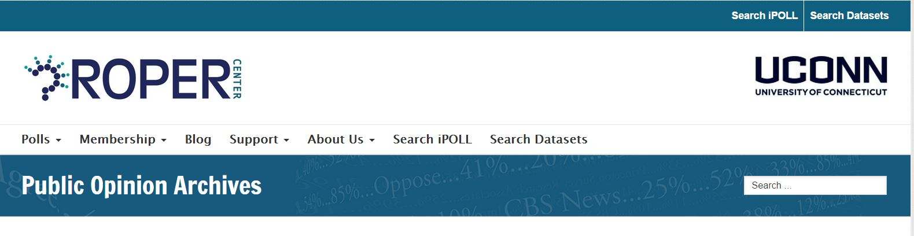
Finding Data
Click on “Search Datasets” on the home page

Slide 38
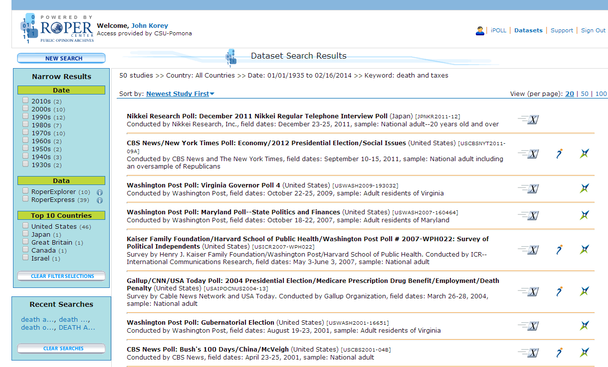
Data Search Results
Notes:
You can narrow your search in several ways by using the left sidebar.
Also, to the right if each study description, there are three columns. An icon in the first column indicates that the study is available for downloading (Roper Express); an icon in the second column means that question wordings are available online (iPOLL); an icon in the third column means that online analysis (Roper Explorer) is available.

Slide 39
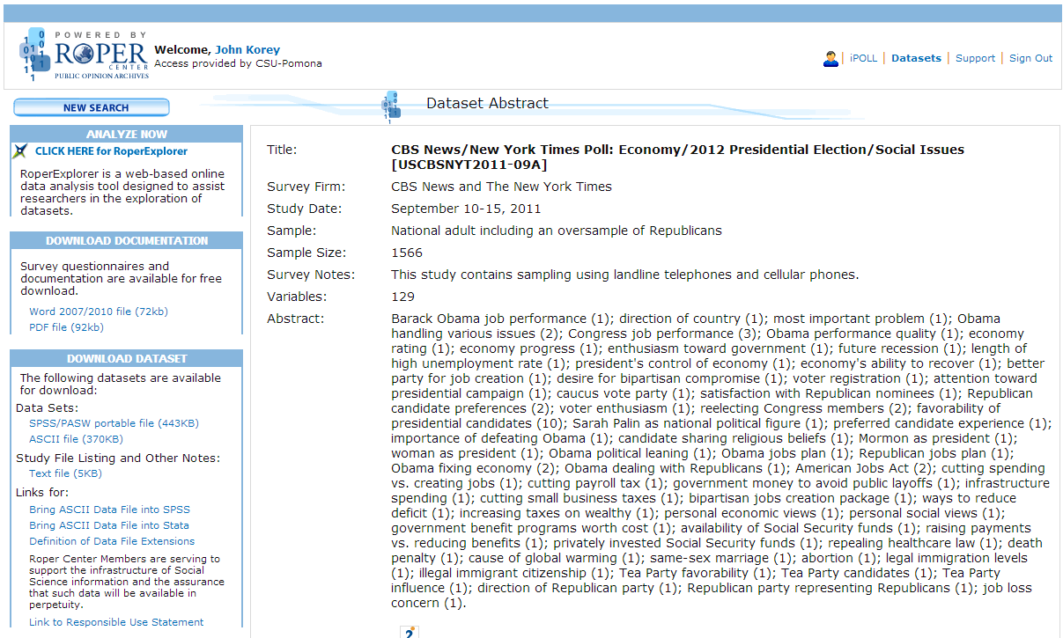
Downloading Data
(RoperExpress)

Slide 40
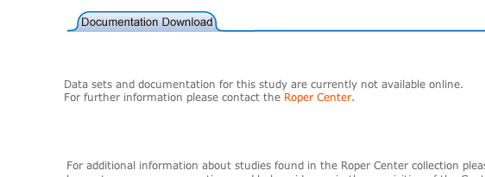
What if Nothing is Available?
Some documentation and/or data sets are not available on-line. If you are interested in one of these, email the survey number and the title to:
Ed Nelson at ednelson@csufresno.edu

Slide 41
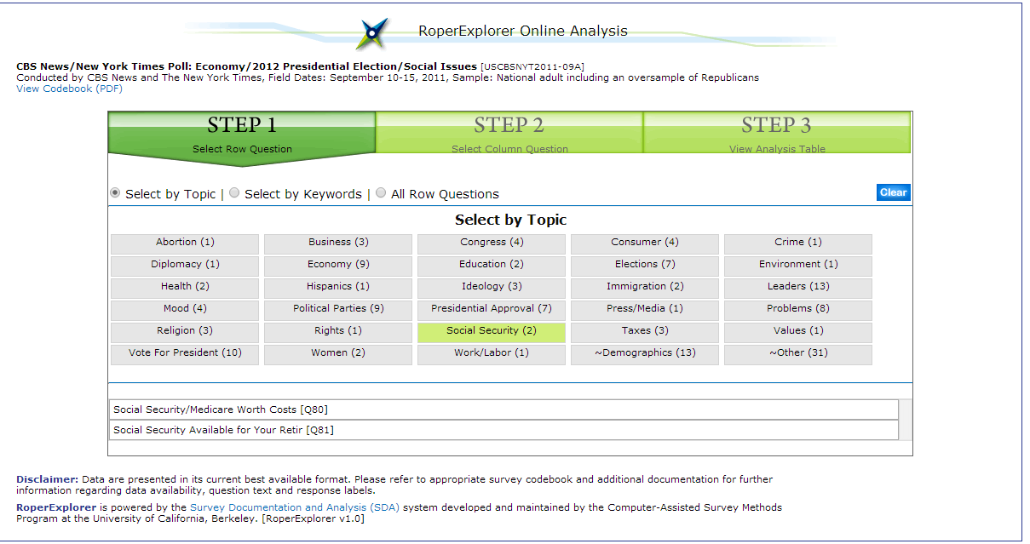
Online Analysis
(RoperExplorer)

Slide 42
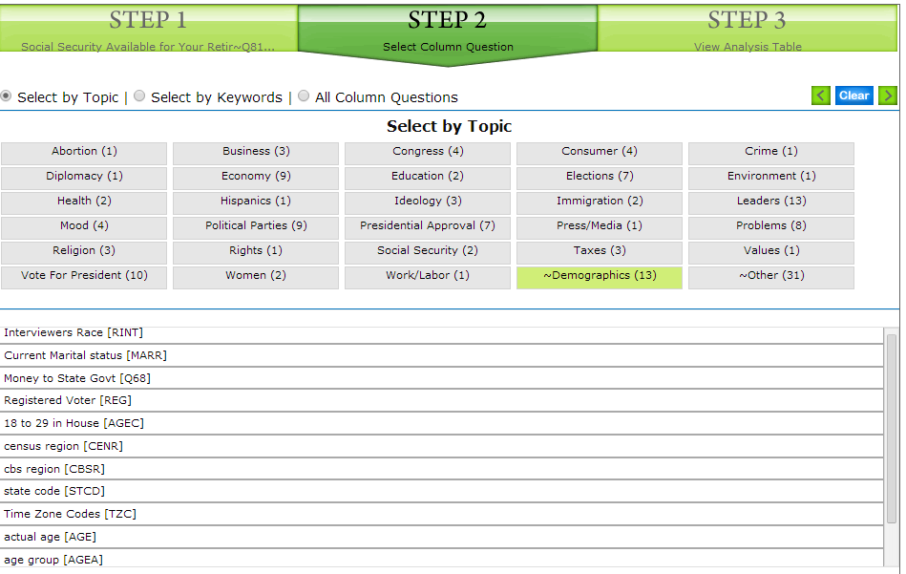
RoperExplorer – Select by Topic

Slide 43
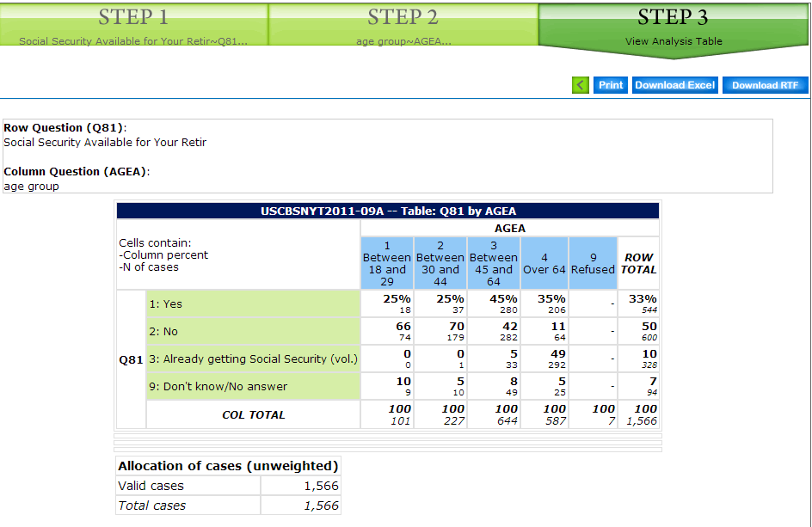
RoperExplorer - Results

Slide 44
Finding Questions
Click on “Search iPOLL” on the home page

Slide 45
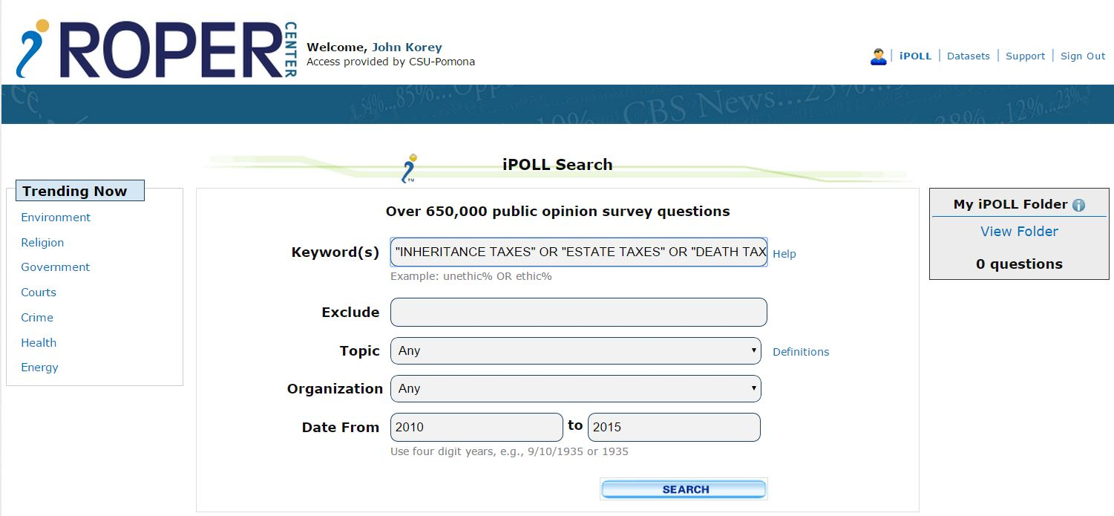
iPOLL Search

Slide 46
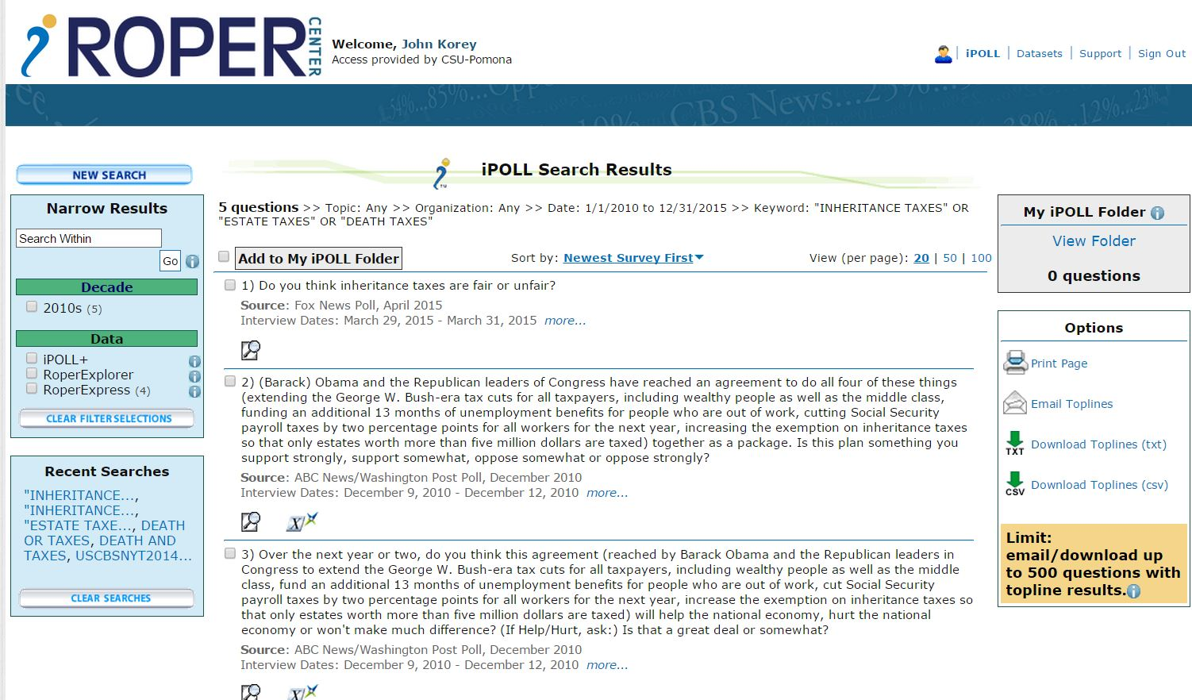
iPOLL Search Results

Slide 47
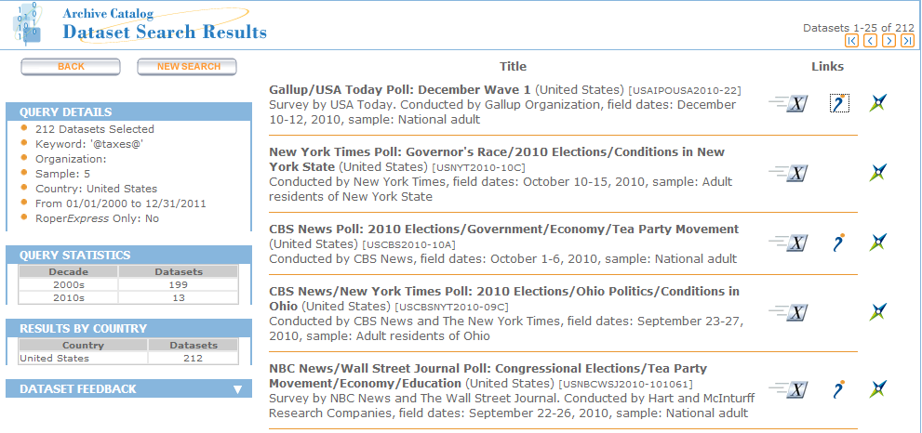
View Questions in iPOLL
Notes:
An icon in the middle column on the right side of the slide indicates that question wordings are available for this poll. Click on it.

Slide 48
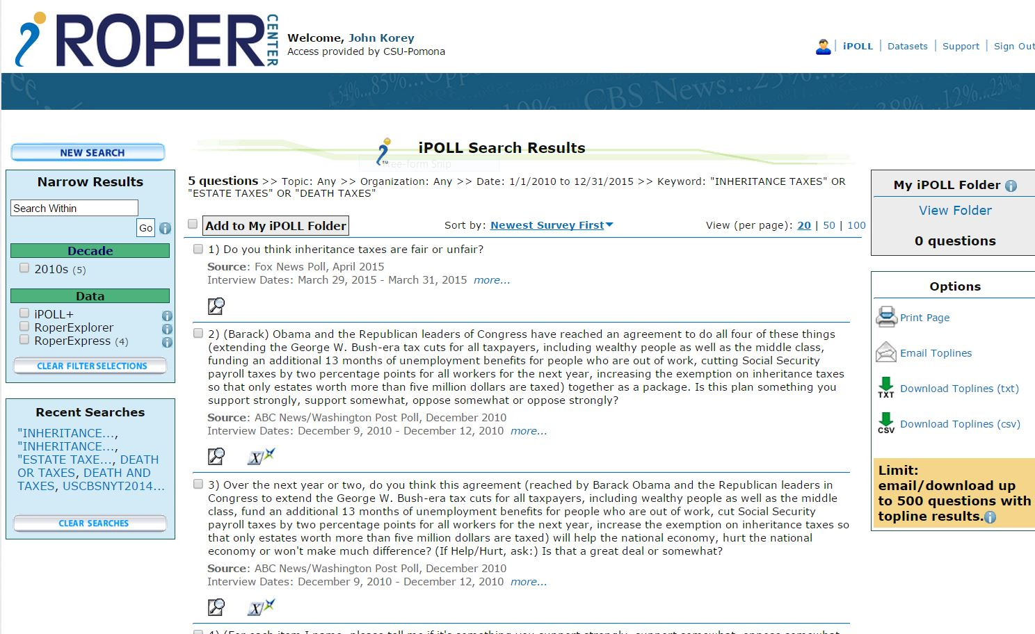
Get Question Details
Notes:
An icon showing a magnifying glass below a question indicates that question details are available for this item. Click on it.

Slide 49
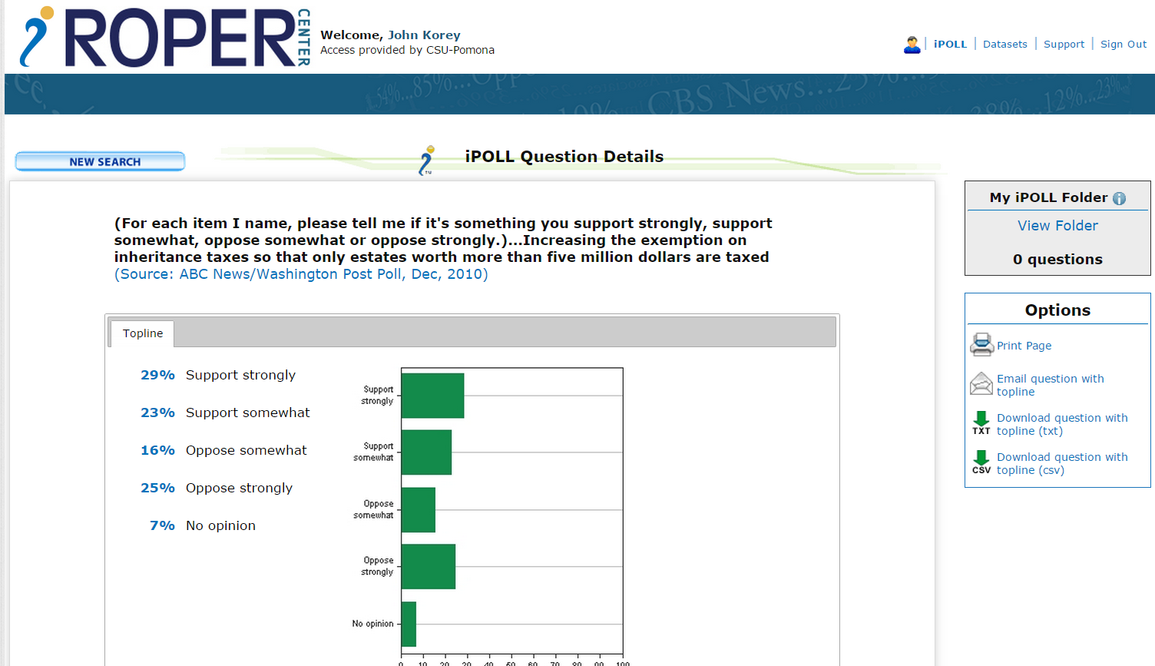
Question Details

Slide 50
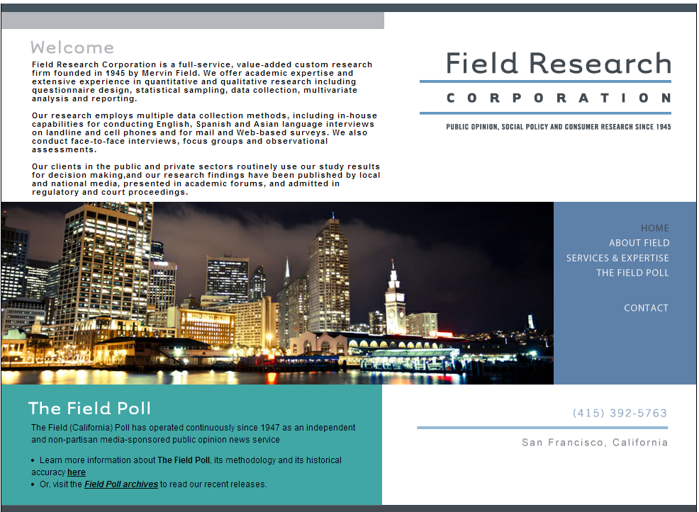
The Field (California) Poll

Slide 51

The Field (California) Poll
Established in 1947
Independent, non-partisan survey of California public opinion
Wide range of political and social topics
Multiple polls each year

Slide 52
Accessing Field Data
Set up your (IE) browser
Find polls and data sets
Download data sets

Slide 53
Setting up your IE browser
Required: setting passive FTP access
Optional: Can set up browser for folder view (makes downloading data a little easier) or FTP directory view
See the SSRIC Field Poll Guide for details
You will only need to do this once for your browser and user account
Notes:
These instructions apply to IE. They don’t seem to be necessary for Mozilla Firefox or Google Chrome..

Slide 54
Finding Polls
Find the poll number from the
  Field Poll Archives
  CALPOLL window via UCDATA
You will be using the poll number to select the data set for download.
Notes:
Poll numbers are in the form “calxxyy,” where xx is the first two digits of the year the survey was conducted, and yy is the number of the poll within that year.

Slide 55
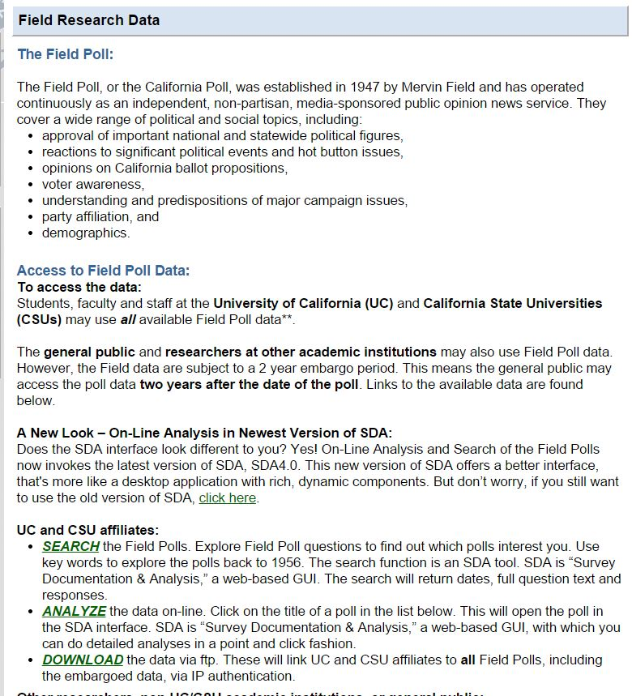
Downloading the Data

Slide 56
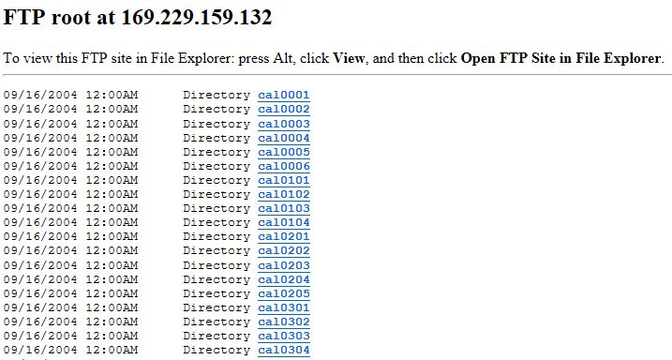
Switching to Folder View

Slide 57
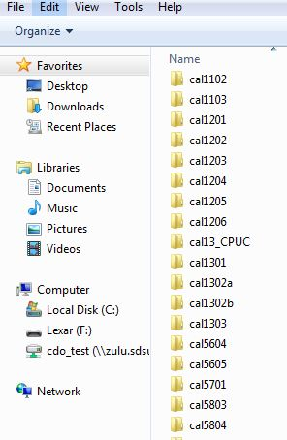
Downloading the Folder

Slide 58
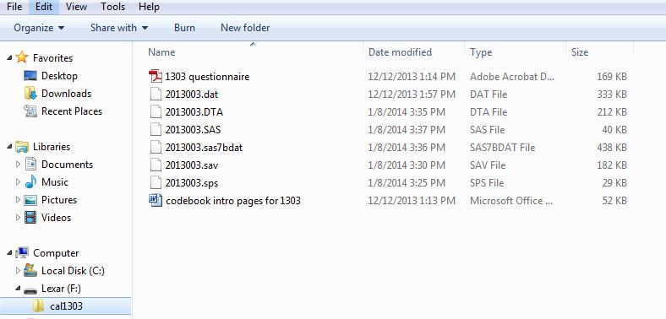
Viewing the Folder Contents

Slide 59
Searching for Variables

Slide 60
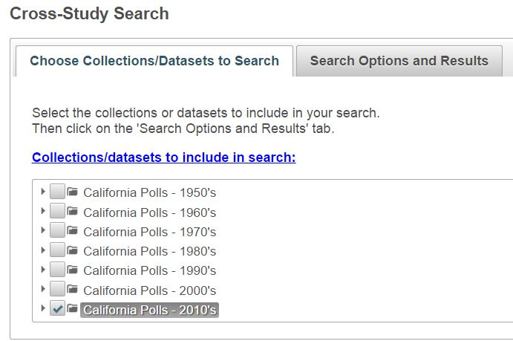
Choosing Datasets to Search
Notes:
I selected “2010’s”

Slide 61
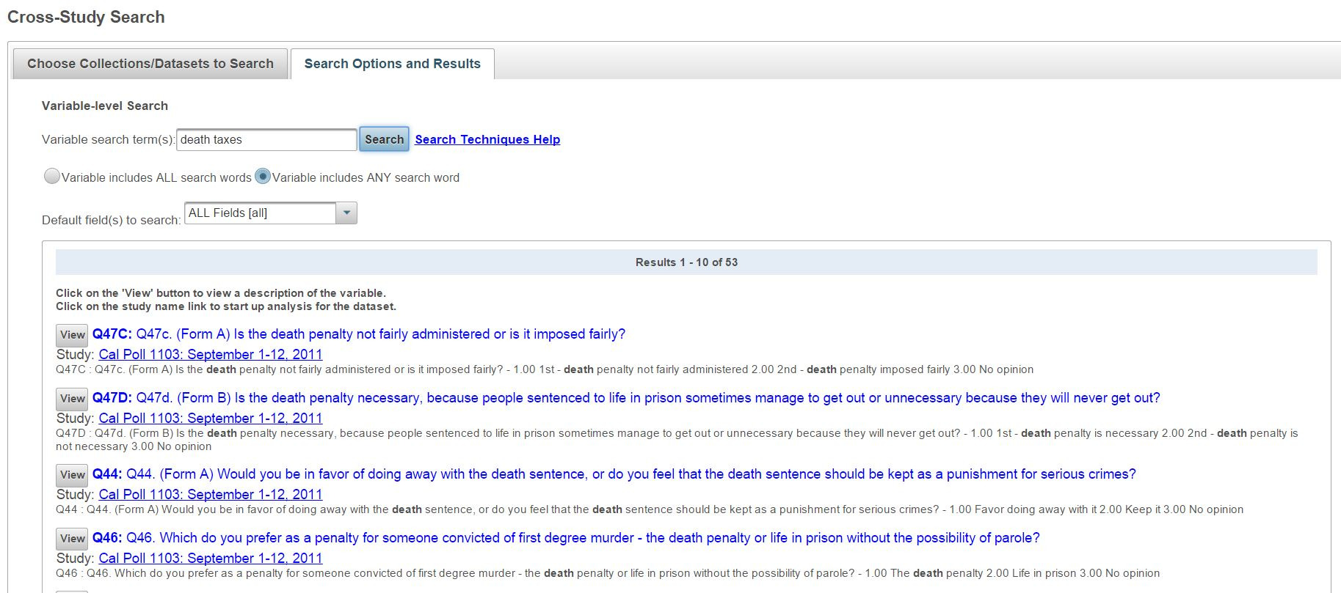
Search Options and Results

Slide 62
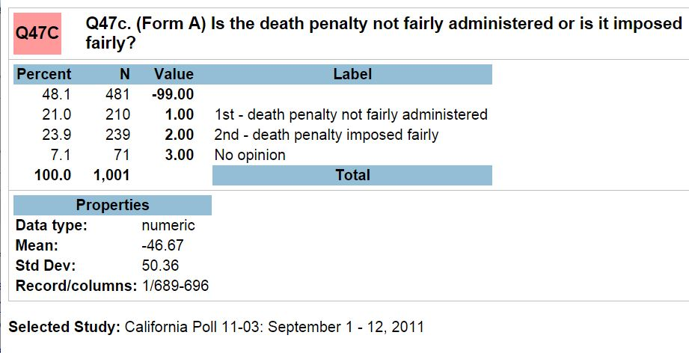
Results from SDA

Slide 63
Online Analysis
Most Field polls that are over two years old can be analyzed online with SDA (Survey Documentation and Analysis) by all users
Embargoed polls (i.e., within the last two years) are also available in SDA format for UC and CSU users.

Slide 64
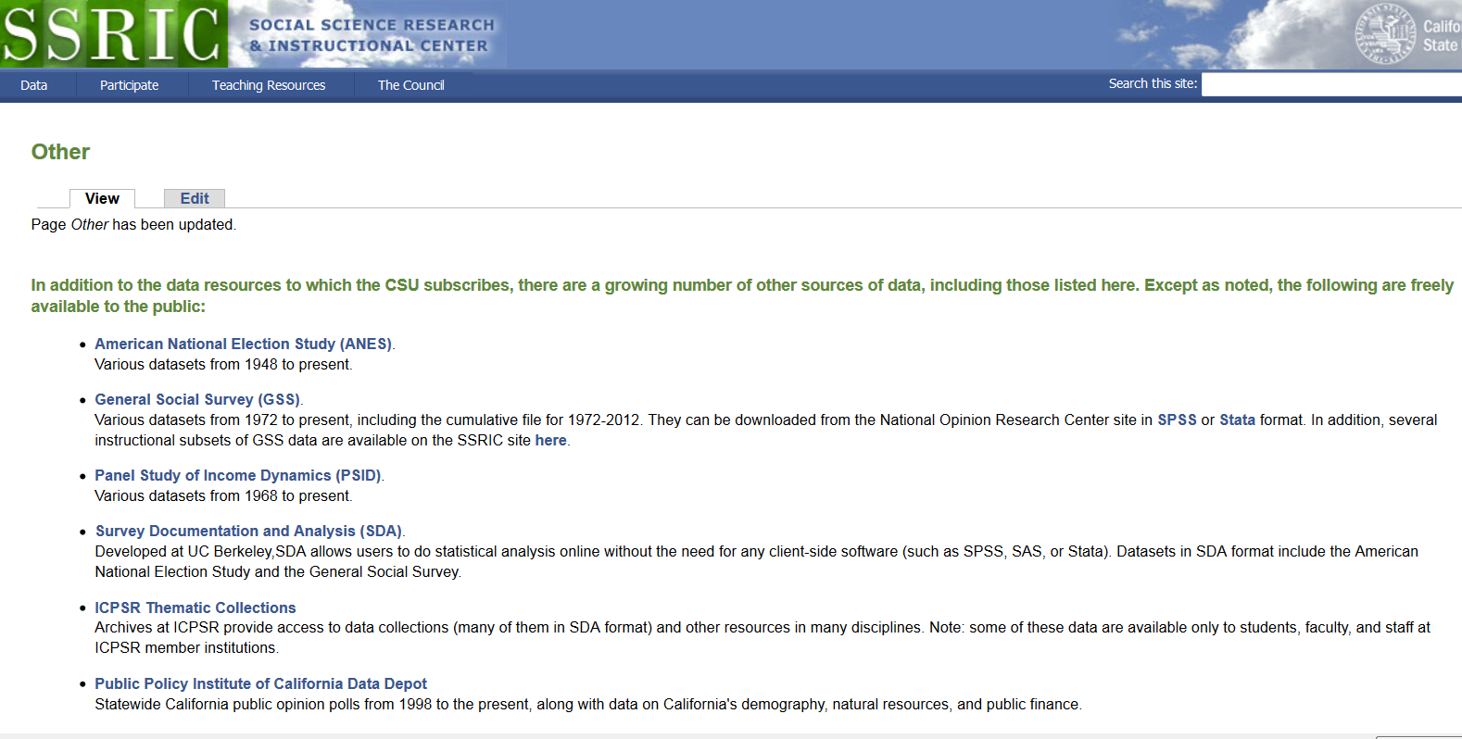
OTHER DATA SOURCES

Slide 65
Instructional Resources
SSRIC
ICPSR
Roper
Other Resources
  Teaching with Data
  MERLOT (Multimedia Educational Resource for Learning and Online Teaching)

Slide 66
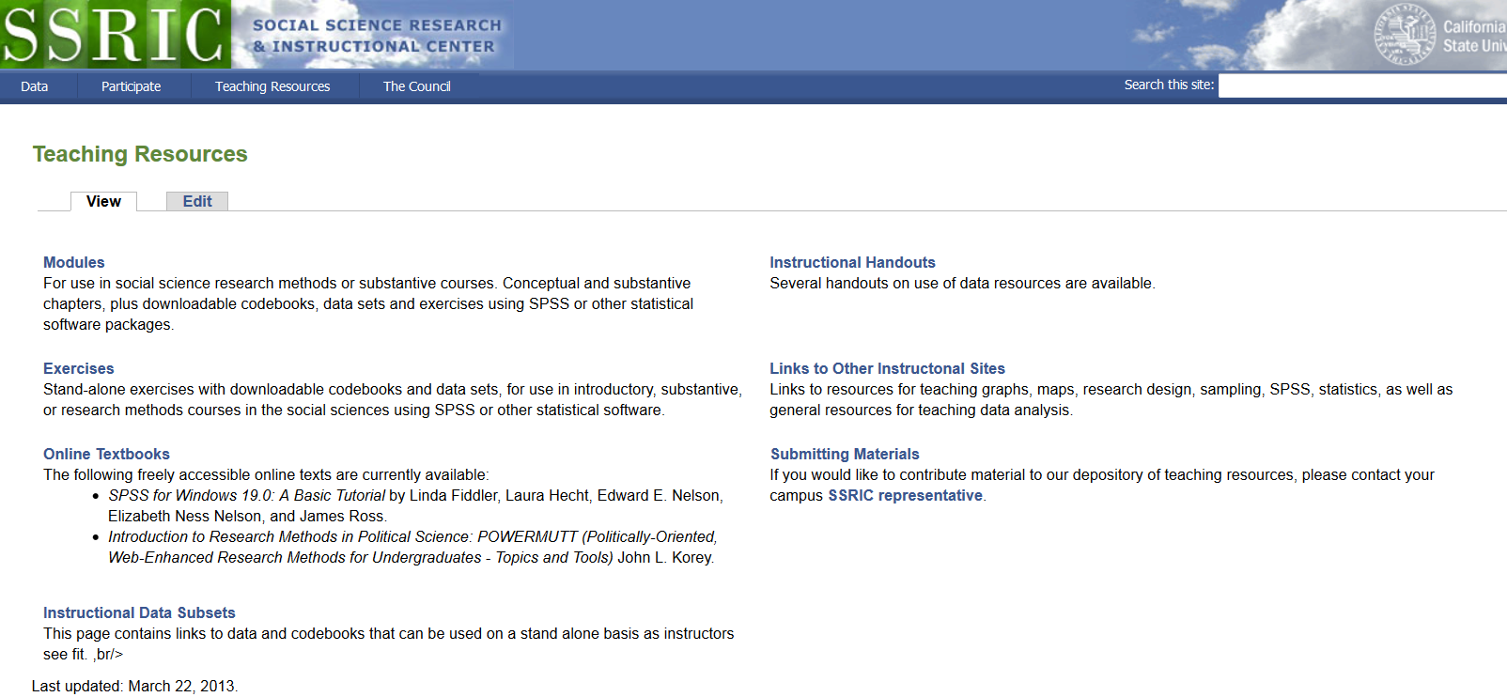
SSRIC Instructional Resources

Slide 67
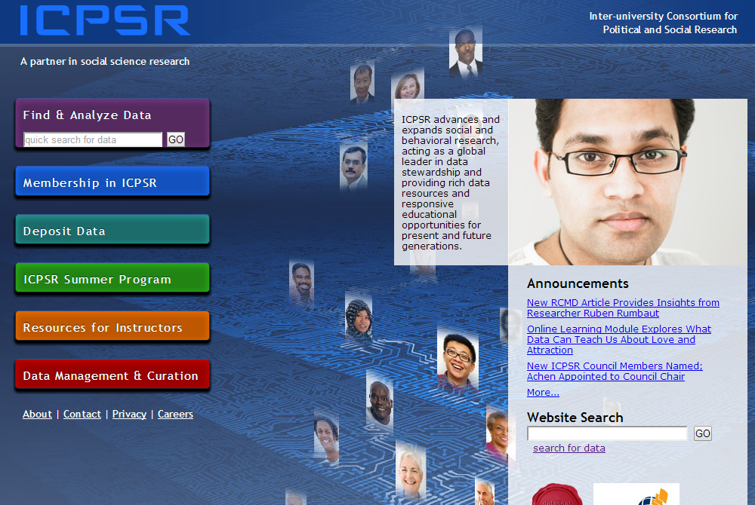
ICPSR Instructional Resources
Notes:
Click on “Resources for Instructors”

Slide 68

Resources for Instructors
Notes:
This section of the ICPSR site is divided into four parts: “Exercises,” “Resources for Students,” “Videos on Teaching,” and “External Resources.” Click first on “Exercises.”

Slide 69
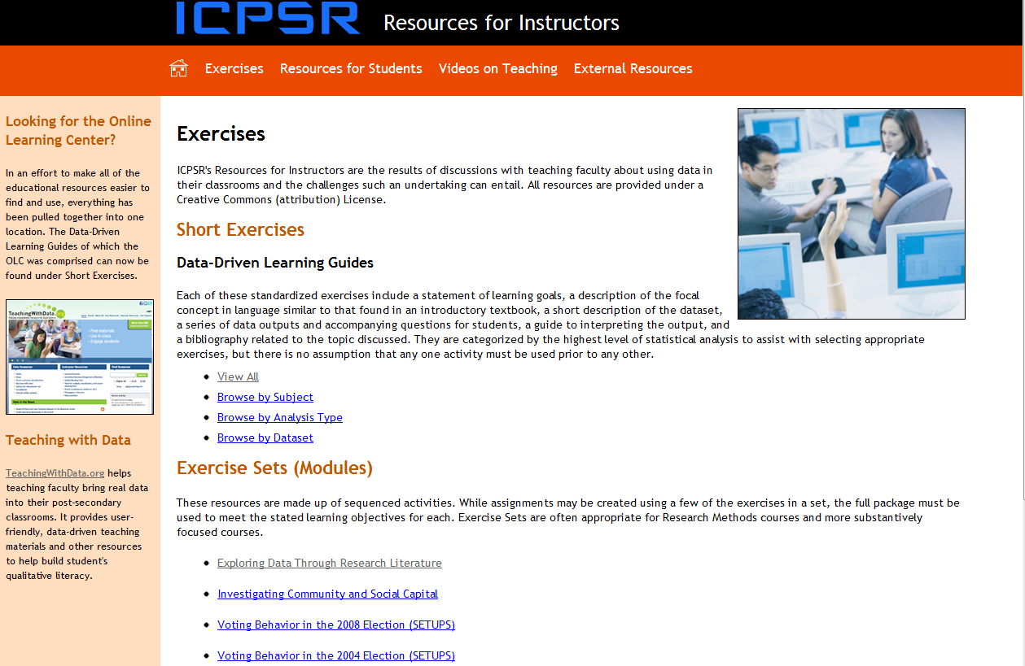
Exercises
Notes:
The “Exercises” subsection consists of a large number of short, self-contained exercises and a small number of more elaborate “modules.”

Slide 70
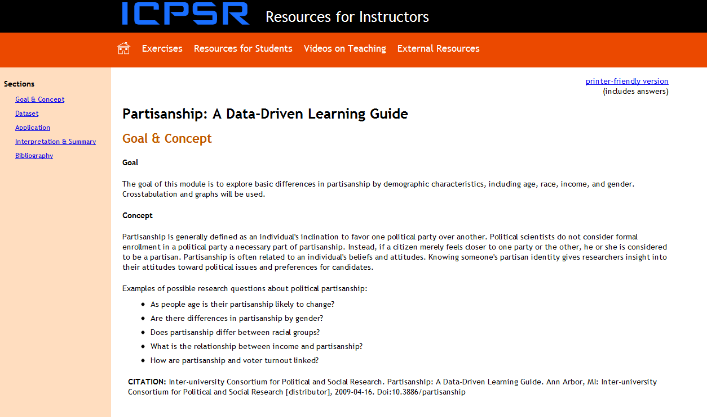
Modules
Notes:
Each module is different. Short exercises share a common format, and consist of: Goal and Concept, Dataset, Application, “Interpretation and Summary, and Bibliography. Click on “Resources for Students.”

Slide 71
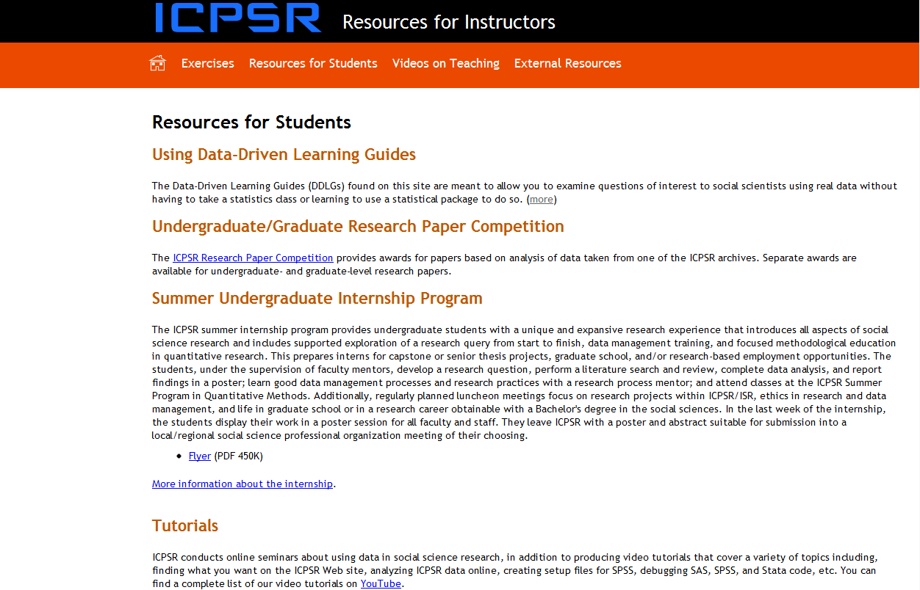
Resources for Students
Notes:
“Using Data-Driven Learning Guides” describes the components of the short exercises shown on the previous slide. Information is provided on two ICPSR programs specifically for students, the “Research Paper Competition” and the “Internship Program.” “Tutorials” include a large number of videos produced by ICPSR and available on YouTube.

Slide 72
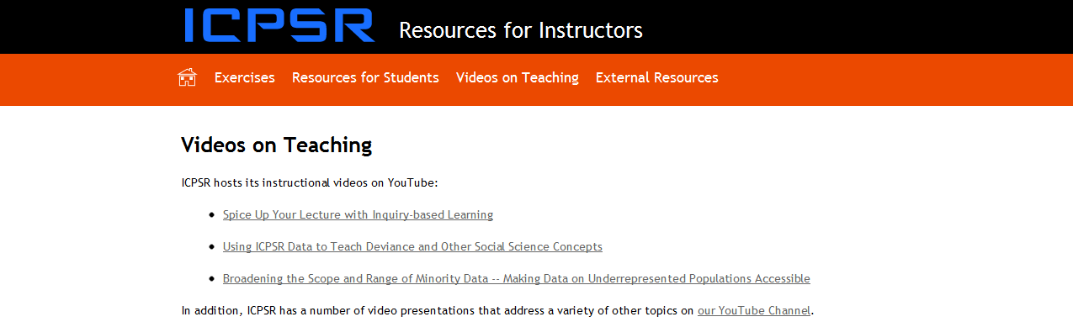
Videos on Teaching
Notes:
“Videos on Teaching” again references ICPSR’s YouTube collection.

Slide 73
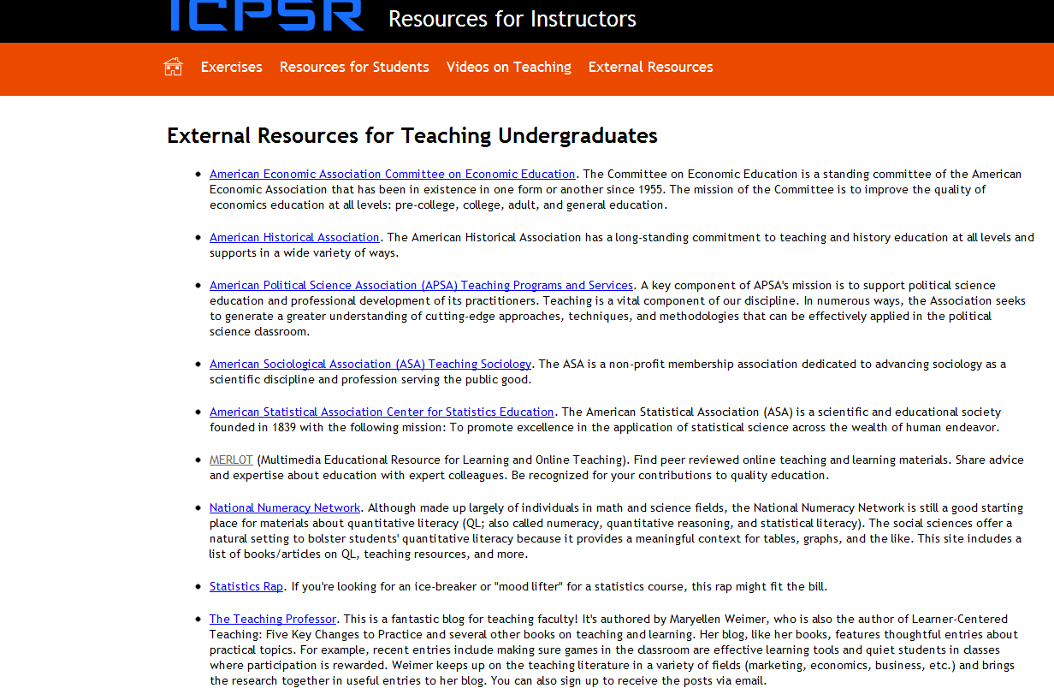
External Resources
Notes:
“External Resources for Teaching Undergraduates” links to a small but useful set of sites containing instructional materials. See especially “Teaching with Data” at http://www.teachingwithdata.org/qssdl/welcome.action. BTW: an extensive set of links to instructional resources may be found at http://www.ssric.org/tr/links.

Slide 74
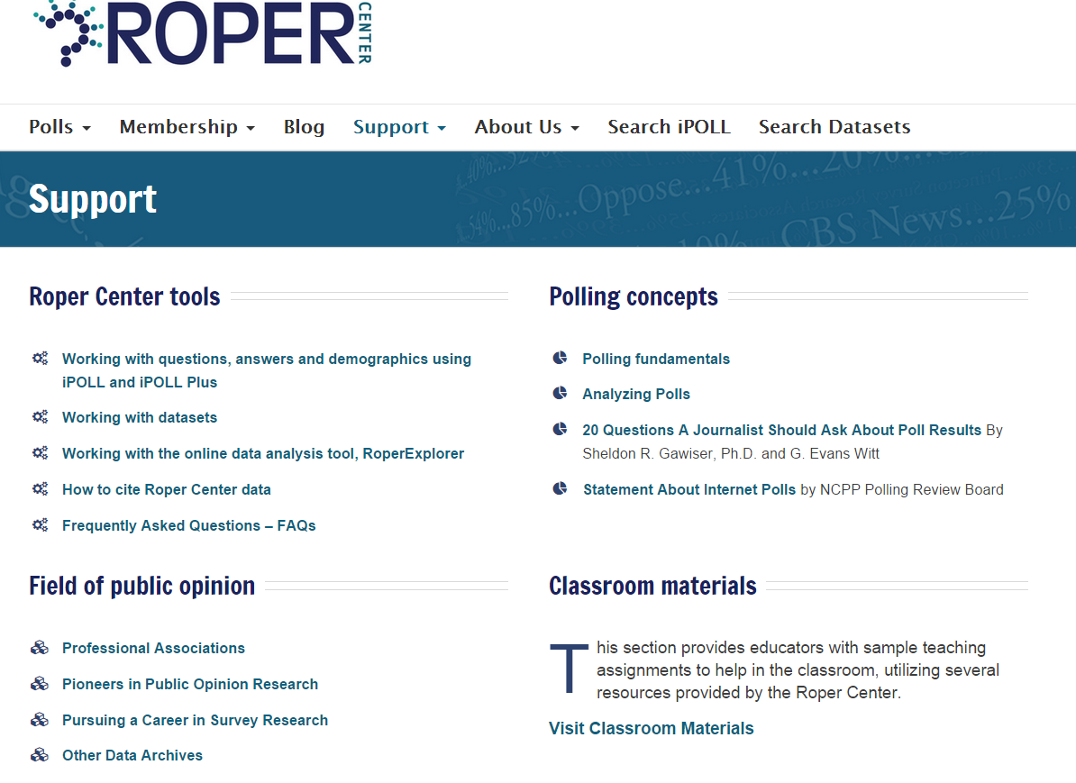
Roper Instructional Resources
Notes:
“The Basics” (a.k.a. Polling 101) and “Analyzing Data” (a.k.a. Polling 201) provide an excellent introduction to survey research.
For a video tutorial on datasets, go to: DATA ACCESS (menu bar at top) → DATASET COLLECTION → Dataset Tutorials.
For a video tutorial on iPOLL, go to: DATA ACCESS (menu bar at top) → IPOLL DATABANK → iPOLL Tutorials.

Slide 75
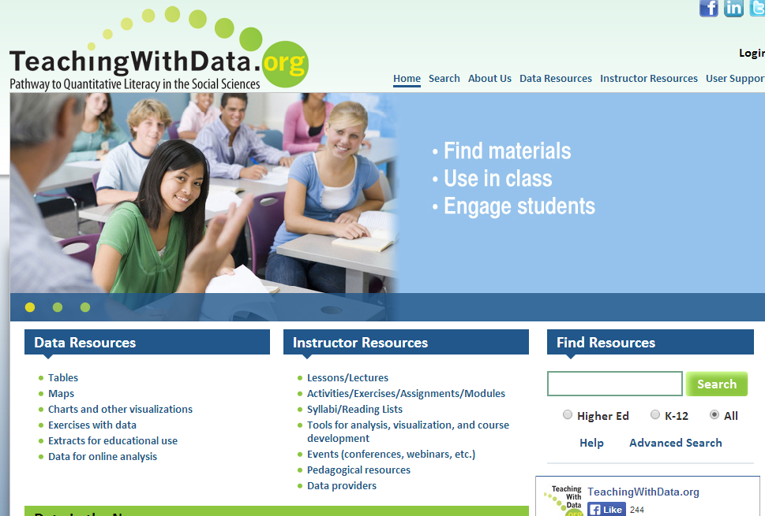
Teaching with Data
Notes:
Under Data Resources under Tables & Figures click on Exercises with Data
Return to the main page and search for resources by discipline or subject.

Slide 76
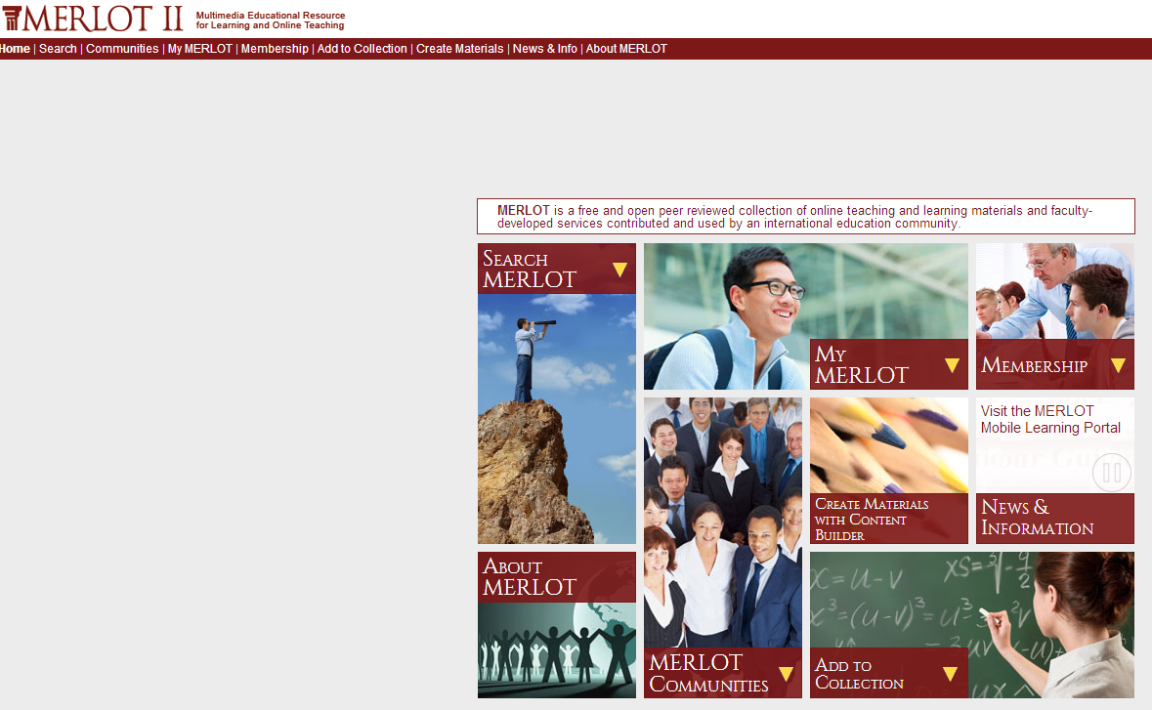
MERLOT

Slide 77
Other Workshops

Slide 78
Workshops on SPSS
SPSS – introductory workshop
  Creating SPSS data file
  Transforming data
  Descriptive statistics
SPSS – intermediate workshop
  Crosstabulations
  Using means
  Correlation and regression
  Charts

Slide 79
Workshop on Online
Statistical Analysis
SDA (Survey Documentation and Analysis)
  Requires no site license
  Extremely easy to learn
  Excellent for classes where you want to introduce students to statistical analysis
  Tools available – frequencies, crosstabulations, correlation and regression

Slide 80
Workshop on Data in the Classroom
Statistical literacy – issues and examples
  Causality
  Experimental and survey design
  Unintentional consequences
  Sampling and statistical inference
  Change over time
Where do we get the data?

