Slide 1

Social Science Data Base Workshop
Cal Poly, Pomona
February 21, 2014

Slide 2
Presenter: John L. Korey
Political Science (Emeritus)
Cal Poly Pomona
jlkorey@csupomona.edu

Slide 3
  These Powerpoint Slides
The only URL you need: List of Links Used in This Workshop

Slide 4
Workshop Agenda
  Overview of the SSRIC
  Data Archives
  Data in the Classroom
    Instructional Resources
  Other SSRIC Workshops

Slide 5
SSRIC
  Oldest CSU affinity group (since 1972)
  Representatives from CSU campuses meet three times per year
  Cal Poly, Pomona campus representatives:
    Mario Guerrero, Political Science
    Sandra Emerson, Political Science
    Mike Reibel, Geography and Anthropology

Slide 6
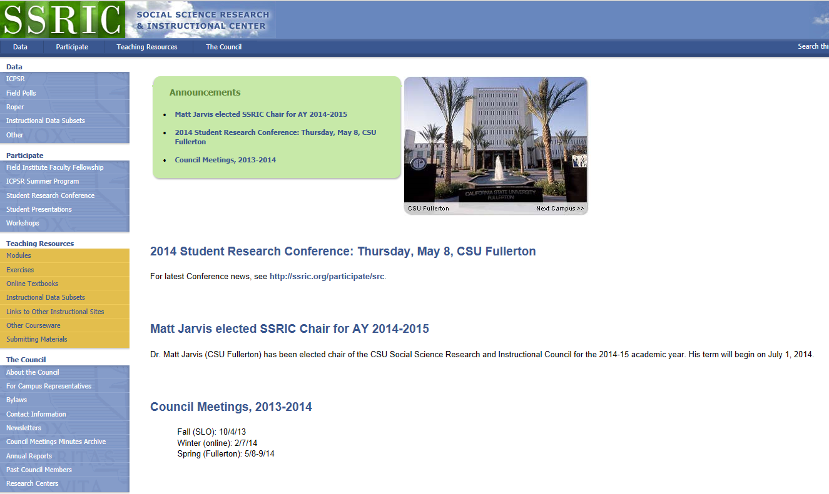
http://www.ssric.org
Notes:
The following three slides walk through the ssric.org website, and provide an overview of the services offered

Slide 7
Data (see “Data” tab at ssric.org)
  Subscription Data Bases
    Inter-university Consortium for Political and Social Research (ICPSR)
    Field Poll
    Roper
  Other

Slide 8
Programs (see “Participate” tab at ssric.org)
  Field Poll Faculty Fellowship
  (deadline April 15, 2014)
  ICPSR summer program in Ann Arbor, Michigan (deadline April 18, 2014)
  Annual Student Research Conference
  May 8, CSU Fullerton
  http://www.ssric.org/participate/src
  Workshops (like this one)

Slide 9
Teaching Resources (see “Teaching Resources” tab at ssric.org)
  Modules and Exercises
  Online Textbooks
  Instructional Subsets
  Links to Other Instructional Sites
  Handouts, etc.

Slide 10
Social Science Databases
The California State University subscribes to social science databases to support
  teaching
  research
  administration
Available to campuses by annual subscription

Slide 11
Social Science Databases
Assistance from the SSRIC
  Note: SSRIC members are not staff data consultants or technical assistance providers, but we will do what we can to help students, faculty, and staff to access data
Campus representatives
http://www.ssric.org/reps

Slide 12
Social Science Databases
Accessing subscription data bases
On-campus access - IP authenticated
Off-campus access
  Field: not available (could try VPN?)
  ICPSR and Roper: first time, on-campus or use library proxy server (same as other library databases); after that, you can access from anywhere

Slide 13
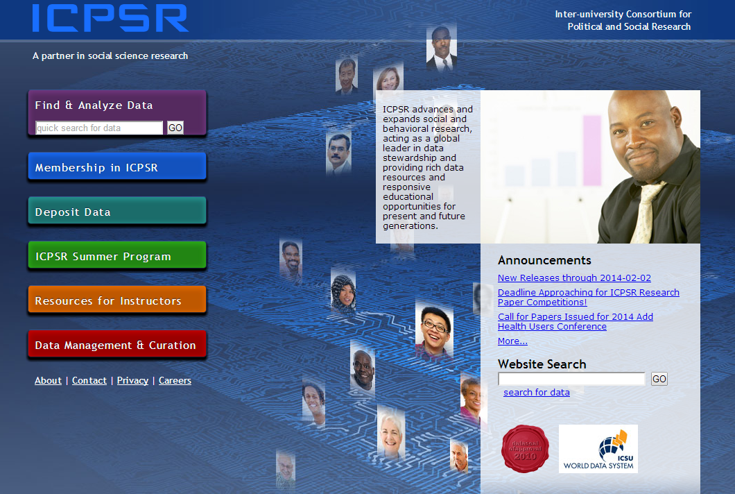
ICPSR
Inter-university Consortium for
Political and Social Research

Slide 14
ICPSR
Primary social science data archive for the U.S.
Founded in 1962; CSU joined in 1972
  Over 700 member institutions worldwide
Services
  Vast data archive accessible via the web
  Summer program
  Instructional resources

Slide 15
Using ICPSR Data
Log on/Create an Account
Locate the study
Select the data for download
Download the data
Save the data for analysis

Slide 16
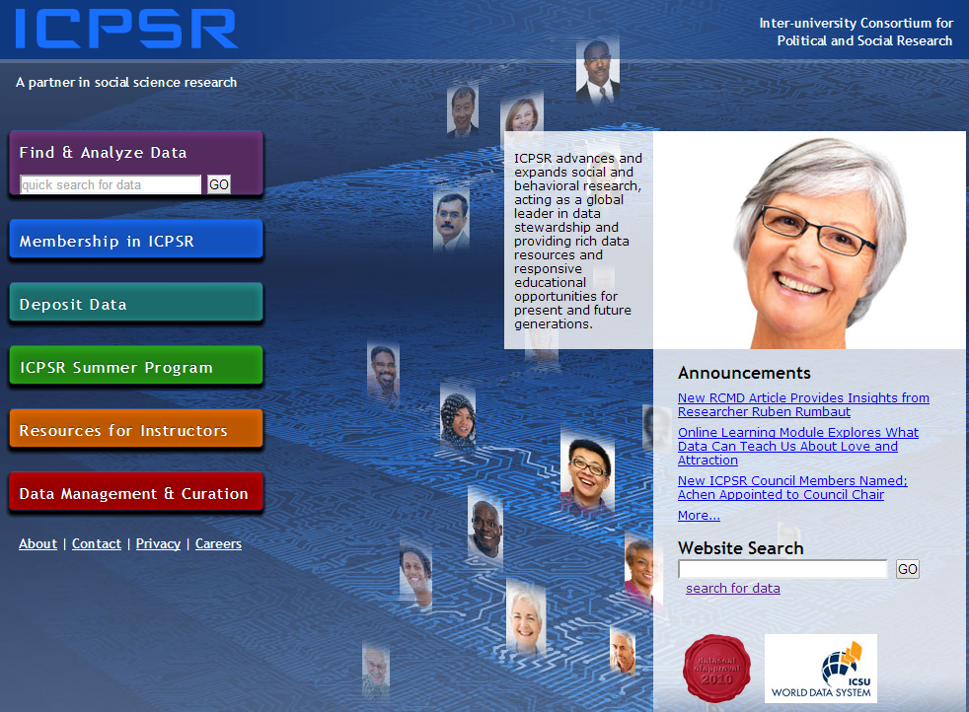
Create An Account
Notes:
Click on Find and Analyze Data (or any tab)

Slide 17
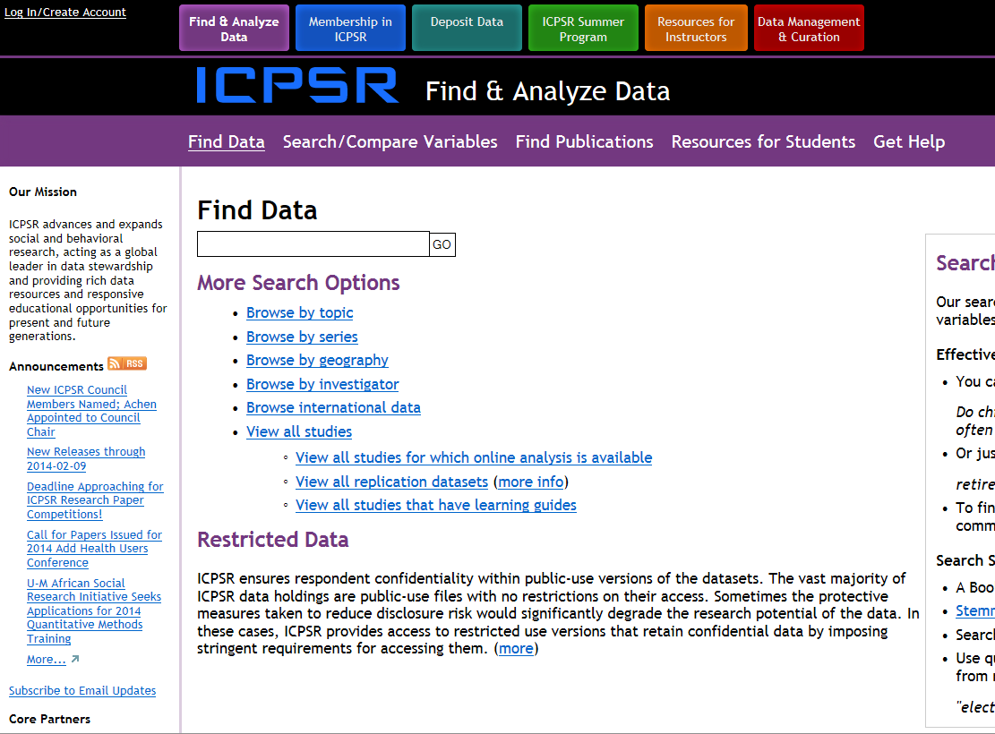
Create an Account
Notes:
Click on “Log In/Create Account”

Slide 18
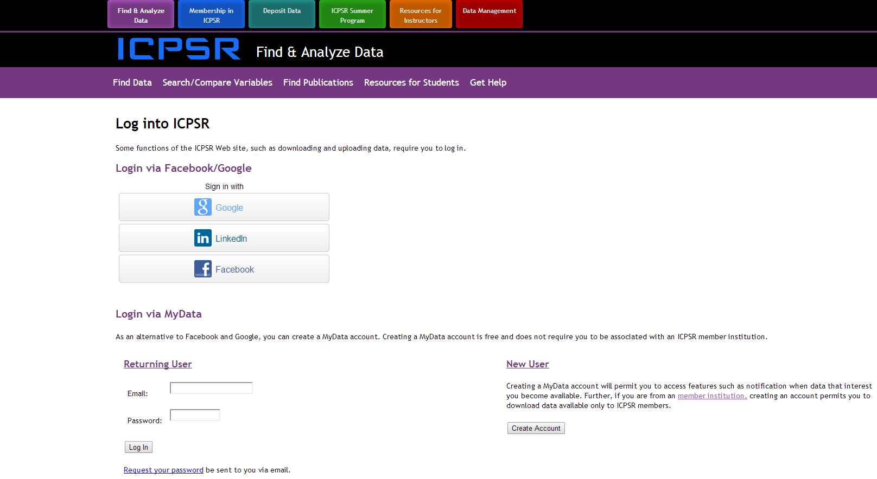
Create an Account

Slide 19
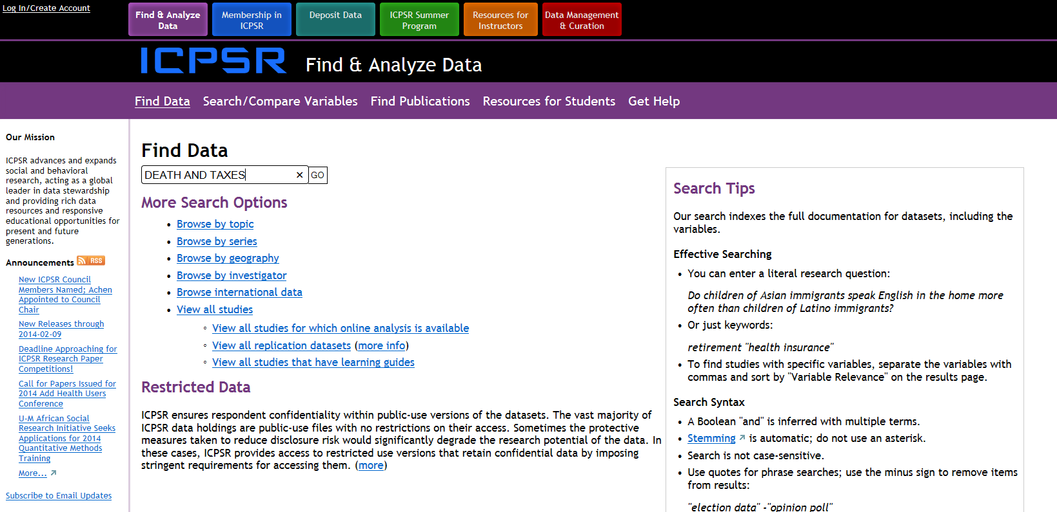
Locate the Study
Notes:
In the “Find Data” box, type in “DEATH AND TAXES” without the quotation marks (not case sensitive). Leaving out “AND” or typing “OR” produces same results. Typing just one of the keywords produces more; putting term in quotes produces fewer.

Slide 20
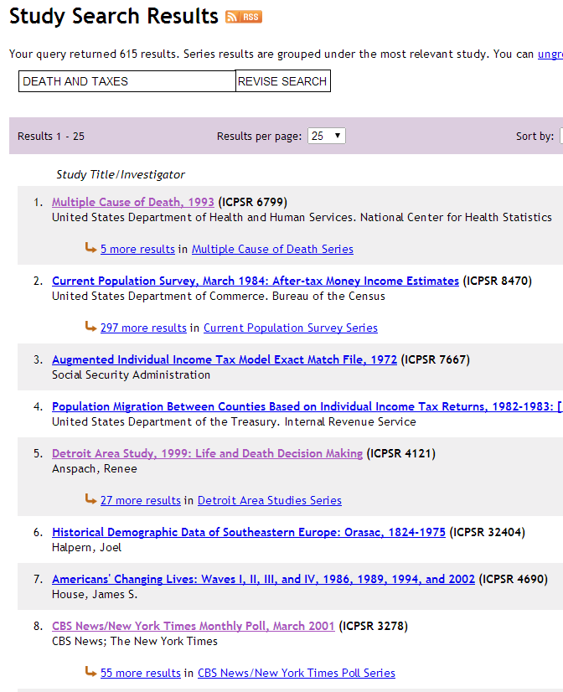
Locate the Study
Notes:
Click on #8 (CBS/NYT Poll)

Slide 21
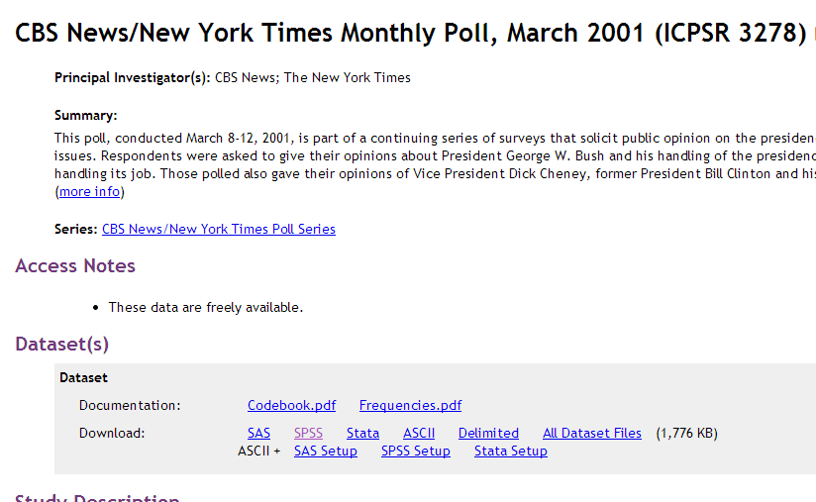
Select Data for Download
Notes:
Under “Download,” click on SPSS.

Slide 22
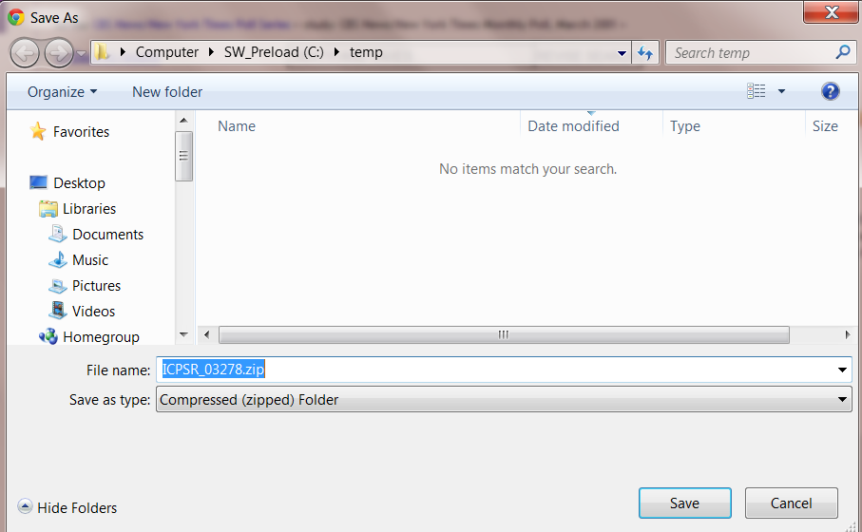
Download the Data
Notes:
Click on Save

Slide 23
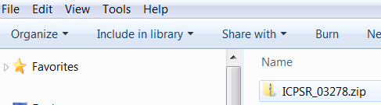
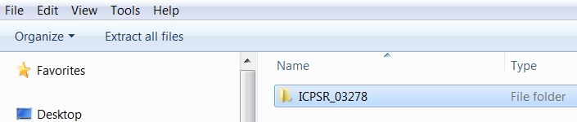
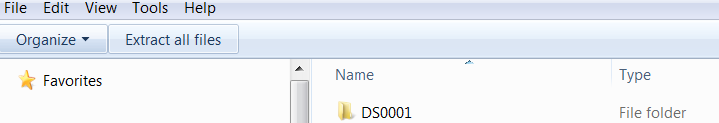
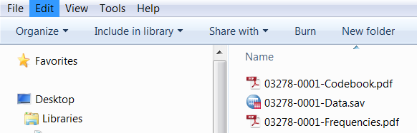
Save the Data for Analysis
Notes:
Click on each of the files shown above until you get to the bottom screen. The first two of the files found here (the codebook in PDF format and the data in SPSS system file format) are the ones you want.

Slide 24
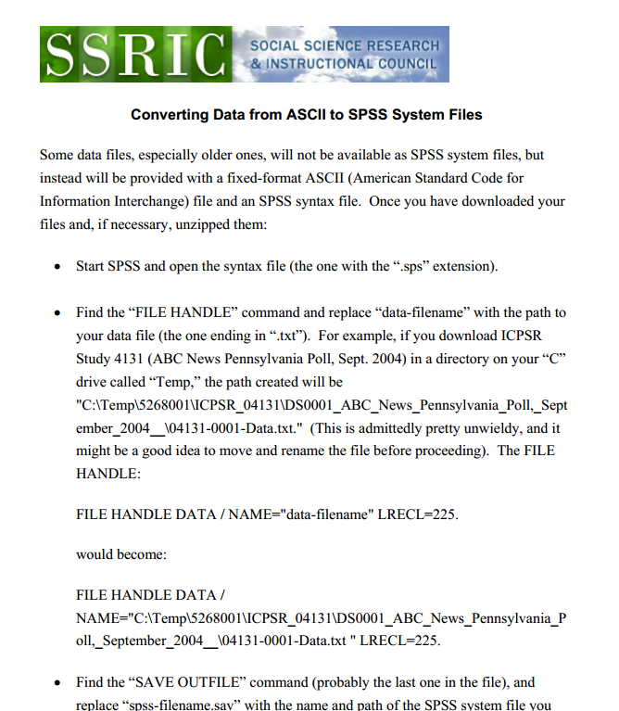
Converting ASCII Files
Notes:
Some old datasets come with only a raw data ASCII (American Standard Code for Information Interchange) file and an SPSS “syntax” file. By running the data against the syntax file, you can create an SPSS system file. You’ll need to made a few changes in the syntax file. The handout linked to this page will show you how.

Slide 25
SPSS Syntax Files
Manfred te Grotenhuis and Chris Visscher, How to Use SPSS Syntax: An Overview of Common Commands (Thousand Oaks, CA: Sage, 2014).
Notes:
On even rarer occasions, you won’t even gat a syntax file, and will have to create your own. The book cited here will show you how.

Slide 26
Other Research Tools
Search/Compare Variables
Bibliography of Data Related Litrerature
Online Data Analysis
Archive Partners

Slide 27
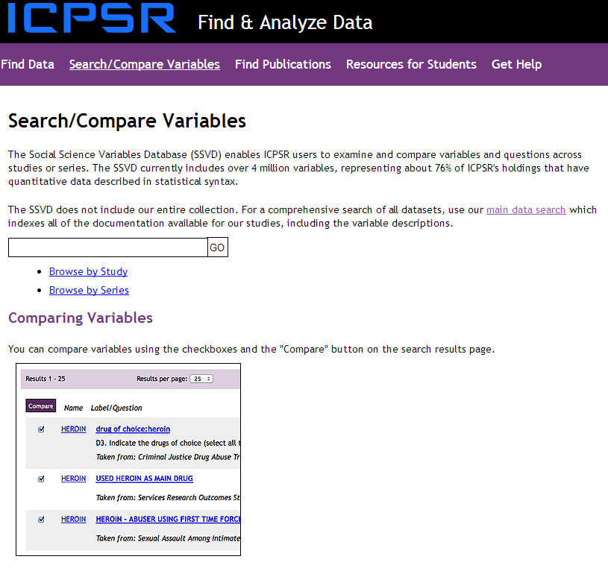
Search/Compare Variables
Notes:
This feature is useful if you plan to design your own questionnaire ad would like to see how others have dealt with making the same or similar measurements.

Slide 28

Bibliography of
Data Related Literature
Notes:
This feature will let you know of works that have used a particular dataset in the ICPSR archives.

Slide 29
Online Data Analysis
Simple Crosstabs: if a dataset decription says that you can perform simple crosstabs, you can do so online by clicking on the link and following the instructions.
SDA: some datasets also allow more extensive analyses using SDA (Survey Documentation and Alalysis). The SSRIC offers a separate workshop on SDA.

Slide 30
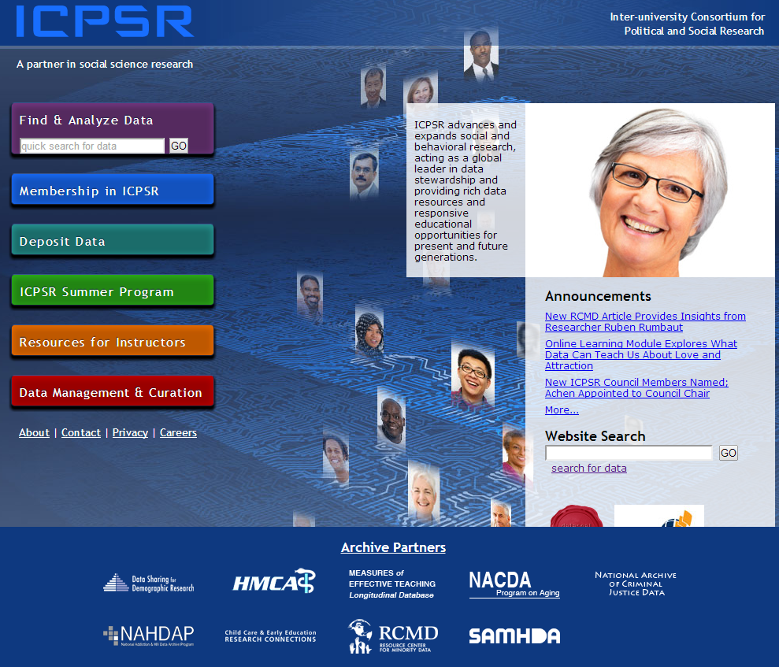
Archive Partners

Slide 31
Other ICPSR Resources
New User Tutorial
ICPSR YouTube Videos and Recorded Webinars
SSRIC ICPSR Guide

Slide 32

The Field (California) Poll

Slide 33

The Field (California) Poll
Established in 1947
Independent, non-partisan survey of California public opinion
Wide range of political and social topics
Multiple polls each year
Mervin Field

Slide 34
Accessing Field Data
Set up your (IE) browser
Find polls and data sets
Download data sets

Slide 35
Setting up your IE browser
Required: setting passive FTP access
Optional: Can set up browser for folder view (makes downloading data a little easier) or FTP directory view
See the instructions for details:
http://www.ssric.org/data/field_polls
You will only need to do this once for your browser and user account
Notes:
These instructions apply to IE. They don’t seem to be necessary for Mozilla Firefox.

Slide 36
Finding Polls
Find the poll number
  Field Poll Archives (http://field.com/fieldpollonline/subscribers/)
  The CALPOLL window
    Accessible via UCDATA
    (http://ucdata.berkeley.edu/)
You will be using the poll number to select the data set for download.
Notes:
Poll numbers are in the form “calxxyy,” where xx is the first two digits of the year the survey was conducted, and yy is the number of the poll within that year.

Slide 37
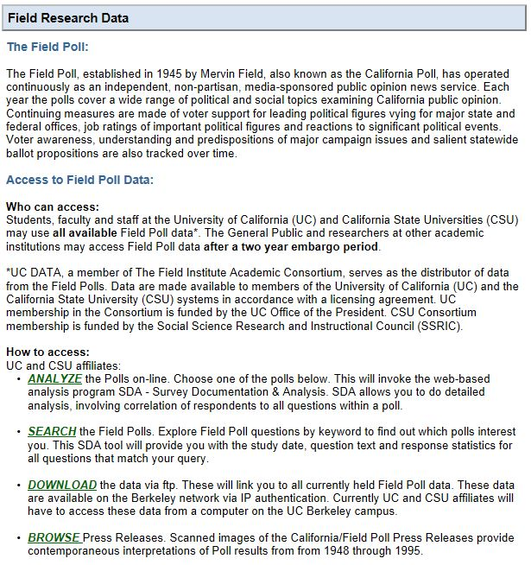
Downloading the Data
Click on search

Slide 38
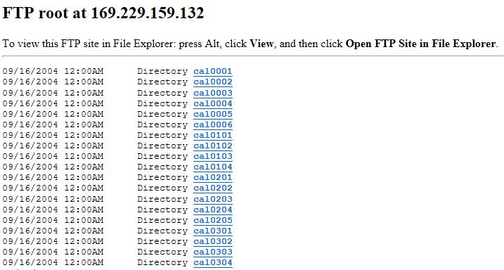
Switching to Folder View

Slide 39
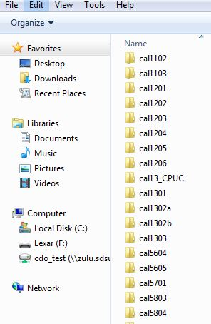
Downloading the Folder

Slide 40
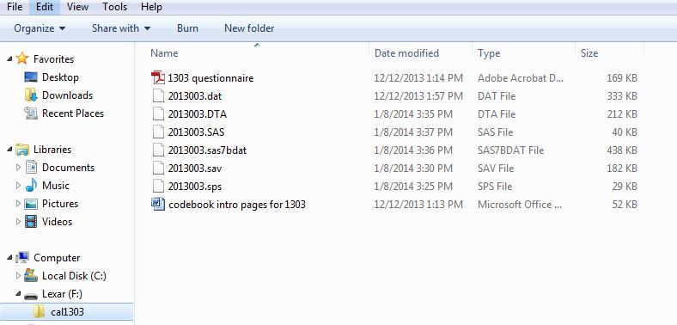
Viewing the Folder Contents

Slide 41
Searching for Variables
Click on search

Slide 42
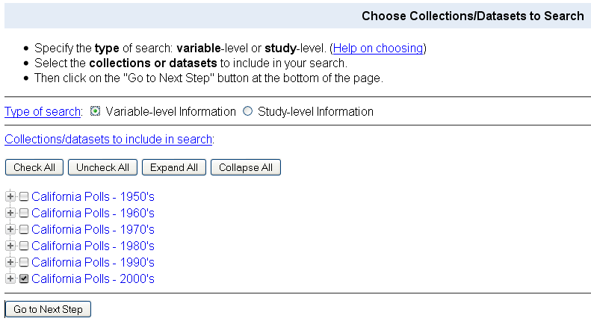
Choosing Datasets
I selected 2000’s

Slide 43
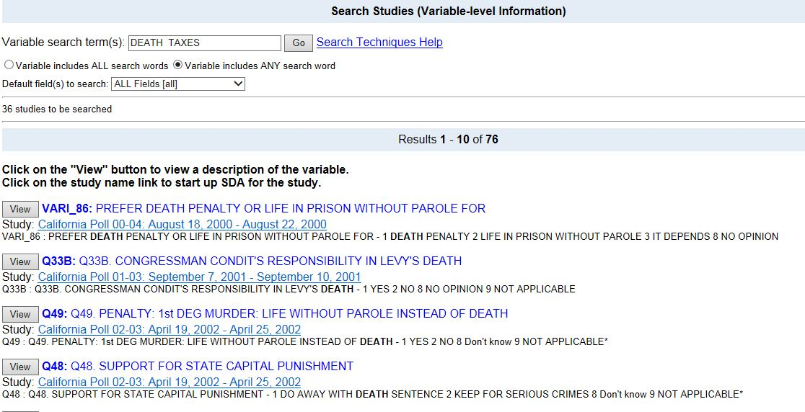
Keywords/Search Results

Slide 44
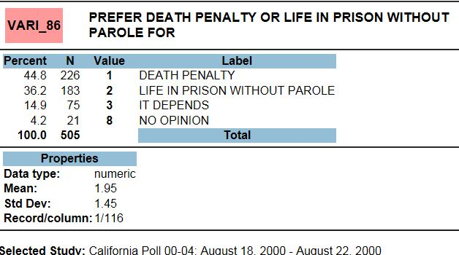
Results from SDA

Slide 45
Online Analysis
Most Field polls that are over two years old can be analyzed online with SDA (Survey Documentation and Analysis)
Effective later this calendar year (2014), embargoed polls (i.e., within the last two years) also will be available in SDA format for CSU users.

Slide 46
Other Field Resources
SSRIC Field Poll Guide

Slide 47
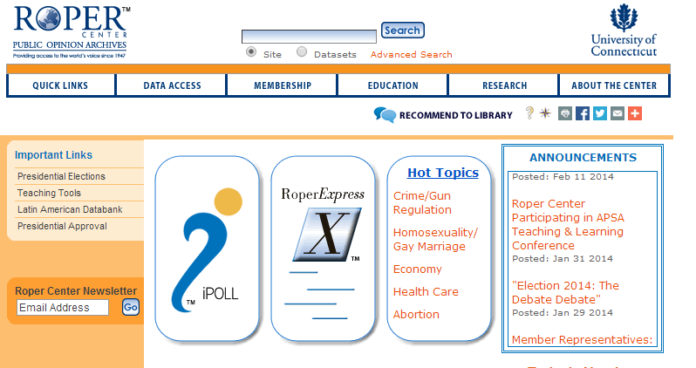
The Roper Center

Slide 48
What is the Roper Center?
Roper Express (datasets for download)
Roper Explorer (online analysis)
iPoll (survey questions)

Slide 49
Creating your Own Account
The first thing you need to do is to create your own personal account at the Roper Center.
You’ll need this account to download data sets and to analyze data online.
These accounts are free.
To create your own account, you’ll need be on a computer on a CSU campus that has subscribed to the social science data bases.
Point your mouse at “Quick Links” in the upper left of the Roper home page. Click on “iPOLL Login” as shown on the next slide.
Click on “Register” at the top of the page as indicated in the next slide.

Slide 50
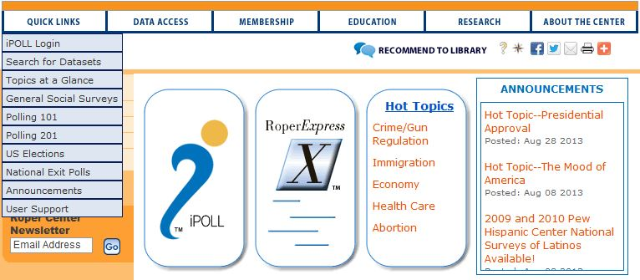
http://ropercenter.uconn.edu/
Go to this URL.
Click here.

Slide 51
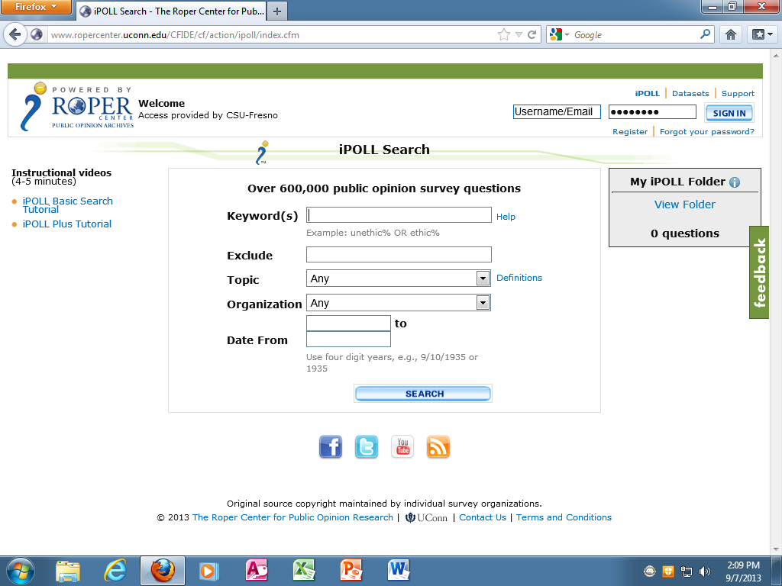
Creating your Own Account
Click here.

Slide 52
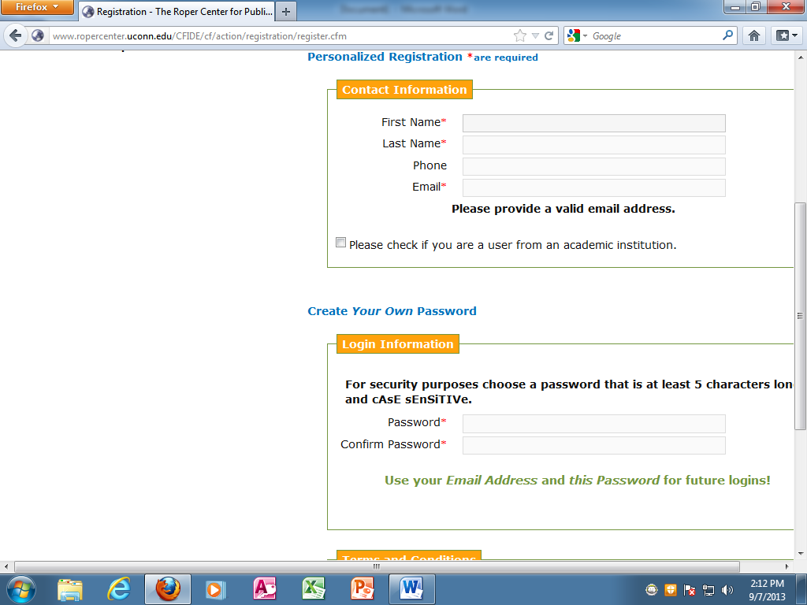
Creating your Own Account
Enter your information here.
Create your password.

Slide 53
Logging onto your Account
When you want to use the Roper Center and it asks you to sign into your account, use your email address as your user name and the password you just created as your password.
Now that you have your account, you can access the Roper Center from off campus.
When you need to sign into your account, it will ask you to do so.
Now let’s look at the menu bar at the top of the Roper Center home page.

Slide 54
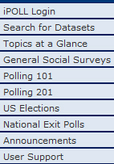
Menu Bar
Quick Links
“iPOLL Login” takes you to iPOLL which is a searchable database of over 600,000 survey questions.
“Search for Datasets” takes you to a searchable database of over 18,000 surveys.
“Topics at a Glance” takes you to a list of survey topics in the Roper archive.
“Polling 101” and “Polling 201” are introductions to survey research that you can use in your classes.
“User Support” takes you to a page with information about online tutorials, webinars, online how-to-guides, help sheets, FAQs, user services support, technical support and other resources.

Slide 55
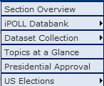
Menu Bar
Data Access
“iPOLL Databank” takes you to more information about iPOLL – an archive of survey questions .
“Dataset Collection” takes you to more information about the surveys in the Roper archive.
“Topics at a Glance” appears in both “Quick Links” and “Data Access” and is a list of survey topics in the Roper archive.
“Presidential Approval” takes you to the latest poll results for the president's approval ratings and to a historical look at approval ratings of prior presidents.
“US Elections” shows you historical data on elections since 1976 and takes you to exit polls.

Slide 56
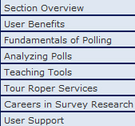
Menu Bar
Education
“Fundamentals of Polling” and “Analyzing Polls” provide you with materials on survey design that you can in use in your classes.
“Teaching Tools” shows you assignments that can be used in your classes.
“Tour Roper Services” take you to an overview of the services that the Roper Center can offer you

Slide 57
Menu Bar
“Membership,” “Research” and “About the Center” provide you with more information about the Roper Center and the services it provides you.
Under “Research” you will find information about other data archives such as the ICPSR and webinars that will give you information about the Roper Center that might answer questions you have about Roper.

Slide 58
Finding Data
Click on Quick Links →
Search for Datasets

Slide 59
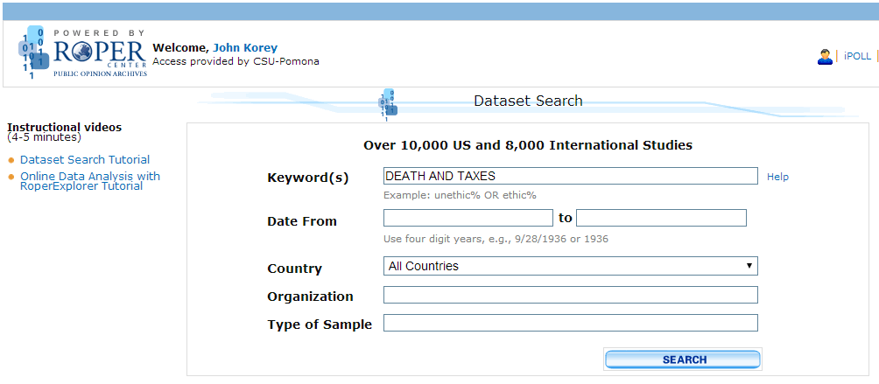
Finding Data
Notes:
Like ICPSR, 1) not case sensitive; and is implied; using quotes decreases hits. Unlike ICPSR, OR increases hits.

Slide 60
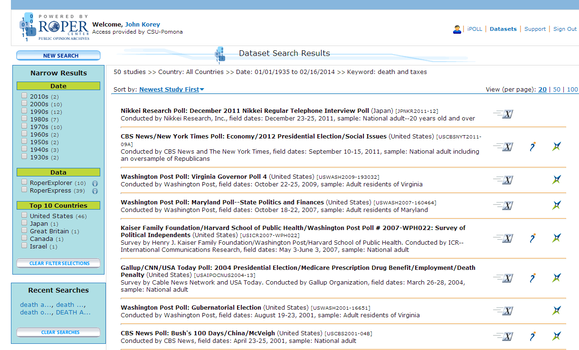
Finding Data
Notes:
Can Narrow search
Icons for Roper Express (downloadable), iPoll (question wordings), and Roper Explorer (online analysis)

Slide 61
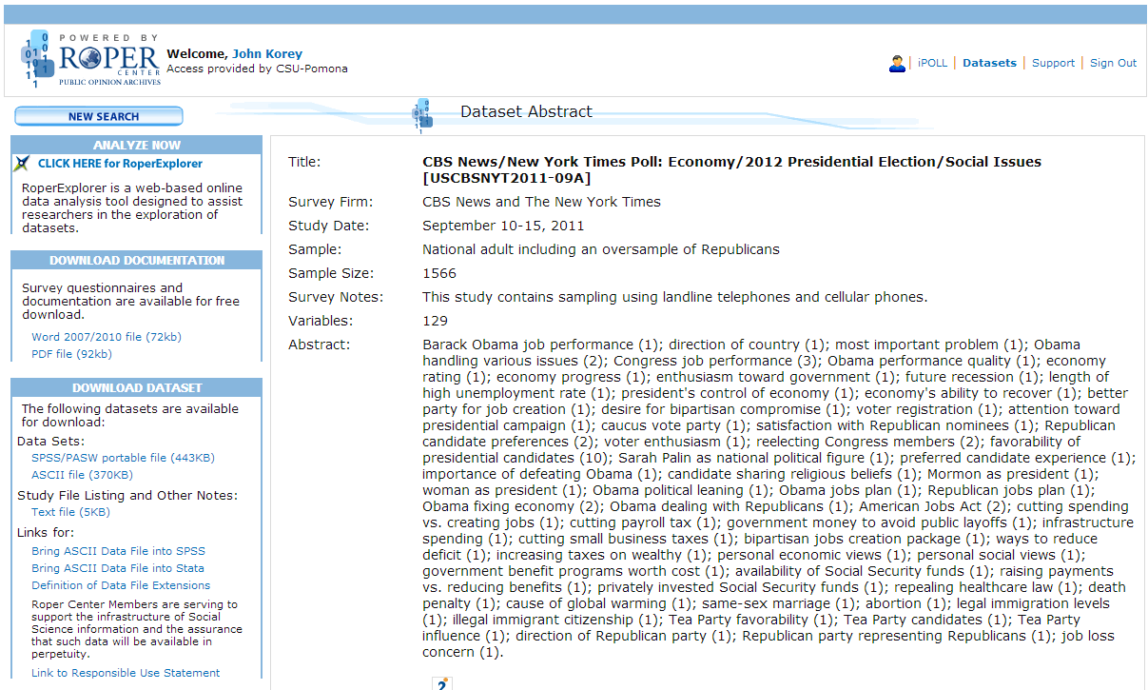
Downloading Data
(RoperExpress)

Slide 62
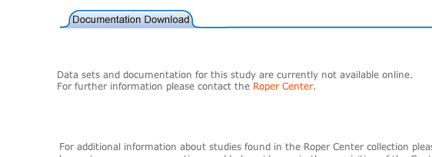
What if nothing is available?
Some documentation and/or data sets are not available on-line. If you are interested in one of these, email the survey number and the title to:
Ed Nelson at ednelson@csufresno.edu

Slide 63
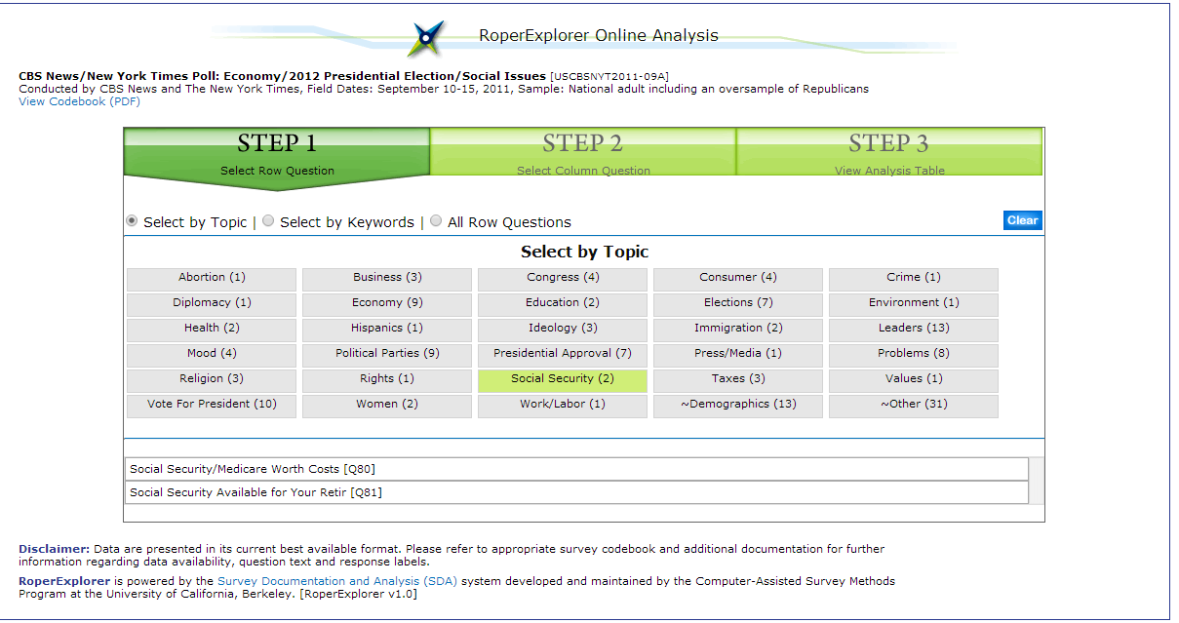
Online Analysis
(RoperExplorer)

Slide 64
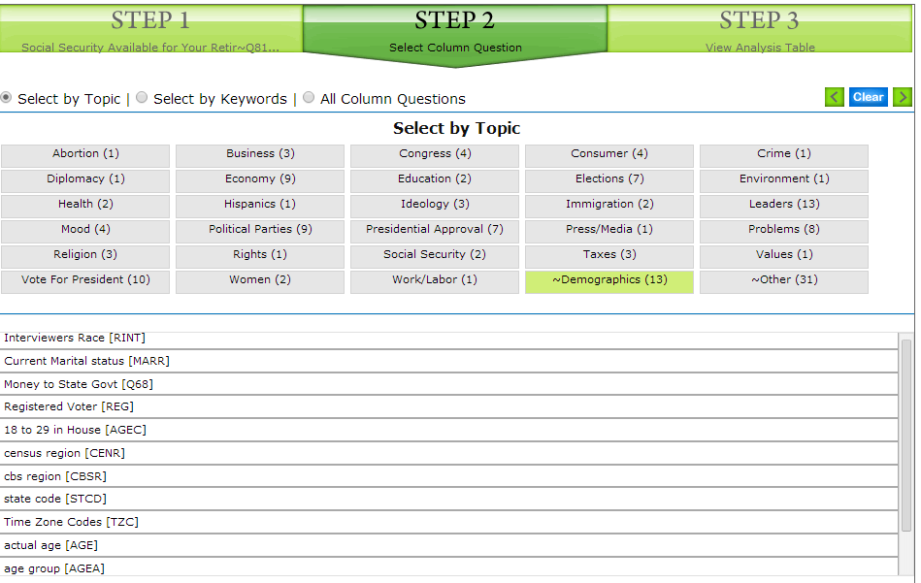
Online Analysis
(RoperExplorer)

Slide 65
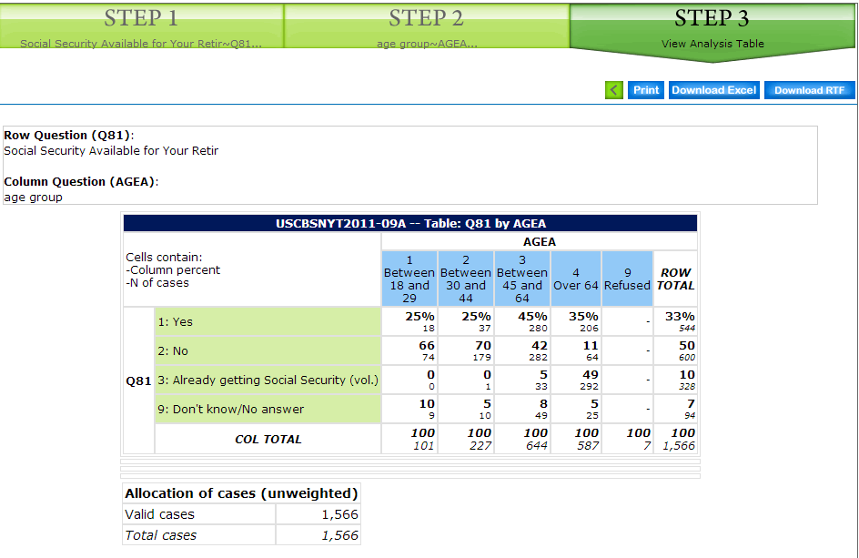
Online Analysis
(RoperExplorer)

Slide 66
iPOLL
iPOLL is a searchable database of over 600,000 survey questions.
To get into iPOLL:
  Point your mouse to “Quick Links” and click on “iPOLL Login” or
  Click on the iPOLL logo on the home page.

Slide 67
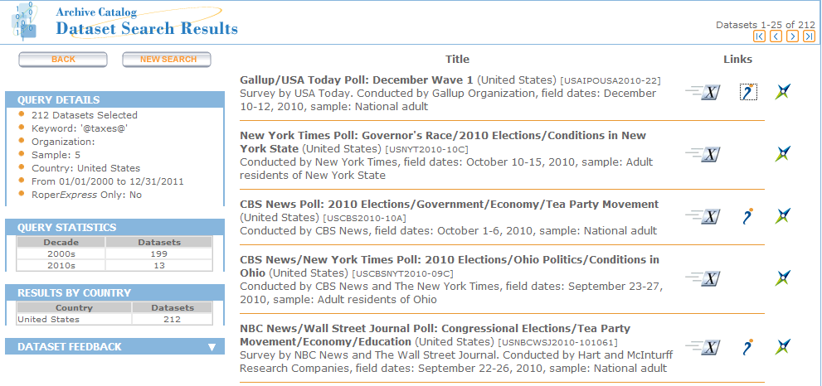
View Questions in iPOLL

Slide 68
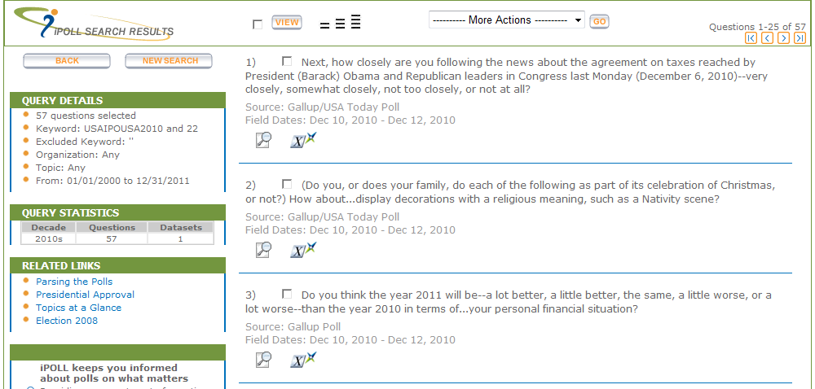
Get Question Details

Slide 69
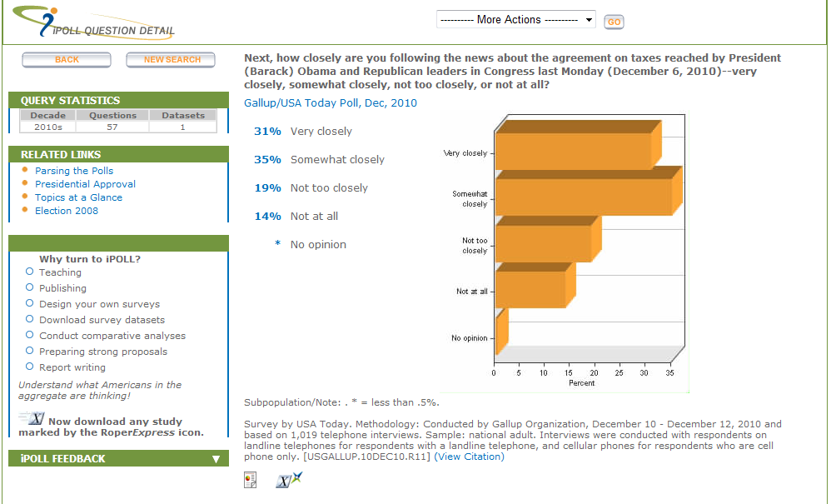
Question Details

Slide 70
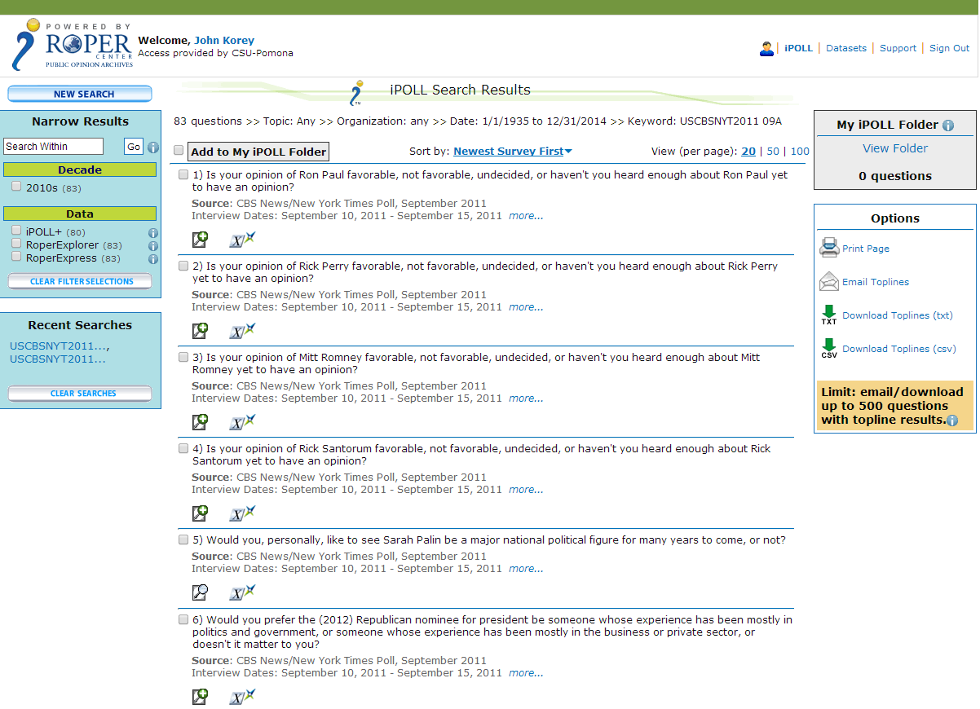
iPOLL

Slide 71
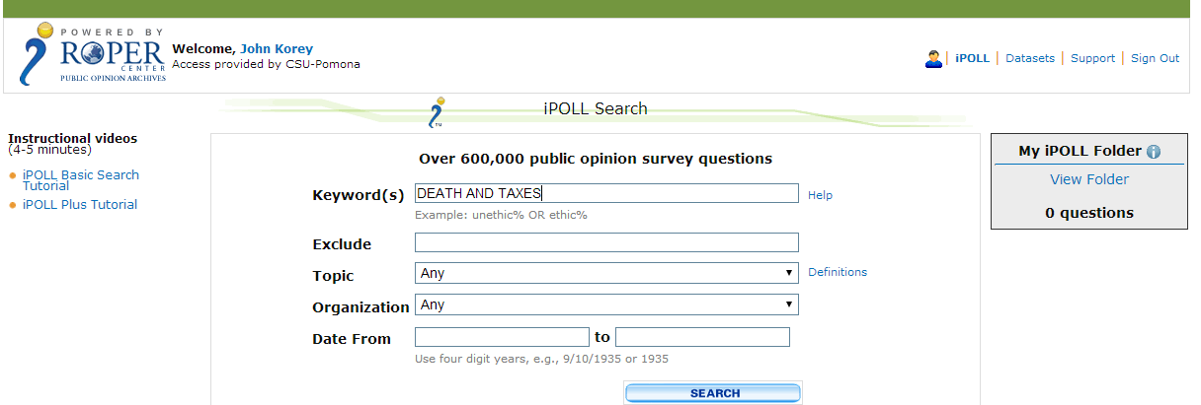
iPOLL Search

Slide 72
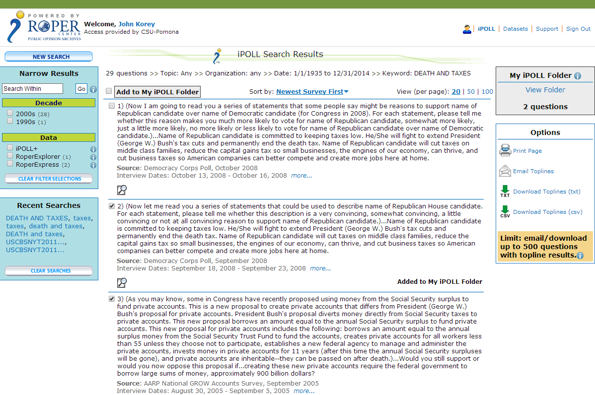
Results

Slide 73
Learning More about Roper
Here are some sources for learning more about Roper.
  Point to “Research” in the menu bar and click on “Webinars” where you can register for the webinars that interest you.
  Watch the following tutorials:
    iPOLL Basic Search Tutorial -- http://webapps.ropercenter.uconn.edu/CFIDE/cf/video/ipoll_basic_search_tutorial.html

Slide 74
Other Roper Resources
SSRIC Roper Guide

Slide 75
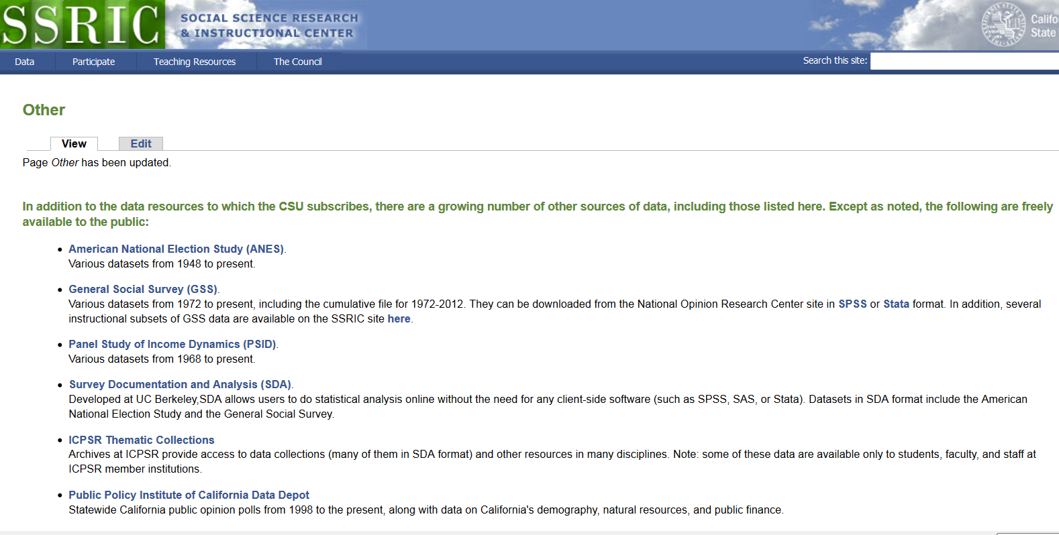
OTHER DATA SOURCES

Slide 76
Instructional Resources
SSRIC
ICPSR
Roper
Other Resources
  Teaching with Data
  MERLOT (Multimedia Educational Resource for Learning and Online Teaching)

Slide 77
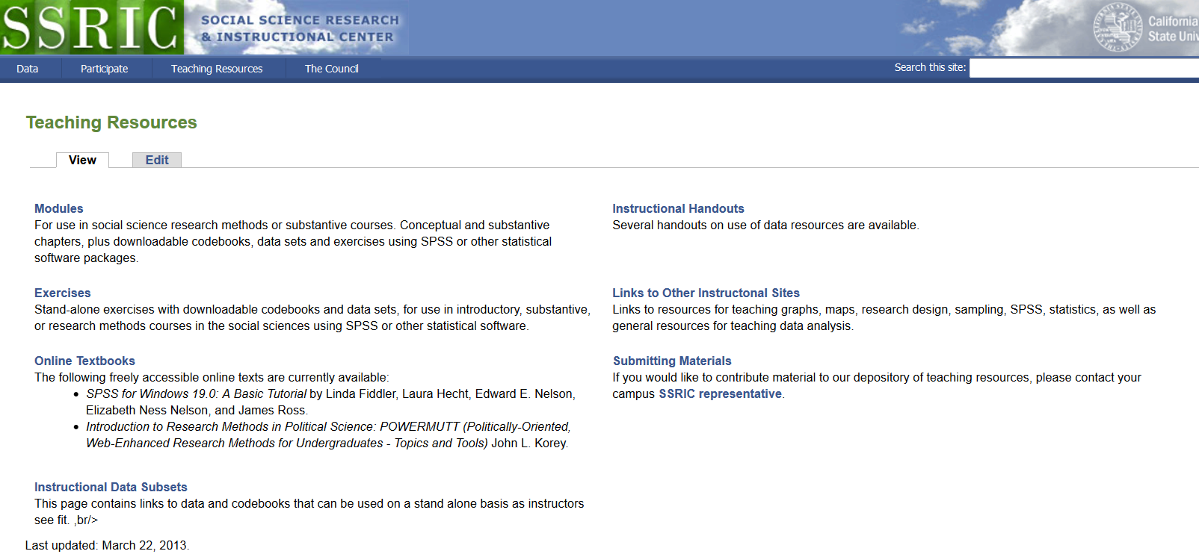
SSRIC Instructional Resources

Slide 78
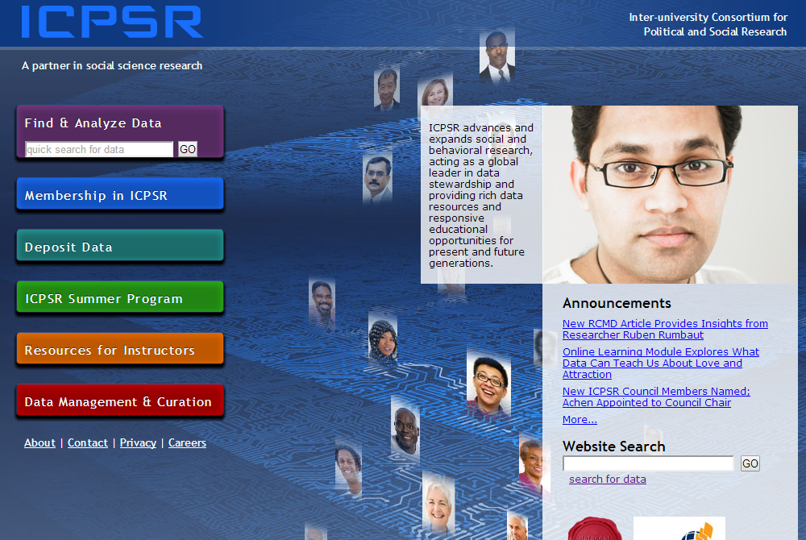
ICPSR Instructional Resources
Notes:
Click on “Resources for Instructors”

Slide 79

ICPSR
Notes:
This section of the ICPSR site is divided into four parts: “Exercises,” “Resources for Students,” “Videos on Teaching,” and “External Resources.” Click first on “Exercises.”

Slide 80
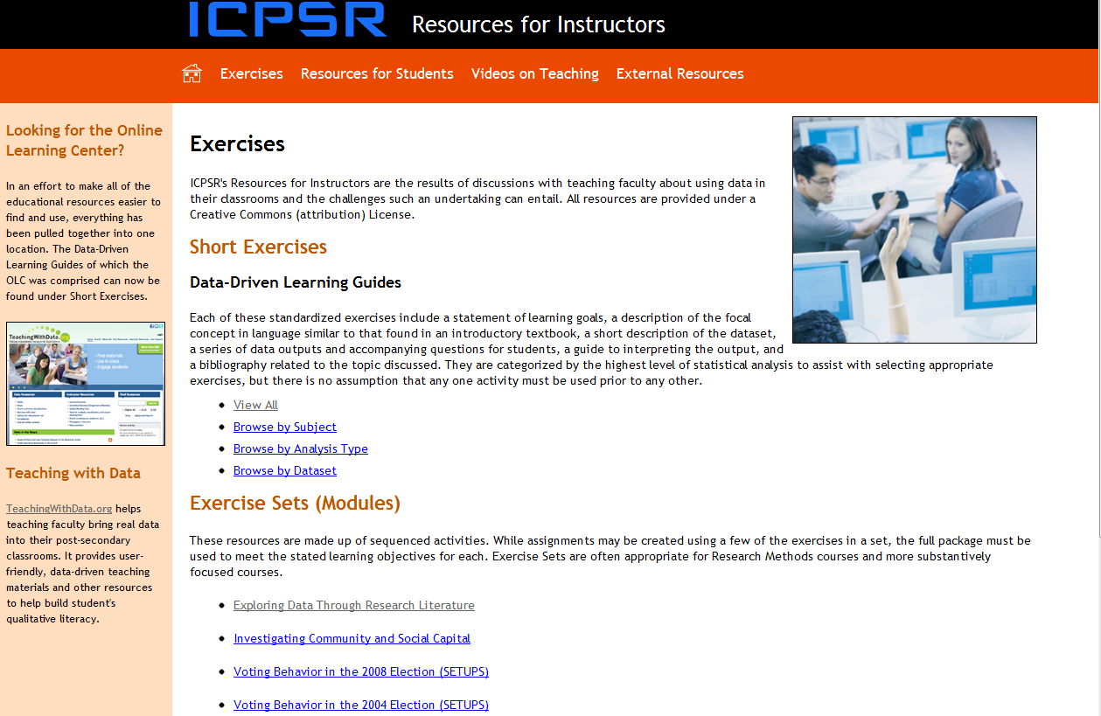
ICPSR
Notes:
The “Exercises” subsection consists of a large number of short, self-contained exercises and a small number of more elaborate “modules.”

Slide 81
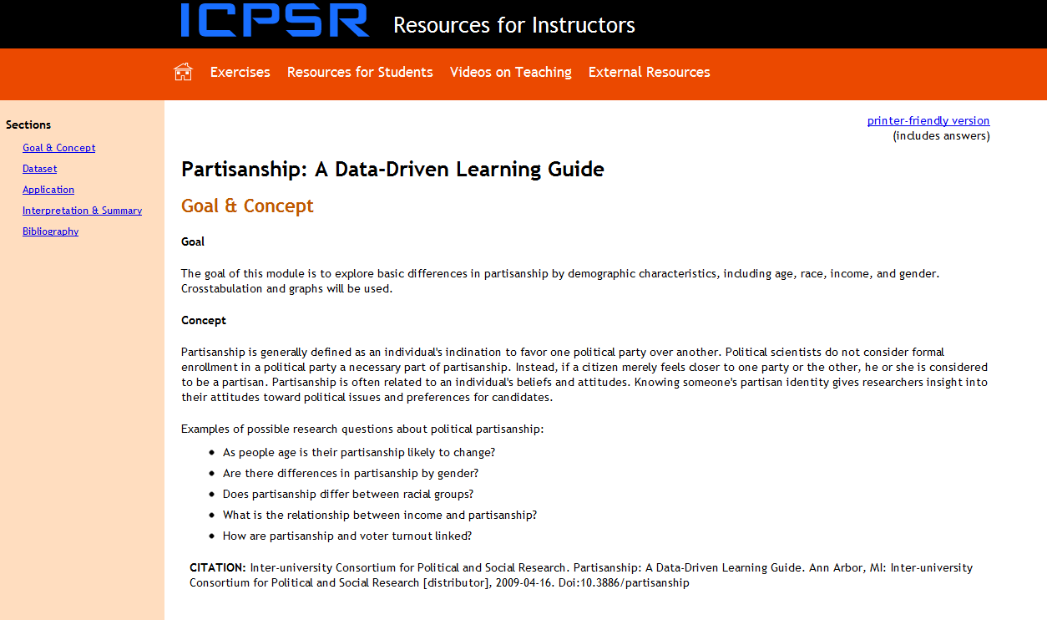
ICPSR
Notes:
Each module is different. Short exercises share a common format, and consist of: Goal and Concept, Dataset, Application, “Interpretation and Summary, and Bibliography. Click on “Resources for Students.”

Slide 82
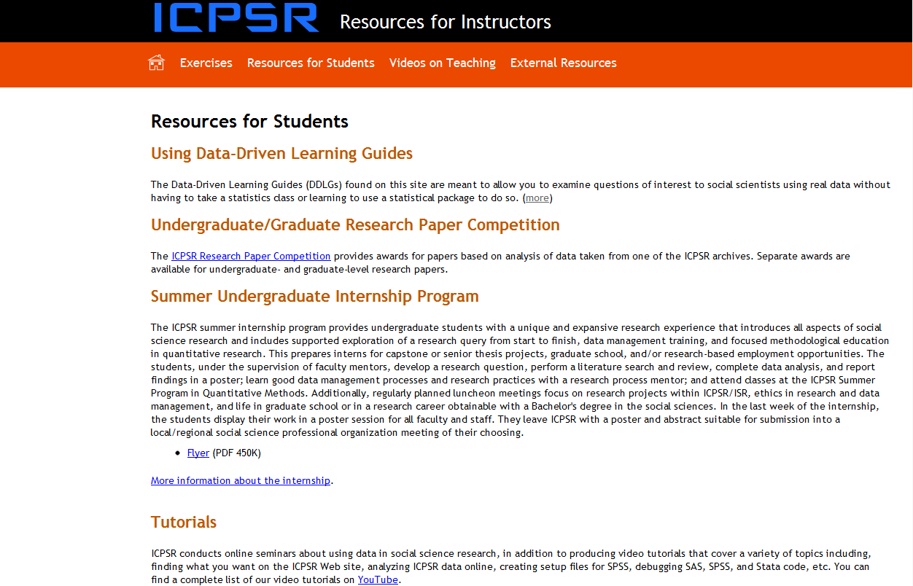
ICPSR
Notes:
“Using Data-Driven Learning Guides” describes the components of the short exercises shown on the previous slide. Information is provided on two ICPSR programs specifically for students, the “Research Paper Competition” and the “Internship Program.” “Tutorials” include a large number of videos produced by ICPSR and available on YouTube.

Slide 83
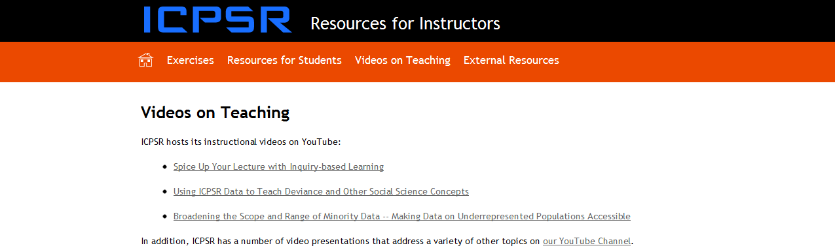
ICPSR
Notes:
“Videos on Teaching” again references ICPSR’s YouTube collection.

Slide 84

ICPSR
Notes:
“External Resources for Teaching Undergraduates” links to a small but useful set of sites containing instructional materials. See especially “Teaching with Data” at http://www.teachingwithdata.org/qssdl/welcome.action. BTW: an extensive set of links to instructional resources may be found at http://www.ssric.org/tr/links.

Slide 85

ROPER Instructional Resources
Notes:
“The Basics” (a.k.a. Polling 101) and “Analyzing Data” (a.k.a. Polling 201) provide an excellent introduction to survey research.
For a video tutorial on datasets, go to: DATA ACCESS (menu bar at top) → DATASET COLLECTION → Dataset Tutorials.
For a video tutorial on iPOLL, go to: DATA ACCESS (menu bar at top) → IPOLL DATABANK → iPOLL Tutorials.

Slide 86

Teaching with Data
Notes:
Under Data Resources under Tables & Figures click on Exercises with Data
Return to the main page and search for resources by discipline or subject.

Slide 87

MERLOT

Slide 88
Other Workshops

Slide 89
Workshops on SPSS
SPSS – introductory workshop
  Creating SPSS data file
  Transforming data
  Descriptive statistics
SPSS – intermediate workshop
  Crosstabulations
  Using means
  Correlation and regression
  Charts

Slide 90
Workshop on Online
Statistical Analysis
SDA (Survey Documentation and Analysis)
  Requires no site license
  Extremely easy to learn
  Excellent for classes where you want to introduce students to statistical analysis
  Tools available – frequencies, crosstabulations, correlation and regression

Slide 91
Workshop on Data in the Classroom
Statistical literacy – issues and examples
  Causality
  Experimental and survey design
  Unintentional consequences
  Sampling and statistical inference
  Change over time
Where do we get the data?

