Slide 1
Survey Documentation and Analysis (SDA)
Social Science Research
and Instructional Council (SSRIC)
Workshop

Slide 2
Workshop Agenda
Overview
What is online analysis?
Available SDA data sets
Statistical procedures (Frequencies, Crosstabs, Means, Regression, Correlation)
Subsetting and downloading data sets
Teaching resources for SDA

Slide 3
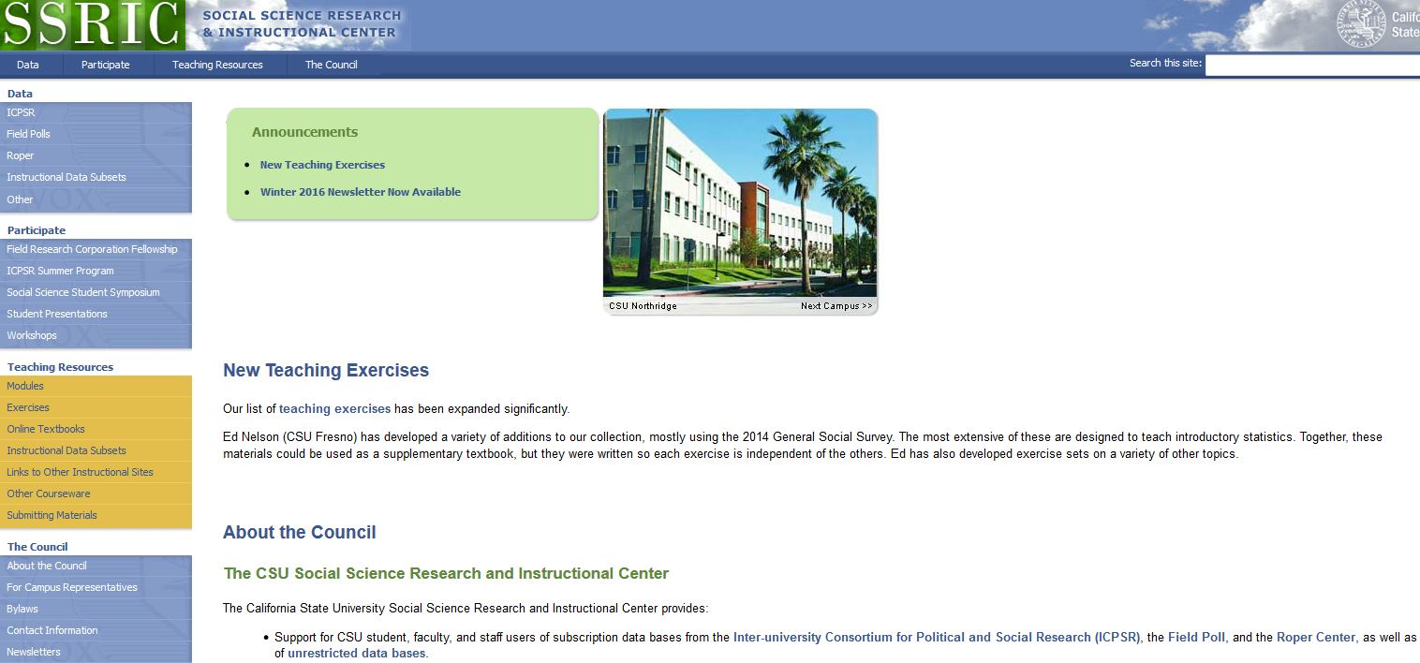
Social Science Research and Instructional Council’s Home Page

Slide 4
SSRIC Council
Oldest CSU affinity group – founded in 1972
Supports the social science data bases (ICPSR, Roper, Field)
Promotes use of data analysis in research and teaching
Provides the opportunity for students to present their work in a non-threatening, professional setting

Slide 5
Activities of the SSRIC Council
Social Science Student Symposium
  at Fresno State in 2017 in late May
  at San Diego State in 2016
Field Faculty Fellowship – selects faculty fellow who can put 12 questions on a statewide Field Poll; proposals due on April 15
Offers workshops on CSU campuses
  Social science data bases (ICPSR, Roper, Field)
  SPSS (introductory and intermediate)
  SDA
  Using data in the classroom

Slide 6
What is Online Data Analysis?
Online data analysis refers to analyzing data over the internet using web-based statistical software
The software we’re using is Survey Documentation and Analysis (SDA) which was developed at the University of California, Berkeley

Slide 7
Other Statistical Packages
SPSS (all CSU campuses have a SPSS site license)
PSPP
Stata
R

Slide 8
Advantages of SDA
Doesn’t require a site license and only requires a computer with an internet connection
Easy to learn. Can show students how to use SDA in 10 minutes or less
Has most of the statistical procedures you would need in an introductory statistics course
Help menus are clear and useful

Slide 9
Disadvantages of SDA
Can only be used with data sets that have already been created in a format that can be read by SDA
Requires a site license to create SDA data sets
More limited in the statistical applications that are available

Slide 10
Available SDA Data Sets

Slide 11
SDA Data Sets
While SDA is an extremely easy statistical package to learn to use, it’s difficult to create SDA data sets
So we typically use SDA data sets that have been created for us
Fortunately there is quite a bit of high quality data in SDA format

Slide 12
Sources for SDA Data Sets
SDA Archive located at UC Berkeley
ICPSR archive located at the University of Michigan
Field Poll archive located at UC Berkeley

Slide 13
Statistical Procedures

Slide 14
Available Statistical Procedures in SDA
Frequencies and crosstabulation
Means
Regression
Correlation matrix
Comparison of correlations
Logit/Probit regression (not discussed in this workshop)

Slide 15
Using SDA
Select the data set
Look at the codebook
Decide what statistical procedure to use
Fill in what you want to do
Run it

Slide 16
Data Set
We’re going to use the General Social Survey 1972-2014 Cumulative Data File
To select only the 2014 GSS use the Selection Filter(s) box and enter the following – year(2014)

Slide 17
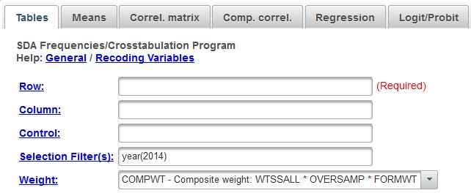
Selecting the 2014 GSS

Slide 18
Frequencies

Slide 19
Use of Frequencies
Used to get frequency distributions, summary statistics, and charts
Enter the variable names that you want to use in the ROW box – reliten, pornlaw, sex, age
Separate the variables with a comma or a space
Click on RUN THE TABLE

Slide 20
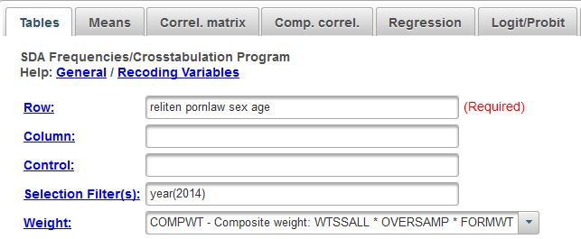
Frequencies Dialog Box

Slide 21
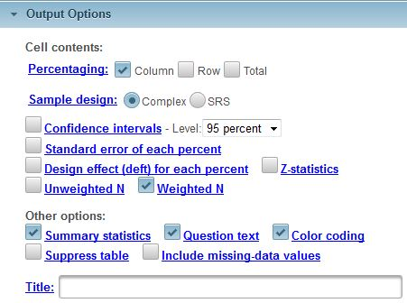
Frequencies Output Options

Slide 22
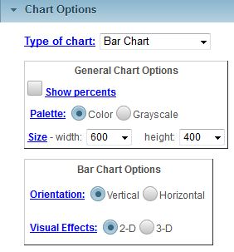
Frequencies Chart Options

Slide 23
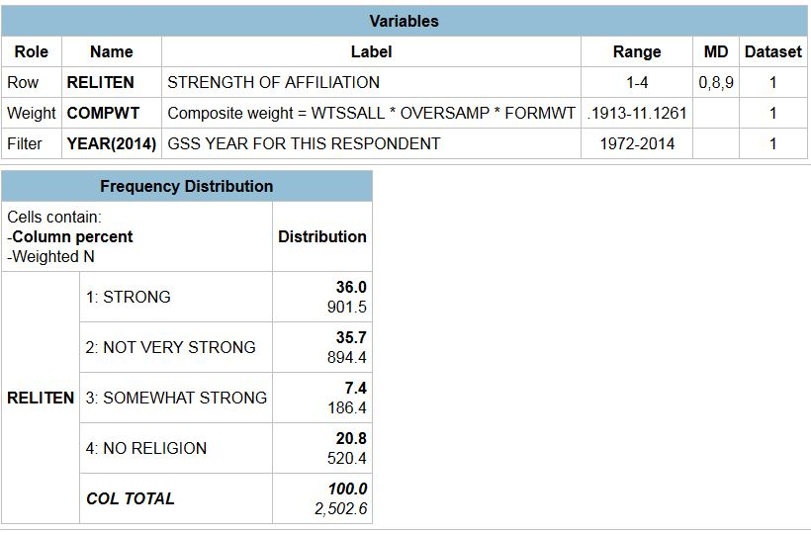
Frequencies Output for Reliten

Slide 24
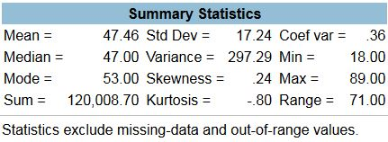
Summary Statistics for Age

Slide 25
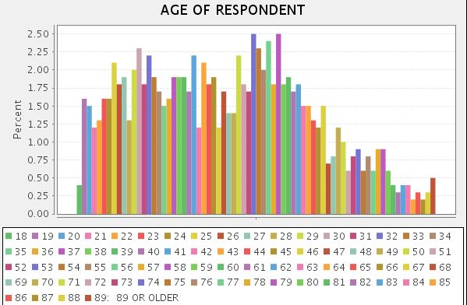
Bar Chart for Age

Slide 26
Crosstabulation

Slide 27
Use of Crosstabulation
Crosstabulation is used to explore the relationship between two variables which are usually nominal or ordinal measures
Let’s use reliten as our independent variable and pornlaw as our dependent variable to create two bivariate crosstabulations.
The dependent variable goes in the ROW box and the independent variable goes in the COLUMN box

Slide 28
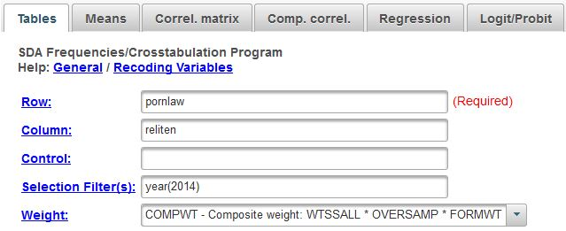
Crosstabulation Dialog Box

Slide 29
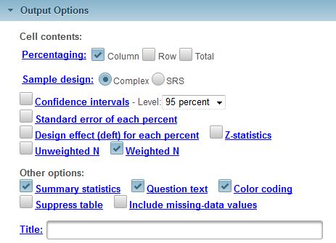
Crosstabs Output Options

Slide 30
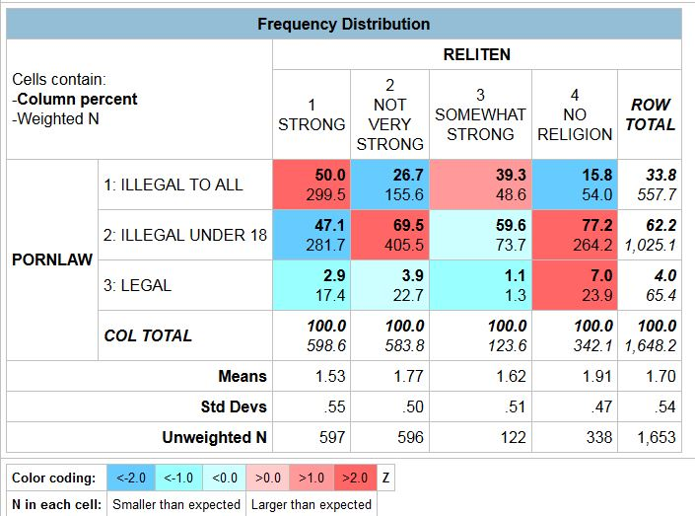
Crosstabs Output for Pornlaw by Reliten

Slide 31
Your Turn
Let’s run two more bivariate (i.e., two variable) crosstabs
  Independent variable: sex
  Dependent variables: reliten and pornlaw
You can list both dependent variables in the ROW box separated by a comma or blank space
Go ahead and run the tables

Slide 32
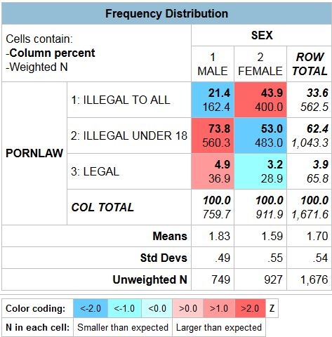
Crosstabulation Output for
Pornlaw by Sex

Slide 33
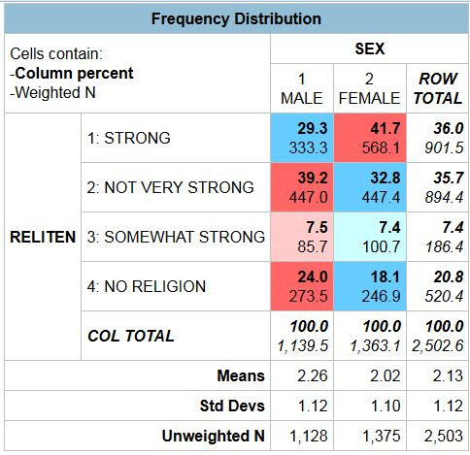
Crosstabulation Output for
Reliten by Sex

Slide 34
What Did We Discover?
Reliten is strongly related to pornlaw
Sex is also related to both reliten and pornlaw
This raises the question that the relationship between reliten and pornlaw could be spurious. Sex is related to both reliten and pornlaw and could be creating the relationship between reliten and pornlaw
How do we test this possibility? We’ll run a three-variable crosstabulation with reliten as our independent variable, pornlaw as our dependent variable, and sex as our control variable

Slide 35
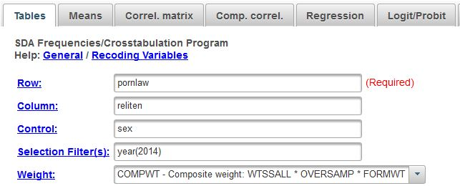
Crosstabulation Dialog Box for a Three-Variable Table

Slide 36
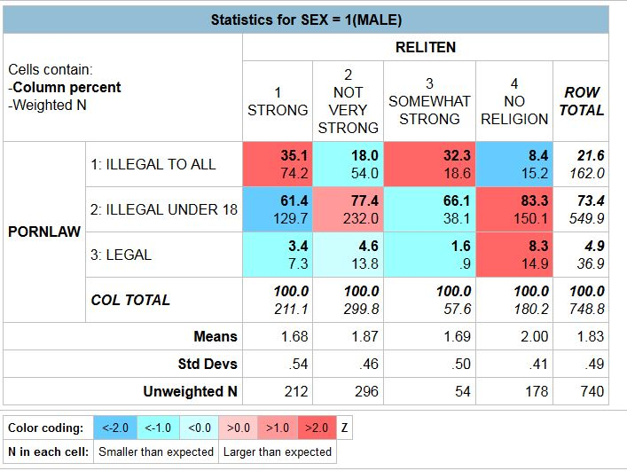
Crosstabulation Output for
Pornlaw by Reliten for Males

Slide 37
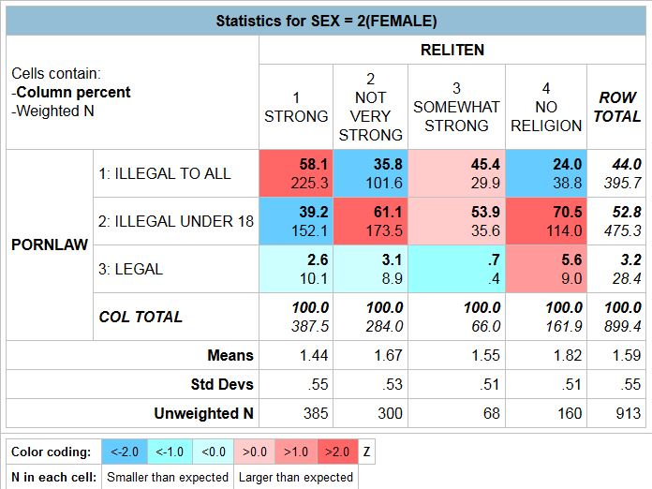
Crosstabulation Output for
Pornlaw by Reliten for Females

Slide 38
Spuriousness
Was the relationship between RELITEN and PORNLAW spurious due to SEX?
How do you know?
Does that mean that the relationship can never be spurious?

Slide 39
Means

Slide 40
Use of Means
Means can be used in a number of ways:
  Calculate and compare means
  Independent-sample t test
  Analysis of variance

Slide 41
Comparing Men and Women in Terms of Television Viewing
Let’s start by running the frequency distribution for tvhours
You’ll notice that there are a few respondents who watch a lot of television which we will define as 14 or more hours per day
These are extreme values which we often call outliers and these outliers can affect our analysis

Slide 42
Filtering Out the Outliers
So we’re going to filter out these outliers
We can do by using the SELECTION FILTER(S) box
We already have something in this box – year(2014)
We’re going to add an additional filter – tvhours(0-13) This means we want to use only the cases which have values from 0 to 13 in our analysis

Slide 43
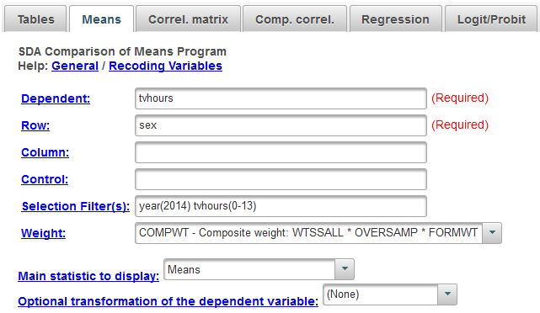
Using the Selection Filter(s) Box

Slide 44
Means Dialog Box
The DEPENDENT box is where you put the variable for which you are going to compute means. This is always an interval or ratio variable
The ROW box includes the variable that defines the groups you want to compare
You can use the COLUMN and CONTROL boxes to break the data down even more finely

Slide 45
Means Dialog Box for
Tvhours by Sex

Slide 46
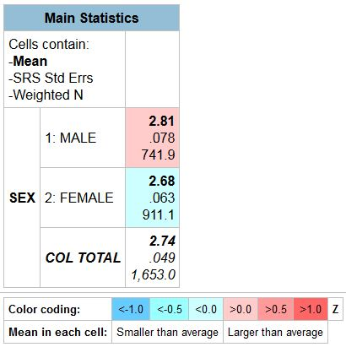
Means Output Box for
Tvhours by Sex

Slide 47
Independent Samples t Test
The independent-samples t test can be used to determine if the difference between two groups is statistically significant
We test the null hypothesis that the mean for the population of all males is equal to the mean for the population of all females
If we can reject this null hypothesis, then we have evidence to suggest that our research hypothesis that there is a difference between these two population means is true

Slide 48
Independent-Samples t test continued
SDA doesn’t have a command for the independent-samples t test but it does have a command for one-way analysis of variance
One-way analysis of variance will give you the F statistic
When the independent variable is a dichotomy, F is the square of t
So all you need to do to get t is to take the square root of F

Slide 49
How Do You Tell SDA to do a
One-Way Analysis of Variance?
Click on OUTPUT OPTIONS and check the ANOVA STATS box
You also have to click the box for SRS STANDARD ERRORS. This is because SDA will only carry out the one-way analysis of variance if you assume simple random sampling

Slide 50
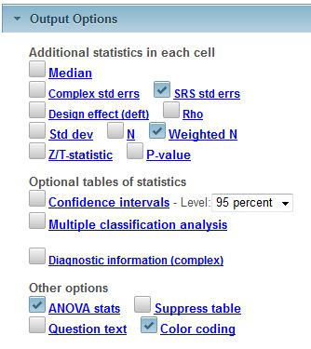
Output Options for
One-Way Analysis of Variance

Slide 51
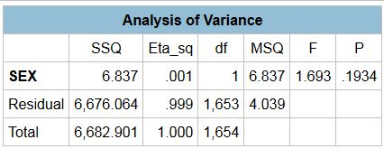
One-Way Analysis of Variance
Output

Slide 52
Using a Variable That Has More Than Two Categories
What if our independent variable has more than two categories?
Use one-way analysis of variance
Let’s use degree (i.e., respondent’s highest educational degree) as our independent variable

Slide 53
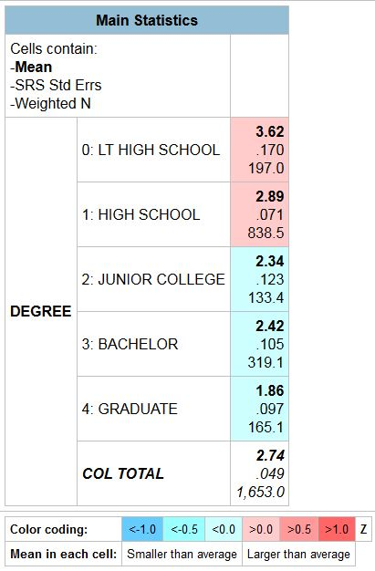
Mean Number of Hours Watching Television by Education

Slide 54
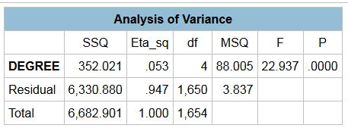
One-Way Analysis of Variance for Tvhours by Degree

Slide 55
Regression

Slide 56
Uses of Regression
Regression can be used when you have a set of variables which are interval or ratio and you want to determine the effect of one or more of these variables on a dependent variable
Note that this does not imply causation
Nominal and ordinal variables can be used as independent variables by converting them to dummy variables

Slide 57
Bivariate Regression
Let’s look at the relationship between the respondent’s age (age) and the amount of television one watches (tvhours)
Enter the variables
  DEPENDENT BOX -- tvhours
  INDEPENDENT BOX -- age

Slide 58
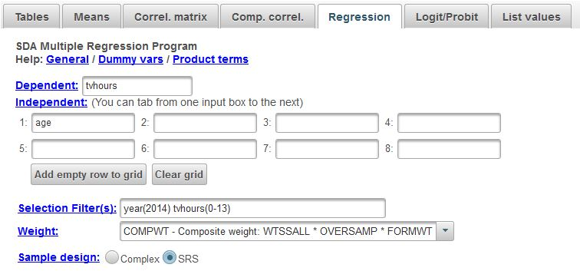
Bivariate Regression Dialog Box

Slide 59
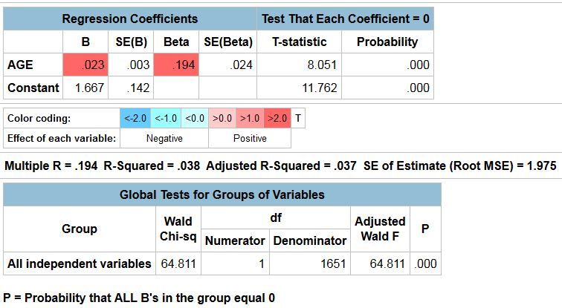
Bivariate Regression Output

Slide 60
Dummy Variable
Multiple Regression
Now let’s add in another variable -- sex
But sex is not a continuous variable. How do we enter a variable like SEX into the regression analysis? Answer: create a dummy variable
Dummy variables take on the values of 1 and 0. You can create as many dummy variables as there are categories. Consider the dummy variables for sex
  Dummy variable for males (value 1) – 1 if male and 0 if female
  Dummy variable for females (value 2) – 1 if female and 0 if male

Slide 61
Using Dummy Variables in Regression
If a variable has k categories, then you can create k dummy variables
But when you enter the dummy variables into regression, you only enter k – 1 dummy variables
The dummy variable that you leave out is the comparison group

Slide 62
Creating a Dummy Variable
sex(m:2)
  sex is the name of the variable to want to make into a dummy variable
  m indicates the value of the category than you want to omit
  2 indicates that you want to omit the category that has the value of 2 (i.e., females)
  Female becomes the comparison group
  Run the table

Slide 63
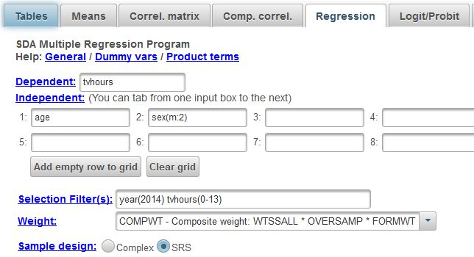
Dialog Box for Dummy Variable Multiple Regression

Slide 64
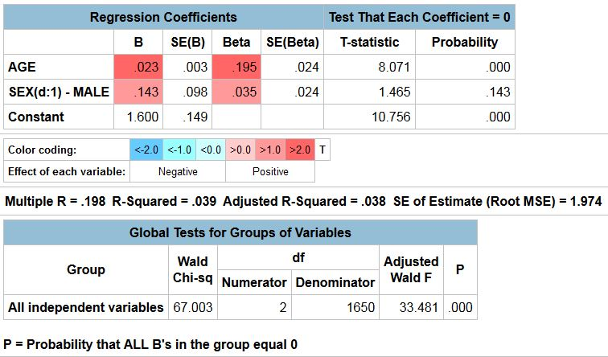
Dummy Variable Multiple Regression Output

Slide 65
Adding More Variables into the Regression
Now let’s add two more variables into the regression – paeduc and educ
Now you will have four variables in the regression – age, paeduc, educ, and the dummy variable for sex

Slide 66
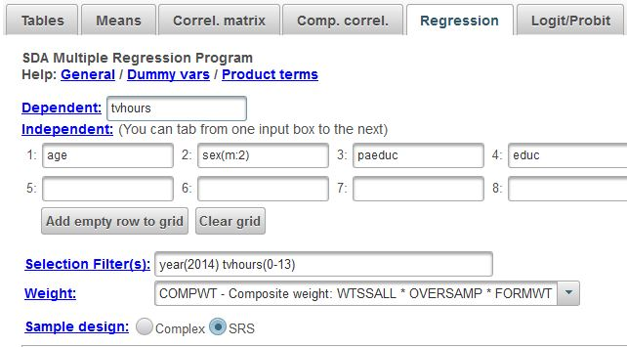
Multiple Regression Dialog Box for Adding in More Independent Variables

Slide 67
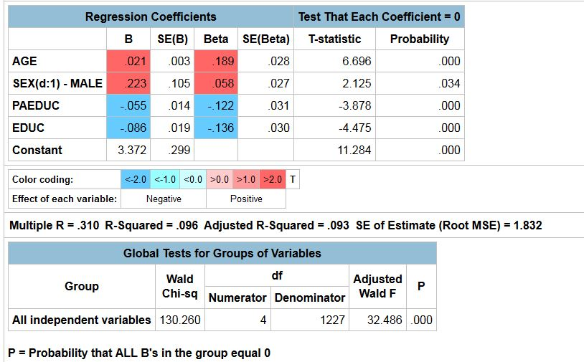
Multiple Regression Output for Adding in More Independent Variables

Slide 68
Correlation

Slide 69
Uses of Correlation
Correlation can be use to measure the strength of the relationship between two interval or ratio variables
We’re going to limit our discussion to the Pearson Correlation and the Squared Pearson Correlation (sometimes called the Coefficient of Determination)
The Pearson Correlation assumes linear relationships

Slide 70
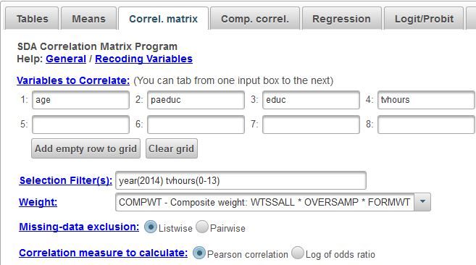
Correlation Dialog Box

Slide 71
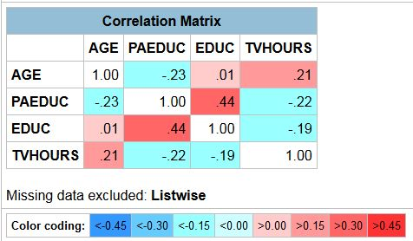
Correlation Output

Slide 72
Multicollinearity
Multicollinearity occurs when a set of independent variables in a regression analysis are highly intercorrelated
When you have high multicollinearity the standard errors of your regression coefficients become less reliable
The standard errors of the regression coefficients increase which makes it harder to reject the null hypothesis in your tests of significance

Slide 73
Comparison of Correlations
Correlation can also be used to compare correlations for different groups of respondents
Let’s compare the Pearson correlation between age and tvhours for males and females

Slide 74
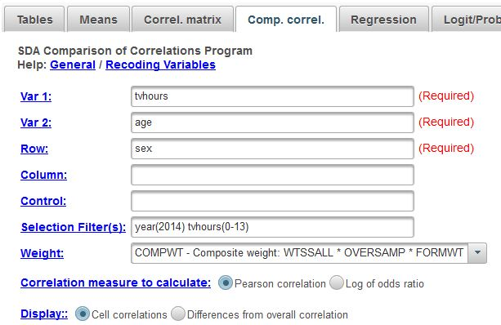
Comparison of Correlations
Dialog Box

Slide 75
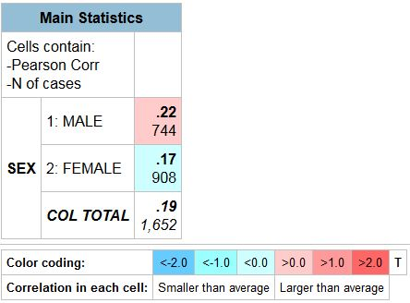
Comparison of Correlations Output

Slide 76
Subsetting and Downloading

Slide 77
Subsetting and Downloading Files
We’re going to create and download a subset of the GSS cumulative file
Let’s start by selecting cases from 2014
Then we’re going to select the following variables – the case identification variables, marital, agewed, divorce, widowed
At the end of each intermediate step, click on the next tab

Slide 78
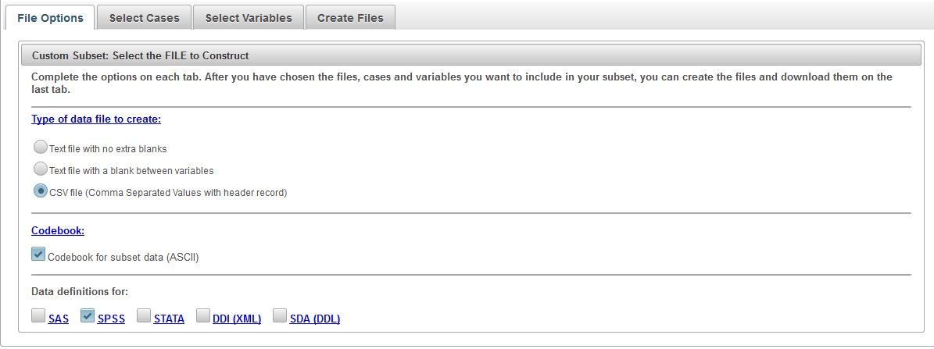
Step 1 – File Options

Slide 79
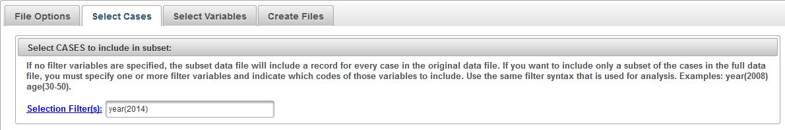
Step 2 – Select Cases

Slide 80
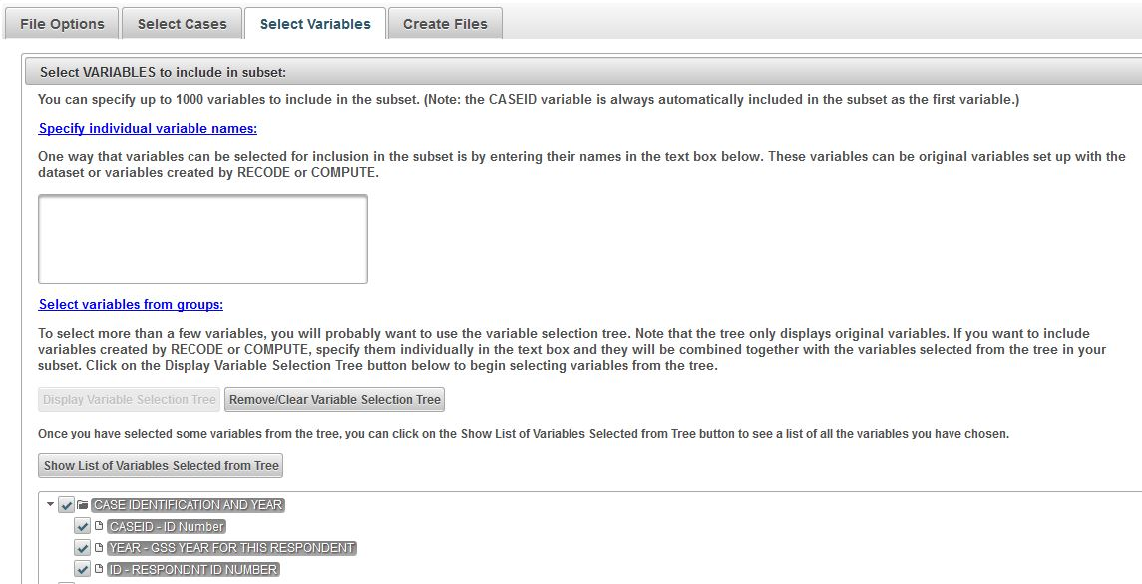
Step 3 – Select Variables

Slide 81
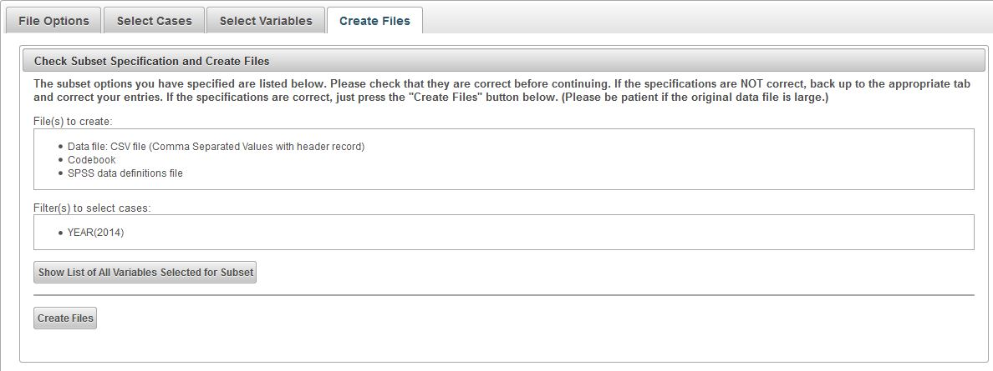
Step 4 – Create Variables

Slide 82
Downloading the Files
Click on the file(s) you want to download
The easiest way is to download all the files by clicking on ZIP ARCHIVE – ALL FILES

Slide 83
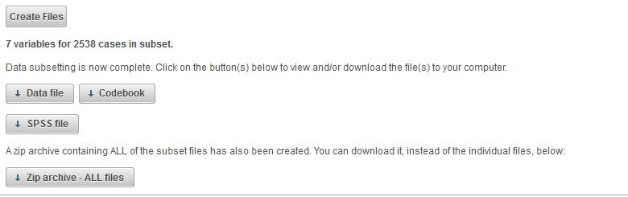
Step 5 – Downloading the Files

Slide 84
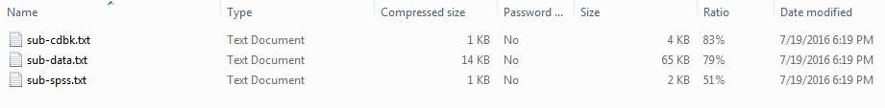
Downloaded Files Output

Slide 85
Creating a SPSS system file
Run the SPSS syntax file to create the SPSS system file
You will need to make some changes to the syntax file
  On the FILE HANDLE command, indicate the path to the data file that you downloaded
  On the SAVE OUTFILE command, indicate the path for the SPSS system file that you want to save
  Insert periods at the end of all SPSS commands
For more information, see look on the SSRIC’s web page

Slide 86
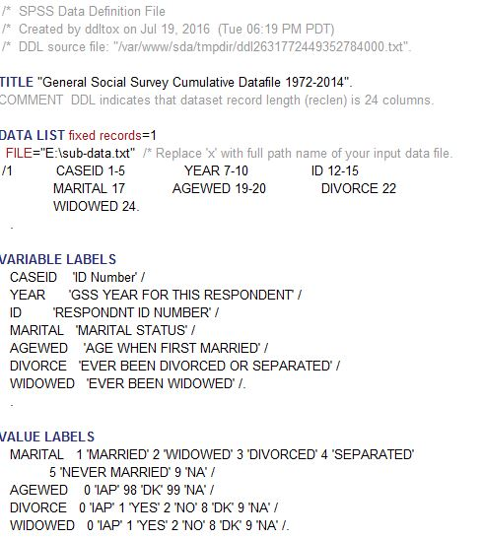
SPSS Syntax File – Part 1

Slide 87
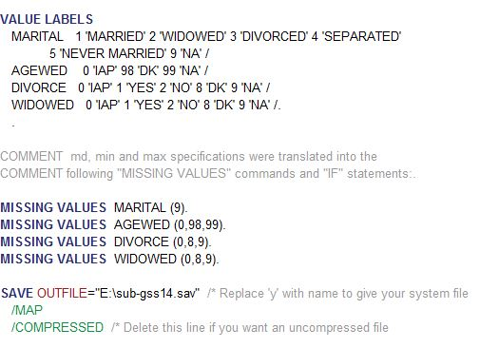
SPSS Syntax File – Part 2

Slide 88
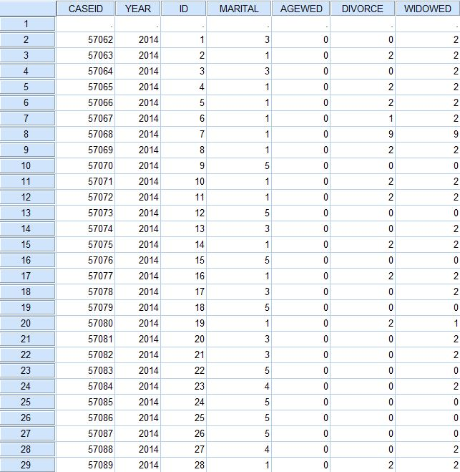
SPSS System File That You Created

Slide 89
Create Your Own System File
Subset and download your own GSS system file
Run FREQUENCIES for some of your variables

Slide 90
Teaching Resources for SDA
Data Driven Learning Guides at ICPSR
Modules at ICPSR
  Investigating Community and Social Capital
  Voting Behavior: The 2012 Election
Social Science Research and Instructional Center
  General Social Survey (2014): Statistics (SDA version) (available in August, 2016)
  Field Poll (February, 2013): Gun Control (SDA) (available in August, 2016)

Slide 91
Contact Me
Ed Nelson
CSU, Fresno
ednelson@csufresno.edu

