Slide 1
Integrating Quantitative Literacy Resources into the Classroom (originally presented at the Pacific Sociological Meeting in Portland, Oregon, 2014)
Social Science Research and
Instructional Council
August, 2014

Slide 2
Agenda
Quantitative Literacy
Teaching Resources
Survey Documentation and Analysis (SDA)
Discussion

Slide 3
Quantitative Literacy
Rhonda Dugan
Sociology
CSU Bakersfield
rdugan2@csub.edu

Slide 4
What is Quantitative Literacy (QL)?
Emergence in 1990s
General Education requirement
QL is not a synonym for “statistics”
National Council on Educational Statistics (NCES): “Knowledge & skills to perform quantitative tasks…such as balancing a checkbook [or] figuring out a tip…”

Slide 5
What does Quantitative Literacy (QL) Involve?
Ability to perform algebraic/logical operations
Develop problem solving skills
Foster analytical skills to apply across disciplines

Slide 6
Dimensions of Quantitative Literacy (QL)?
Five dimensions (Steen 1997):
Practical
Civic
Professional
Recreational
Cultural

Slide 7
QL in Sociology
American Sociological Association (ASA): focus on “scientific literacy” of sociology majors
Address the scientific reasoning gap
Increase integration of data analysis, computer literacy in undergraduate sociology courses
Key: early classroom exposure

Slide 8
Integrating Data Analysis Project (IDA), 2002
Collaborators: ASA, Social Science Data Analysis Network (SSDAN) at Univ. of Michigan
Funded by National Science Foundation (NSF)
Consortium of 12 sociology departments
Incorporate use of data modules (U.S. Census, GSS)

Slide 9
Quantitative Literacy
Focus: How sociology departments can incorporate QL in curricula
Provide students empirical experience
Active learning
Comprehension of social problems, community concerns
Potential challenges
Availability of technology
Large enrollment-based courses
Time

Slide 10
Bibliography
Howery, Carla B. and Havidan Rodriguez. 2006. “Integrating Data Analysis (IDA): Working with Sociology Department to Address the Quantitative Literacy Gap.” Teaching Sociology, 34: 23-38
National Center for Educational Statistics. “National Assessment of Adult Literacy.”
Steen, Lynn. 1997. Why Numbers Count: Quantitative Literacy for Tomorrow’s America. New York: College Board.
Sweet, Stephen and Kerry Strand. 2006. “Cultivating Quantitative Literacy: The Role of Sociology.” Teaching Sociology, 34(1): 1-4
Wilder, Esther Isabelle. 2010. “A Qualitative Assessment of Efforts to Integrate Data Analysis throughout the Sociology Curriculum: Feedback from Students, Faculty, and Alumni.” Teaching Sociology, 38(3): 226-246.

Slide 11
Teaching Resources
Ed Nelson
Sociology
CSU Fresno
ednelson@csufresno.edu

Slide 12
Resources
Teaching with Data
Merlot
Inter-University Consortium for Political and Social Research (ICPSR)
Social Science Data Analysis Network (SSDAN)
Roper Center for Public Opinion Research
Field Institute
Social Science Research and Instructional Council (SSRIC)

Slide 13
Teaching with Data

Slide 14
Merlot

Slide 15
ICPSR

Slide 16
Social Science Data Analysis Network

Slide 17
SSDAN – DataCounts!

Slide 18
SSDAN – CensusScope

Slide 19
Roper Center

Slide 20
Field Poll

Slide 21
SSRIC

Slide 22
Survey Documentation and Analysis (SDA)
Josh Meisel
Sociology
Humboldt State University
meisel@humboldt.edu

Slide 23
Easy Access Data Sources
No background in statistics necessary
Ability to quickly create tables drawing on government agency data sets
Criminology and Juvenile Delinquency:
OJJDP Statistical Briefing Book

Slide 24
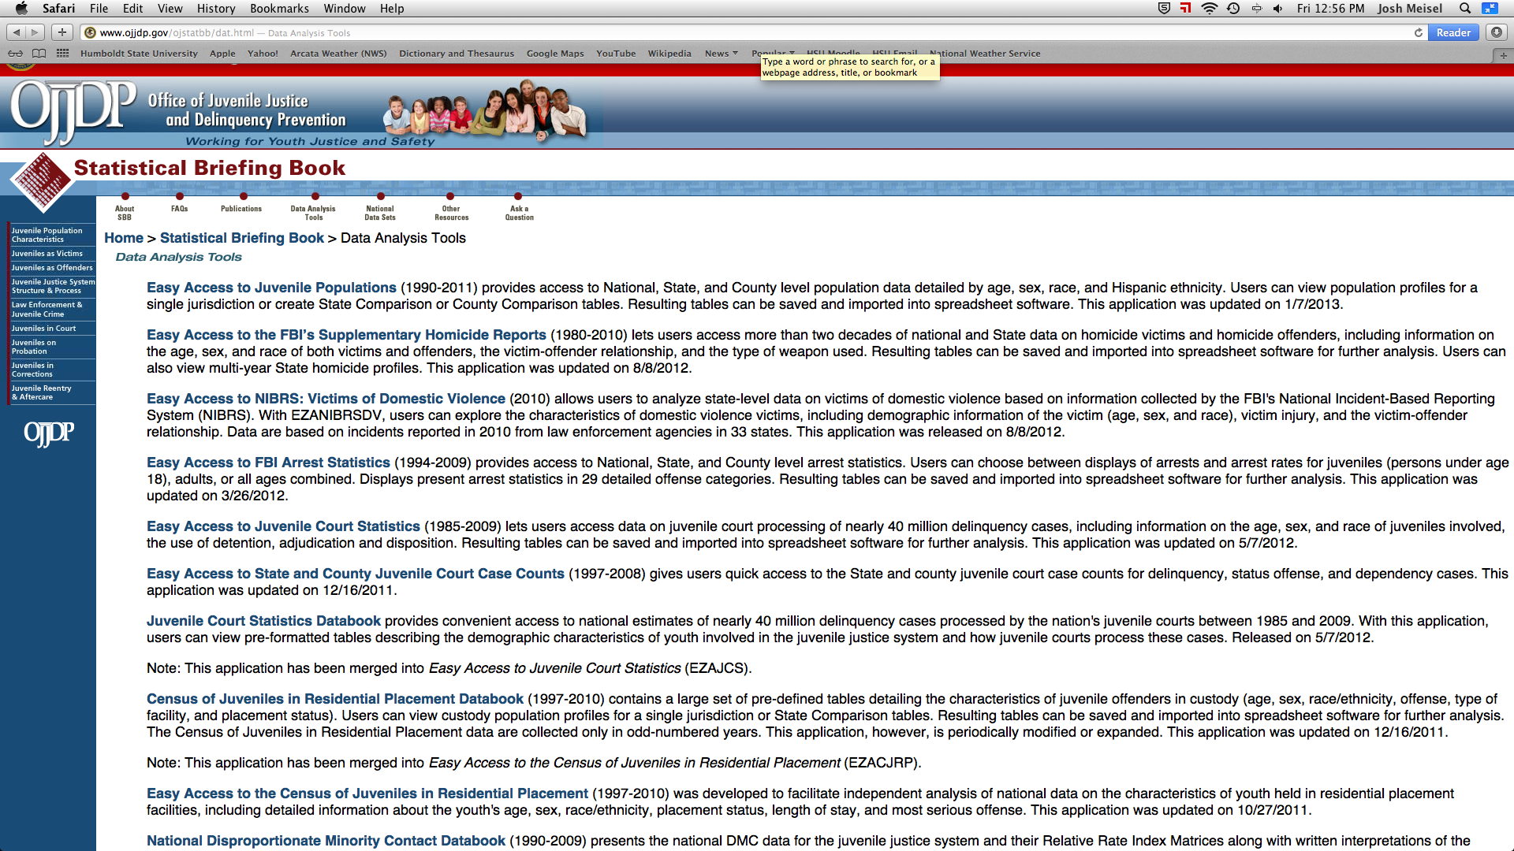
OJJDP Statistical Briefing Book

Slide 25
Online Data Analysis
What is it?
Advantages and disadvantages
Available SDA Data Sets
Available statistical Procedures
Using SDA

Slide 26
Sources for SDA Data Sets
SDA Archive located at UC Berkeley
ICPSR Thematic Collections
Field data located at UC Berkeley
List of SDA data sets at CSU Long Beach

Slide 27
ICPSR
China Multi-Generational Panel
National Archive of Computerized Data on Aging
National Archive of Criminal Justice Data Substance
Abuse and Mental Health Data

