Slide 1

Inter-University Consortium for Political and Social Research

Slide 2
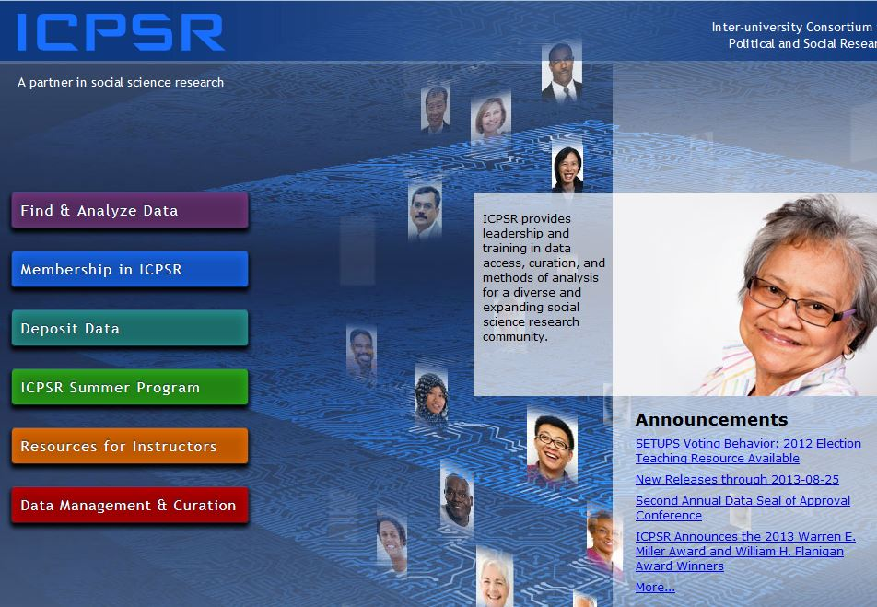
http://www.icpsr.umich.edu
Click here to find and analyze data

Slide 3
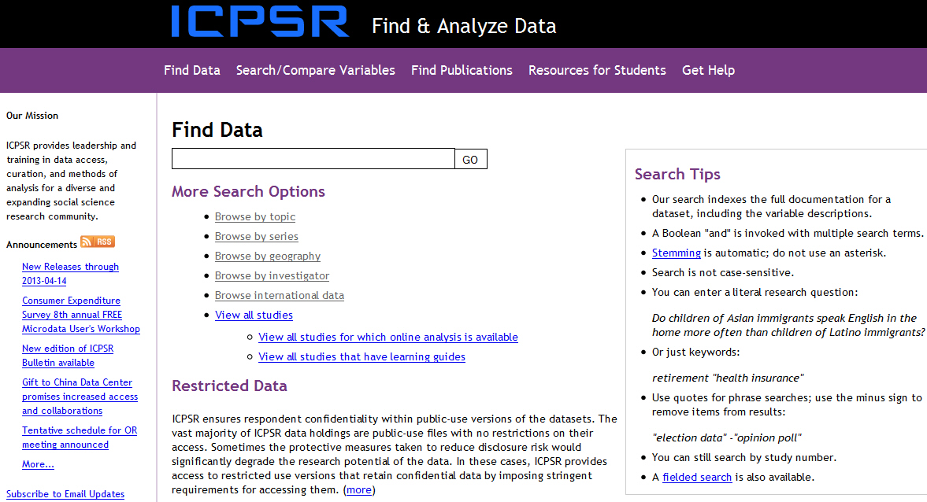
Find and Analyze Data

Slide 4
Searching for Data from ICPSR
Enter “immigration” in the “Find Data box.”
Explore the different ways of browsing.
Click on “Go”.

Slide 5
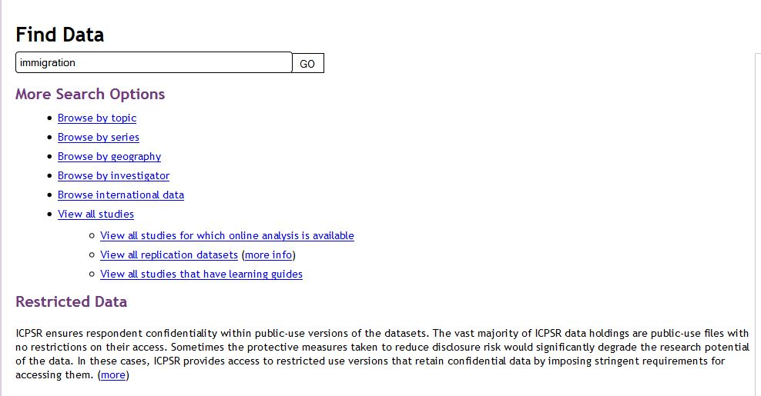
Searching for Data from ICPSR

Slide 6
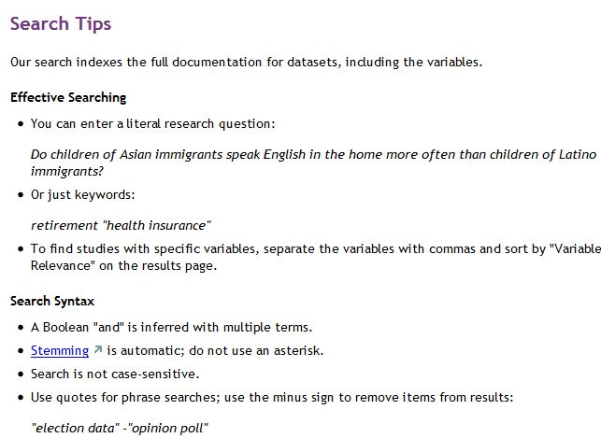
Searching Tips

Slide 7
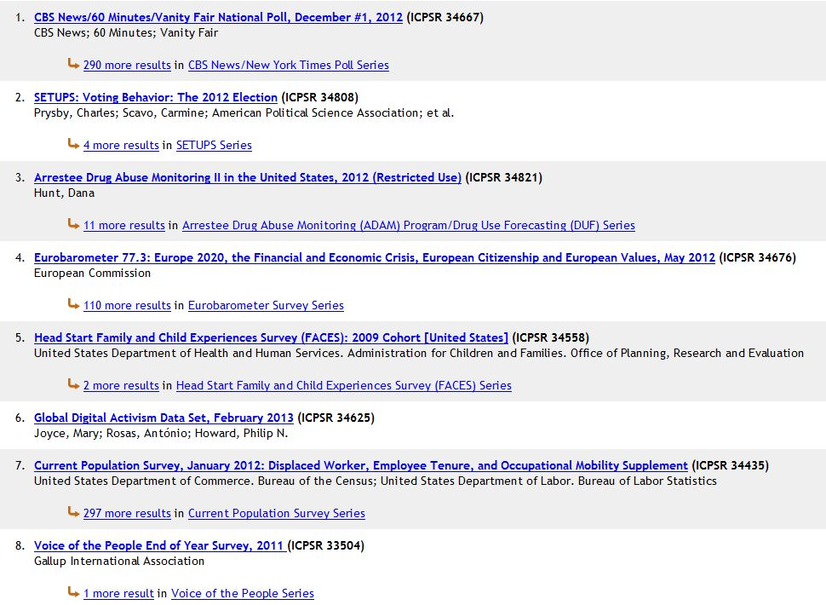
Finding a Data Set (Your data sets may be in a different order)
Click on this dataset.

Slide 8
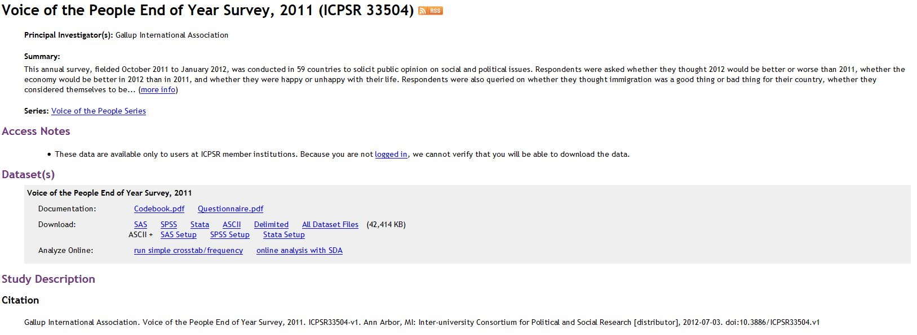
Voice of the People (ICPSR 33504)

Slide 9
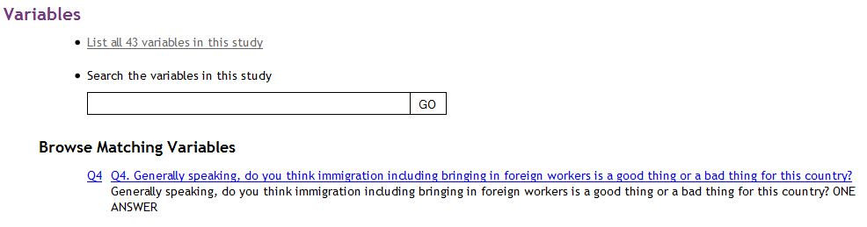
Getting More Information About the Variables in the Data Set
Click to see variable

Slide 10
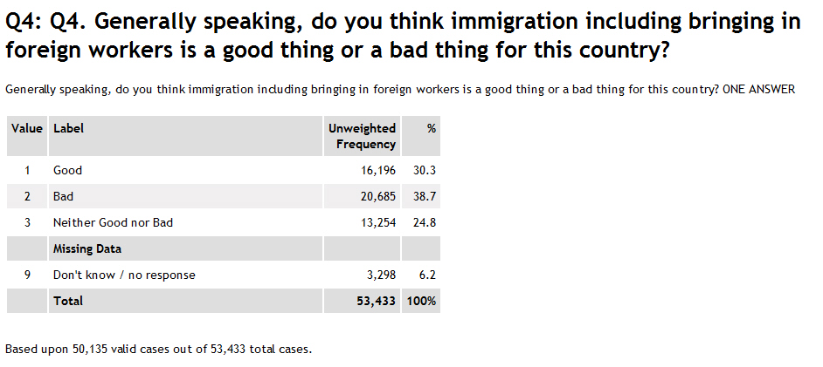
Looking at a Key Variable

Slide 11
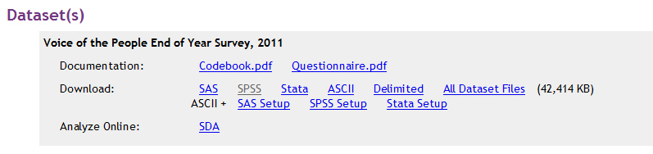
Downloading the Data Set
We’re going to download the SPSS file. Click here.

Slide 12
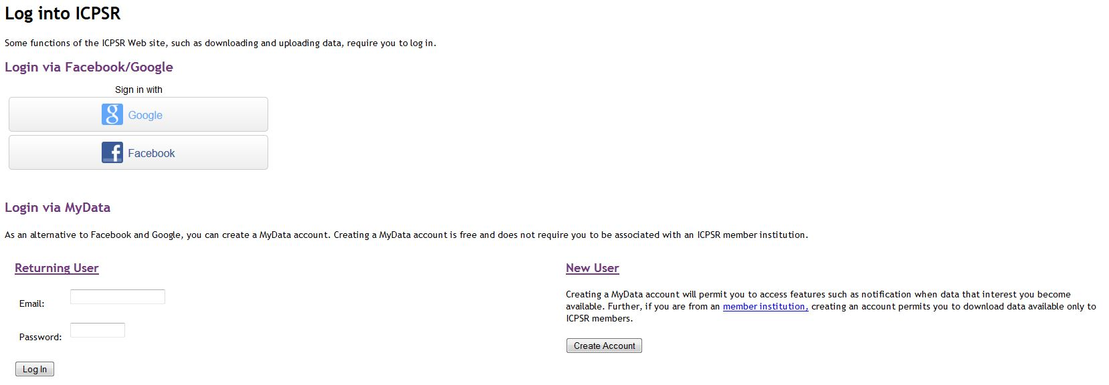
Creating an Account
Note: you will have to create an account to download a data set.
Click here.

Slide 13
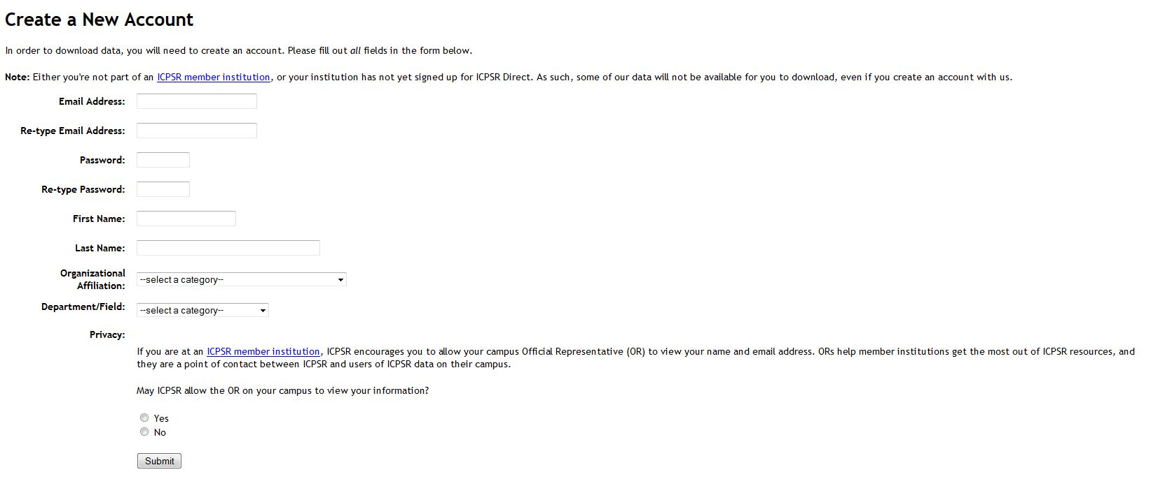
Creating an Account
Note: Fill out and click
on submit.

Slide 14
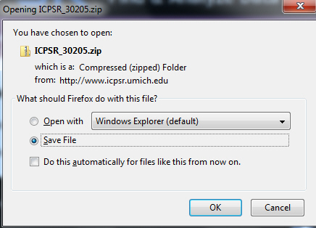
Downloading
Note: Once you have created an account, it will start the download process.

Slide 15
Downloading
Select “Save File”.
In Firefox file will be saved to your downloads folder.
File will be saved as a zip file.
Open the zip file.
Keep opening folders until you see codebook.pdf, questionnaire.pdf and data.sav.

Slide 16
Opening the .sav File
You can move the zip file from the downloads folder to wherever you want to keep it on your hard drive.
Open SPSS and then open the .sav file.

Slide 17
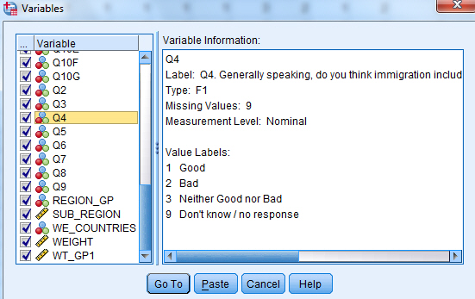
Mini Codebook
Utilities/Variables

Slide 18
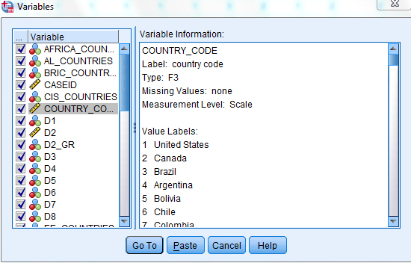
Mini Codebook
Utilities/Variables

Slide 19
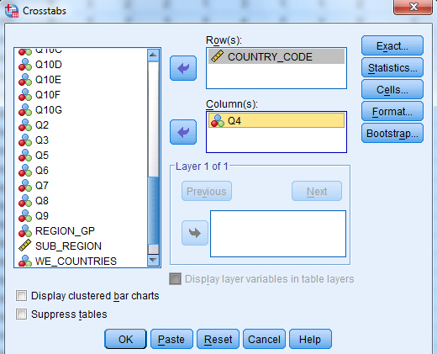
Getting a Crosstab

Slide 20
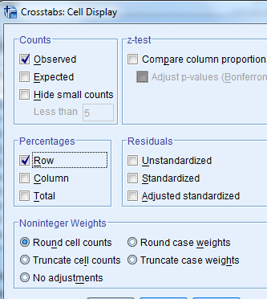
Crosstabs

Slide 21
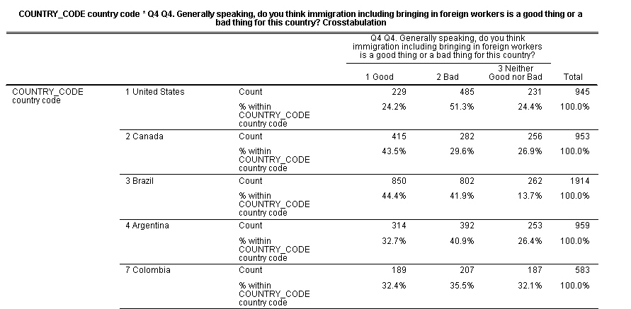
Crosstabs

Slide 22

Searching the Variables Database
“Search/Compare Variables” is found on the menu bar under Find & Analyze Data.
The Social Science Variables Database contains over 4 million questions.
Represents about 76% of the ICPSR collection.
Let’s search for questions on immigration.

Slide 23
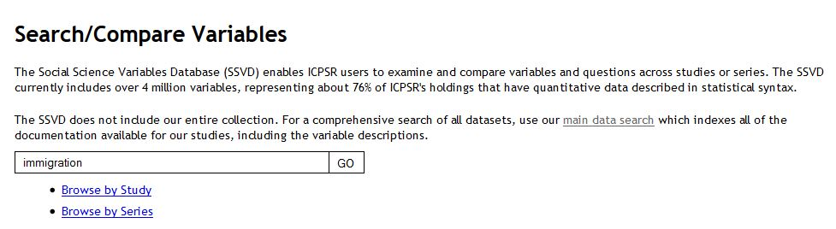
Searching Variables
Click here.

Slide 24
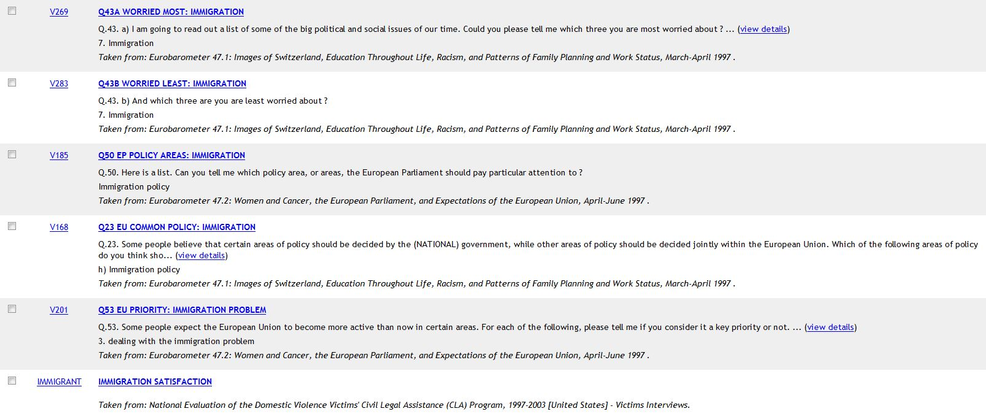
Searching Variables

Slide 25
Publications
You can also search the publications archive which includes articles and books that have used ICPSR data
“Find Publications” is found on the menu bar under Find & Analyze Data.
Let’s search for articles and books on immigration.

Slide 26
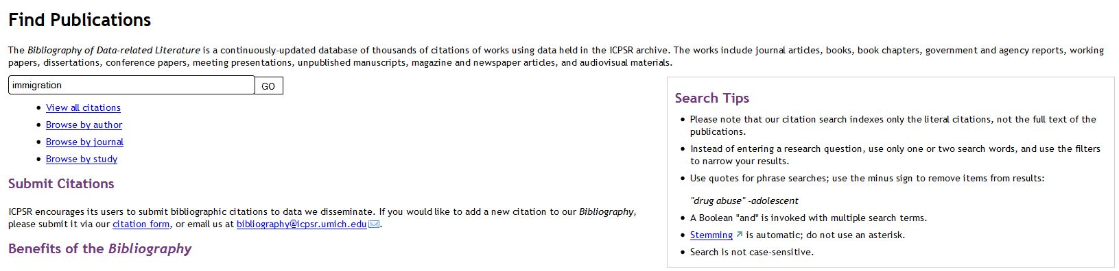
Publications
Click here.

Slide 27
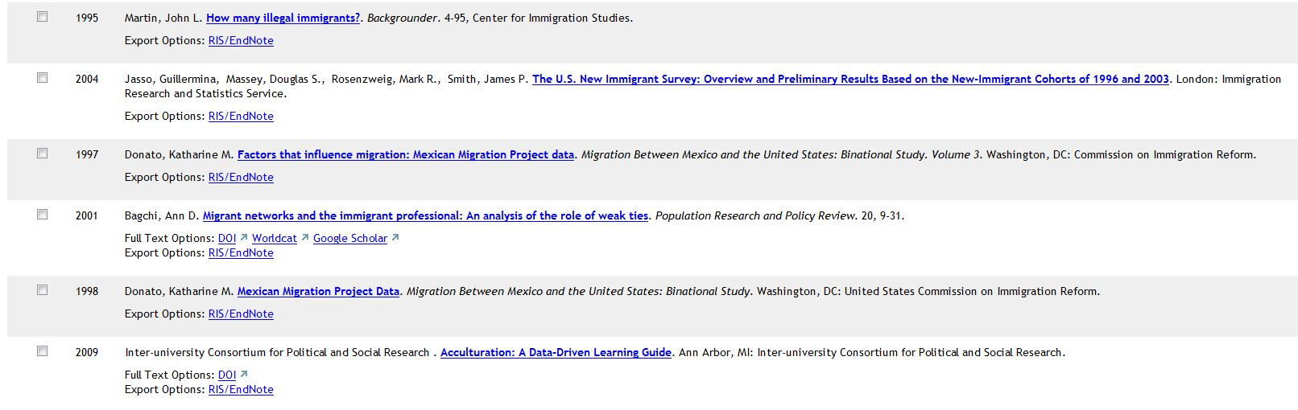
Publications

Slide 28
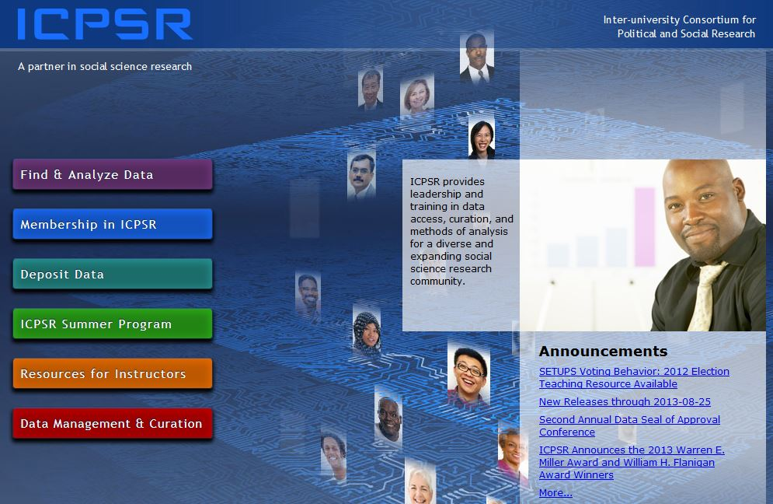
Resources for Instructors
Click here.

Slide 29
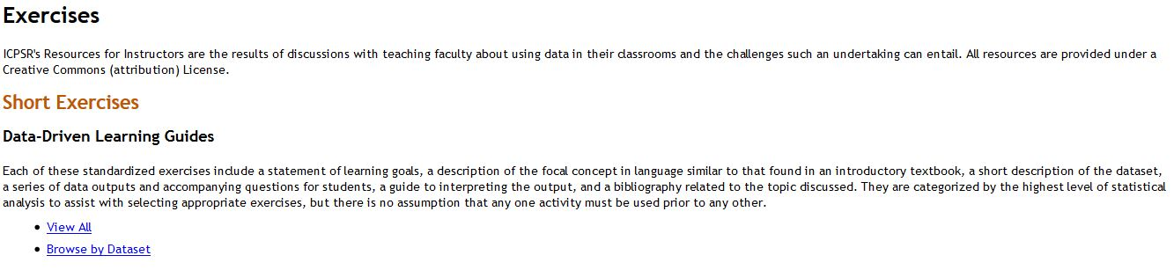
Exercises

Slide 30
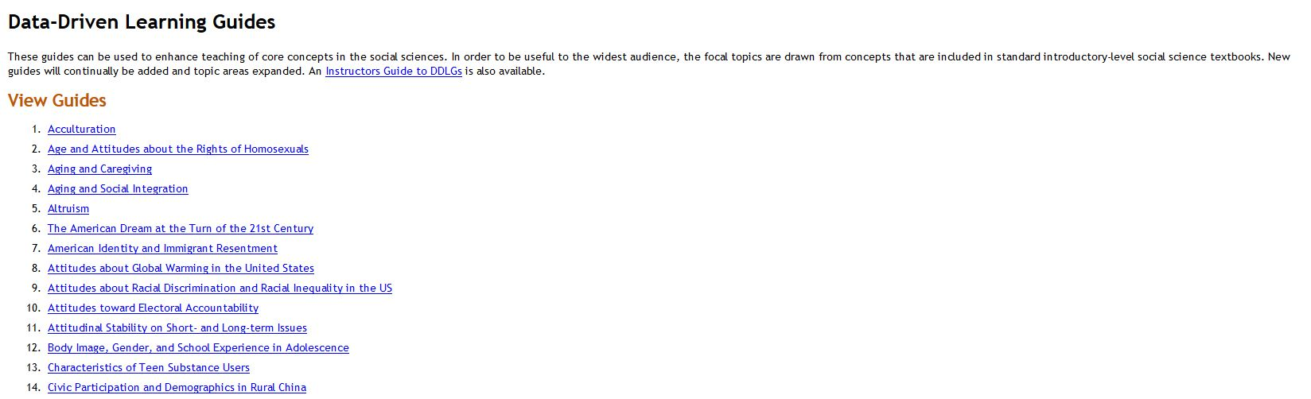
Data Driven Learning Guides
Let’s look at this one.

Slide 31
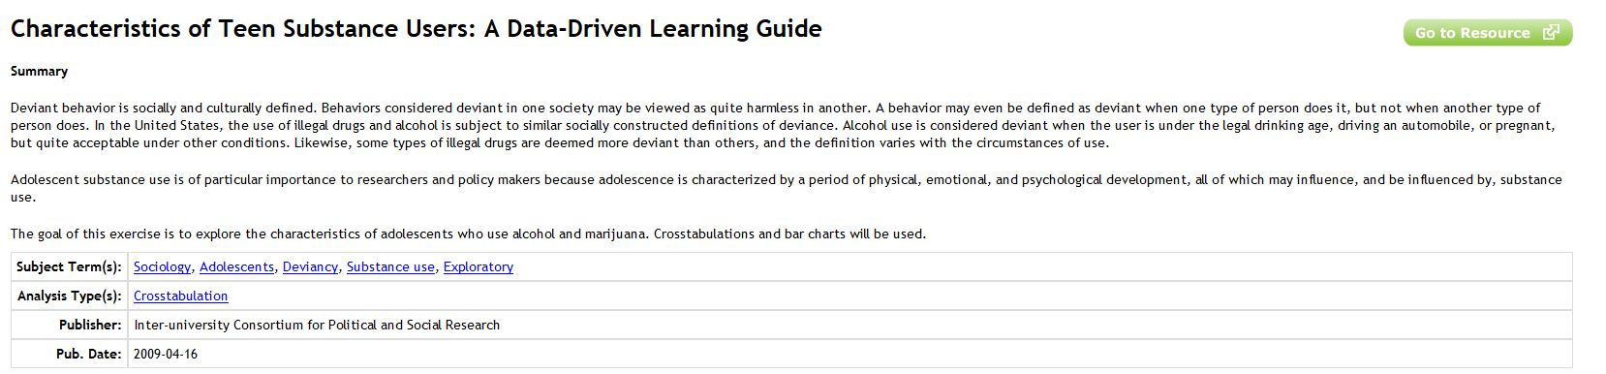
Characteristics of Teen Substance Users

Slide 32
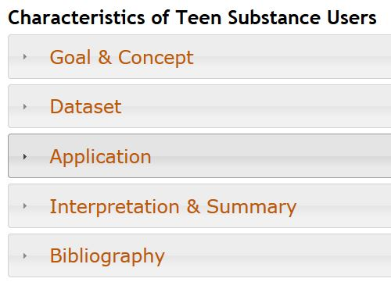
Characteristics of Teen Substance Users

Slide 33
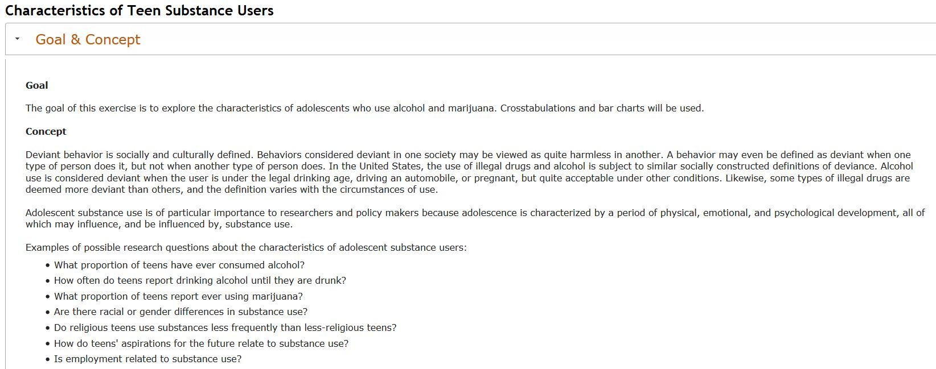
Characteristics of Teen Substance Users
Goals & Concepts

Slide 34
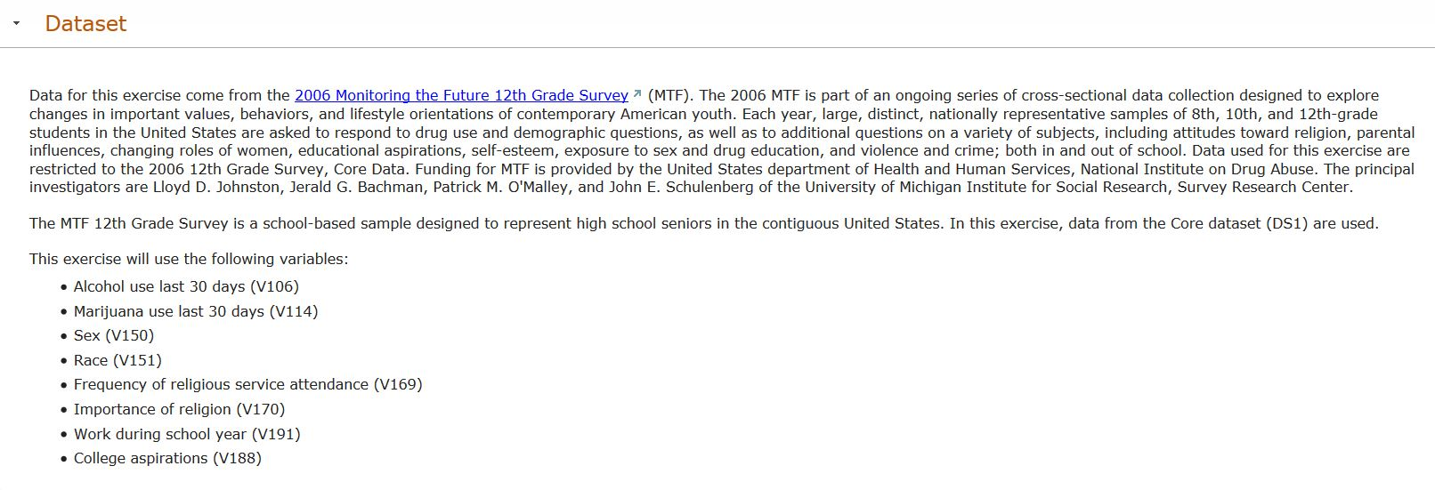
Characteristics of Teen Substance Users
Dataset

Slide 35
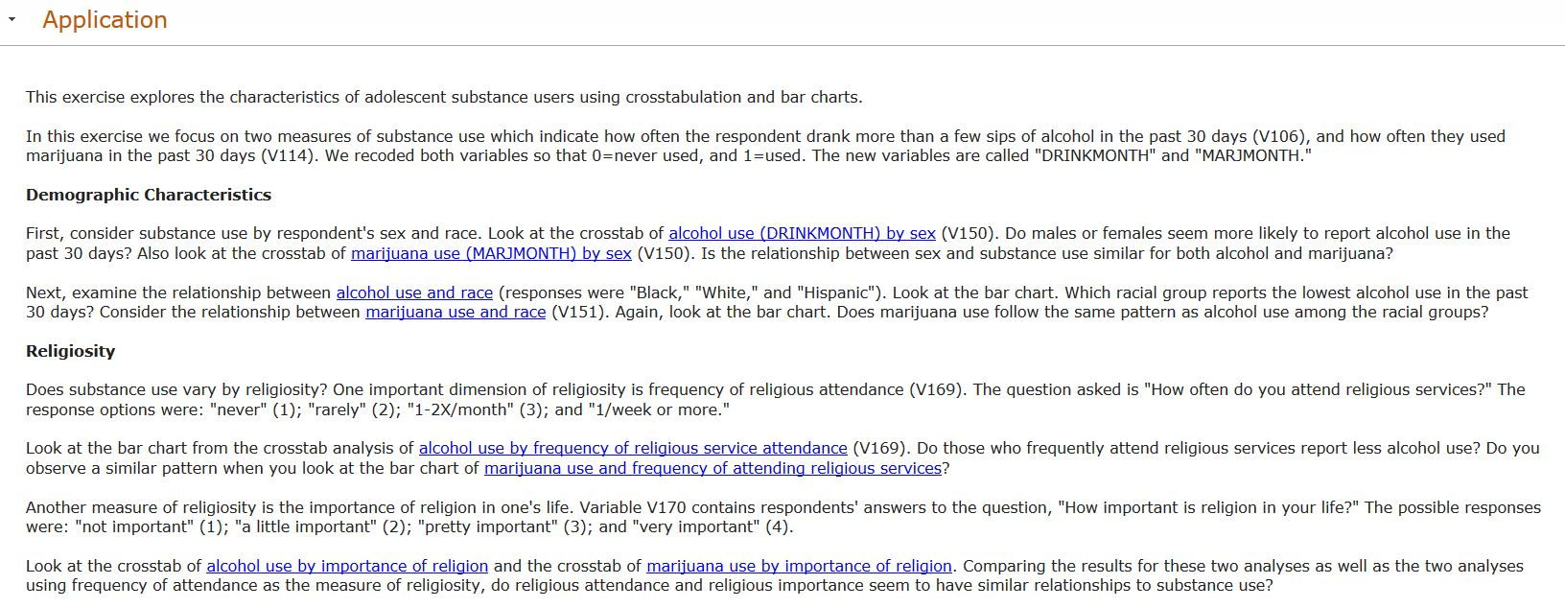
Characteristics of Teen Substance Users
Application (Student Exercise)

Slide 36
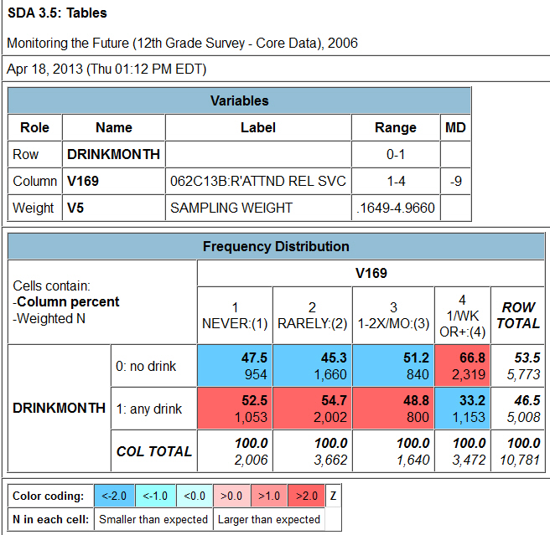
Characteristics of Teen Substance Users
Crosstab from SDA

Slide 37
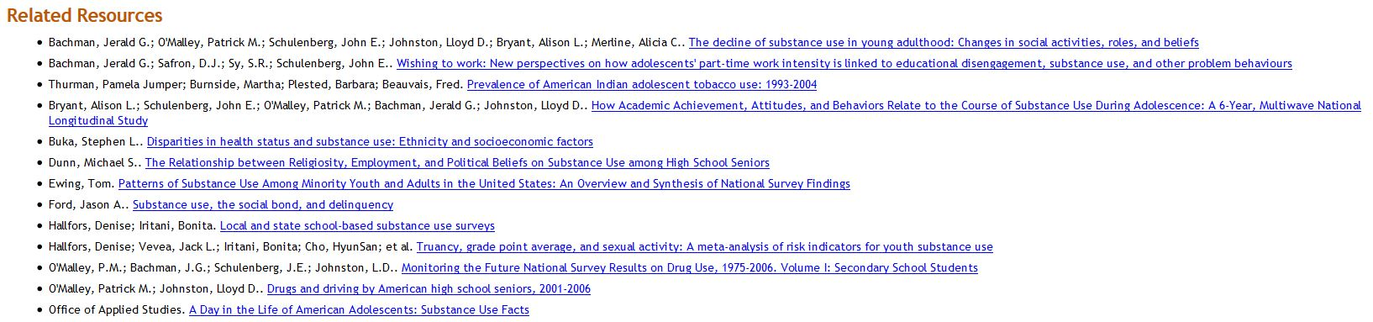
Characteristics of Teen Substance Users
Bibliography

Slide 38
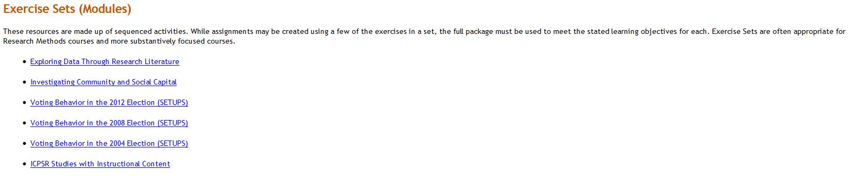
Modules

Slide 39

Investigation Community and Social Capital – Lori Weber (Chico)

Slide 40
Social Science Research and Instructional Council (SSRIC)
Another way to learn more about ICPSR is by going to the SSRIC’s web site.
The home page is on the next slide.
Click on “ICPSR” under “Data” in the upper left.
Explore the SSRIC web site while you are there. There is lots of information about other data archives (e.g., Field and Roper) and teaching resources.

Slide 41
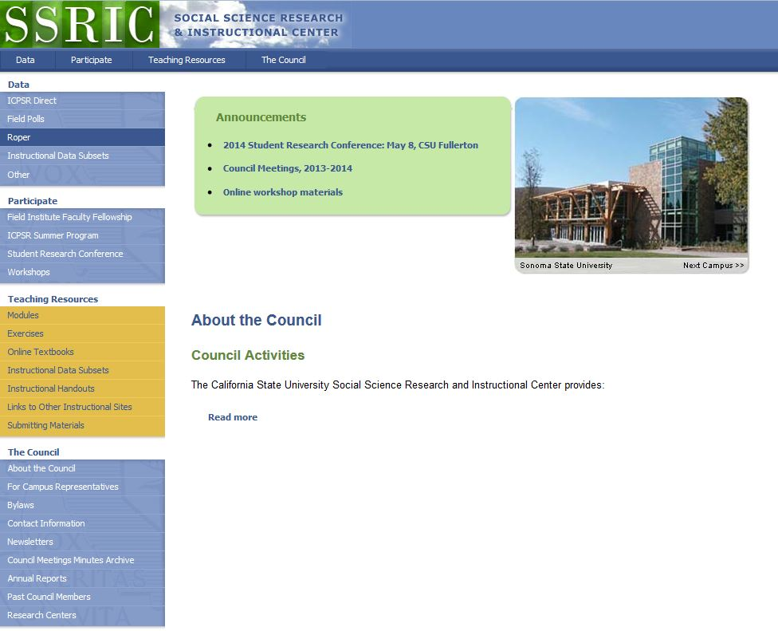
http://ssric.org

Slide 42
SSRIC
Here are some of the resources you will find on the SSRIC web site. Some of these resources are available only to faculty and students in the CSU.
  Under “Data” on the left you can get information about ICPSR, Field, Roper and instructional data sets.
  Under “Participate” there is information about the Field Faculty Fellow, the ICPSR Summer Program, the SSRIC’s Student Research Conference, and workshops that the SSRIC will come to your CSU campus and offer.

Slide 43
SSRIC
Under “Teaching Resources” there are exercises and data sets that you could use in your classes. There is also an extensive set of links to other sites of methodological and statistical relevance. These resources are typically available to everyone regardless of whether you are part of the CSU or not.
Under “Council” you can look up the SSRIC campus representative on your campus and learn more about the SSRIC Council.

