Slide 1

ICPSR:
  Resources for Instructors
  Finding and Analyzing Data
Notes:
This presentation is controlled by mouse clicks. Clicking on a hyperlink will open up the target Web page in a window in your default browser. Otherwise, if there are animations on a slide, each click will activate the next one. If there are none, or if they’ve all been activated, a click will transition to the next slide.

Slide 2
ICPSR
Inter-university Consortium for Political and Social Research
http://www.icpsr.org
Notes:
The ICPSR was founded in 1962; the CSU joined in 1972. Services include a summer program and a variety of web-based resources for research and instruction. Important note: to access many datasets in the archive, you need to be affiliated with an ICPSR member institution.

Slide 3
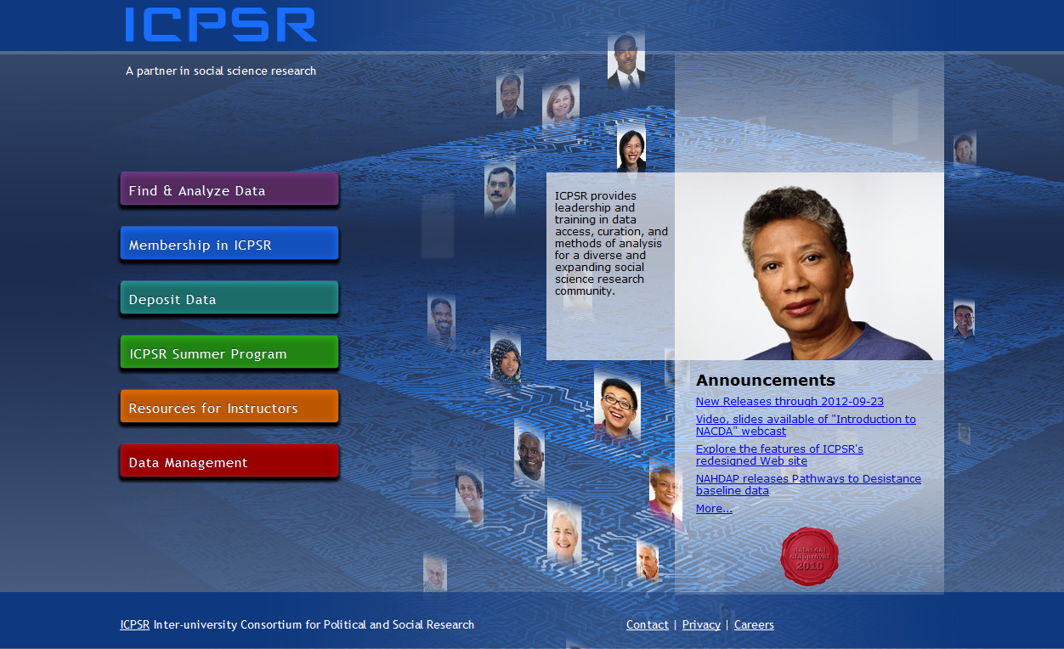
ICPSR
Notes:
Here’s the ICPSR home page as of September 26, 2012. ICPSR provides a number of resources, including a summer program for faculty and advanced students. In this presentation, we’re going to focus on just two sections of the ICPSR site: “Resources for Instructors” and “Find and Analyze Data.” Click first on “Resources for Instructors.”

Slide 4

ICPSR
Notes:
This section of the ICPSR site is divided into four parts: “Exercises,” “Resources for Students,” “Videos on Teaching,” and “External Resources.” Click first on “Exercises.”

Slide 5
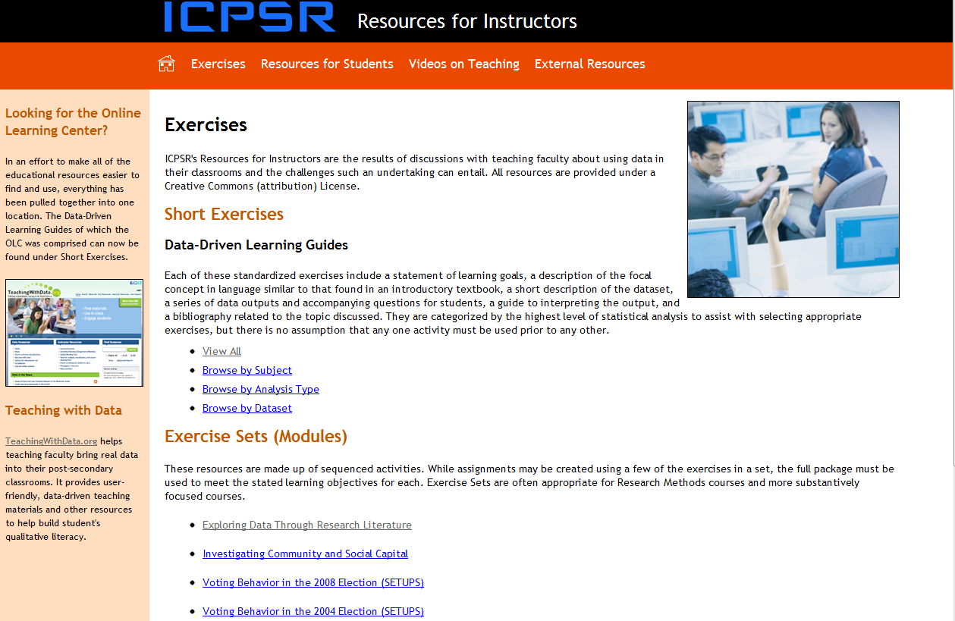
ICPSR
Notes:
The “Exercises” subsection consists of a large number (49 as of Sept. 26, 2012) of short, self-contained exercises and a small number (6 as of that same date) more elaborate “modules.”

Slide 6
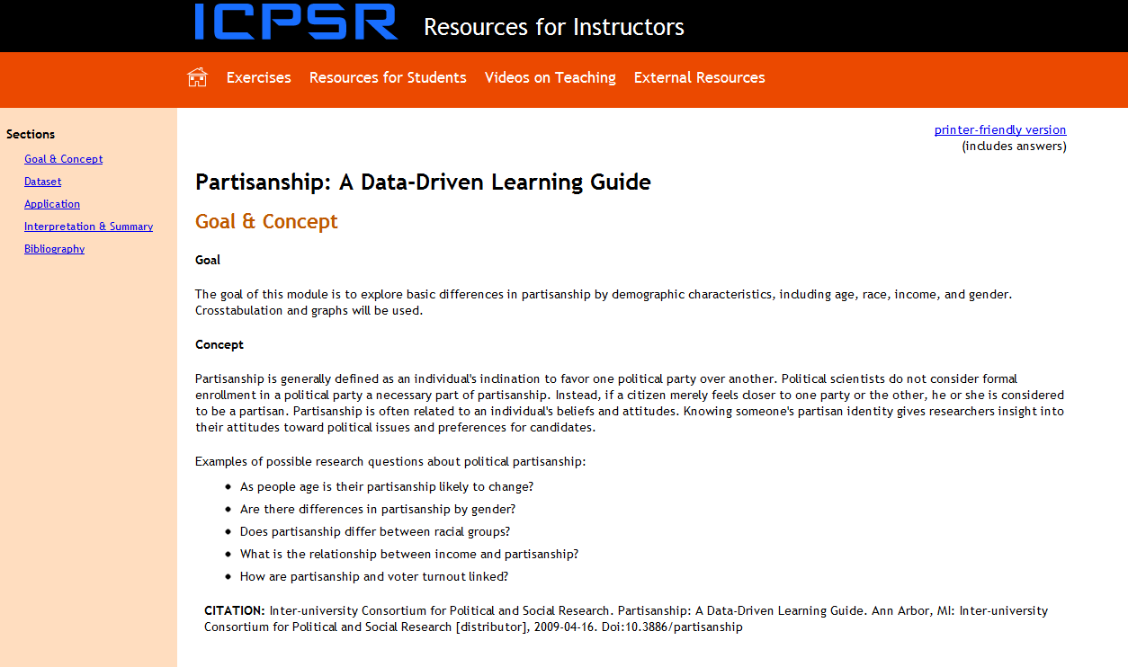
ICPSR
Notes:
Each module is different. Short exercises share a common format, and consist of: Goal and Concept, Dataset, Application, “Interpretation and Summary, and Bibliography. Click on “Resources for Students.”

Slide 7
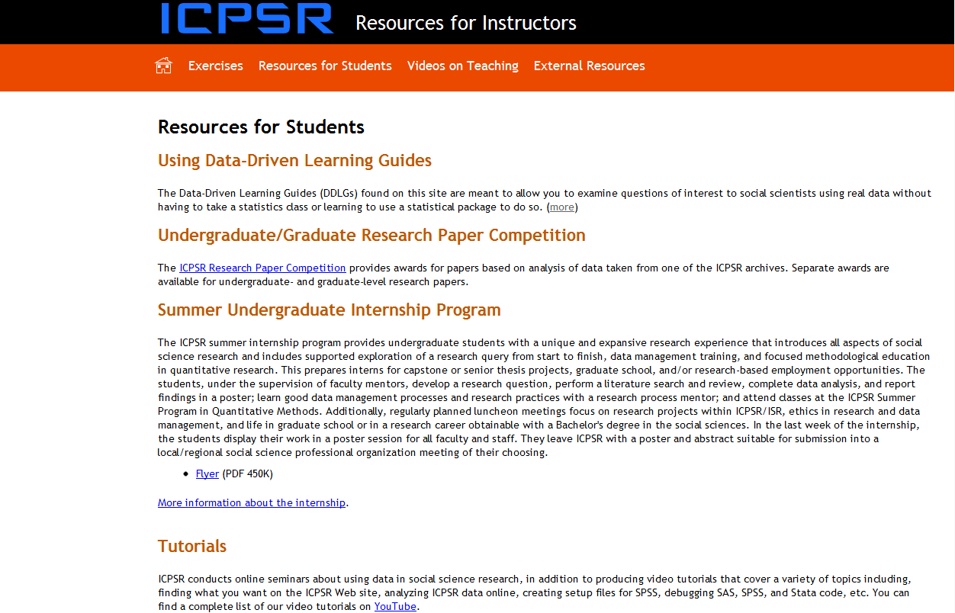
ICPSR
Notes:
“Using Data-Driven Learning Guides” describes the components of the short exercises shown on the previous slide. Information is provided on two ICPSR programs specifically for students, the “Research Paper Competition” and the “Internship Program.” “Tutorials” include a large number of videos produced by ICPSR and available on YouTube.

Slide 8
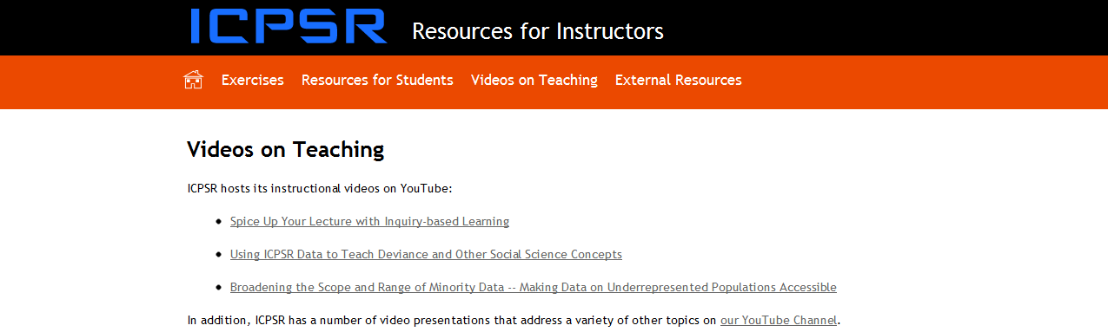
Notes:
“Videos on Teaching” again references ICPSR’s YouTube collection.

Slide 9
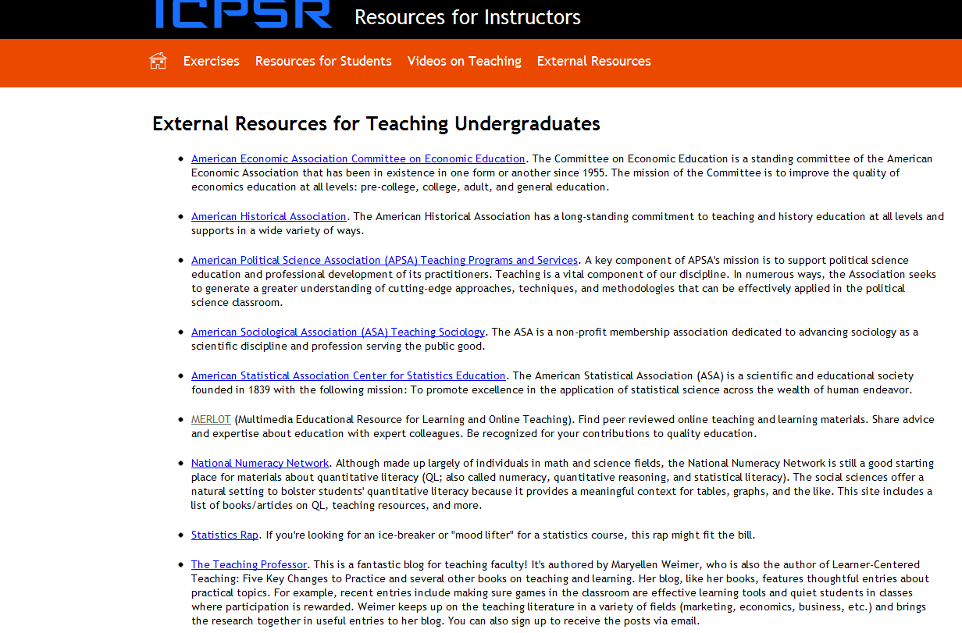
ICPSR
Notes:
“External Resources for Teaching Undergraduates” links to a small but useful set of sites containing instructional materials. See especially “Teaching with Data” at http://www.teachingwithdata.org/qssdl/welcome.action. BTW: an extensive set of links to instructional resources may be found at http://www.ssric.org/tr/links.

Slide 10
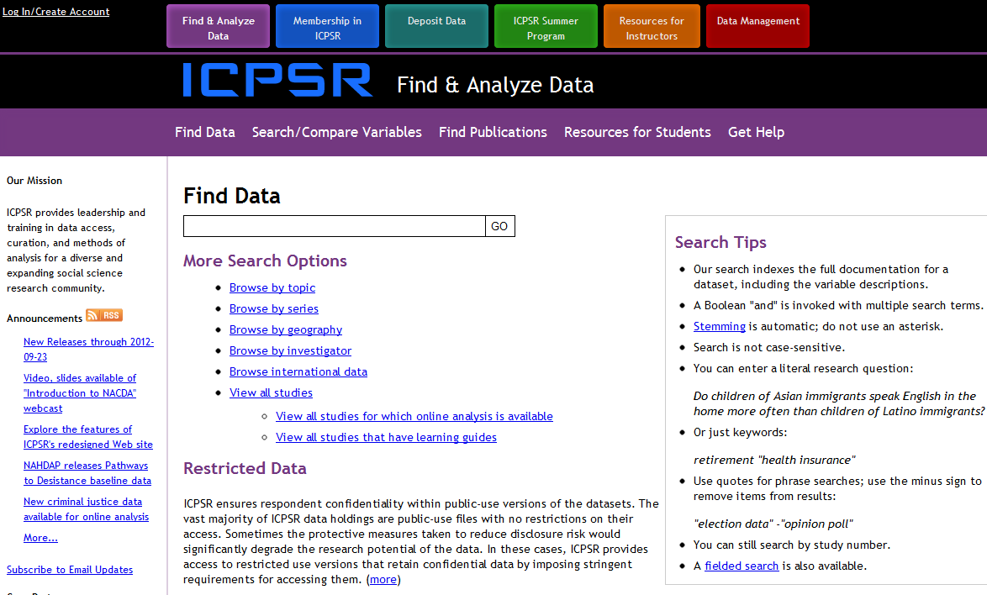
ICPSR
Notes:
Now let’s turn to using ICPSR’s data archive. From the main menu, click on “Find and Analyze Data,” or do so from the menu bar at the top of your current page. Either way will take you to the search page shown here. Read the “Search Tops” on the right. In the “Find Data” search box, type the words “death” and “taxes” (without the quotation marks). Inevitably, this is equivalent to typing “death and taxes” (again without the quotation marks).

Slide 11
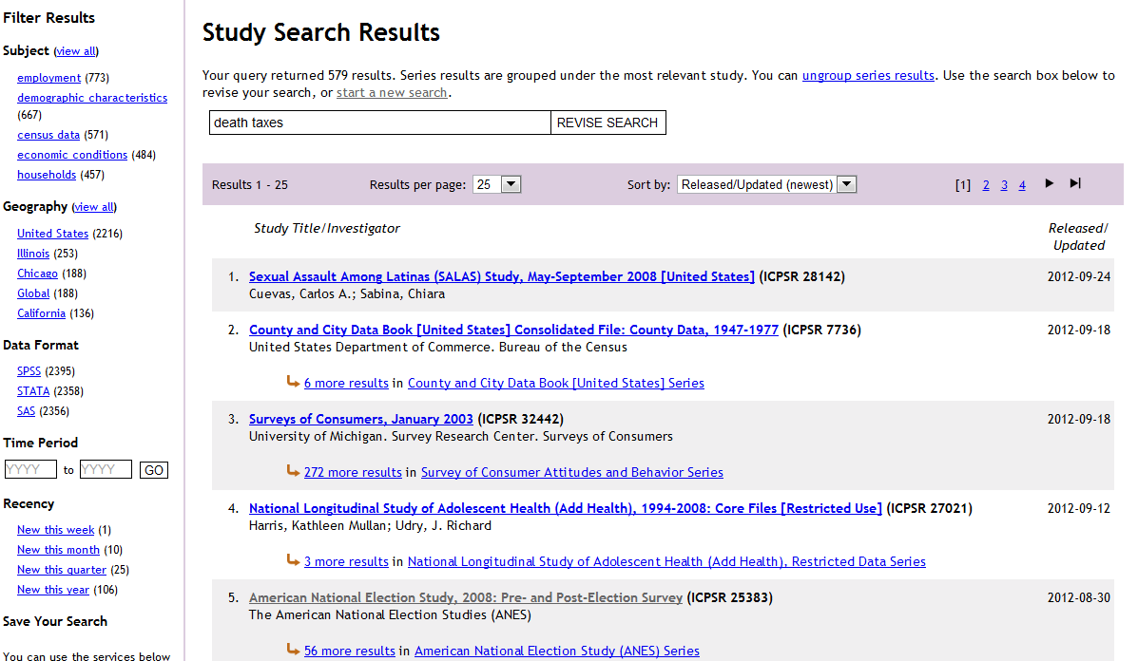
ICPSR
Notes:
Here are the results obtained on September 26, 2012, with results sorted by date of release, from newest to oldest. Note that results can be sorted and filtered in various ways. Click on the 5th entry shown, the 2008 American National Election Study.

Slide 12
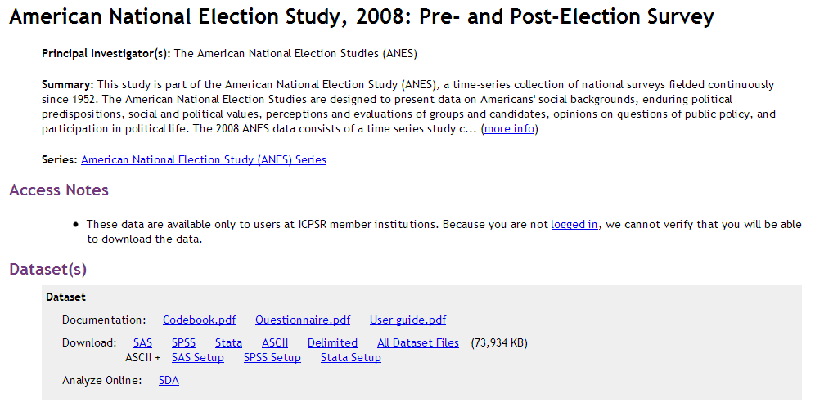
ICPSR
Notes:
Here’s a description of the study, but before downloading the data, you’ll need to log in to (or create) an ICPSR account.

Slide 13
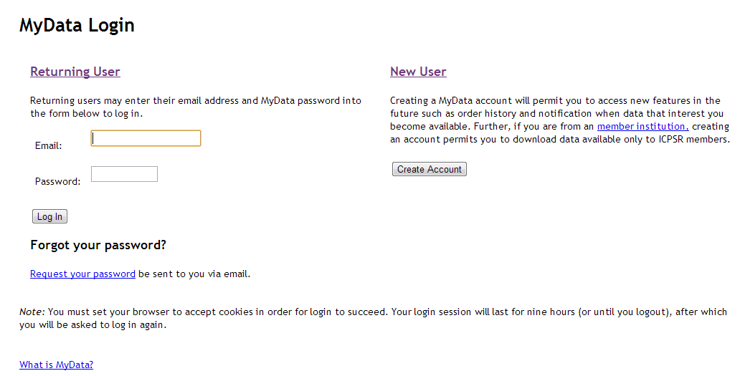
ICPSR
Notes:
While some of the data in the ICPSR archives are freely available, much of the archive requires that you be affiliated with a member institution. The first time you access proprietary ICPSR data, you’ll need to create a (free) account. To do this, you need to be using a campus computer or, from off campus, going through an on-campus proxy server. For more information about proxy access, see your campus’s ICPSR Official Representative (OR).

Slide 14
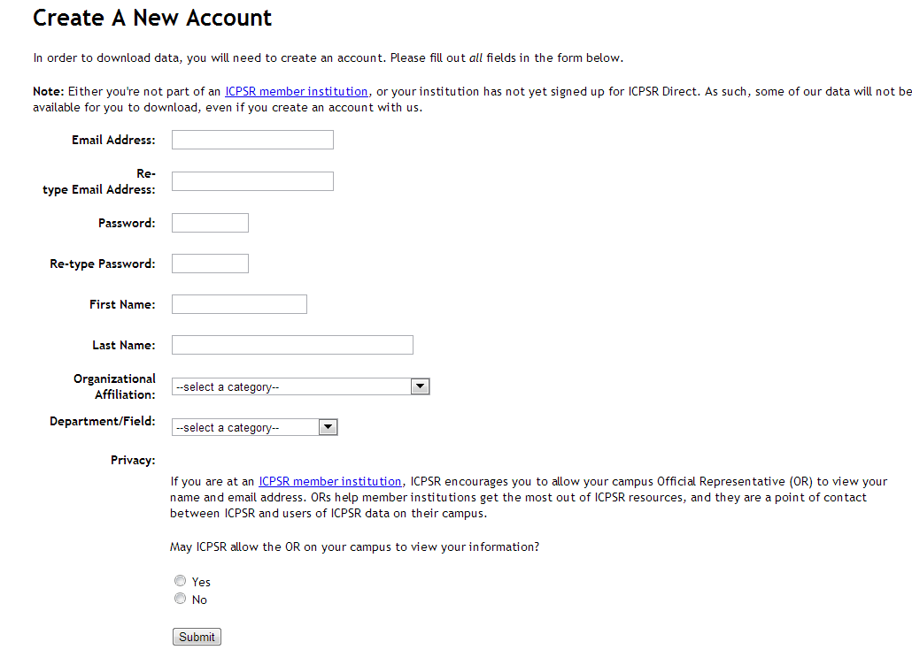
ICPSR
Notes:
We do recommend that you check “Yes” for the last item on this page. Doing so will help your campus Official Representative in assisting you with use of the data.

Slide 15
ICPSR
See: http://www.ssric.org/files/ASCII_to_SPSS.pdf
Notes:
Downloading this dataset requires that you be logged in. (Don’t worry about downloading the codebook, questionnaire, or user guide; you’ll get these automatically when you download the data. In this example, we’ll assume that you will be using SPSS to do your analysis. As is commonly the case, this dataset is already available as an SPSS system file, so just click on SPSS. With some data, a system file may not be available. Where that’s the case, you can create a system file from the raw data (ASCII file) and an SPSS setup (or syntax) file using the instructions in the linked PDF file. Warning: if you’re not familiar with SPSS syntax files, this can be a little tricky.

Slide 16
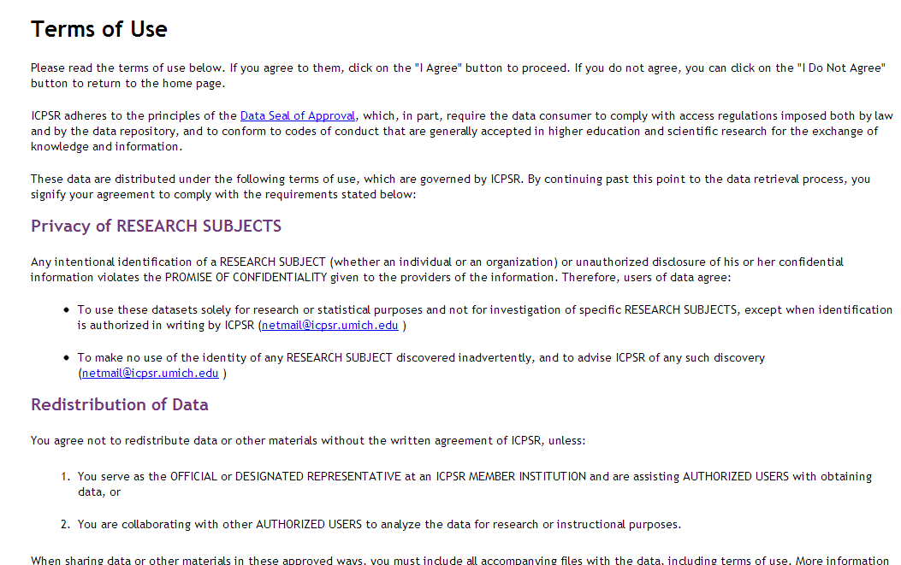
ICPSR
Notes:
Read the terms of use. If you agree, click on “I agree” at the bottom of the page (not shown here).

Slide 17
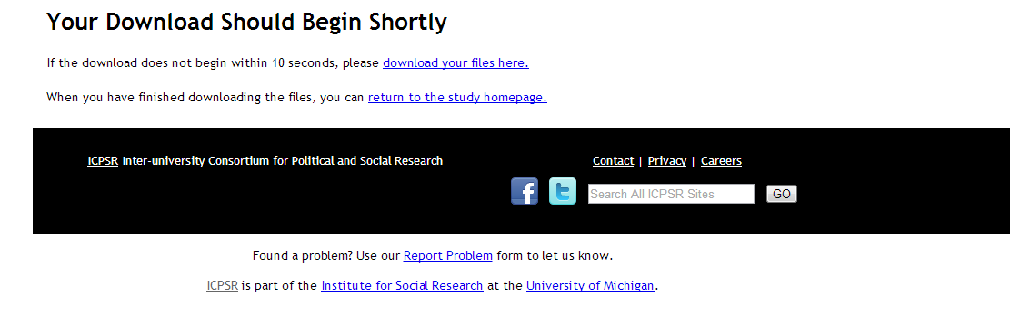
ICPSR
Notes:
Your data will be downloaded as a “zip” file. After download, unzip the file using the normal procedure for your operating system.

Slide 18
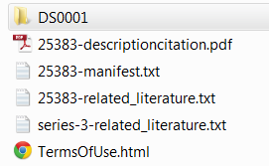
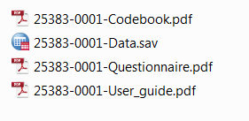
ICPSR
Notes:
Double-click on the folder storing the files you’ve unzipped, then double-click on the folder called here “DS0001.” This folder contains the codebook, the data (in SPSS system file format), the questionnaire, and the user guide. You can now open up the data in SPSS.

Slide 19
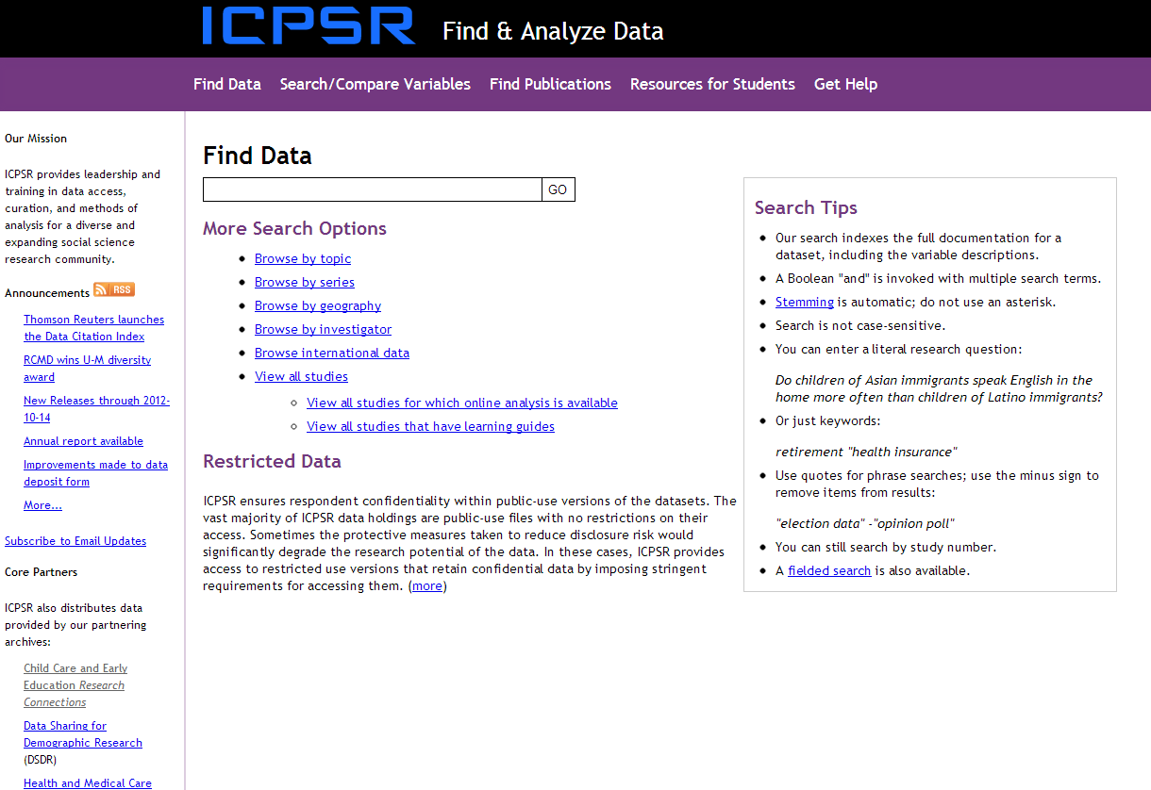
ICPSR
Notes:
In addition to its own archive, ICPSR also makes available data from various “core partners.” Some of these are listed in the left sidebar. Scroll down to the bottom of this list and click on “See more…” for a complete list of these “thematic collections.” Most of the data in these collections is freely available. Much of it can be analyzed online using Survey Document and Analysis (SDA), an online statistical package developed at UC Berkeley.

Slide 20
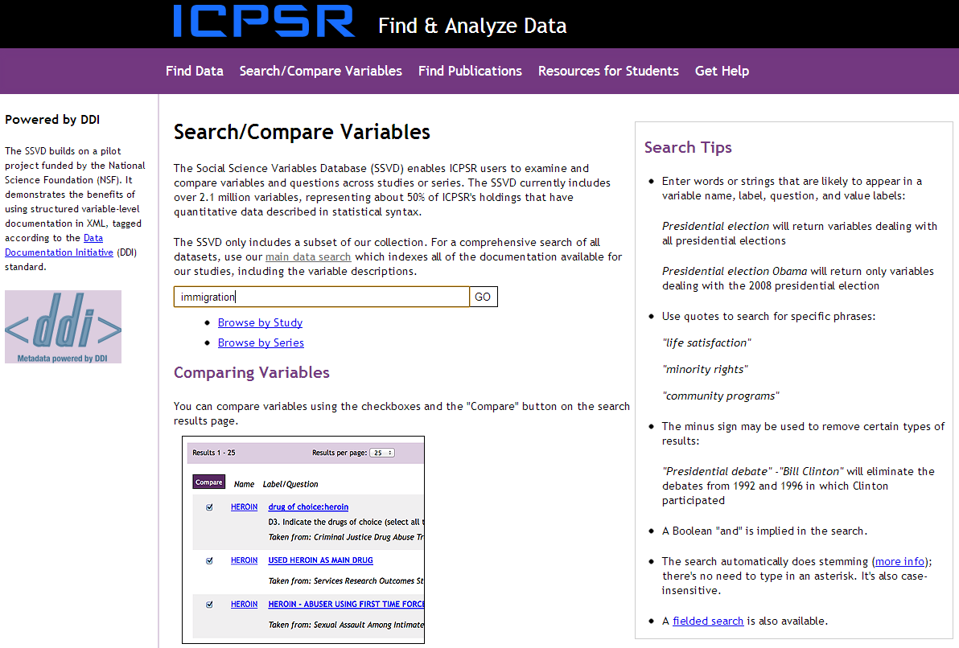
ICPSR
Notes:
In addition to finding data, you can also search and compare variables. This resource is freely available. If you are looking for studies that include data on a specific topic, or if you are designing your own questionnaire, this is a great resource. It allow you to see the specific wording of a question, and the response categories. In this example, we’ve searched on the keyword “immigration.”

Slide 21
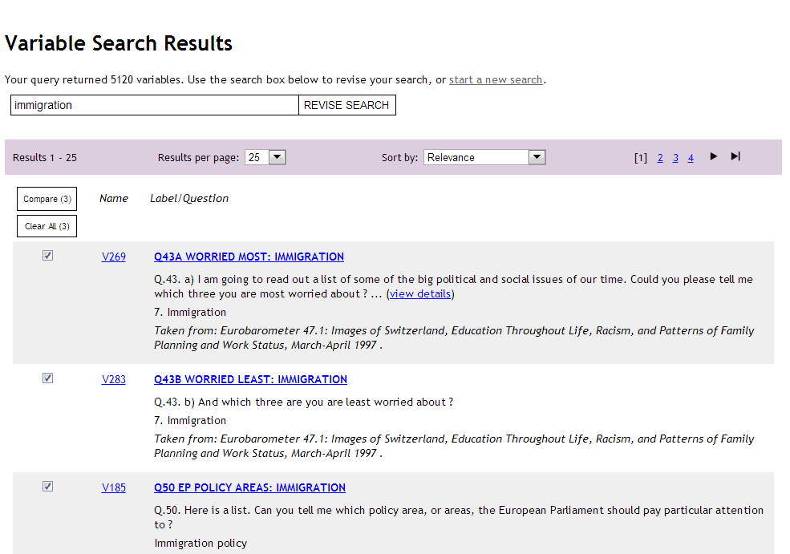
ICPSR
Notes:
We’ll check and compare the first three variables listed. All happen to be from the same study, but you can also compare variables from different studies (to, for example, see how different studies word similar questions and response categories).

Slide 22
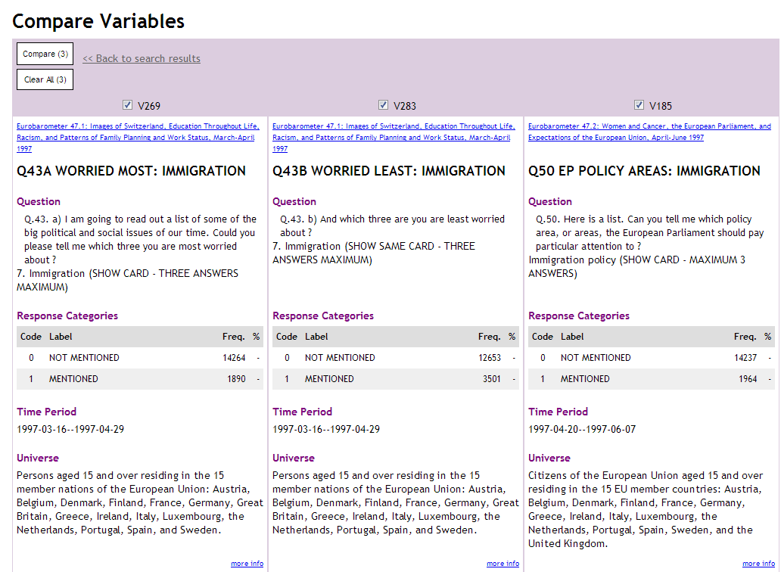
ICPSR
Notes:
Here are the results.

Slide 23
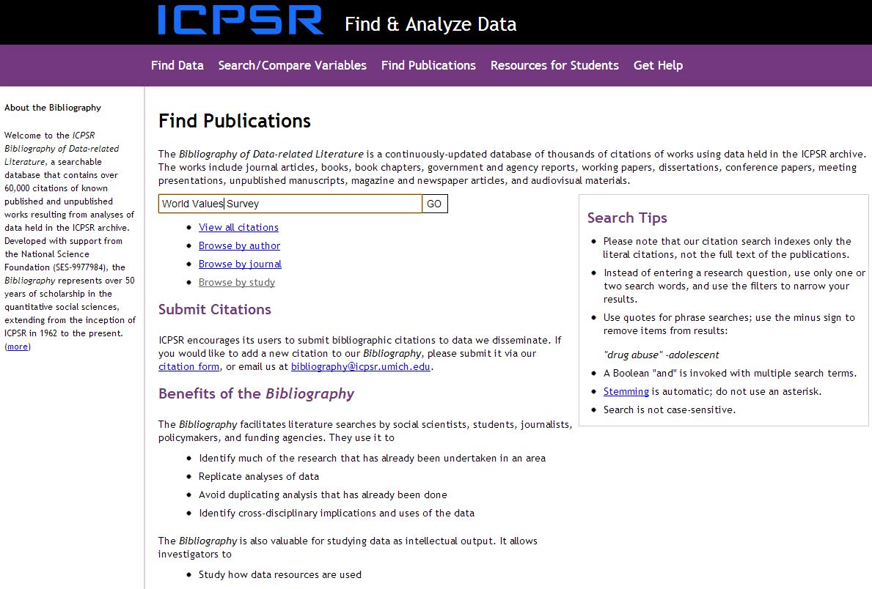
ICPSR
Notes:
You can also find publications using a datasets. This resource is also freely available. In this example, we are searching for publications using the World Values Survey.

Slide 24
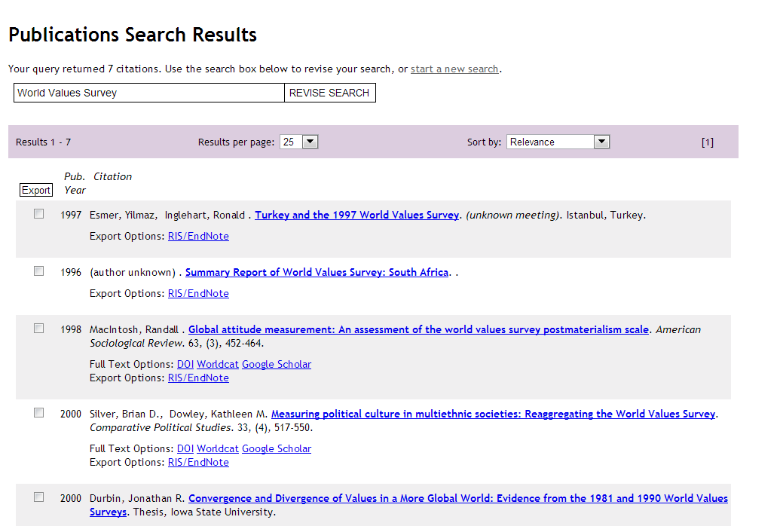
ICPSR
Notes:
Here are the results.

Slide 25
Social Science Research and Instructional Council (SSRIC)
Another way to learn more about the ICPSR is by going to the SSRIC’s web site.
The home page is on the next slide.
Click on “ICPSR” under “Data” in the upper left.
Explore the SSRIC web site while you are there. There is lots of information about other data archives (e.g., Field and Roper) and teaching resources.

Slide 26
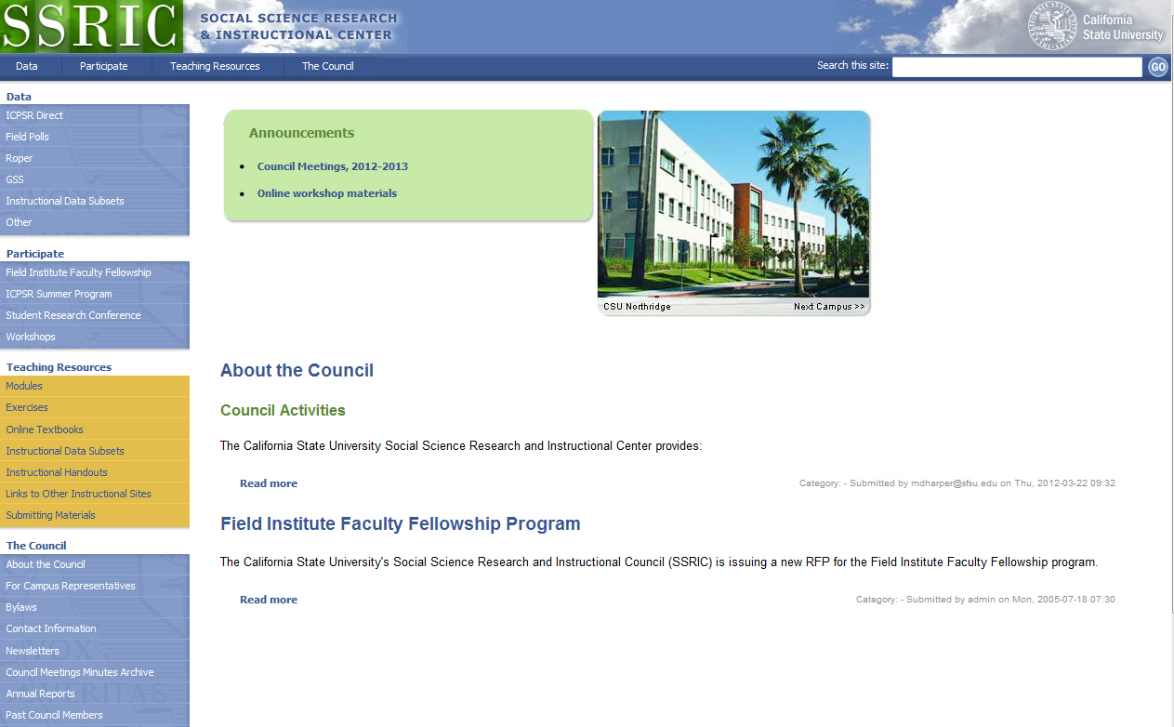
http://ssric.org

Slide 27
SSRIC
Information you can find on the SSRIC web site. Many of the items listed below are available only to faculty and students in the CSU.
  Under “Data” on the left you can get information about ICPSR, Field, Roper, the General Social Survey, and other sources of data.
  Under “Participate” there is information about the Field Faculty Fellow, the ICPSR Summer Program, the SSRIC’s Student Research Conference, and workshops that the SSRIC will come to your campus and offer.

Slide 28
SSRIC
Under “Teaching Resources” there are exercises and data sets that you could use in your classes. There is also an extensive set of links to other sites of methodological and statistical relevance. These resources are typically available to everyone regardless of whether you are part of the CSU or not.
Under “Council” you can look up your SSRIC campus representative on your campus and learn more about the SSRIC Council.

