Slide 1

The Field (California) Poll

Slide 2
What is the Field Poll?
The Field Poll was established in 1947 by Mervin Field.
An independent non-partisan survey of California public opinion covering a wide range of political and social topics.
One of the major statewide public opinion polls in California.
Conducted by Field Research Corporation which is located in San Francisco.
The Field Poll typically conducts approximately three to seven polls annually.

Slide 3
How do we get access to
The Field Poll?
CSU campuses subscribe yearly to the social science databases which include:
  The Field Poll
  The Roper Center for Public Opinion Research
  The Inter-university Consortium for Political and Social Research
Campuses that subscribe have free access to all these databases for their students, faculty and staff.

Slide 4
Browsers
We will be using Firefox as our browser for this PowerPoint.
If you are using Internet Explorer or Google Chrome, you will need to set your browser to use passive FTP. The default setting in Firefox is to use passive FTP.
To get the instructions for setting Internet Explorer to use passive FTP, click on this link:
http://ssric.org/data/field_polls

Slide 5
Where are the data stored?
The CSU has an arrangement with UCDATA at Berkeley to provide CSU campuses that subscribe to the social science databases access to The Field Polls.
Access to The Field Polls is IP authenticated. This means that in order to access The Field Polls, you will need to do so from your CSU campus.

Slide 6
UCDATA Website
The UCDATA website allows you to:
  Search The Field Polls from 1956 to 2006. Soon UCDATA will have search capabilities beyond 2006.
  Download The Field Poll data to your computer so you can analyze the data. Field Polls can be downloaded as SPSS files or as raw data files.
  Analyze The Field Poll data online using a statistical package called Survey Documentation and Analysis (SDA).
To go to the UCDATA site, click on the following link: http://ucdata.berkeley.edu/data_record.php?recid=3

Slide 7
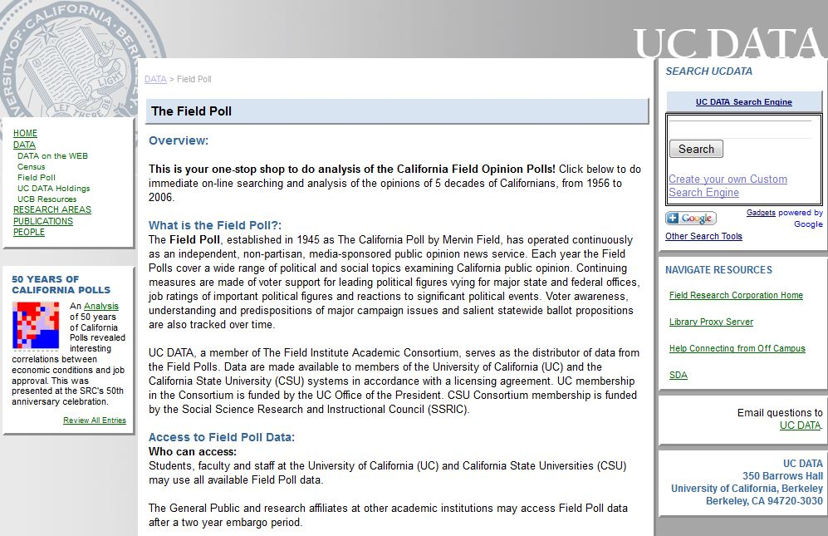
UCDATA Website

Slide 8
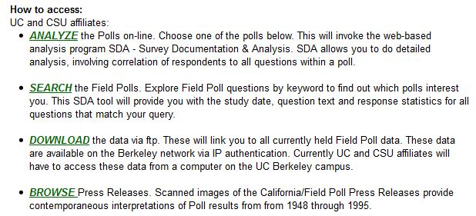
UCDATA Website
Click here to search.

Slide 9
Searching the Field Polls on the UCDATA Website
The first thing you have to decide is whether to search the variable-level information or the study-level information.
If you’re not sure which to search, click on the “Help on choosing” link.
We’ll use the default which is variable-level searching. This will search the variable names, variable labels, question text and category labels.
When you click on “Search” you will go to the page on the next slide.

Slide 10
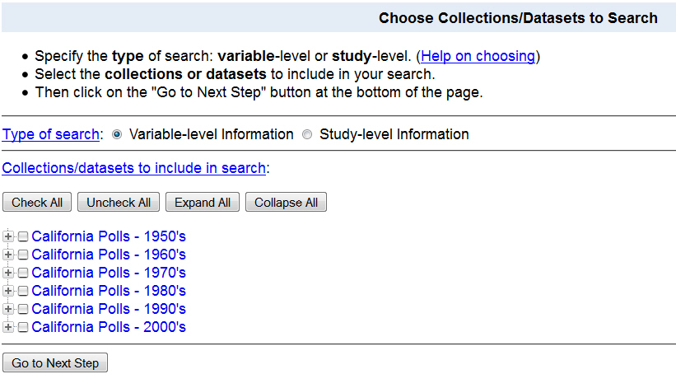
Search Page
Click here to expand all years.

Slide 11
Search Page
You can select which years you want to search by clicking on the appropriate box.
Let’s click on “Expand All” which will show you all the polls for all years.
The next slide shows the seven polls for 2006.

Slide 12
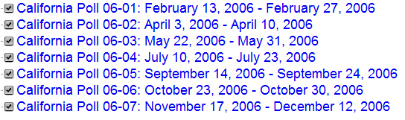
Searching the 2006 Field Polls
Select the 2006 polls by checking the seven boxes for 2006.

Slide 13
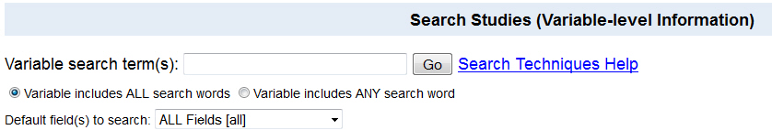
Searching the 2006 Field Polls
Click on “Go to Next Step” and you’ll see the following.
Enter your search term(s) in the box. Let’s enter “abortion” in the box to find all questions with the word “abortion” anywhere in the question.

Slide 14
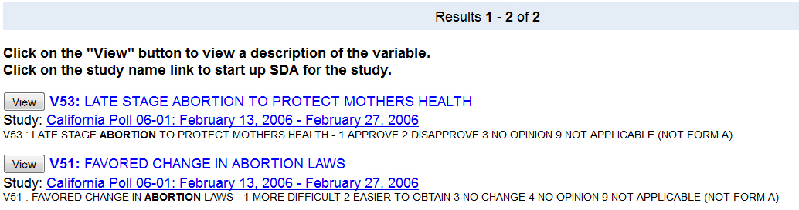
Search for the word “abortion” anywhere in the question
The search found two questions that included the word “abortion” anywhere in the question.

Slide 15
Viewing the Questions
Both of these questions are in the first survey conducted in 2006. This is referred to as “Poll 06-01.
Click on the “View” button to see the frequency distribution for that variable. Let’s look at “V51” which is the variable name.

Slide 16
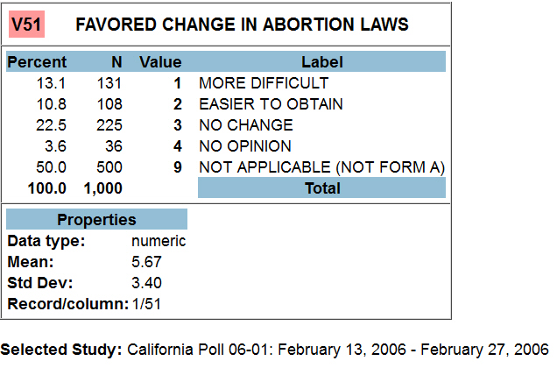
Favor Change in Abortion Laws
Field Poll 06-01

Slide 17
Favor Change in Abortion Laws
Field Poll 06-01
Notice that this question had two forms – Form A and Form B.
This question is Form A. So all those respondents who received Form B are coded as “Not Applicable (not Form A).”
Let’s say that we want to download the data from this Field Poll so we can analyze the data further.

Slide 18
Downloading Data
We know we want to download Field Poll 06-01.
We have to go back to the download page on the UCDATA website.
On your browser (in Firefox) you should see a tab that says “UC DATA:DATA:Field Poll.” Click on that tab which will take you back to a page we looked at earlier. If you have trouble finding it, just click on the following link: http://ucdata.berkeley.edu/data_record.php?recid=3

Slide 19
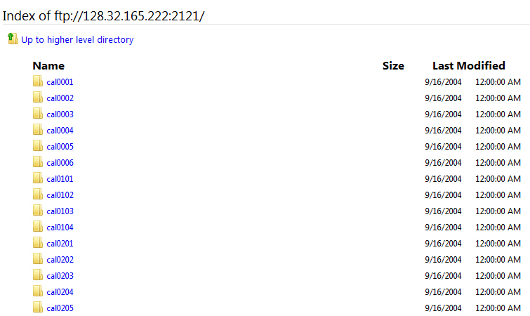
Downloading Data
You should see the following:

Slide 20
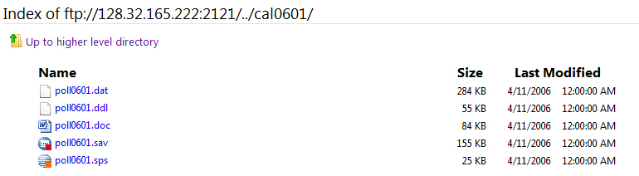
Downloading Data
You want to scroll down until you see Field Poll 06-01.
Click on the folder icon to open it.

Slide 21
Files to Download
You’ll see a list of files you can download.
The files that you will want to download are:
  poll0601.doc which is a Word file that contains the codebook.
  poll0601.sav which is the SPSS file that contains the data.
In Firefox you can right click on each of these files and save them to your download folder.

Slide 22
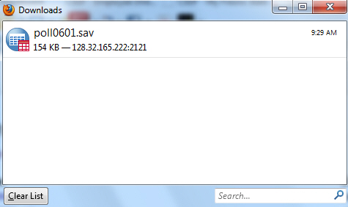
Downloading
When you download the file in Firefox, this is what you will see.

Slide 23
Downloading
The file will now be in the download folder on your hard drive.
Go to your download folder and make sure that the file is there.
You can move it to whatever folder you want to put it in by clicking on it and dragging it to the appropriate folder.

Slide 24
Analyzing your Data
Now that you have downloaded Field Poll 06-01 you can open SPSS and analyze your data.
Another option is to analyze the data online using Survey Documentation and Analysis (SDA).
SDA is an online statistical package written at UC Berkeley. You can use SDA on any computer where you have internet access and you don’t need a site license. It’s free.

Slide 25
Analyzing your Data Using SDA
Let’s do some simple statistical analysis of Field Poll 06-01 using the UCDATA website.
Go back to the UCDATA home page by clicking on this link -- http://ucdata.berkeley.edu/data_record.php?recid=3
When conducting your analysis, it is important to always apply sample weights when running your tabulations. The survey data will not be representative if the sample weights are not applied.
Scroll down the page and you will see what is on the next slide.

Slide 26
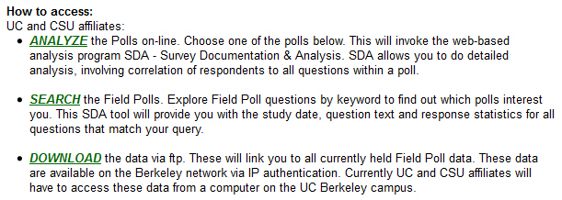
Using SDA to Analyze your Data
Click on “Analyze” to open SDA.
Click here to analyze data using SDA.

Slide 27
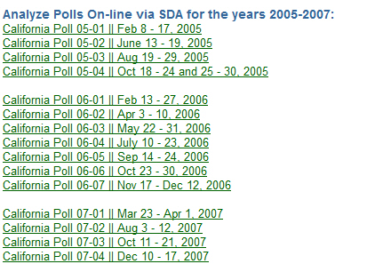
Using SDA to Analyze your Data
Scroll down the page until you find Field Poll 06-01 and click on it.
This should open SDA and you’ll see what’s on the next slide.

Slide 28
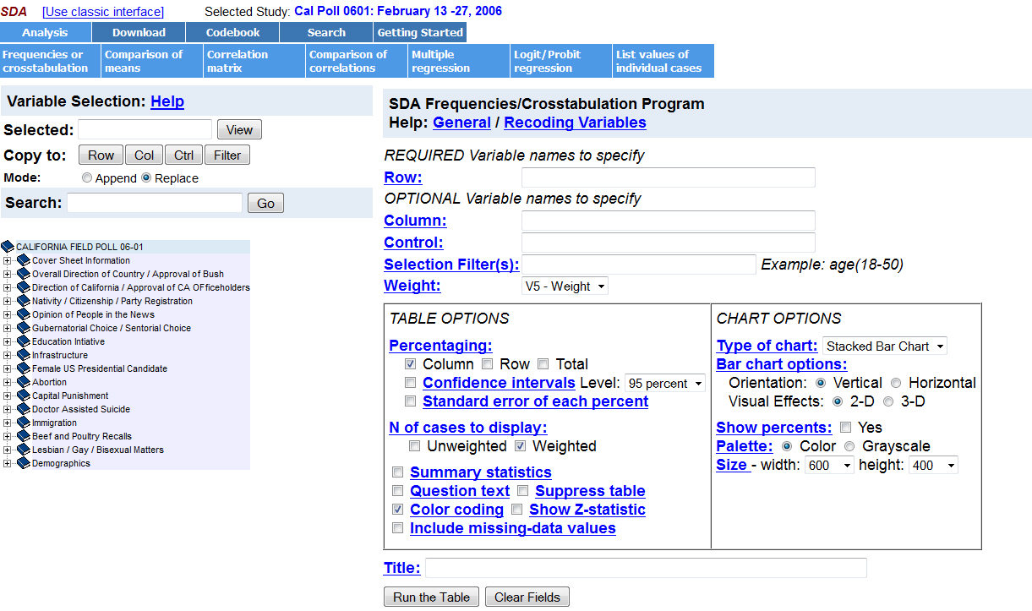
Using SDA to Analyze your Data

Slide 29

Using SDA to Analyze your Data
In the left-hand margin you will see a list of variable categories. One of these categories is “Abortion.” Click on the + sign and it will expand the list and show the variables. One of those variables is V51.
Enter the variable name, V51, in the “Row” box.

Slide 30
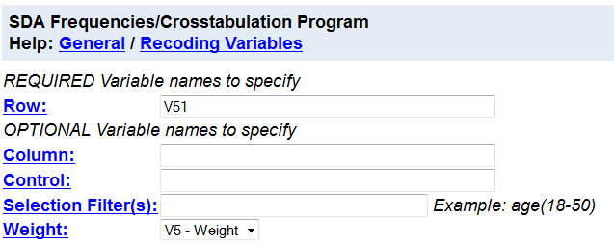
Using SDA to Analyze your Data
This is what you will see.
Click on “Run the table” at the bottom of the screen.

Slide 31
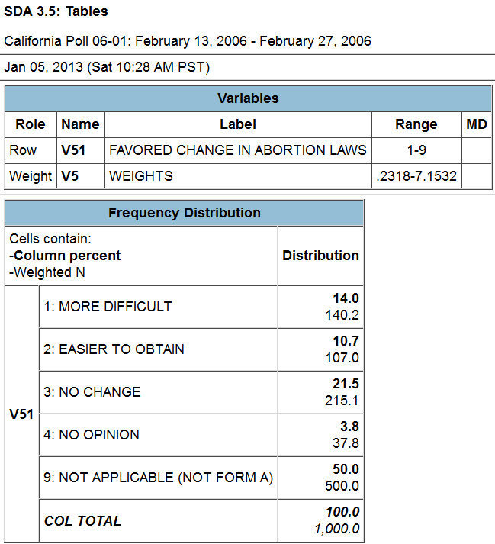
Using SDA to Analyze your Data
You’ll see the frequency distribution for V51.
Always make sure that a weight has been selected. The survey data will not be representative if the sample weights are not applied.
Weights has been applied.

Slide 32
Using SDA to Analyze your Data
Now let’s run a crosstabulation of V51 by sex which will show us how men and women responded to V51.
Go back to the SDA page that shows the variables in the left-hand margin. You will see “Demographics.” Click on the + sign and it will expand the list so you will see all the demographic variables in the poll.

Slide 33
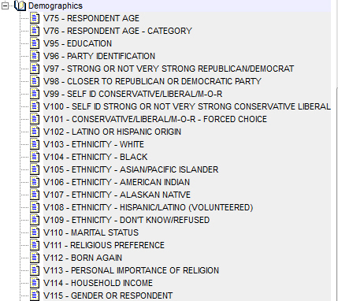
Using SDA to Analyze your Data
This is what you will see. Note that sex is V115.

Slide 34
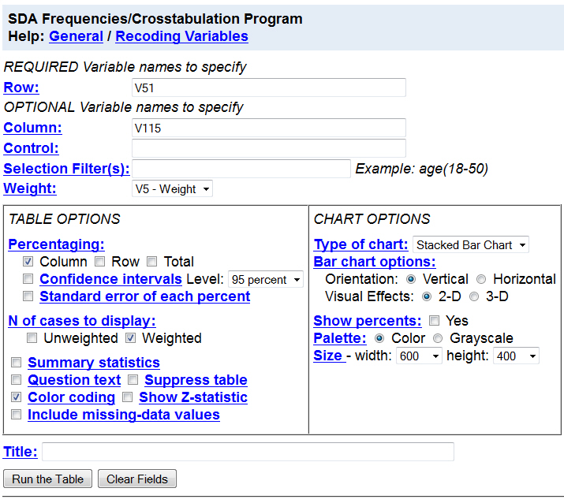
Using SDA to Analyze your Data
Enter V115 into the “Column” box. Click on “Run the Table” and you will see what is on the next slide.

Slide 35
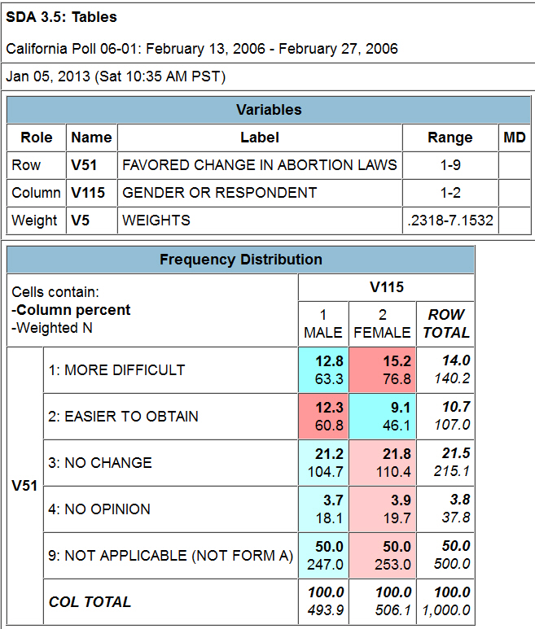
Using SDA to Analyze your Data

Slide 36
UCDATA Website
In this PowerPoint we have demonstrated how to use the UCDATA website to do the following:
  Search The Field Polls from 1956 to 2006. Soon UCDATA will have search capabilities beyond 2006.
  Download The Field Poll data to your computer so you can analyze the data. Field Polls can be downloaded as SPSS files or as raw data files.
  Analyze The Field Poll data online using a statistical package called Survey Documentation and Analysis (SDA).

Slide 37
Field Research Corporation
To learn more about The Field Poll and Field Research Corporation, go to their website at http://www.field.com/ .
Their home page is on the next slide.
At the bottom of the page, there is a link to the “Field Poll archives.” Click on the link and you will see the archive of past Field poll reports.

Slide 38
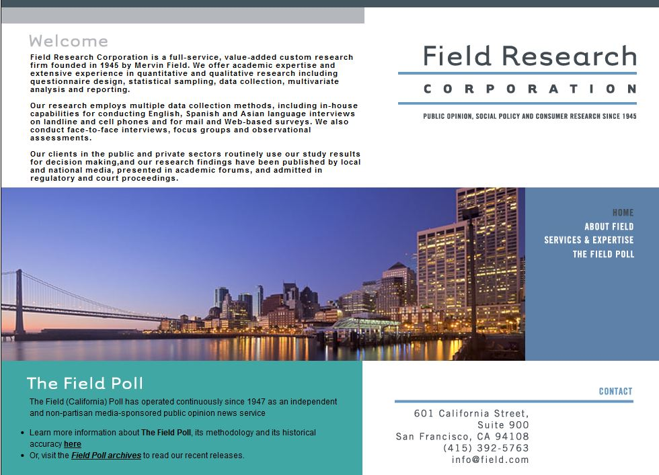
More About The Field Poll
Click here to learn more about the poll methodology.
Click here to look at the Field archives.

Slide 39
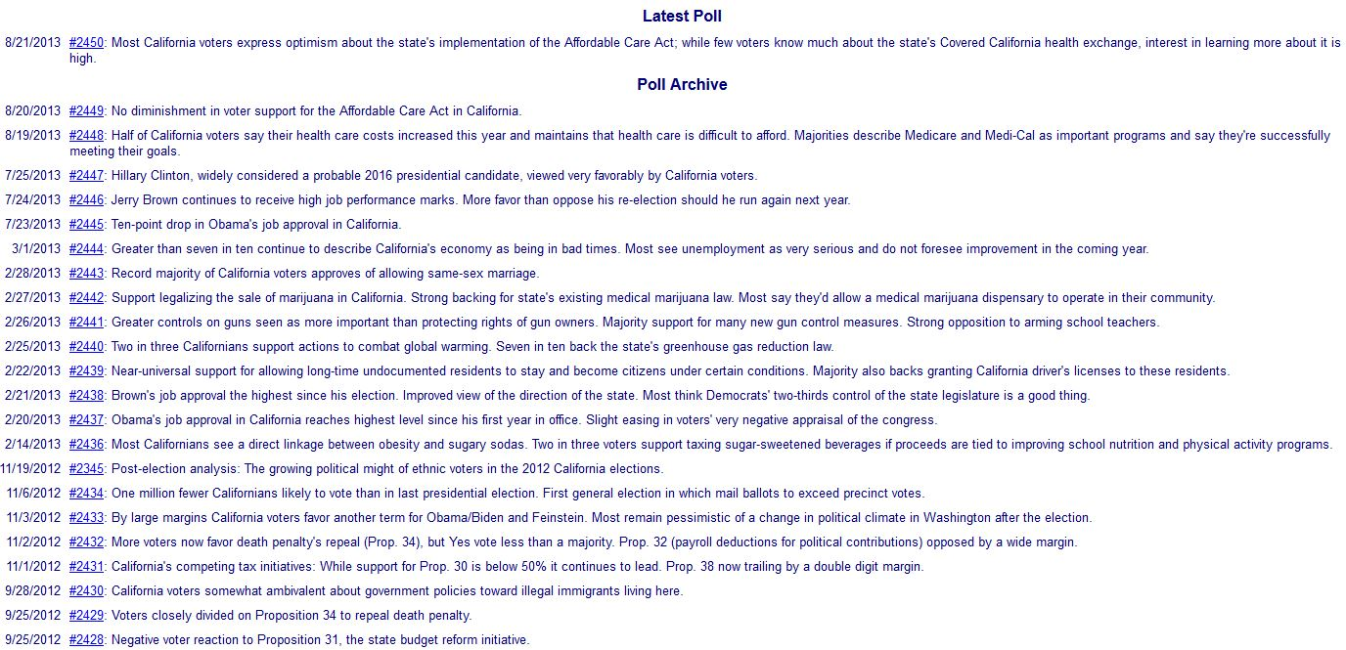
Field Poll Archives
Click on any of the reports to read it.

Slide 40
Field Poll Methodology
It’s important to keep in mind that The Field Institute changed its sampling design in 2006.
Surveys conducted prior to 1979 were conducted among a random sample of California adults using a door-to-door cluster sampling design.
Between 1979 and 2005, all Field Poll surveys were conducted by telephone among a random sample of California adults using a random digit dial sampling methodology,
Surveys conducted since 2006 have been conducted using a random sample of California voters by telephone using a registration-based sampling methodology.
For a more detailed description of the survey methods used by the The Field Poll, go to The Field Poll’s home page and click on the link toward the bottom of the page.
You’ll see what is on the next slide.

Slide 41
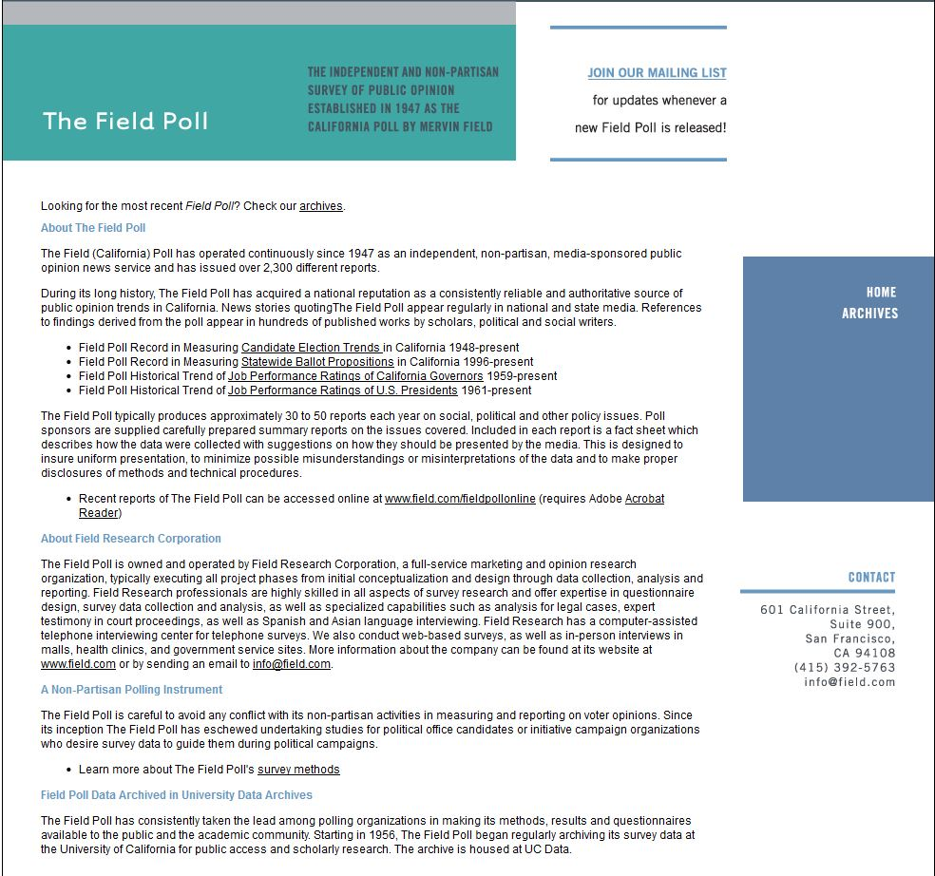
Field Poll Methodology

Slide 42
Social Science Research and Instructional Council (SSRIC)
Another way to learn more about the Field Polls is by going to the SSRIC’s web site.
The home page is on the next slide.
Click on “Field” under “Data” in the upper left.
Explore the SSRIC web site while you are there. There is lots of information about other data archives (e.g., Roper Center and ICPSR) and teaching resources.

Slide 43
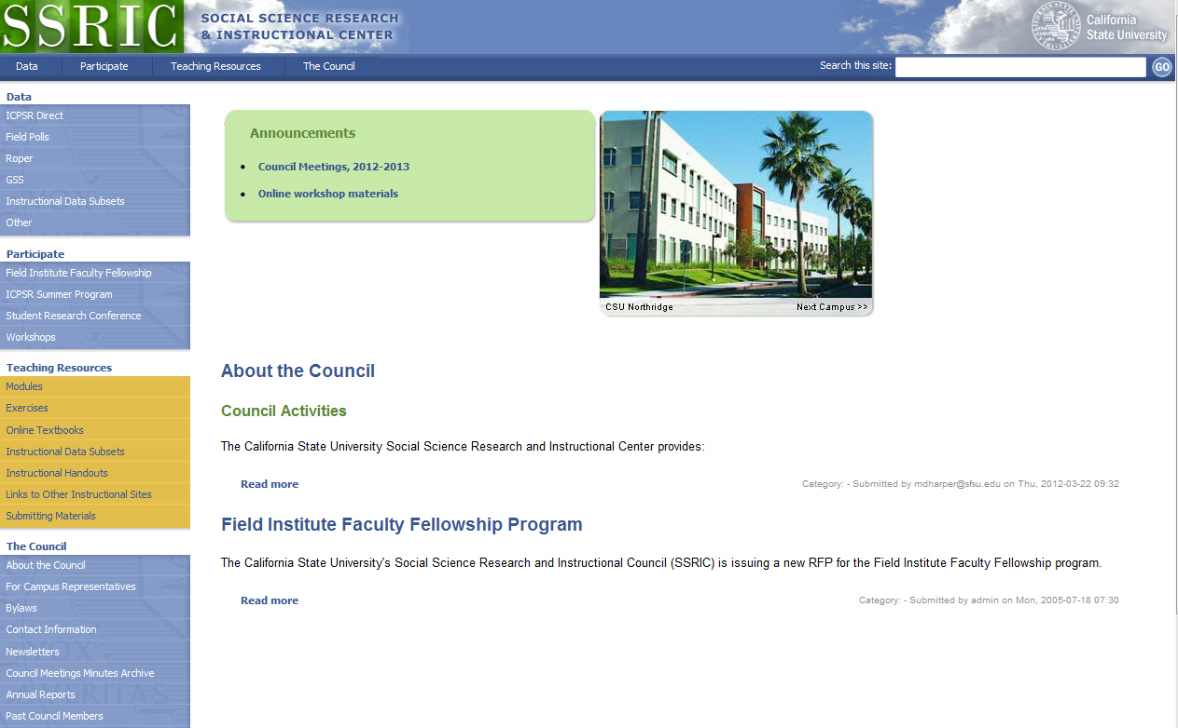
http://ssric.org

Slide 44
SSRIC
Here are some of the resources you will find on the SSRIC web site. Some of these resources are available only to faculty and students in the CSU.
  Under “Data” on the left you can get information about ICPSR, Field, Roper, the General Social Survey, and instructional data sets.
  Under “Participate” there is information about the Field Faculty Fellow, the ICPSR Summer Program, the SSRIC’s Student Research Conference, and workshops that the SSRIC will come to your campus and offer.

Slide 45
SSRIC
Under “Teaching Resources” there are exercises and data sets that you can use in your classes. There is also an extensive set of links to other sites of methodological and statistical relevance. These resources are typically available to everyone regardless of whether you are part of the CSU or not.
Under “Council” you can look up your SSRIC campus representative on your campus and learn more about the SSRIC Council.

