Slide 1
Today’s Agenda
Introductions to and of participants (Ed and John) (10)
Introduction to the SSRIC (John) (15)
Roper (Ed) (30)
ICPSR (John) (30)
Field (Ed) (10)
Break (15)
Public Policy Institute of California Data Depot (John) (10)
The Pew Research Center (Ed) (5)
MERLOT (Ed) (15)
SSRIC teaching resources
  Overview; statistics and research methods exercises (Ed) (20)
  Longitudinal exercises (John) (20)
Notes:
Pass out sign up list.

Slide 2
The Only URLs You’ll Need
SSRIC Home Page
List of URLs Referenced
Notes:
Please open up the list of URLs.

Slide 3

Introduction to the Social Science Research and Instructional Council (SSRIC)
  Oldest CSU affinity group (since 1972)
  Representatives from CSU campuses meet three times per year
  Negotiates with data providers for access to data
  Promotes use of data analysis in research and teaching

Slide 4
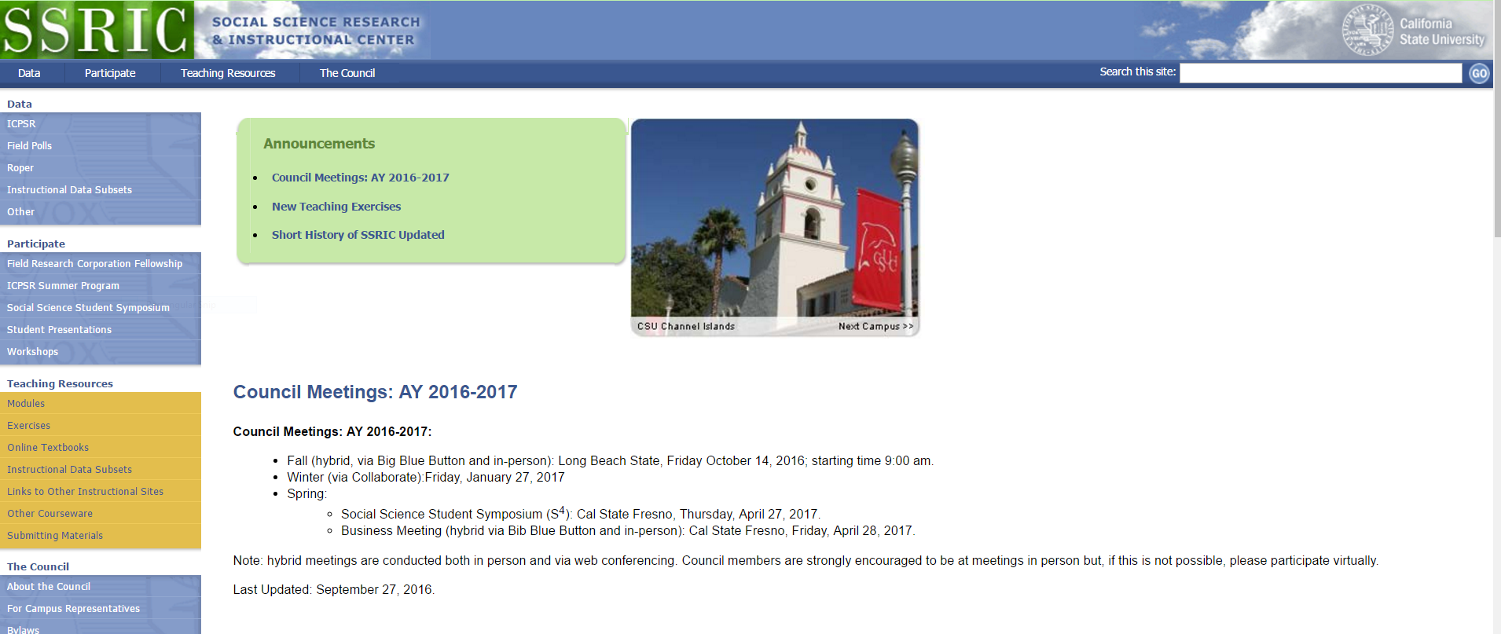
The Center
Notes:
SSRIC also stands for The Social Science Research and Instructional Center, a website housed at San Francisco State University. The remainder of this segment will consist of a brief tour of the site.

Slide 5
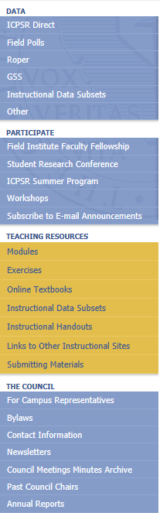
Navigation
Menu Bar:
Sidebar:
Notes:
Let’s start with basic navigation. The menu bar near the top of each page on the site shows the major sections of the Center’s offerings. Moving your cursor over a menu item opens up submenus similar to those shown on the sidebar. The sidebar appears only on the home page, and will likely disappear when the site is redesigned some time in 2017. We’ll discuss each section in turn.

Slide 6
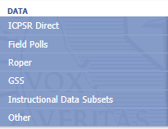
Data
Notes:
The CSU subscribes to two social science data bases (used to be 3). Instructions for downloading data from these resources are provided on the SSRIC site. The Council also offers workshops on the databases and on accessing them. The ICPSR (Inter-university Consortium for Political and Social Research), includes over 700 member institutions from throughout the world, and contains the world’s largest social science data archive. The Field Polls (now discontinued)are surveys of registered California voters and are conducted at least four times a year. The Roper Center houses a vast number of polls from throughout the world. The Council has also created a number of instructional subsets, most of them freely available to any user (not just those affiliated with the CSU). We also provide a limited number of links to other (again, mostly freely available) data sources.

Slide 7
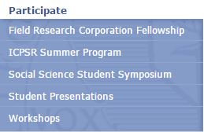
Participate
Notes:
The Council administers or coordinates several programs to serve students, faculty, and staff. These include the Social Science Student Symposium (S4), held annually since 1976; the ICPSR Summer Program, offering advanced training in quantitative methods; and a variety of workshops. Current workshop topics include the Social Science Data Bases, introductory and intermediate sessions on SPSS, SDA (Survey Documentation and Analysis (a server-side statistical analysis package), and Data in the Classroom. You can also sign up to be on our email list.

Slide 8
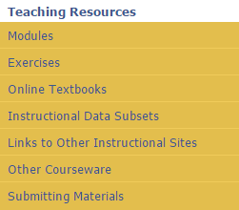
Teaching Resources
ED WILL
DISCUSS LATER
Notes:
Two animations.

Slide 9
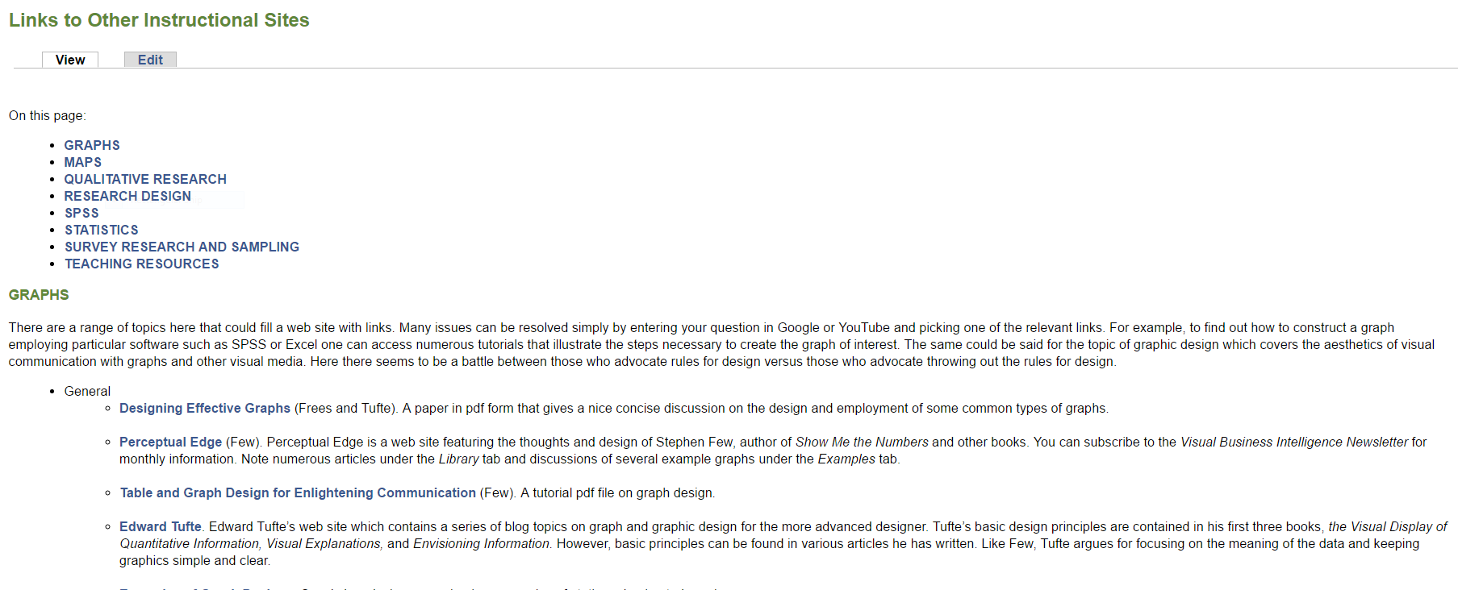
Links to Other Instructional Sites

Slide 10
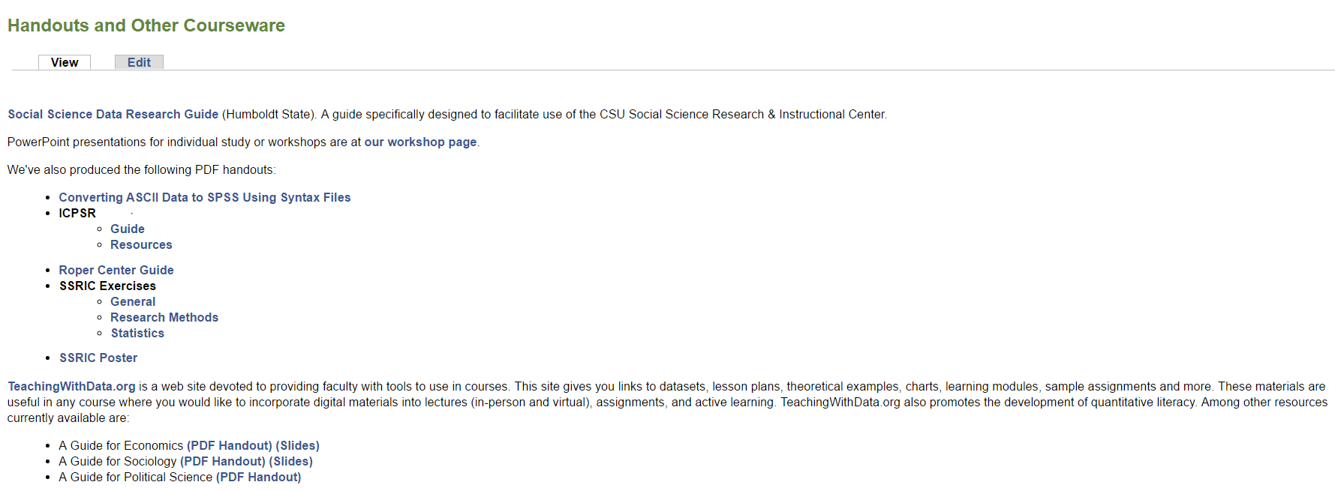
Other Courseware (Handouts)

Slide 11
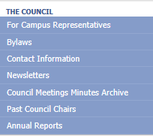
The Council
Notes:
Finally, the site provides information about the Council itself. Probably most relevant to most users are the list of campus contacts and the Center’s newsletters, published each year in the fall and winter..

Slide 12
Roper Center for Public Opinion Research
Social Science Research and Instructional Council
March 3, 2017

Slide 13
What is the Roper Center?
Archive of public opinion data produced by commercial and media centers.
Contains over 22,000 data sets from over 100 countries many of which can be downloaded with RoperExpress.
iPOLL is a collection of over 650,000 survey questions which can be searched.
RoperExplorer is a data analysis tool that produces frequency distributions and crosstabulations.

Slide 14
How do we get access to the Roper Center for Public Opinion Research?
CSU campuses subscribe yearly to the social science databases which include:
  The Roper Center for Public Opinion Research
  The Inter-university Consortium for Political and Social Research
Campuses that subscribe have free access to all these databases for their students, faculty and staff.

Slide 15
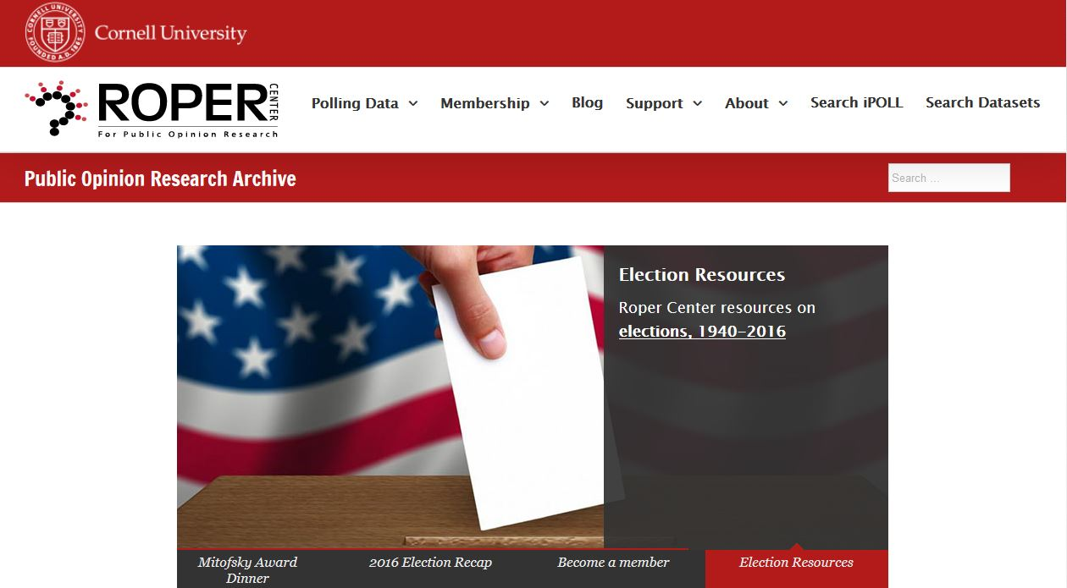
The Roper Center Website

Slide 16
Getting an Account
The first thing you need to do is to create your own personal account at the Roper Center.
These accounts are free.
To create your own account, you’ll need be on a computer on a CSU campus that has subscribed to the social science data bases.
Click on “Search iPOLL” in the upper right of the Roper home page.

Slide 17
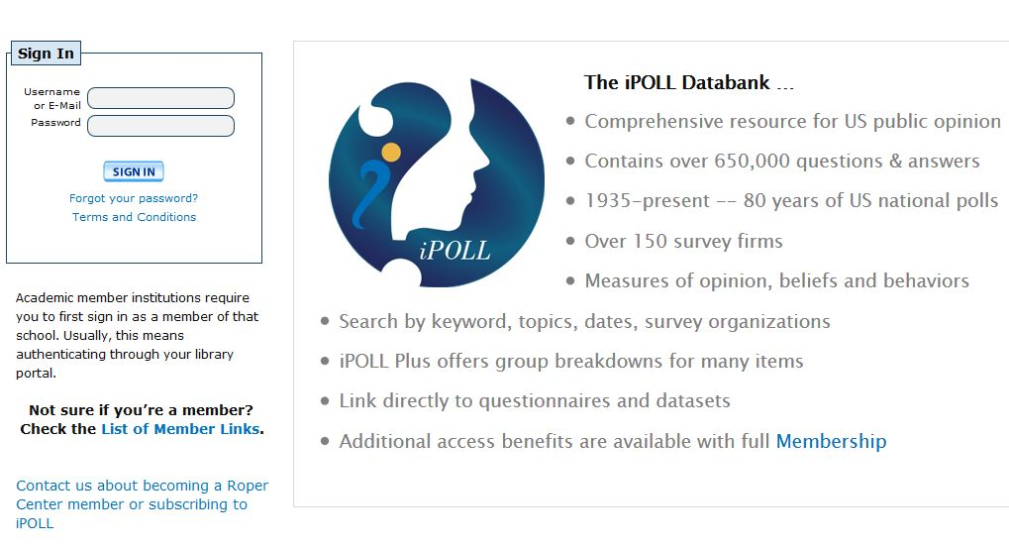
Signing Into your Account
If you have an account already, click on “Sign In” in the upper left of the screen.
If you don’t have an account, click on “Register” in the upper right.

Slide 18
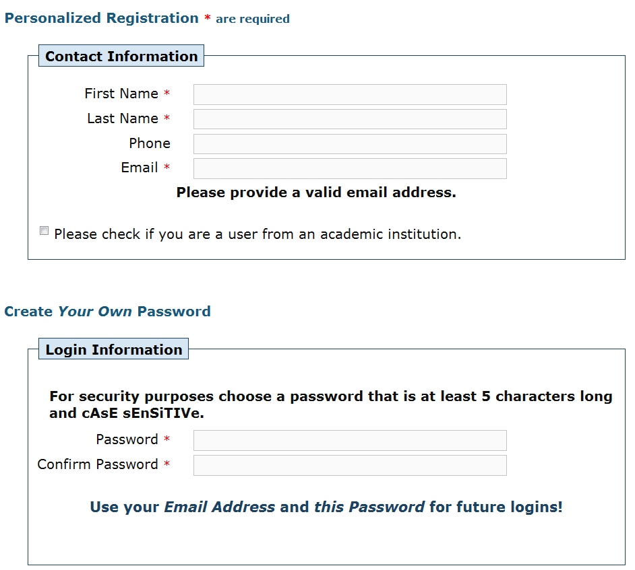
Creating your Own Account
Fill in the form to create your account.
Click “Submit” and your account will be created.

Slide 19
Logging onto your Account
From now on, when you want to use the Roper Center, use your email address as your user name and the password you just created.
Now that you have your account, you can access the Roper Center from off campus.

Slide 20
iPOLL
The first thing you will see is the iPOLL search page which is on the next slide.
iPOLL is a searchable database of over 650,000 survey questions.
iPOLL allows you to search by keywords you think would be used in the questions.
It’s important to keep in mind that Roper does not have the data set for every one of these questions.

Slide 21
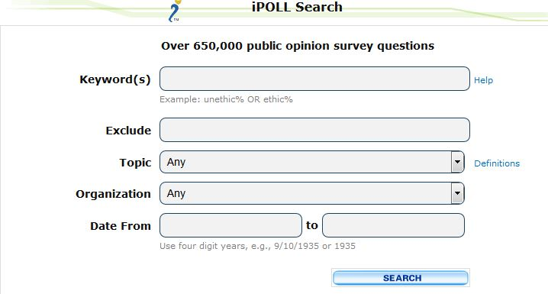
iPOLL Search Page

Slide 22
Doing an iPOLL Search
Enter your search words in the “Keyword(s)” box. We’re going to start by searching for “religion”.
You can exclude questions that contain specific words in the “Exclude” box. We’re going to leave this blank.
You can select certain topics and survey organizations. Click on the drop down arrow to see what these are.
You can specify a date range. We’re going to search for 2000 to 2017.
Click on “SEARCH.”

Slide 23
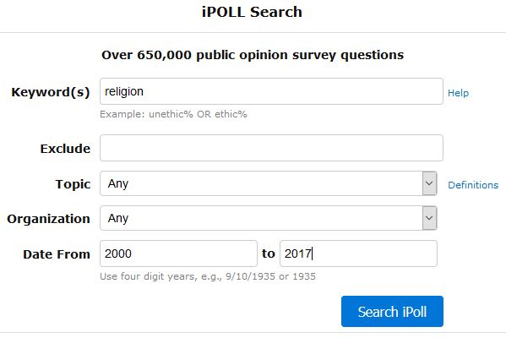
Example of an iPOLL Search

Slide 24
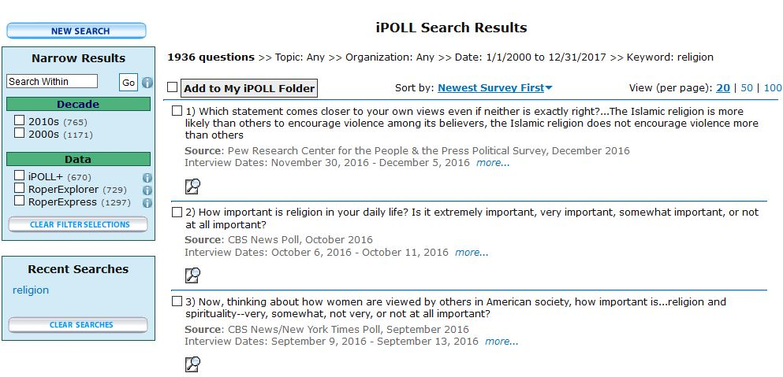
Example of iPOLL Search Results
(your results may differ)

Slide 25
What’s in the Search Results?
The search results show you the survey question, source and interview dates.
The results are sorted by the newest survey first. You can click on “Newest Survey First” to change this to sorting by oldest search first.

Slide 26
Viewing the Question Details
In the lower-left of each question you will see an icon that looks like a magnifying glass.
Click on this icon for one of the questions listed.
The question details will show you how respondents answered this question.

Slide 27
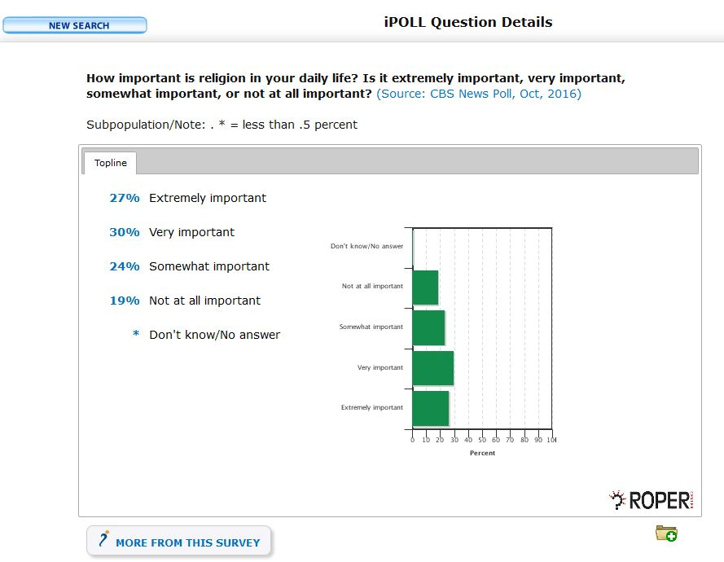
Question Details

Slide 28
RoperExpress and RoperExplorer
Below some of the questions, you will see the RoperExpress and RoperExplorer icons.
The RoperExpress icon looks like a slanted X.
The RoperExplorer icon looks like a four-pointed star.
Sometimes the icons will be combined and will look like a slanted X with the star to its right.
Depending on your search results you may have to look through several pages of results to find a question with these icons

Slide 29
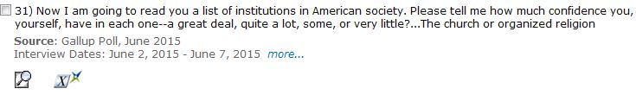
Example of a Question that has both the RoperExpress and RoperExplorer Icons

Slide 30
Using RoperExpress and RoperExplorer
RoperExpress is used to download data and RoperExplorer is used to get frequency distributions and crosstabulations.
Click on the RoperExpress and RoperExplorer icon.

Slide 31
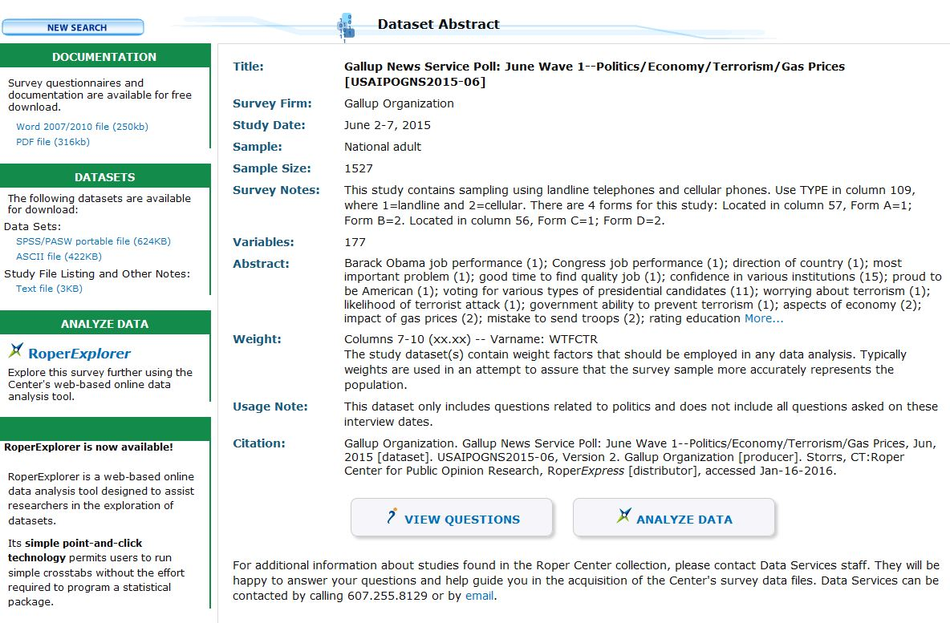
Click on the RoperExpress and RoperExplorer Icons

Slide 32
Searching Within a Search
You recall that our original search for “religion” gave us a lot of questions. Let’s narrow it down.
Let’s go back and look at the search again. The easiest way to do this is to click on new search and repeat the search by entering “religion” into the keywords box and the dates 2000 to 2017 into the date box.
At the left of the search results you will see “Narrow Results.” Under “Narrow Results: you’ll see a Search Box that says “Search Within.”

Slide 33
Searching Within a Search Continued
In the “Search Within” box, enter “attend”.
This will search all the questions for the word “attend”.
Click on “Go”.

Slide 34
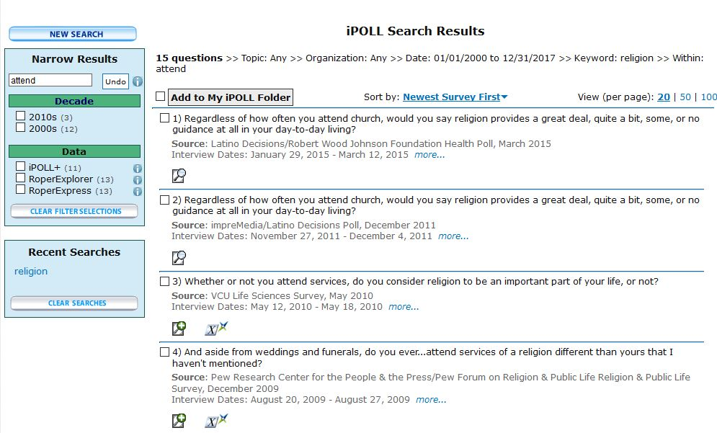
Searching Within a Search
(your results may differ)

Slide 35
Searching Within a Search Results Continued
Now we have limited our search to a smaller number of questions that contain the word “attend” in the question.
We can also narrow the search by decade and limit the search to questions that have downloadable data sets through RoperExpress and questions where the data can be analyzed with RoperExplorer.
We can also go back to our original search and try limiting it in other ways. Try entering the word “important” and then do it again entering the word “pray” in the search box and see what you get. Remember to go back to the original search where you searched for “religion.”

Slide 36
Downloading Data Using RoperExpress
Now let’s talk about downloading Roper Center data.
About 60% of the data sets in the Roper Archive can be downloaded by using RoperExpress.
Let’s download a data set.
Click on “Datasets” in the upper right of your screen.

Slide 37
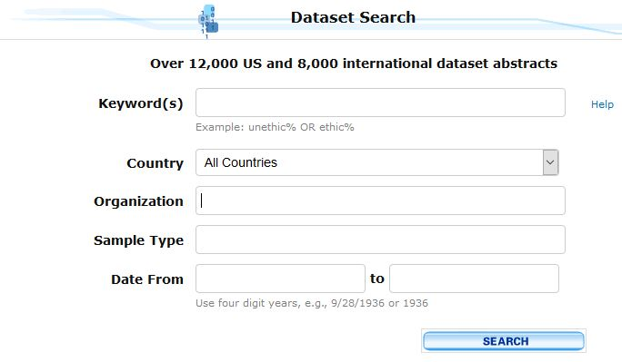
Search for Datasets

Slide 38
Search for Datasets Instructions
The “Search for Datasets” dialog box looks very similar to the iPOLL box.
“Search for Datasets” searches the abstracts of the studies, unlike iPOLL that searches the questions.
Enter “religion” in the “Keyword(s)” box and use 2000 to 2017 for the date range.
The countries box allows you to search for surveys from a particular country. We’ll use the default which is “All Countries.”
Leave the other boxes blank and click on the “Search” button.

Slide 39
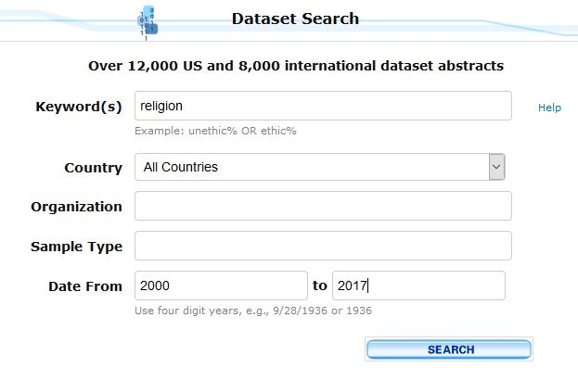
Example of Searching for Datasets

Slide 40
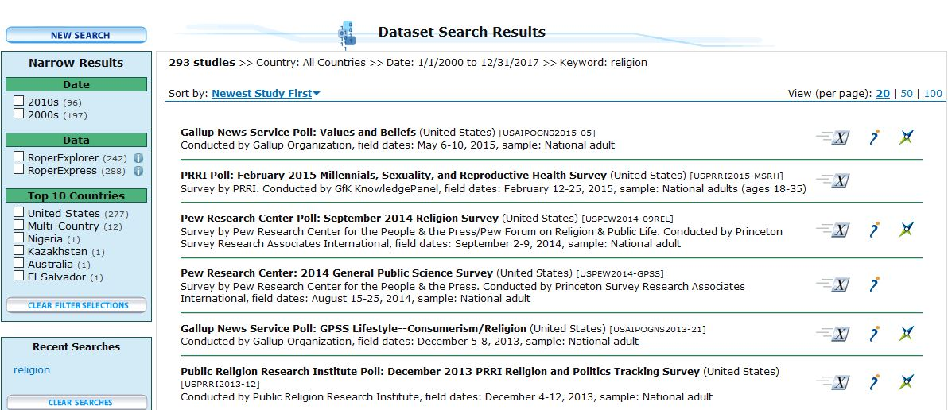
Search for Datasets Results
(your results may differ)

Slide 41
Search Results
One of the surveys listed is the Pew Research Center’s Poll on religion conducted in September, 2014. Your first result may differ.
The RoperExpress icon (looks like a slanted X) indicates that this dataset can be downloaded directly to your computer with RoperExpress.

Slide 42
Search Results Continued
The iPOLL icon indicates that you can view the questions in iPOLL.
The RoperExplorer icon indicates that you can analyze the survey results with RoperExplorer.
Note that you can narrow your results by date, country and by limiting your search to studies that can be downloaded by RoperExpress and analyzed by RoperExplorer.
Let’s download the dataset.

Slide 43
Downloading the Dataset
Click on the RoperExpress icon for the Pew Research Center’s Poll on religion conducted in September, 2014.
If there isn’t a RoperExpress icon, that means that the dataset isn’t available through RoperExpress. Copy and paste the information about the dataset into an email to the Roper Center at data-services@ropercenter.org. You can also call them at 607-255-8129. They will process the data and let you know when it is available through RoperExpress.

Slide 44
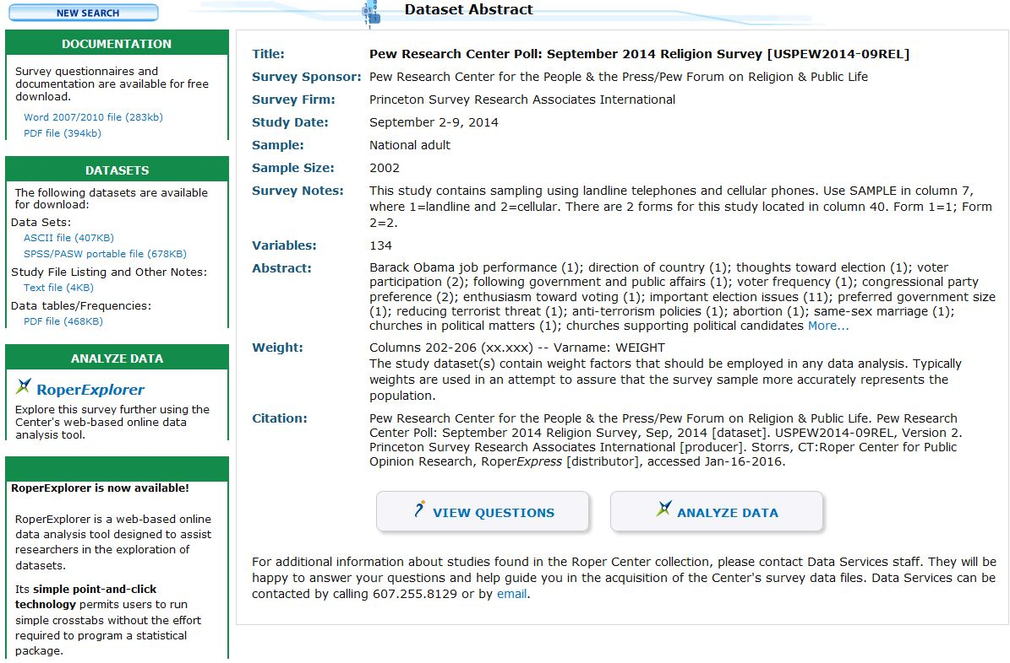
Dataset Abstract

Slide 45
Downloading the Dataset
In the dataset abstract you will see information about this dataset.
On the left you will see information about the documentation for this data set including the questionnaire. For this dataset you can download the documentation as a Word or PDF file.
You will also see information about downloading the dataset itself.

Slide 46
Downloading the Dataset Continued
You will need a Roper Center account to download data.
See the beginning of this PowerPoint for a description of how to get your own account.
This dataset can be downloaded as either an ASCII file or a SPSS portable file.
Let’s download the SPSS file by pointing to “SPSS/PASW portable file” and clicking on it.

Slide 47
More on Downloading the Dataset
We want to save the file so select “Save File” and click “OK”.
The file will now be downloaded to wherever downloaded files are stored on your computer.
Go to your download folder and you should see a file with a .por extension. For this dataset it’s called “p201409rel.por”.
You will need to have SPSS on your computer to open the file. Remember that it is a portable (.por) file.

Slide 48
Using RoperExplorer
RoperExplorer can be used to analyze the data contained in the dataset.
It will give you frequency distributions and crosstabulations.
To do more statistical analysis you should use a statistical package like SPSS.

Slide 49
Learning More about Roper
There are a number of resources for learning more about Roper on their website.
On the Roper home page point your mouse at “Support” and then click on “Roper Center Tools.” You’ll find a number of resources that will help you use the Roper website.
Go to the SSRIC website and click on “Roper” under “Data”

Slide 50
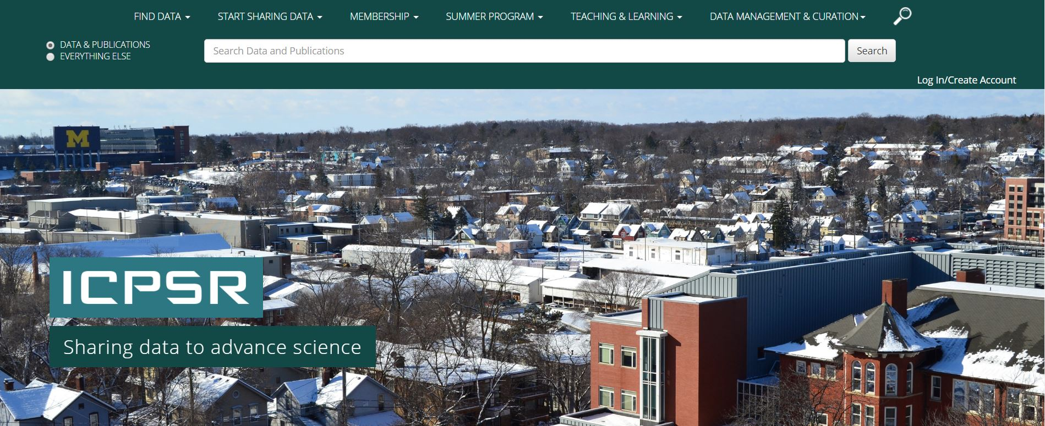
Inter-university Consortium for Political and Social Research

Slide 51
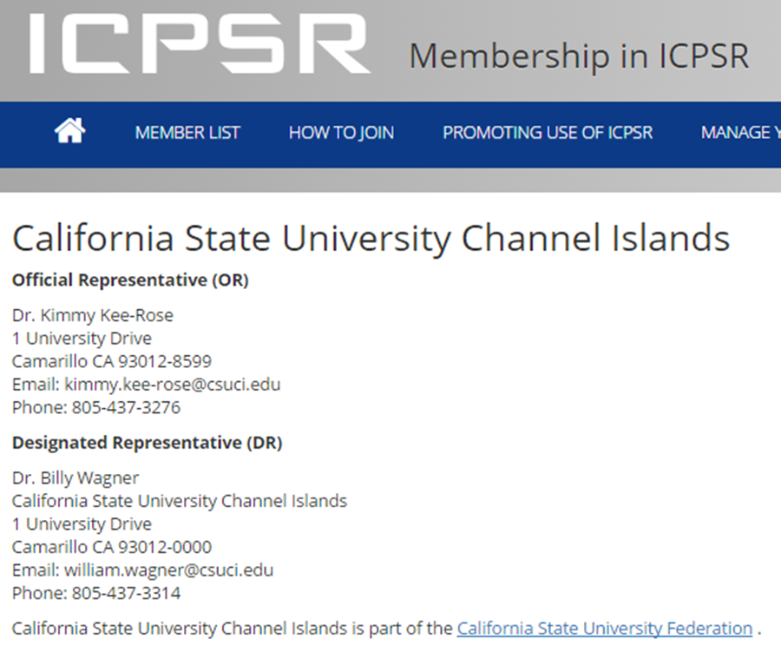
What is the ICPSR?
Primary social science data archive for the U.S.
Founded in 1962; CSU joined in 1972
  765 member institutions worldwide
Notes:
1 animation.

Slide 52
Services
Vast data archive accessible via the web
Summer program
Instructional resources

Slide 53
Using ICPSR Data
Log on/Create an Account
Locate the study
Select the data for download
Download the data
Save the data for analysis

Slide 54
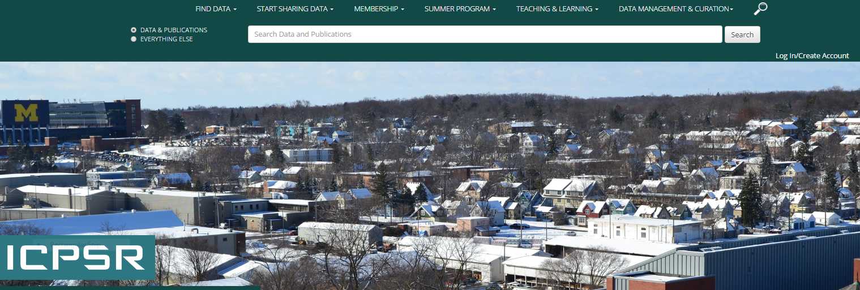
Creating An Account – Step 1
Notes:
One animation. Click on "Log In/Create Account" in lower right-hand corner of menu at top of screen.

Slide 55
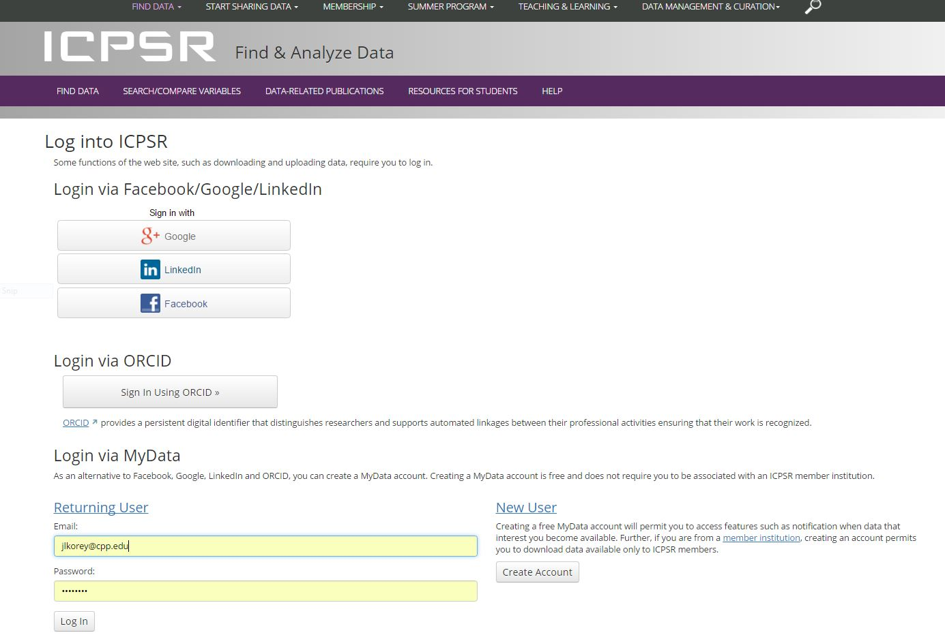
Creating an Account – Step 2
Notes:
2 animations. Create a New User account. Must be done on-campus, then good for 6 months. Whenever you log on from on-campus, you’ll reset the clock for a new 6 months.

Slide 56
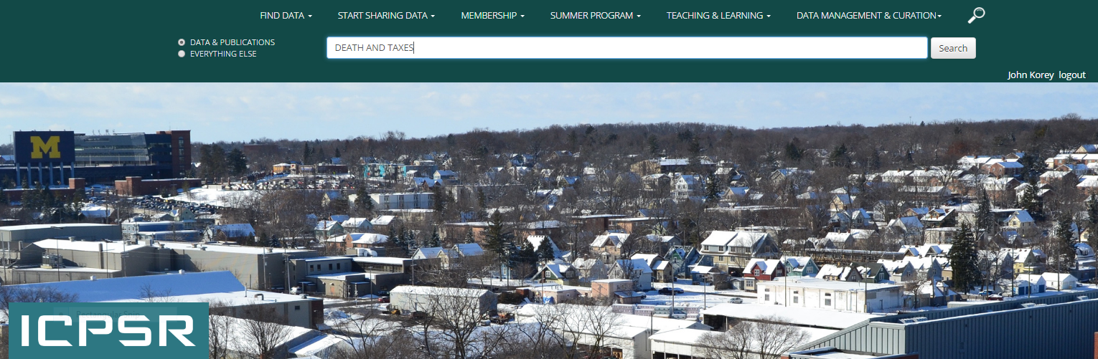
Locate the Study -1
Notes:
One animation. In the “Search” box, type in “DEATH AND TAXES” without quotation marks (not case sensitive). Leaving out “AND” or typing “OR” produces same results. Typing just one of the keywords produces more; putting term in quotes produces fewer.

Slide 57
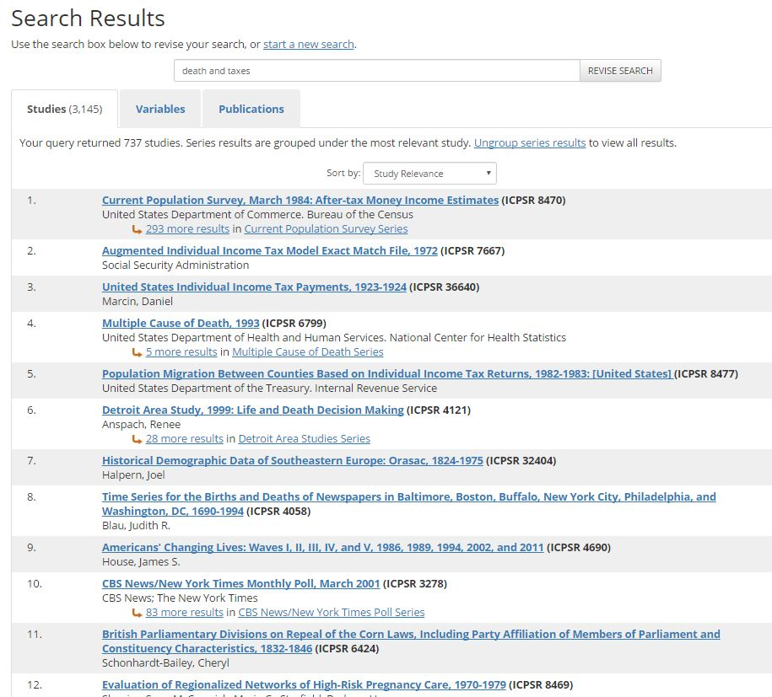
Search Results
Notes:
One animation.

Slide 58
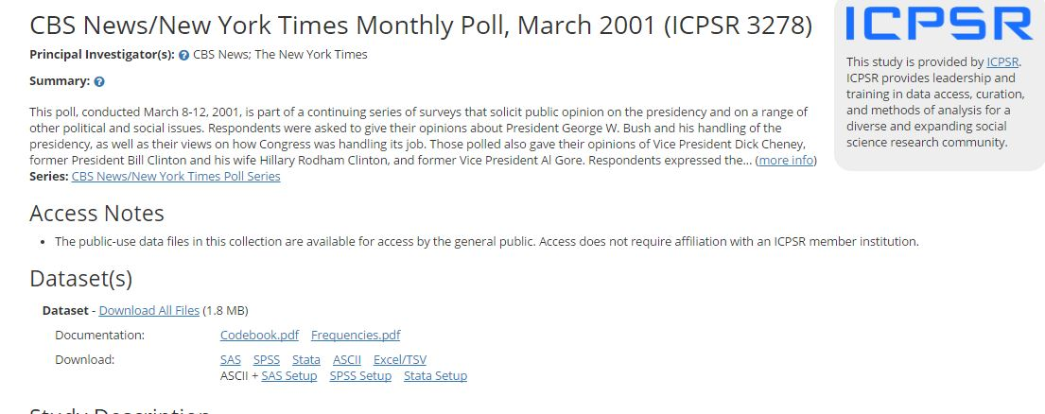
Select Data for Download
Notes:
Hree animations.Under “Download,” near bottom of screen, click on “SPSS.”

Slide 59
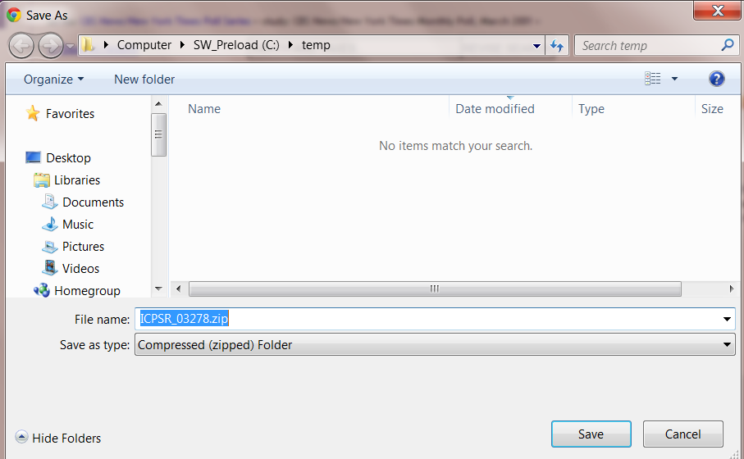
Download the Data

Slide 60
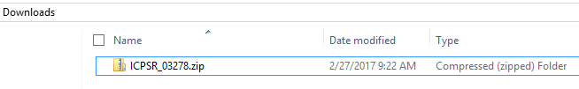

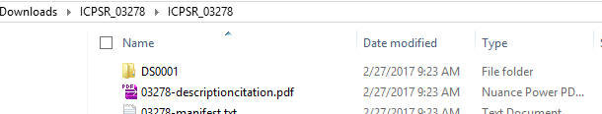
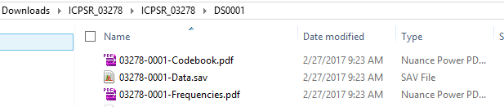
Save the Data for Analysis
Notes:
5 animations. Click on each of the files shown until you get to the bottom screen. The first two of the files found there (the codebook in PDF format and the data in SPSS system file format) are the ones you want. Now you try.

Slide 61
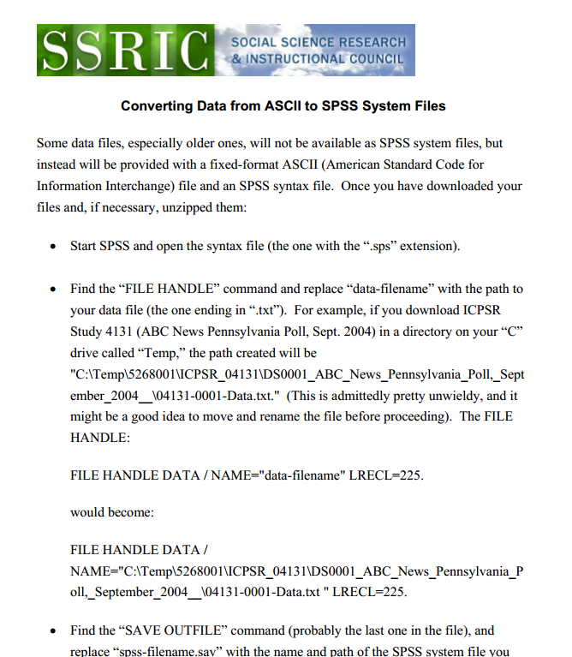
Converting ASCII Files
Notes:
Some old datasets come with only a raw data ASCII (American Standard Code for Information Interchange) file and an SPSS “syntax” file. By running the data against the syntax file, you can create an SPSS system file. You’ll need to made a few changes in the syntax file. The handout linked to this page will show you how.

Slide 62
SPSS Syntax Files
Books (Sage):
Collier, Jacqueline, Using SPSS Syntax: A Beginner's Guide (2010). Amazon: $50.40 (new; paper), $36.96 (Kindle)
te Grotenhuis, Manfred and Chris Visscher, How to Use SPSS Syntax: An Overview of Common Commands (2014). Amazon: $25.70 (new; paper), $13.20 (Kindle)
Notes:
On even rarer occasions, you won’t even gat a syntax file, and will have to create your own. The books cited here will show you how.

Slide 63
Other Research Tools
Search/Compare Variables
Bibliography of Data Related Literature
Online Data Analysis

Slide 64
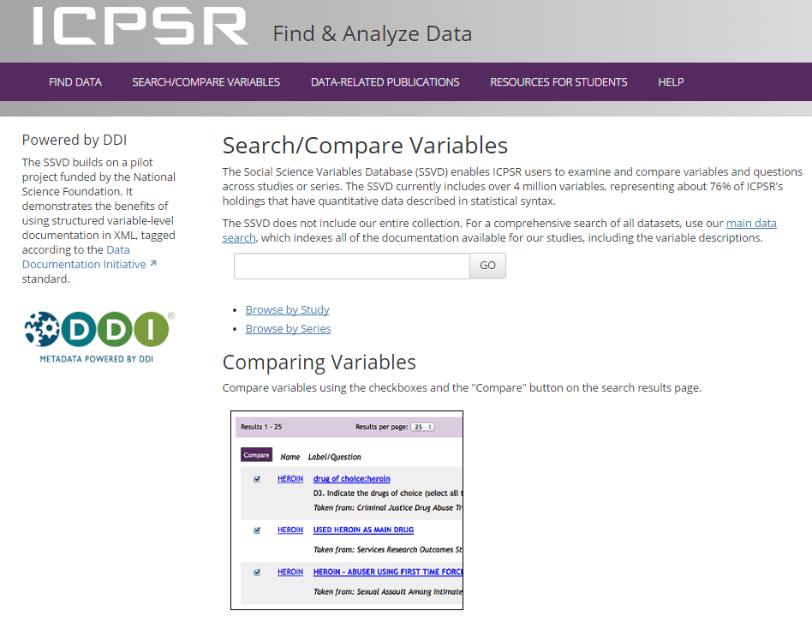
Search/Compare Variables
Notes:
This feature is useful if you plan to design your own questionnaire ad would like to see how others have dealt with making the same or similar measurements.

Slide 65
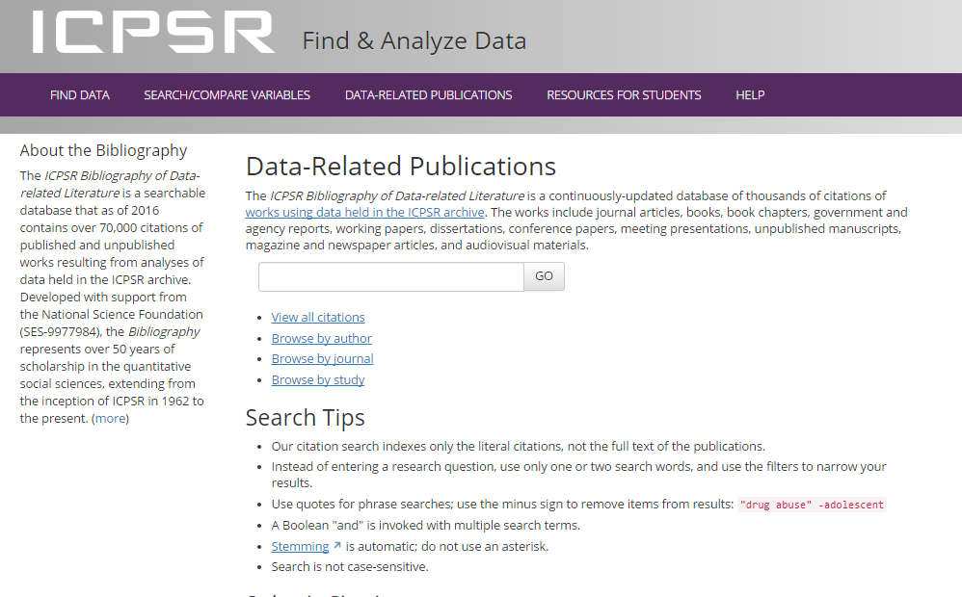
Find Publications
Notes:
This feature will let you know of works that have used a particular dataset in the ICPSR archives.

Slide 66
Online Data Analysis
Simple Crosstabs: if a dataset description says that you can perform simple crosstabs, you can do so online by clicking on the link and following the instructions.
SDA: some datasets also allow more extensive analyses using SDA (Survey Documentation and Analysis). The SSRIC offers a separate workshop on SDA.

Slide 67
The Field (California) Poll
Social Science Research and Instructional Council
March 3, 2017

Slide 68
What is the Field Poll?
The Field Poll was established in 1947 by Mervin Field.
An independent non-partisan survey of California public opinion covering a wide range of political and social topics.
One of the major statewide public opinion polls in California.
It was conducted by The Field Research Corporation which is located in San Francisco.
Unfortunately the Field Poll closed at the end of 2016 and the Field website has been taken down. However, we still have access to the Field Poll archives.

Slide 69
Where are the data stored?
The CSU has an arrangement with UCDATA at Berkeley to provide CSU campuses that subscribe to the social science databases access to the Field Polls.
Access to the Field Polls on CSU campuses is IP authenticated. This means that in order to access the Field Polls, you will need to do so from your CSU campus.

Slide 70
UCDATA Website
The UCDATA website allows you to:
  Search the Field Polls from 1956 through the present.
  Download the Field Poll data to your computer so you can analyze the data. Field Polls can be downloaded as SPSS files or as raw data files.
  Analyze the Field Poll data online using a statistical package called Survey Documentation and Analysis (SDA).

Slide 71
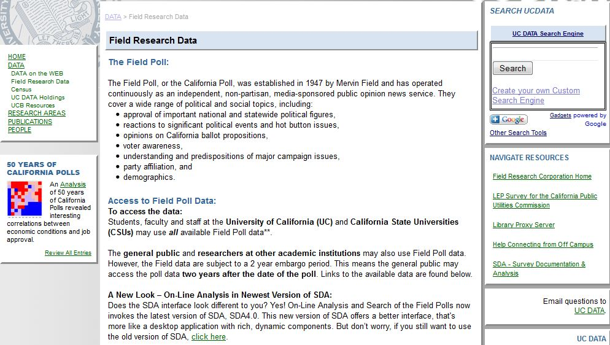
UCDATA for Field Polls

Slide 72
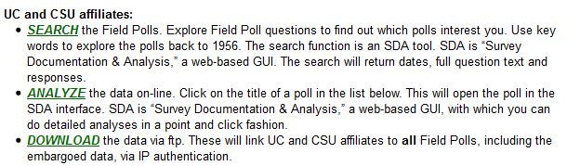
Searching the Field Polls
You can search the Field Polls for variables that deal with your topic of interest, analyze the data online, and download the data sets.

Slide 73
Field Poll Methodology
It's important to keep in mind that The Field Poll changed its sampling methodology twice in its history, once in 1979 and a second time in 2006.
Surveys conducted prior to 1979 were conducted among a random sample of California adults using a door-to-door cluster sampling design.
Between 1979 and 2005, all Field Poll surveys were conducted by telephone among a random sample of California adults using a random digit dial sampling methodology,
Surveys conducted since 2006 have been conducted using a random sample of California voters by telephone using a registration-based sampling methodology.

Slide 74
Learning More About the
Field Polls
Another way to learn more about the Field Polls is by going to the SSRIC’s web site.
Click on “Field” under “Data” in the upper left.

Slide 75

Founded 1994
Offices in San Francisco and Sacramento
President and CEO: Mark Baldassare
  Ph.D., Sociology, UC Berkeley
  Former Professor of Urban and Regional Planning, UC Irvine

Slide 76
Topics of Interest
Climate Change/Energy
Corrections
Economy
Fiscal/Governance Reform
Health and Human Services
Higher Education
K-12 Education
Political Landscape
Population
Water

Slide 77
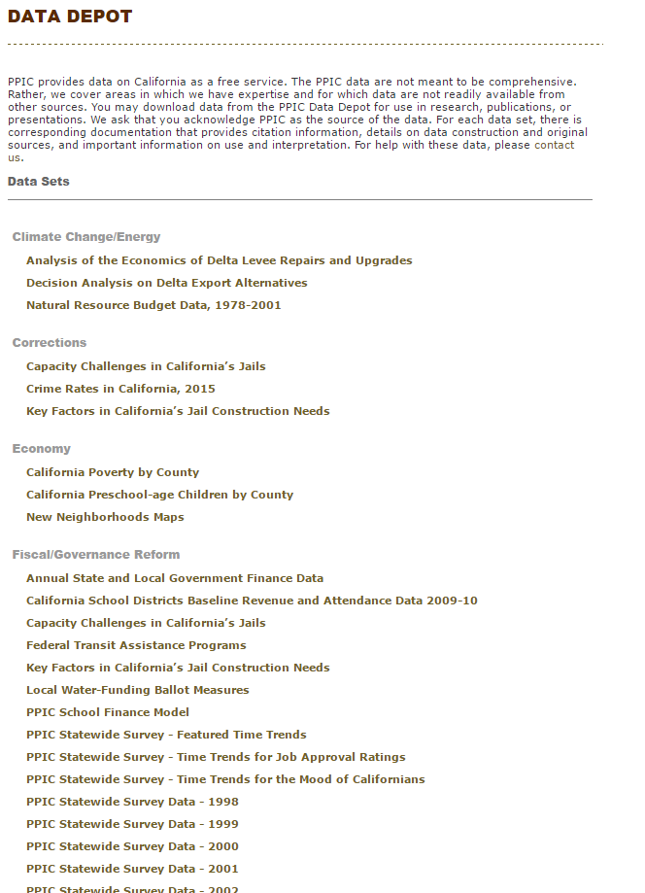
Data Depot
AGGREGATE & MISC.
SURVEY

Slide 78
Cal Aggregate Data: a Few Examples
Crime Rates by County (Excel)
Poverty by County (Excel)
Jail Capacity and Needs (PDF)
Maps of College Enrollment Rates by County (PDF)

Slide 79
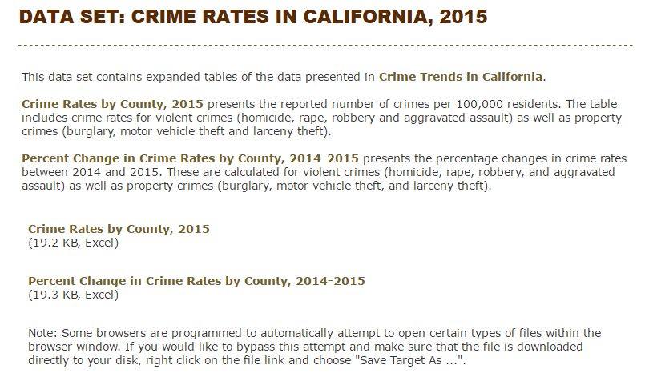
Crime Rates by County
Notes:
One animation. From Data Depot screen, scroll down and click on Crime Rates in California, 2015. Save and open in Excel.

Slide 80
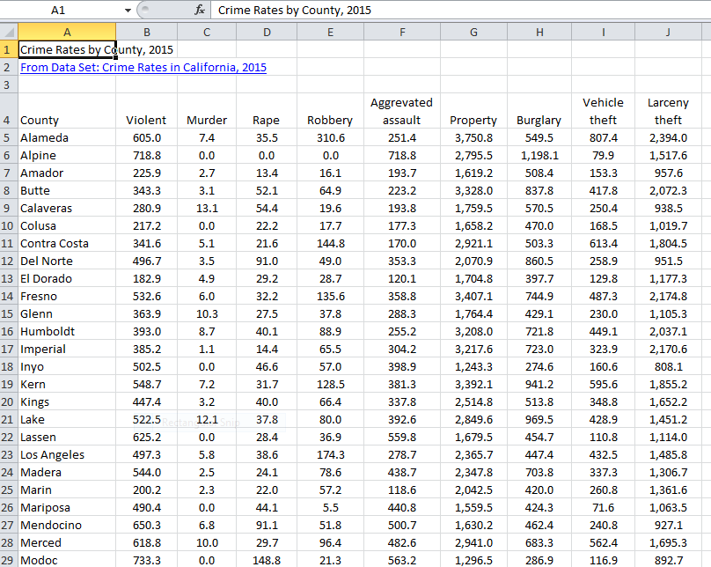
Results

Slide 81
PPIC Statewide Survey
California adults; >= 1,700/survey
Typically ~8 surveys per year
Released 3-6 months after conducted
Land line and cell; random by household
English and Spanish

Slide 82
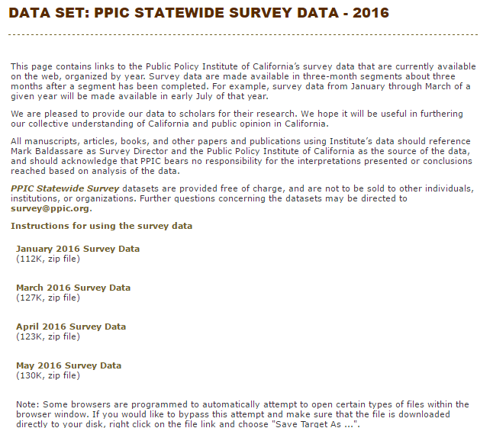
Example – 2016
Notes:
From “Data Depot” screen, scroll down to 2016 and click. Then go to most recent and click again. This will yield a zip file, which you can then save to your computer or flash drive.

Slide 83
Downloading Data
(ZIP File)
  Codebook (MS Word)
  Data (SPSS System File [.sav])

Slide 84
Pew Research Center
Social Science Research and Instructional Council
March 3, 2017

Slide 85
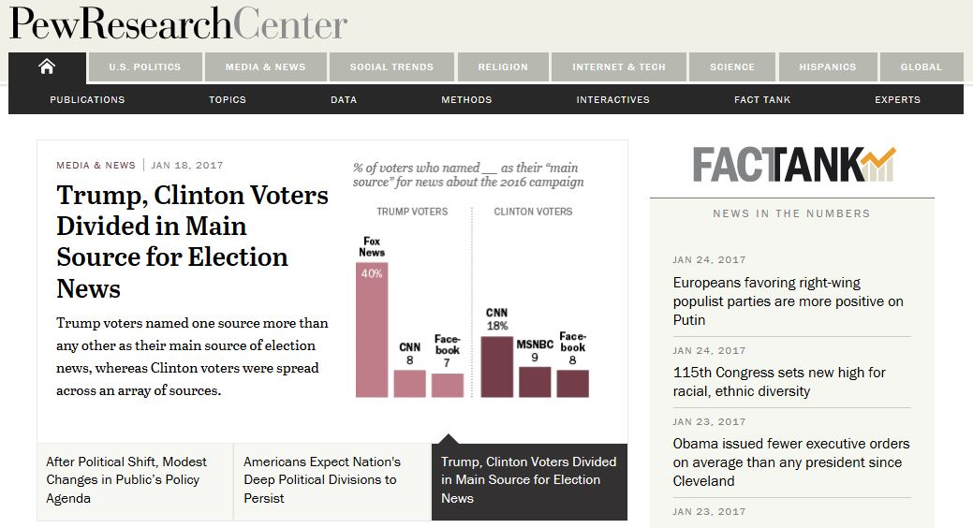
Pew Research Center Home Page

Slide 86
Click on Topics
You can do a site search
Or you can browse the list of topics
You can also search by poll question

Slide 87
Click on Methods
Follow research on twitter
Sign up for monthly newsletter
Browse various methodological reports

Slide 88
Data
Explore various trend lines
Download datasets

Slide 89
Merlot
Social Science Research and Instructional Council
March 3, 2017

Slide 90

Merlot Home Page

Slide 91
About Merlot
“MERLOT is a curated collection of free and open online teaching, learning, and faculty development services contributed and used by an international education community. “
Accounts are free. Go to “My Merlot” and click on “Become a Member”

Slide 92
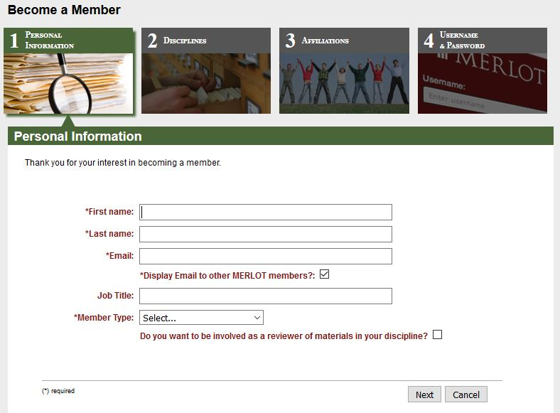
Creating Your Account

Slide 93
Submitting Materials
Go to “Add to Collection”
Then click on submit materials

Slide 94
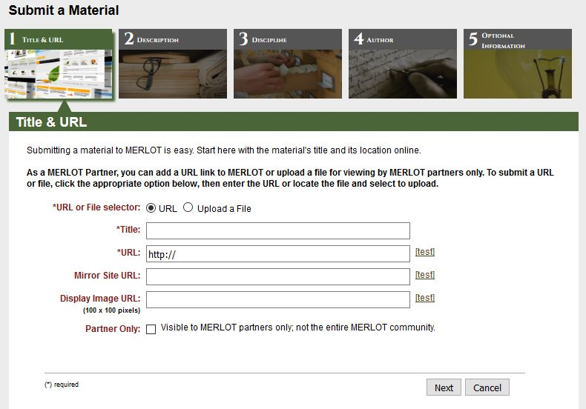
Submit Material

Slide 95
Search for Materials
Click on “Search Materials”
Click on “Advance Material Search”

Slide 96
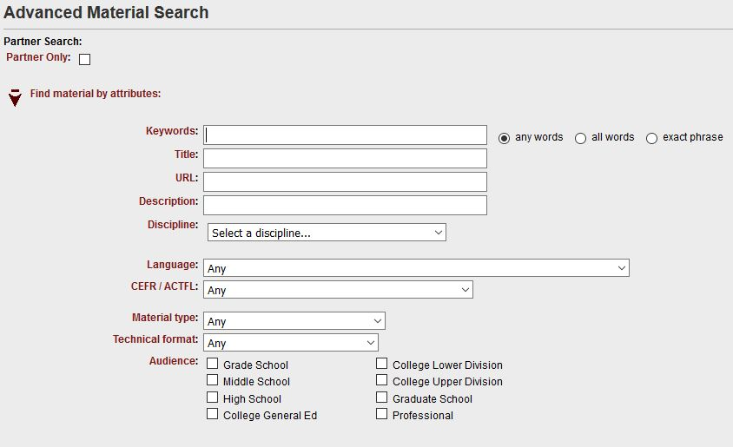
Advanced Material Search Screen

Slide 97
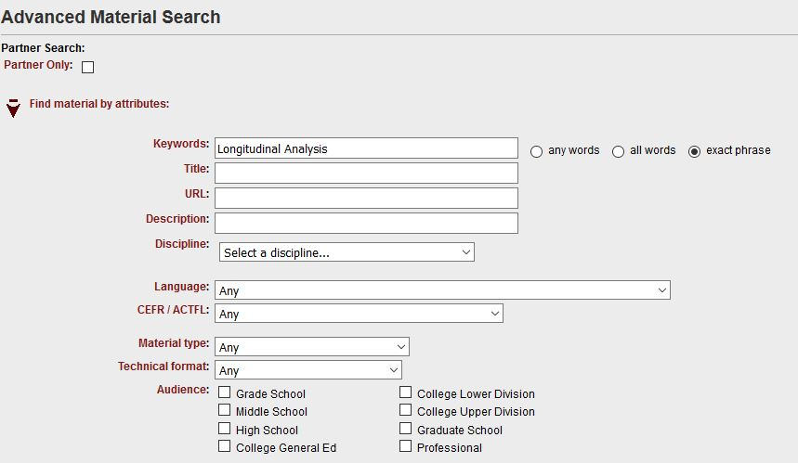
Searching for “Longitudinal Analysis”

Slide 98
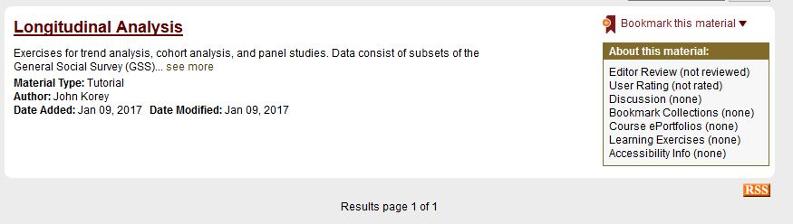
Search Results for
“Longitudinal Analysis”

Slide 99
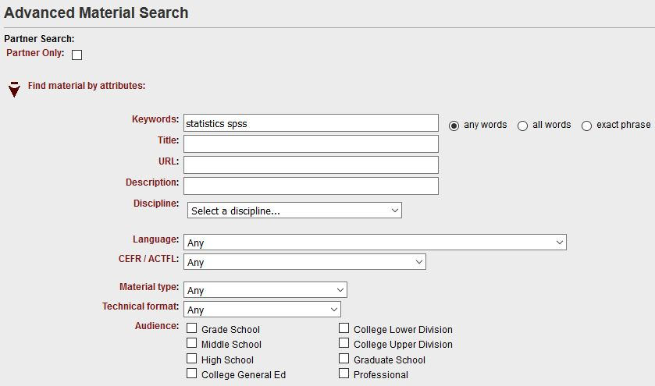
Searching for Statistics and SPSS

Slide 100
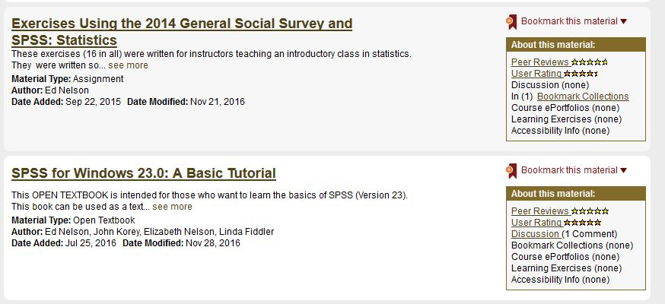
Search Results for Statistics and SPSS

Slide 101

Looking at One of the Search Outcomes

Slide 102
Click on Go to Material

Slide 103

The Actual Material

Slide 104

Merlot Communities

Slide 105

Choose Sociology and Click on Visit

Slide 106
SSRIC Teaching Resources
Social Science Research and Instructional Council
March 3, 2017

Slide 107

SSRIC Home Page

Slide 108

Teaching Resources

Slide 109

Online Text Books

Slide 110

Modules

Slide 111

Exercises

Slide 112

Statistics and SPSS Exercises

Slide 113

STAT15S: Exercise Using SPSS to Explore Multiple Linear Regression

Slide 114

Research Methods Exercises

Slide 115

RESEARCH METHODS 1RM:
Research Design

Slide 116

Teaching Longitudinal Analysis
Origins:

Slide 117
Software Used
SPSS
PSPP: to download, see Nelson, “Notes on Using PSPP.”

Slide 118
Data (SPSS system [.sav] files) and Codebooks (PDF)
GSS Cumulative File, 1972-2014 Subset
  Data
  Codebook
GSS 2010-2012-2014 Panel Study Subset
  Data
  Codebook
ANES 2000-2002-2004 Panel Study Subset
  Data
  CodebookEditor)
Subsets of:
  GSS Cumulative File
  GSS 2010-12-14 Panel Study
  ANES 2000-02-04 Panel Study

Slide 119

Trend Analysis

Slide 120
Cohorts
The GI Generation (born 1927 or earlier)
The Silent Generation (1928-1945)
Baby Boomers (1946-1964)
Gen X (1965-1981)
Millennials (1982-1999)

Slide 121

GSS Cumulative File
Sample Composition

Slide 122

Cohort Analysis – News
Notes:
Now you try with trust (in SPSS).

Slide 123

Cohort Analysis – Trust

Slide 124

Panel Studies – Cognitive Dissonance –H1
Tau-b = .271 p<.001

Slide 125

Panel Studies – Cognitive Dissonance –H2
Tau-b = -.255 p<.001
Notes:
Graphs → Chart Builder → Gallery→ Line→ Multiple Line→ Trust→ Year→ Groups → Rows → Cohort

Slide 126

Panel Studies – Reactivity
Cramer’s V = .053 p=.222
Notes:
“A preschool child is likely to suffer if his or her mother works.”

Slide 127

Panel Studies – The Nader Effect
Notes:
Now you try with regression toward mean.

Slide 128

Panel Studies – Regression Toward the Mean vs. Polarization

Slide 129
Key Teaching Points
“The Facts are always friendly”
- Karl Rogers (GI Generation)
“You can’t always get what you want, but … sometimes … you get what you need.”
- The Rolling Stones (Silent Generation)
Notes:
Karl Rogers (1902-1987)
Rolling Stones (original members all “Silent Generation”)

